Slide 1
Name Artist & Title
Game 016
Avril Lavigne – Happy Ending
Neil Sedaka – Laughter In The Rain
Lorde – Team
John Lennon – Woman
Jay-Z – Can I Get A…
Heart – Never
Jane Child – I Don’t Want To Fall In Love
Duice - Dazzey Duks
Encanto Cast – We Don’t Talk About Bruno
The Grass Roots - Midnight Confessions

Slide 2
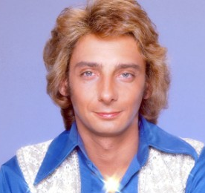
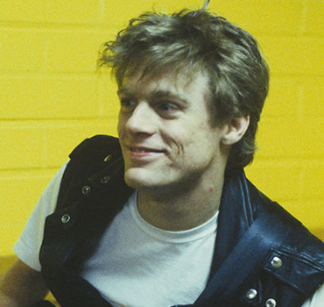
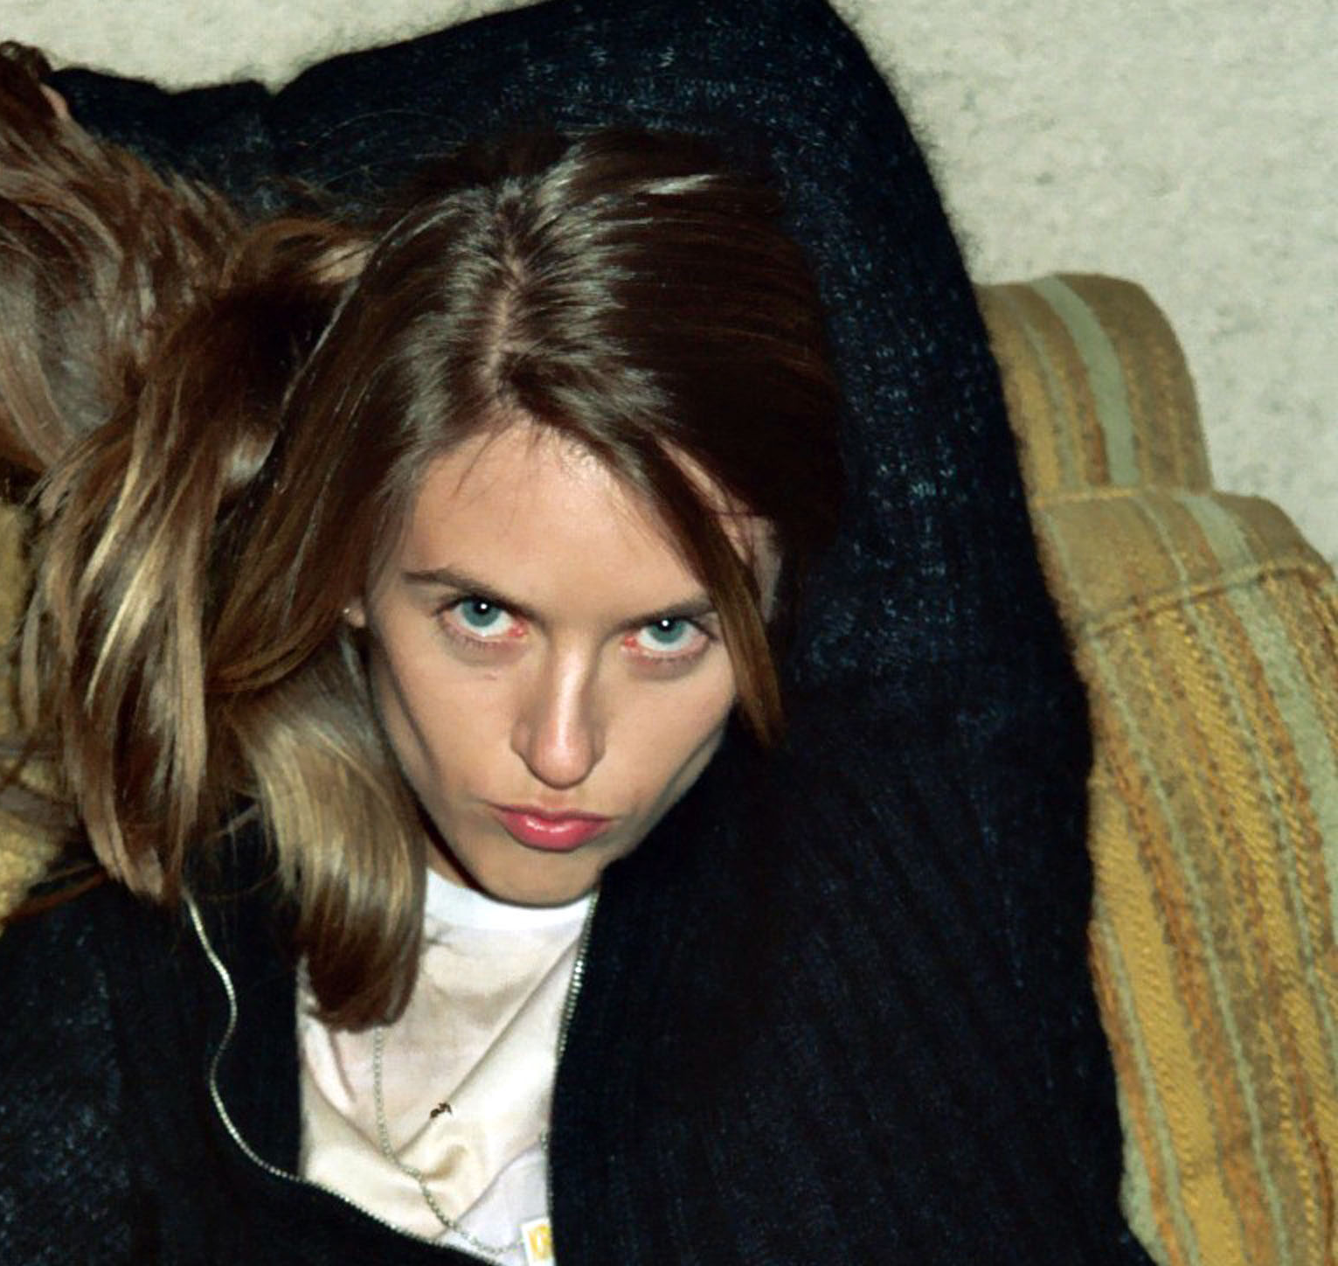
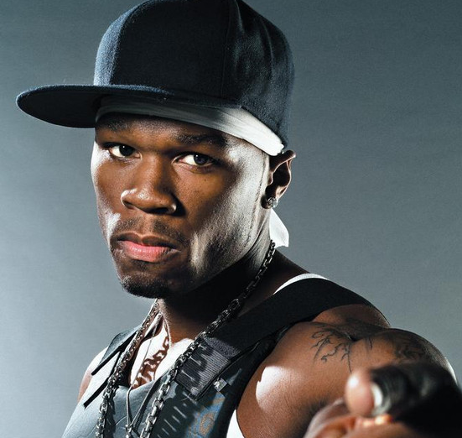
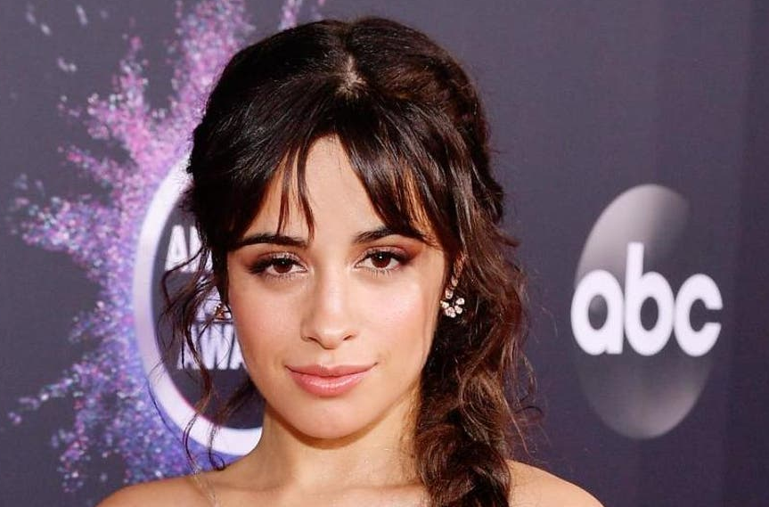
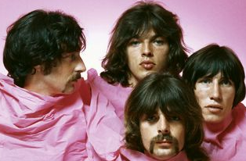
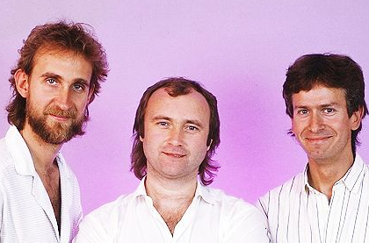
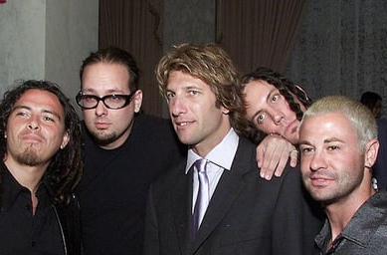
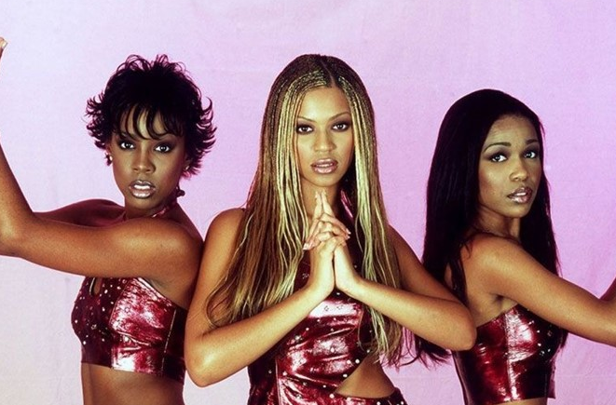
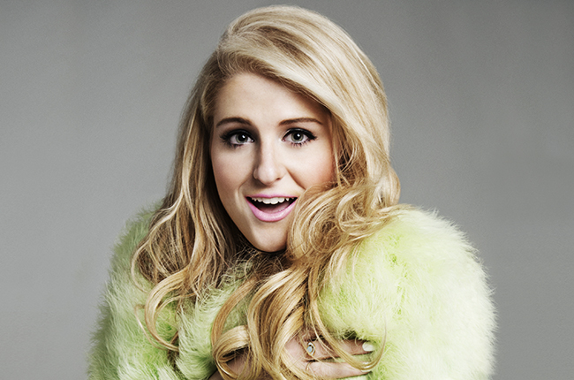
Picture Round
Instructions: Identify the artist or group on the line under each image

Slide 3
Decades In what decade was this version of the song originally released?
Jamie Foxx ft T-Pain – Blame It (2008)
Supremes – Love Child (1968)
Will Smith – Gettin Jiggy Wit It (1997)
Styx – Babe (1979)
Nu Shooz – I Can’t Wait (1985)
Hammer – 2 Legit 2 Quit (1991)
Fergie – Fergalicious (2006)
David Essex – Rock On (1973)
Lizzo - Good As Hell (2019)
Genesis – Land of Confusion (1986)
None

Slide 4
General Knowledge
In describing the tempo of a piece of music, what does the acronym BPM stand for? Beats per minute
What 1979 song by the artist known simply as M reached #1 on the U.S. Billboard Hot 100 while its title was a slightly misspelled version of the genre itself? Pop Muzik
Described as a symbolic anthem of the political changes in eastern Europe, the 1990 song Winds of Change is the best-selling single of all time by a German artist. Name the rock band who released it. Scorpions
In 2003, Get Busy became the first #1 hit for what reggae artist? Sean Paul
Topping the charts in 7 countries and landing in the Top 10 in ten others, what song by DJ duo Duck Sauce was nominated for Best Dance Recording at the 2011 Grammy Awards? Barbra Streisand
What “B” word is defined as the act of performing in public places for gratuities? Busking (street performers are buskers)
What Irving Berlin song was popular not only in his own era, but in the 70s (thanks to Peter Boyle’s performance in Young Frankenstein) and again in the 80s (when Dutch musician Taco’s version became a Top 10 hit in the U.S.)? Puttin’ On the Ritz
To the disappointment of a great many fans, what rock band’s 2023 New Years Eve show at Boston’s TD Garden was postponed due to a vocal injury that its lead singer sustained earlier in the year? Aerosmith (Steven Tyler)
What band, often abbreviated as TMBG, released 23 studio albums as of 2023, has been nominated for 4 Grammys (winning 2, including for the Malcolm in the Middle TV theme), and whose founding duo was nominated (along with other composers) for a Tony Award for Spongebob Squarepants: The Broadway Musical? They Might Be Giants
On July 13, 1985, two Live Aid concerts were held simultaneously - one at Wembley Stadium in London and one at John F. Kennedy Stadium in Philadelphia. How many people attended the concert in Philadelphia? 89,484

Slide 6
Barry Manilow
Bryan Adams
Liz Phair
50 Cent
Camila Cabello
Pink Floyd
Genesis
Korn
Destiny’s Child
Meghan Trainor

