Slide 1
Name Artist & Title
Game 0001

Slide 2
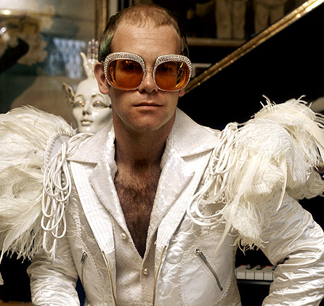
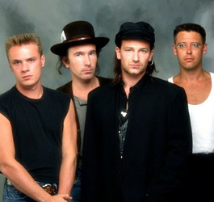
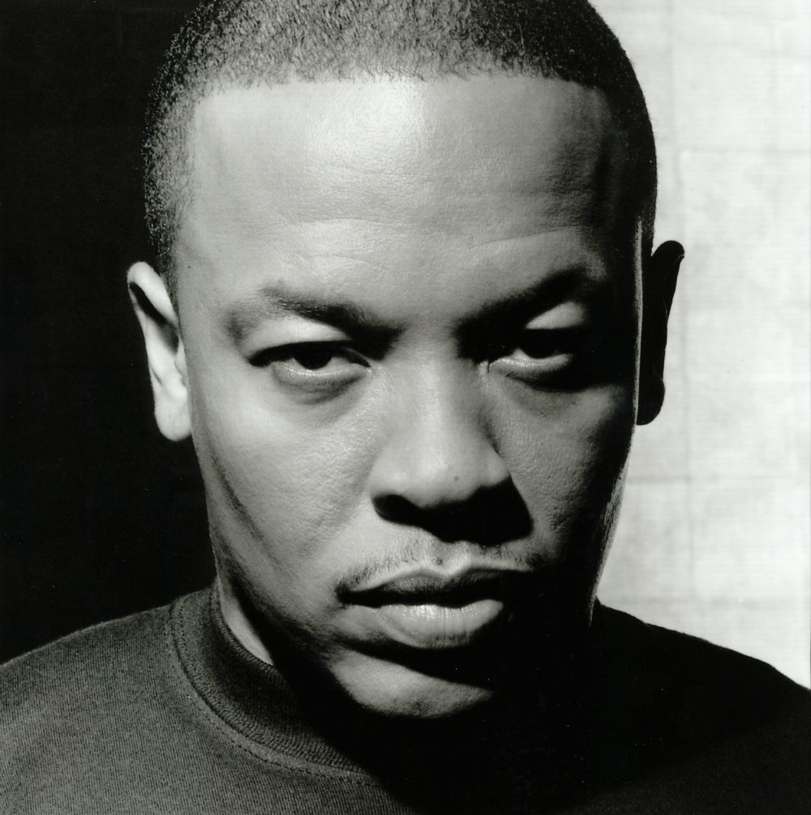
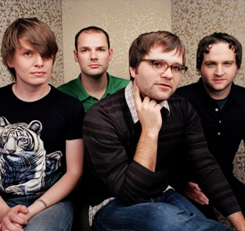
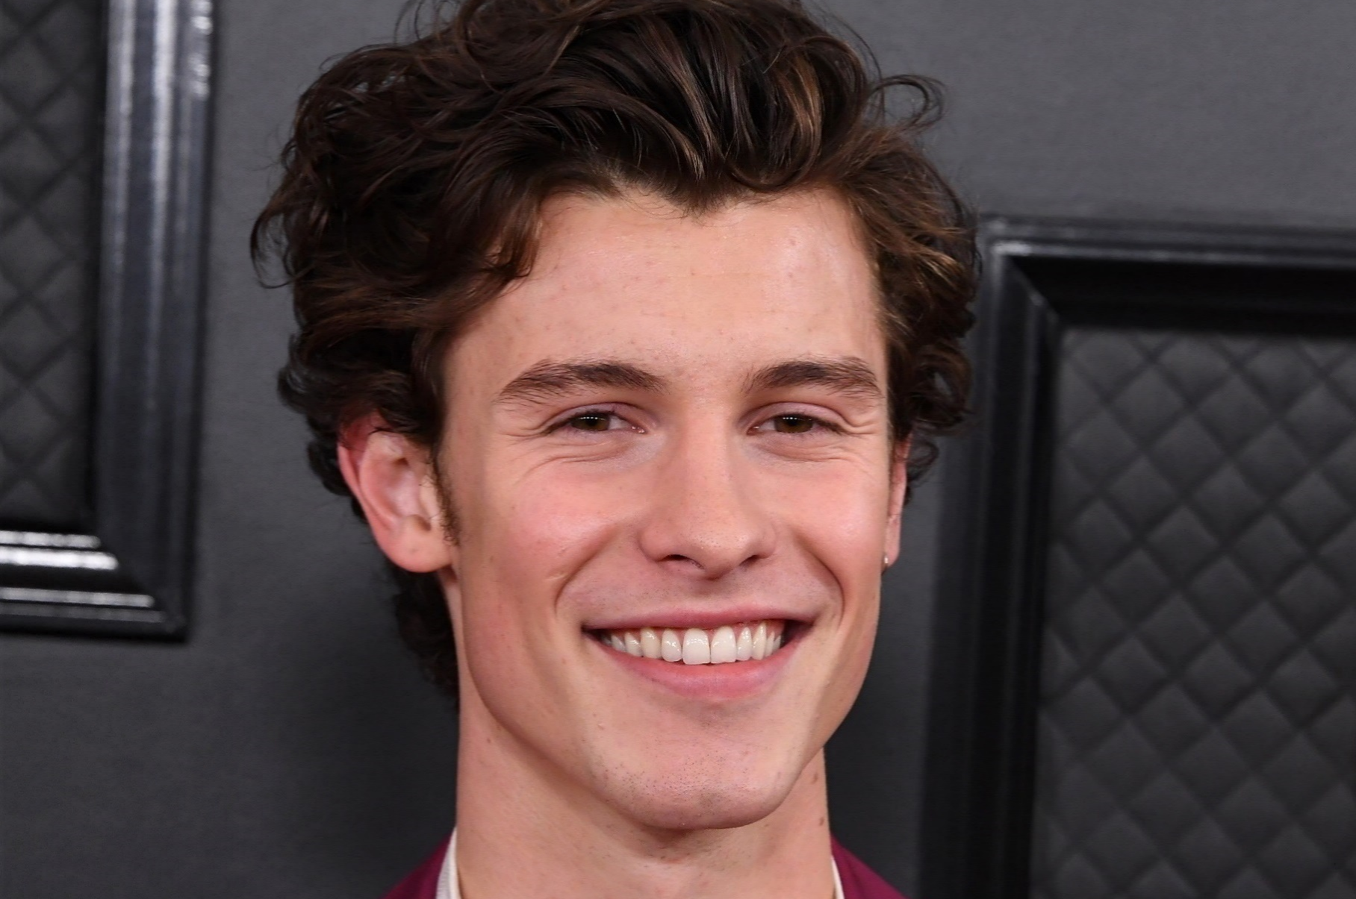
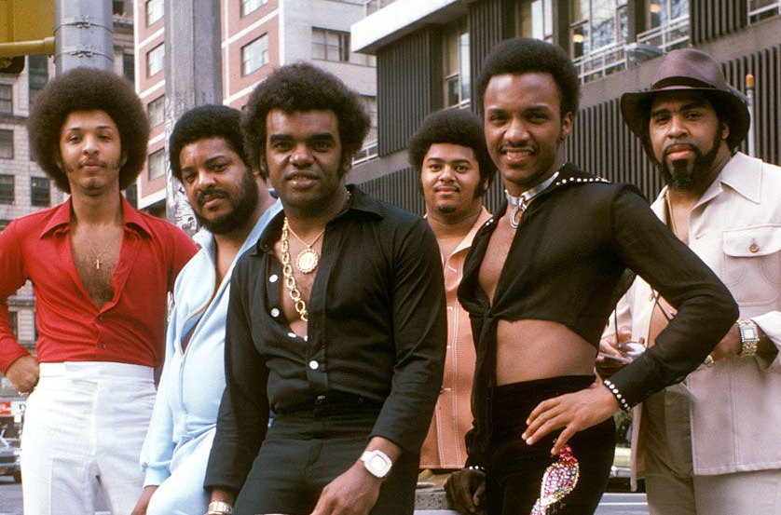
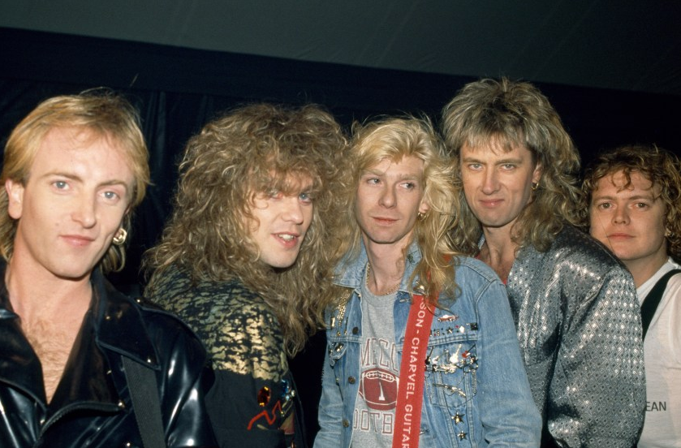
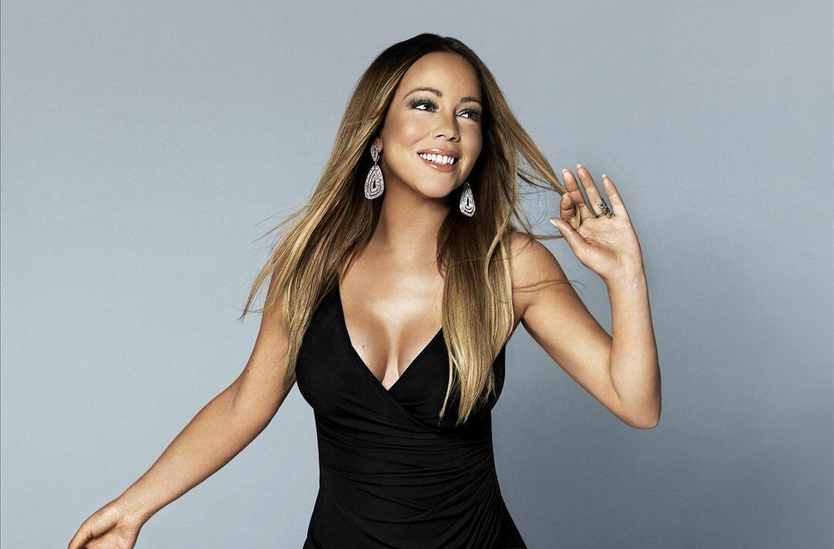
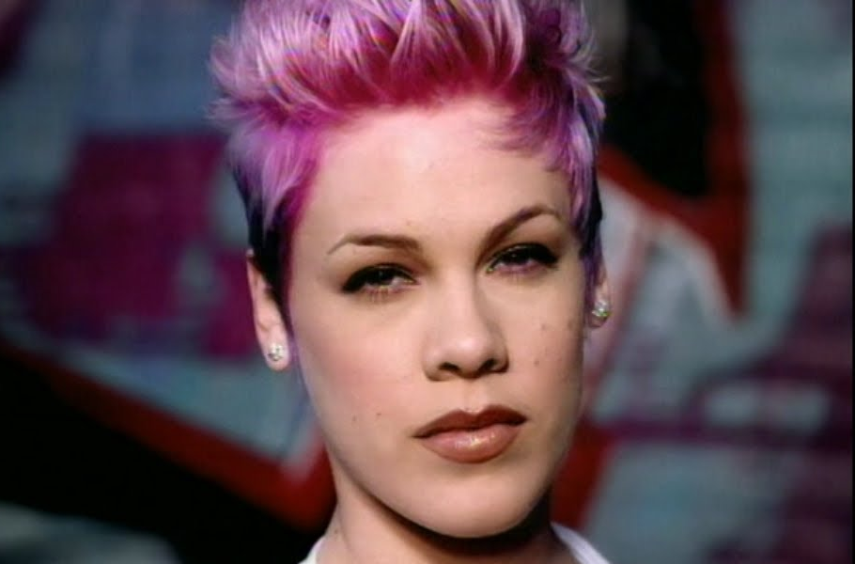
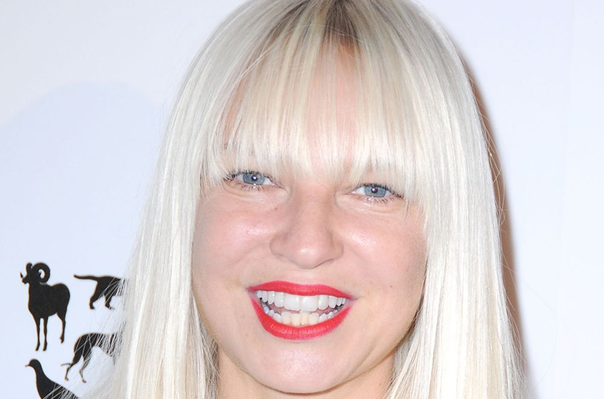
Picture Round
Instructions: Identify the artist or group on the line under each image

Slide 3
Decades In what decade was this version of the song originally released?

Slide 4
Music Trivia
Which of the following is NOT a title to an Elvis Presley song: Just Like That, A Little Less Conversation, Don’t Be Cruel? Just Like That
Which of the original MTV VJs hosted her own show from 2005 on Sirius Satellite Radio (later Sirius XM), and now does the same for iHeartMedia stations? Martha Quinn (The Martha Quinn Show)
Zack de la Rocha fronts what 90s rap and heavy metal band, known for their strong political and social justice themes? Rage Against the Machine
In 2005, what vocal group hit the charts with the song Don’t Cha? Pussycat Dolls
Avicii, the DJ known for hits like Wake Me Up and who sadly passed away in 2018, hailed from what country? Sweden
Commonly used in musical reality show performances to enhance the drama of a song, what term describes the passing or transition from one key to another? Modulation
What 70s rocker appeared in the 1992 film Wayne’s World as himself, causing Wayne and Garth to drop to their knees screaming, “We’re not worthy!”? Alice Cooper
Which 1987 Whitney Houston single became her fourth consecutive U.S. number one and her first U.S. platinum selling single? I Wanna Dance With Somebody (Who Loves Me)
Originally started as farewell tour for Jane’s Addiction in 1991, what now-annual music festival made the city of Chicago its permanent home? Lollapalooza
Dirt Off Your (what?) is the second single released off of Jay-Z’s The Black Album in 2003? Shoulder
Tie Breaker Question: Instruct each team to write this answer on the back of this round’s answer sheet. This answer will only be used in the event of a tie at the end of the game. In the event of a tie, whichever team comes closest to the correct answer wins.
In 2023 Billboard’s staff ranked the 500 Best Pop Songs of all time. At what number did A-HA's 1984 hit Take On Me appear on this list? No. 26

Slide 6
Elton John
U2
Dr. Dre
Death Cab for Cutie
Shawn Mendez
Isley Brothers
Def Leppard
Mariah Carey
Pink
Sia

