Slide 1
Name Artist & Title
Game 0001

Slide 2
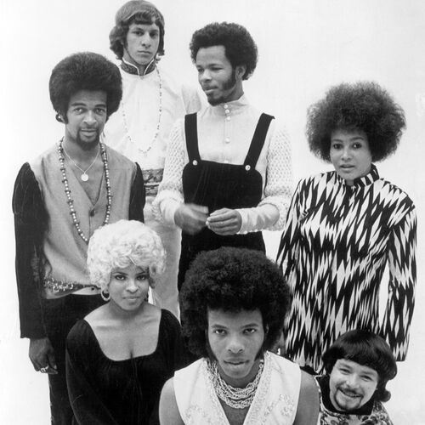
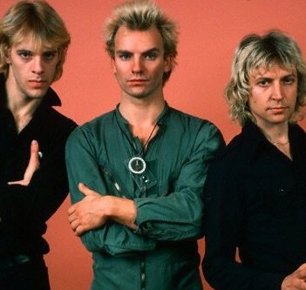
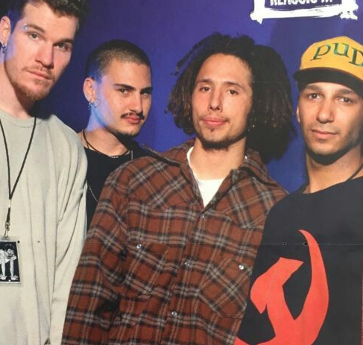
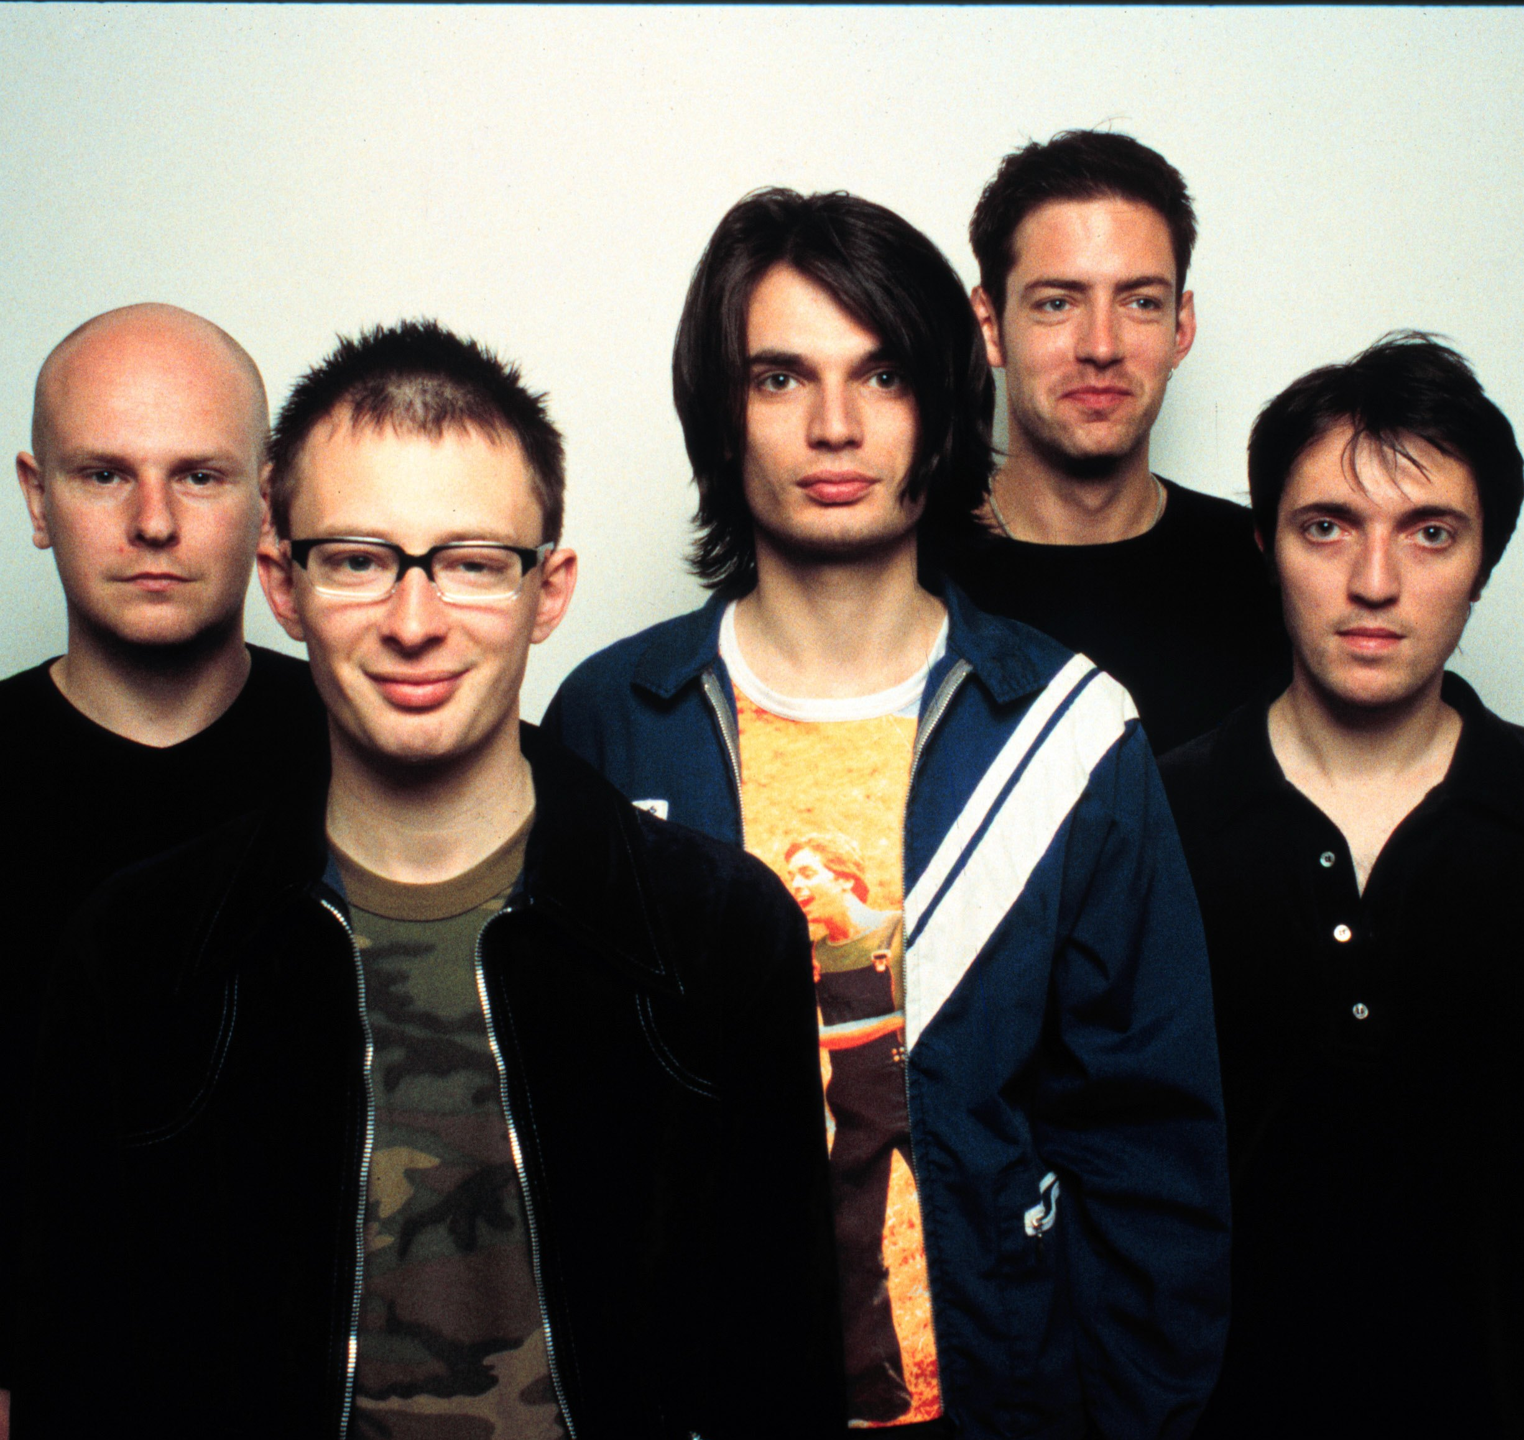
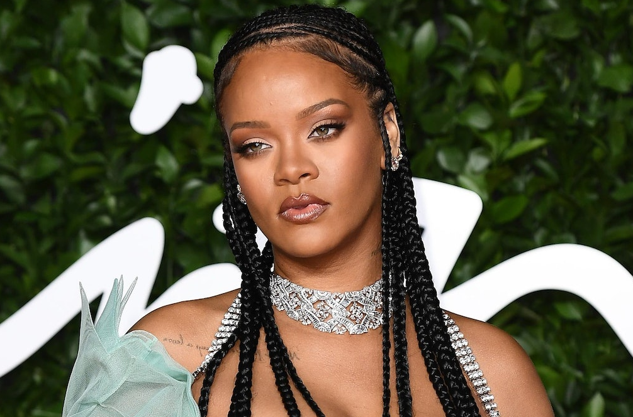
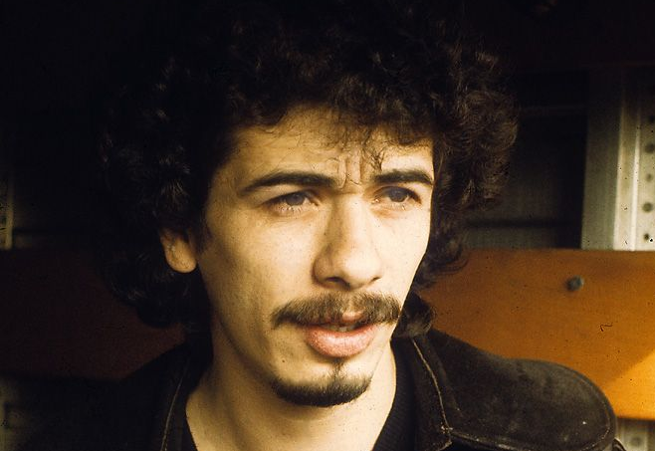
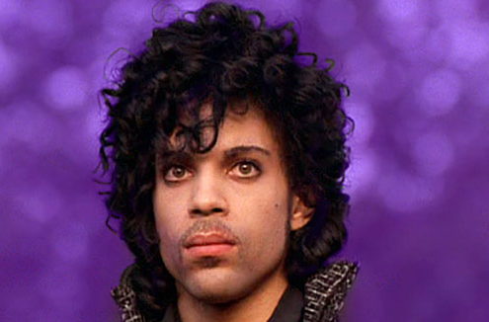
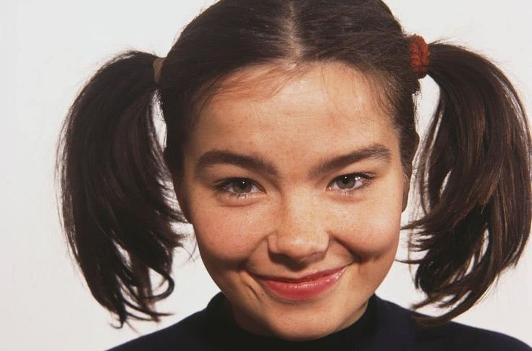
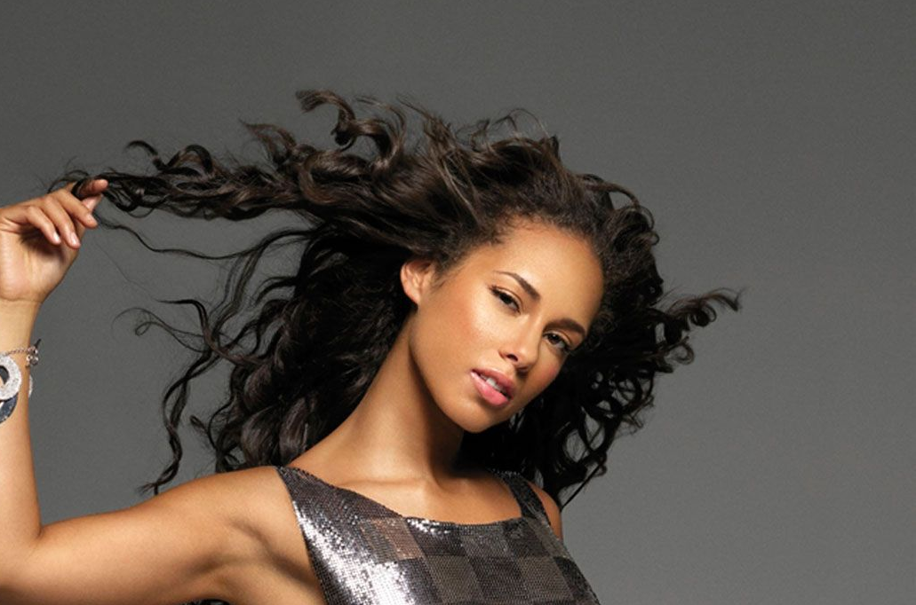
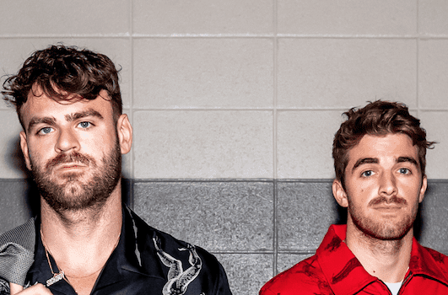
Picture Round
Instructions: Identify the artist or group on the line under each image

Slide 3
Decades In what decade was this version of the song originally released?

Slide 4
General Knowledge
The Bee Gees’ name is actually a spelling of the letters B and G. What do B and G stand for? Brothers Gibb
Which “Friend” did Bruce Springsteen invite onto the stage to dance with him in his 1984 Dancing in the Dark video? Courtney Cox
Black Gives Way to Blue, The Devil Put Dinosaurs Here, and Rainier Fog are three albums released by what band, after the death of their original singer in 2002? Alice In Chains (Layne Staley)
Released in 2008, what Kings of Leon song’s intended title was “Set Us on Fire” until a sound engineer misheard the vocals and recited the now-actual title to the band? Sex on Fire
In a brilliant marketing move, what Rhode Island-based company obtained the phone number 867-5309 – a song title made famous by 80s two-hit wonder Tommy Tutone? Gem Plumbing and Heating Services, Inc.
YoYo Ma is a celebrated classical musician who plays what instrument? Cello
In 1981 Andrew Ridgely formed a pop duo with his best friend who later became a wildly successful solo artist. Who was this friend? George Michael (Wham!)
In what year did Backstreet Boys release their first studio album? 1996
Which 2009 Britain’s Got Talent winner had the UK’s best-selling debut album of all time? Susan Boyle
Macklemore and Ryan Lewis are the first duo in the Hot 100 Chart’s history to have their first 2 singles reach #1. Name both of these chart-topping songs. Thrift Shop and Can’t Hold Us
According to Pollstar (who monitored concert ticket sales and box office gross revenues from 1981 to 2022) the band U2 sold the highest number of tickets during that period. How many tickets did they sell? 26,178,043

Slide 6
Sly and the Family Stone
The Police
Rage Against the Machine
Radiohead
Rihanna
Carlos Santana
Prince
Bjork
Alicia Keys
The Chainsmokers

