Slide 1
Name Artist & Title
Game 012
Soul for Real – Candy Rain
Michael Jackson – Ben
Paperboy – Ditty
Matchbox Twenty – If You’re Gone
Juice Newton – Angel of the Morning
Ella Henderson - Ghost
Madonna – Justify My Love
Pussycat Dolly – Buttons
Rihanna – S&M
Lisa Lisa & Cult Jam – Head to Toe

Slide 2
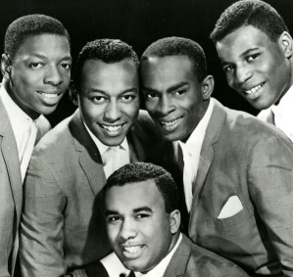
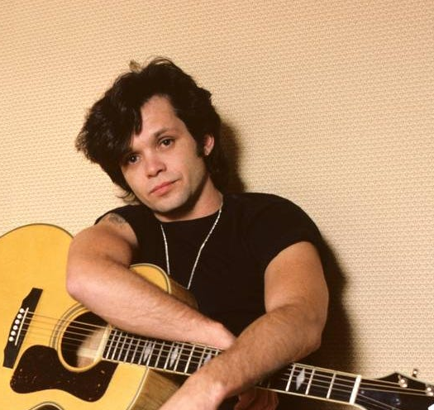
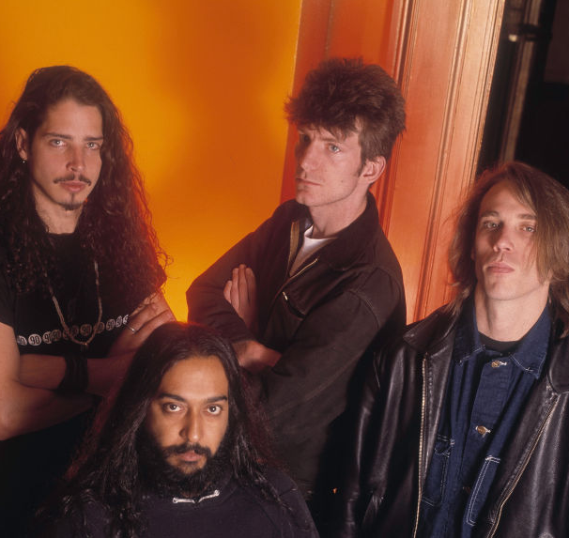
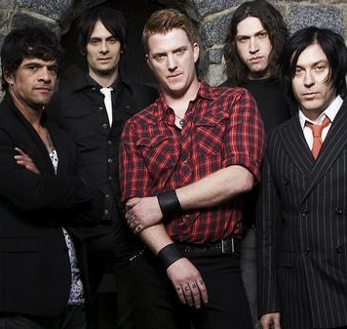
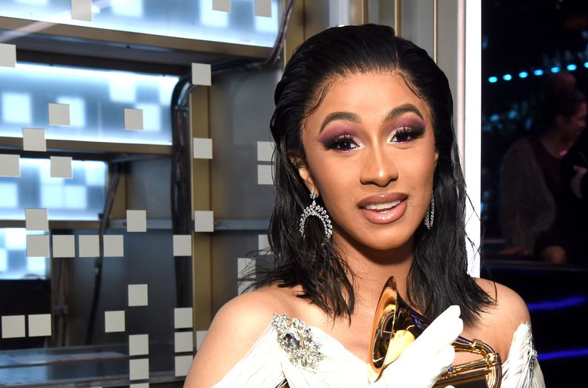
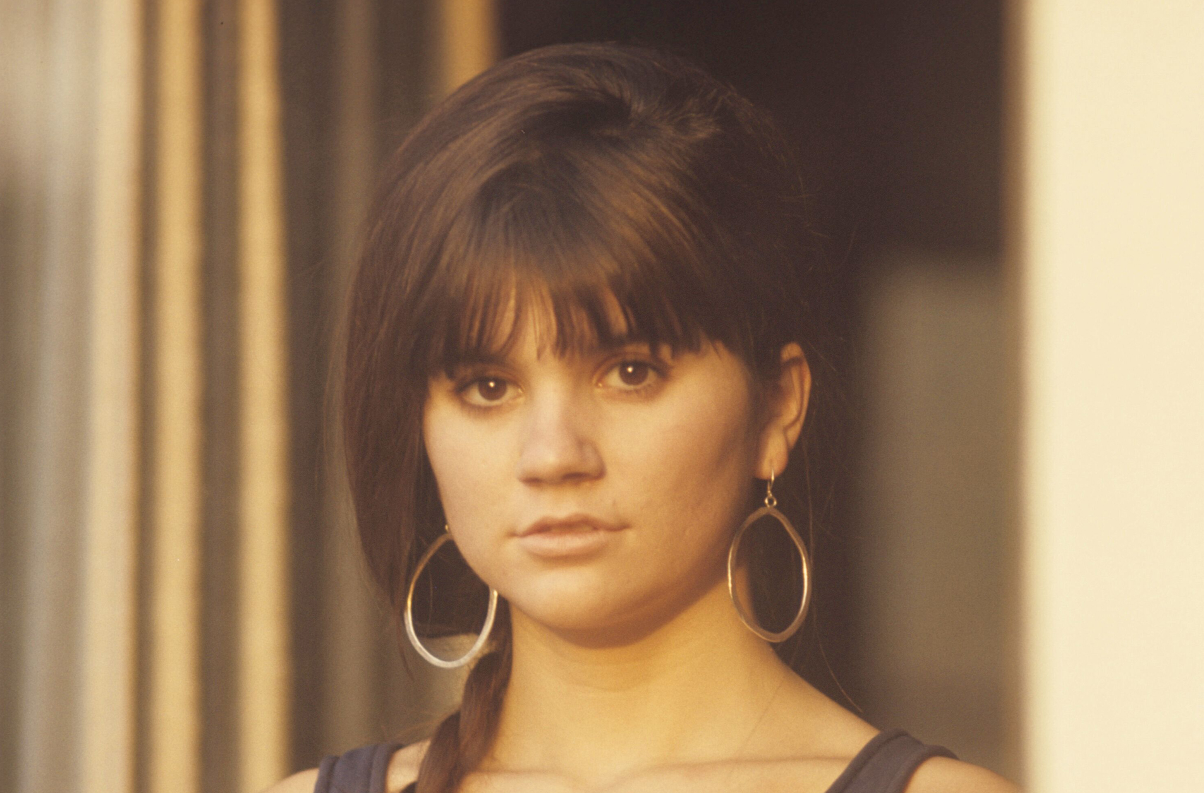
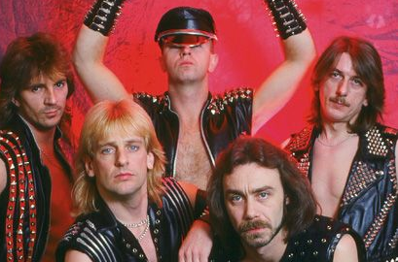
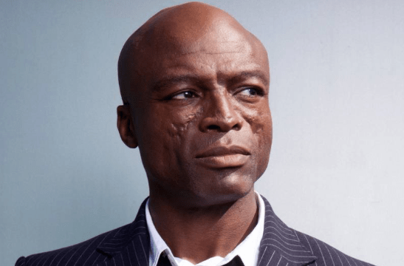

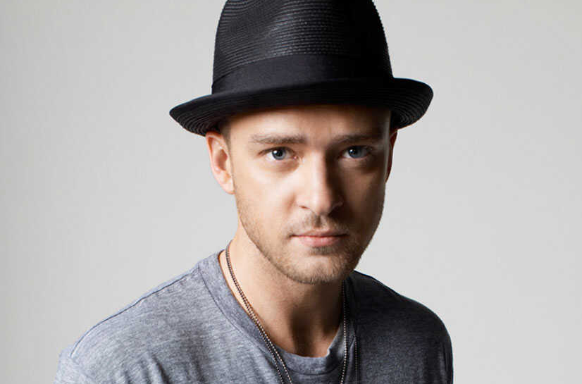
Picture Round
Instructions: Identify the artist or group on the line under each image

Slide 3
Decades In what decade was this version of the song originally released?
Taylor Swift – Wildest Dreams – 2015
Evanescence – Bring Me To Life – 2003
Jan Arden – Insensitive – 1996
Lisa Stansfield – All Around the World – 1989
Sonny & Cher – I Got You Babe – 1965
Tag Team – Whoomp (There It Is) – 1993
Rupert Holmes – Escape (Pina Colada Song) – 1979
Eddy Grant – Electric Avenue – 1982
War – Why Can’t We Be Friends – 1975
Harry Styles – Watermelon Sugar - 2019
None

Slide 4
General Knowledge
In 1975, David Byrne, Chris Frantz, and Tina Weymouth all met as freshman at RISD (Rhode Island School of Design) where they formed a band called The Artistics. They later changed the name to what? Talking Heads
Vonda Shepherd’s signature song Searchin’ My Soul was the TV theme song for what legal comedy drama, that ran from 1997-2002 and starred Calista Flockhart? Ally McBeal
Who won a Grammy Award with Santana for Best Pop Collaboration with Vocals for the 2002 single The Game of Love? Michelle Branch
Name the internationally known singer-pianist-composer who played Leo - Grace Adler’s boyfriend (and later husband) on the TV sitcom Will & Grace. Harry Connick, Jr.
In 2023 who really ‘got her freak on’ when she became the first woman rapper to be nominated and inducted into the Rock and Roll Hall of Fame? Missy Elliot (also accept Misdemeanor)
What did “King of the Blues” B.B. King name all his guitars? (…the reason for which is quite a story!) Lucille
What heavy metal band was exonerated in the mid-80s after being sued by a couple who claimed their music contained subliminal messages that caused their son and his friend to form a suicide pact? Judas Priest (The friend died instantly while the son was horribly disfigured for 3 years before he died. Both boys had troubled childhoods and a history of substance abuse.)
Ben & Jerry’s first band-themed ice-cream flavor to honor a Canadian band is called If I Had a Million Flavours. Name the band. Barenaked Ladies
Who sang the theme song for the 2002 James Bond film Die Another Day? Madonna
In 1997 Scotland introduced the first clone of an adult mammal, a sheep named after what famous American country singer? (need first and last name) Dolly Parton
Regarded as one of music’s earliest celebrities, Frederic Chopin was a Polish-born composer and virtuoso pianist of the Romantic Era. In what year was Chopin born? 1810

Slide 6
The Spinners
John Mellencamp
Soundgarden
Queens of the Stone Age
Cardi B
Linda Rondstadt
Judas Priest
Seal
Aaliyah
Justin Timberlake

