Slide 1
Name Artist & Title
Game 014
Mase – Feel So Good
Yvonne Elliman – If I Can’t Have You
Demi Lavato – Sorry Not Sorry
Sammy Hagar – Your Love Is Driving Me Crazy
Paperboy – Ditty
Black Eyed Peas – Don’t Phunk With My Heart
Finger Eleven – Paralyzer
Tom Jones - What’s New Pussy Cat
Iggy Azalea ft Rita Ora – Black Widow
Sweet - Ballroom Blitz

Slide 2
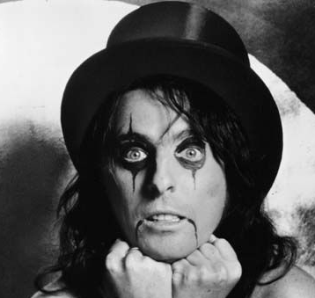
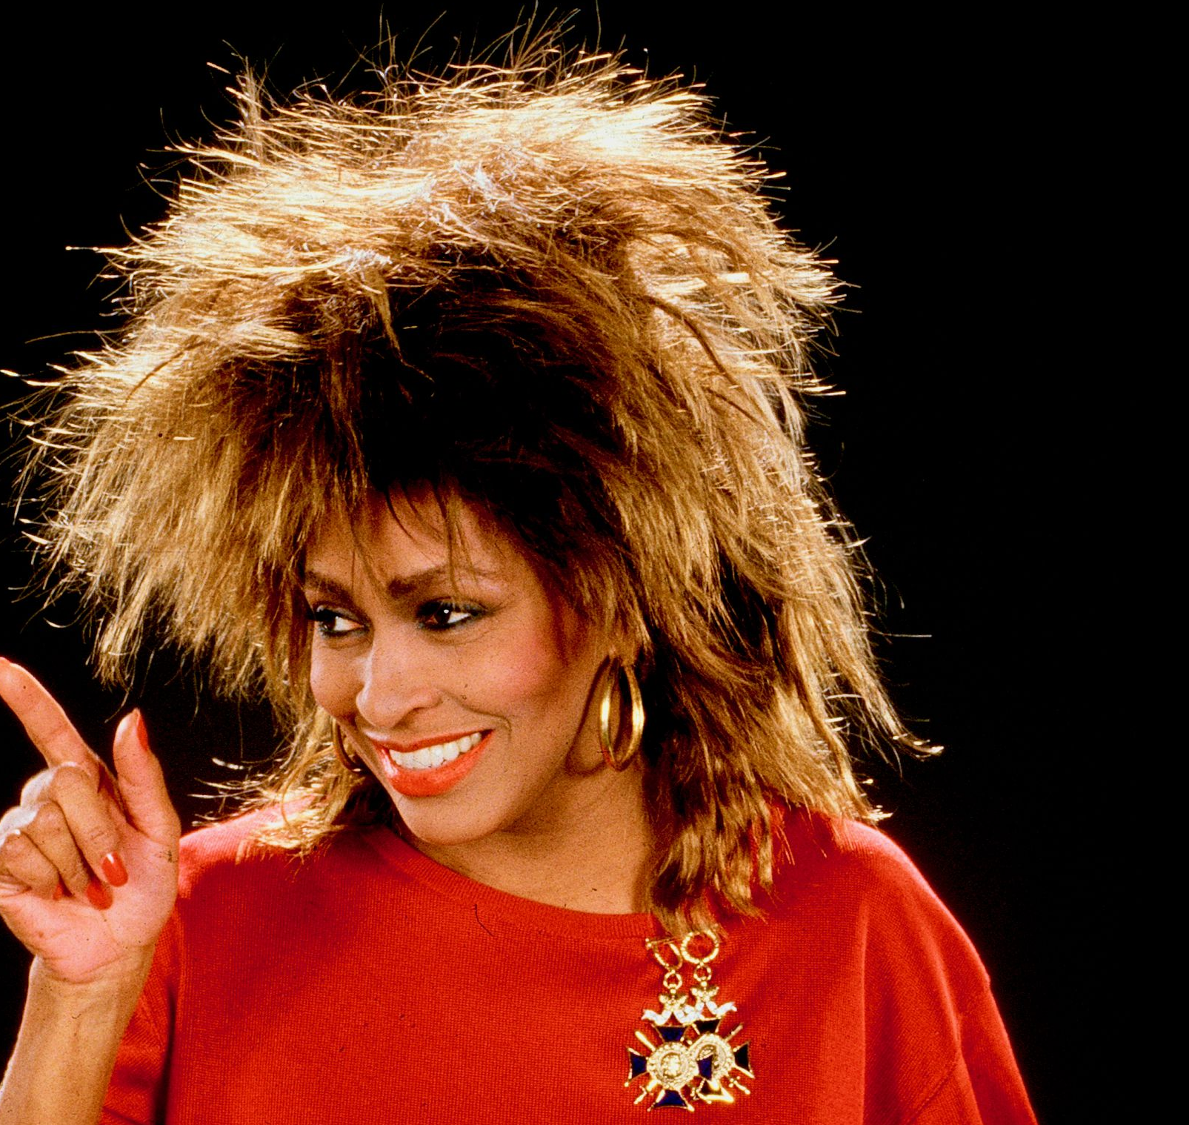
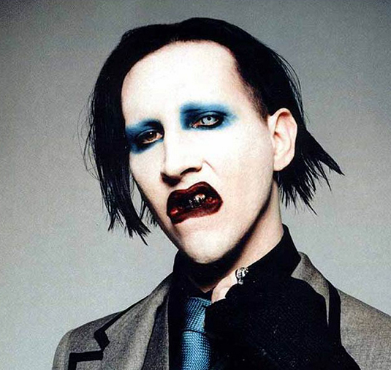
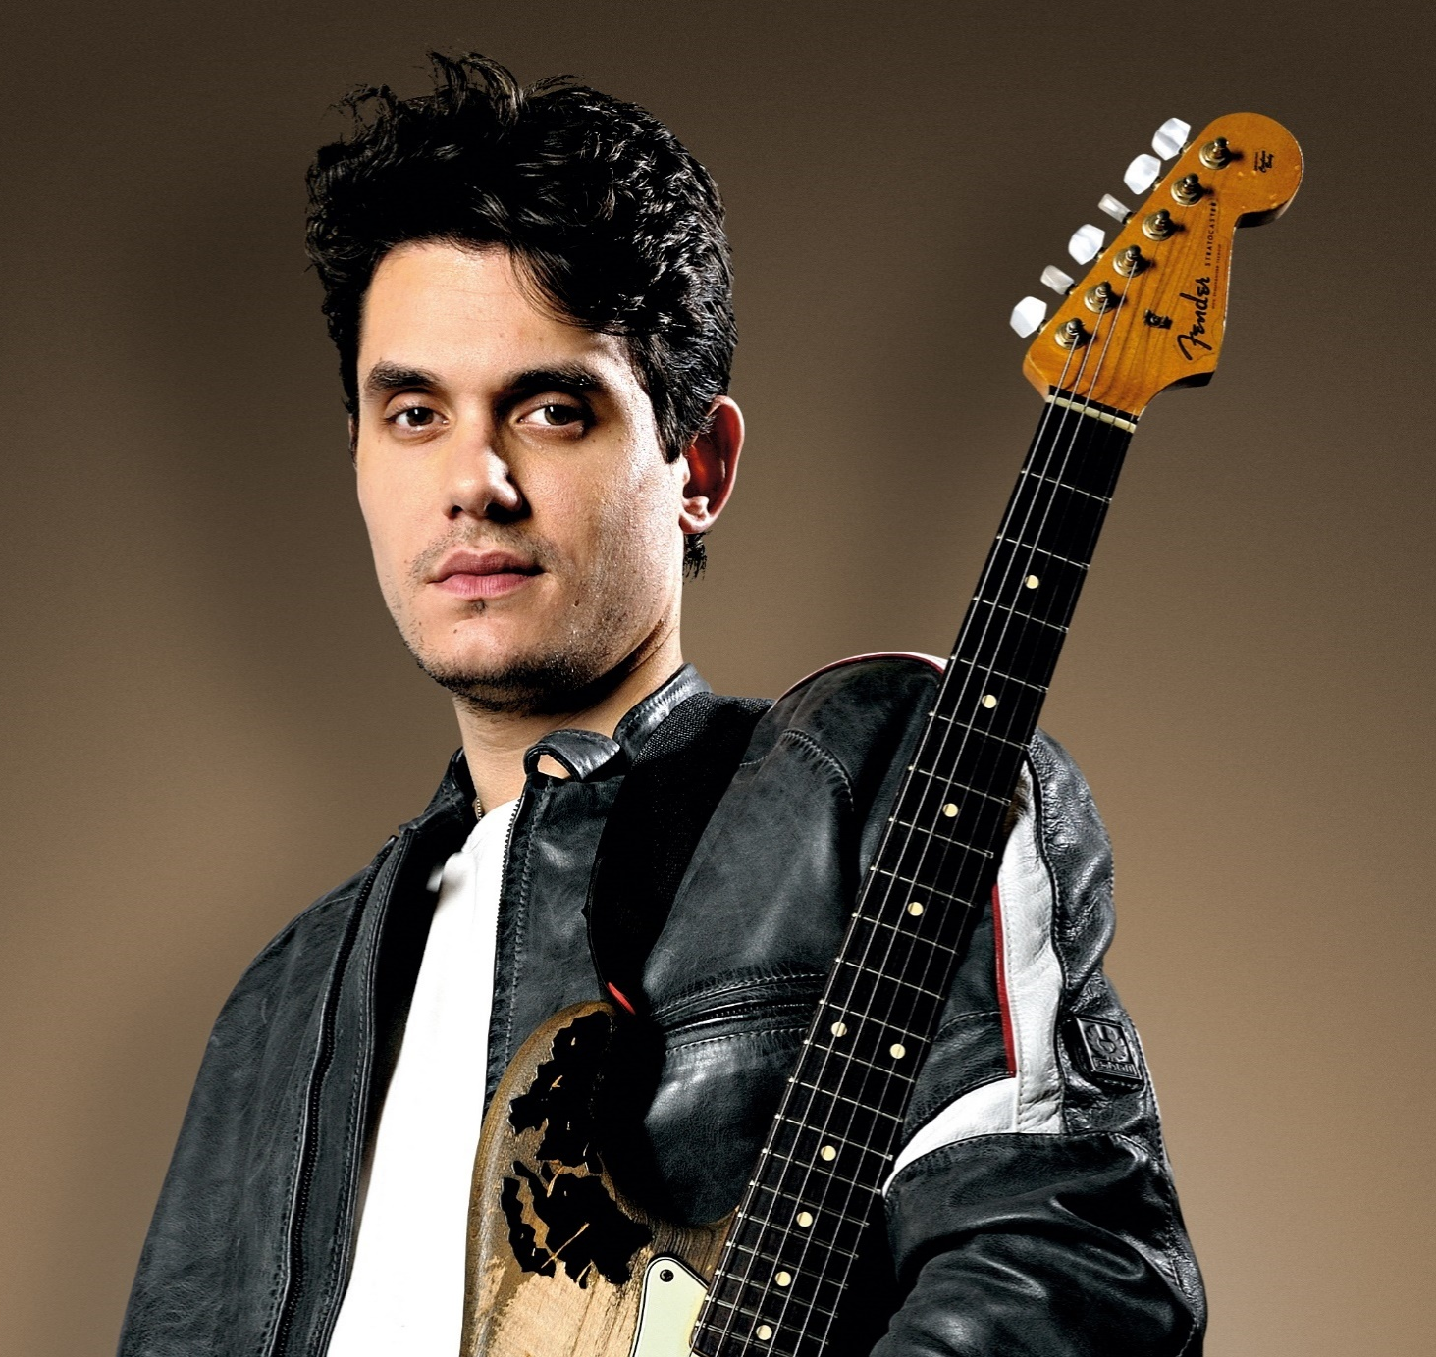
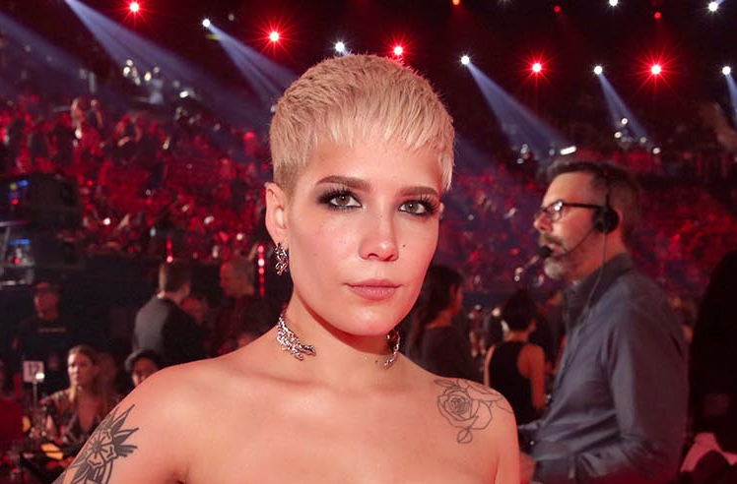
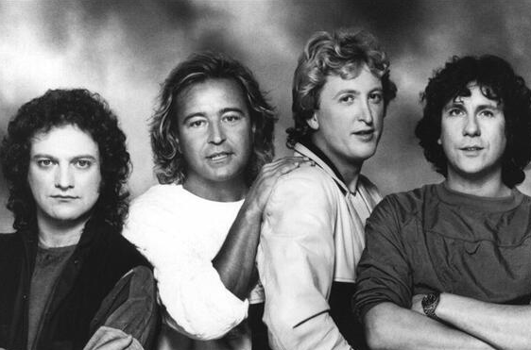
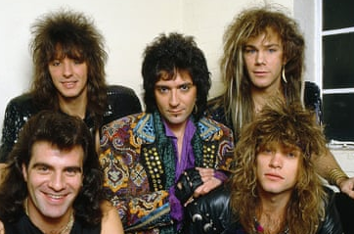
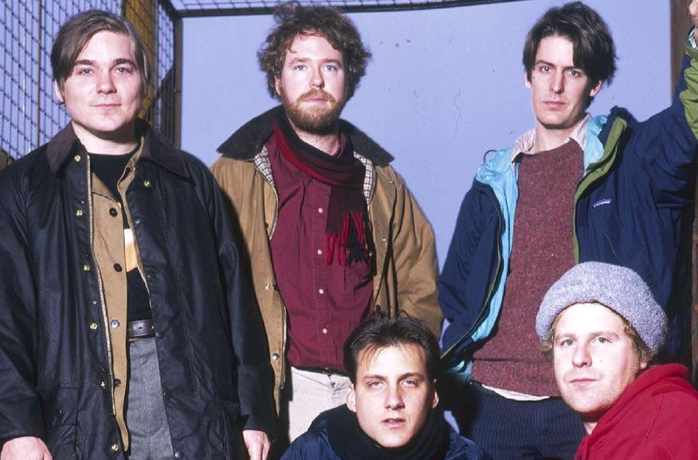
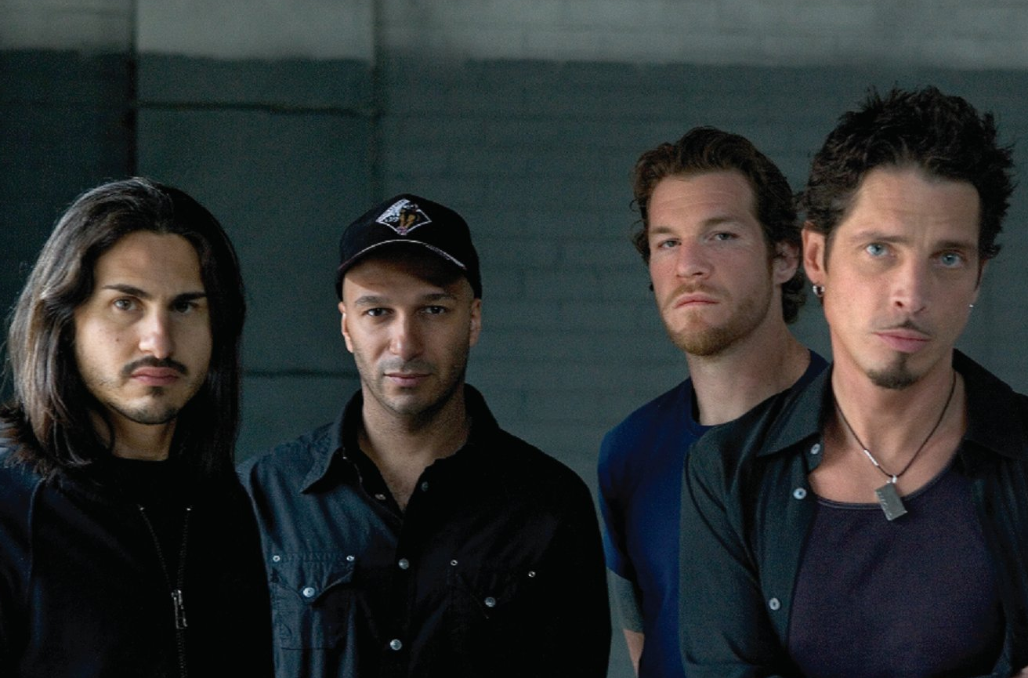
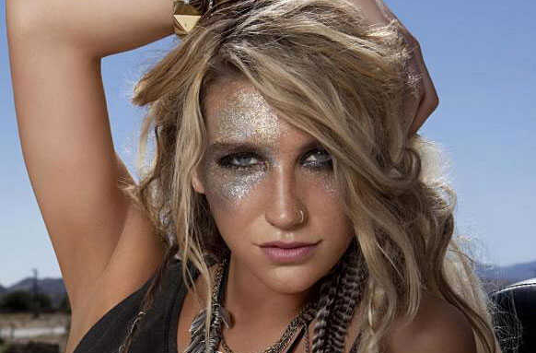
Picture Round
Instructions: Identify the artist or group on the line under each image

Slide 3
Decades In what decade was this version of the song originally released?
Gerry Rafferty – Baker Street (1978)
Eminem – Godzilla (2020)
Duran Duran – Come Undone (1993)
Little Big Town – Girl Crush (2014)
Huey Lewis & The News – Stuck With You (1986)
Mims – This Is Why I’m Hot (2007)
Third Eye Blind – Semi Charmed Life (1997)
Led Zeppelin – Good Times Bad Times (1969)
Neil Diamond – Love On The Rocks (1980)
Grand Funk Railroad – We’re An American Band (1973)
None

Slide 4
General Knowledge
In what year did Pink Floyd release their 11th studio album The Wall? 1979
Heavily influenced by the music, style, and fashions of the 1950s in the south, Stray Cats were a quintessential example of what music genre - its name created by the blending of two words? Rockabilly (‘rock’ from rock and roll and ’billy’ from hillbilly)
Name the Dr. Dre ft. Snoop Dogg song that begins with the line, “One, two, three and to the fo’?” Nuthin' but a 'G' Thang
In 2017, which country artist was performing live onstage at the Route 91 Harvest music festival in Las Vegas when a gunman began shooting into the crowd, killing 60 people and injuring 800 others? Jason Aldean
The Great Highland bagpipe is native to which country in the United Kingdom? Scotland
What song by folk rock band America was banned on some U.S. radio stations because of its supposed drug reference, but made it to #1 on the U.S. Billboard Hot 100 anyway? A Horse With No Name (“horse” is slang for heroin)
Name the 1983 song, from the album of the same name, that became Spandau Ballet’s first U.K. #1 single. True
After dancing as a Fly Girl for the sketch comedy TV show In Living Color, Jennifer Lopez left the show to work as a backup dancer for what singer, and appeared in the music video for That’s the Way Love Goes? Janet Jackson
Placing at #46 on Hit Parader Magazine’s list of Top 100 Metal Vocalists of All Time, Chester Bennington was the lead singer of what alternative/metal/hip hop fusion band? Linkin Park
In 2011 and 2012, Sure Thing and Adorn – two songs by what artist are the two hits that reached #1 on the R&B charts? Miguel
On September 8, 2009 Black Eyed Peas performed I Gotta Feeling for the 24th season Kick Off Party for The Oprah Winfrey Show. How many fans surprised Oprah by performing a choreographed dance on Michigan Avenue’s Magnificent Mile, right in front of the stage? 21,000 people

Slide 6
Alice Cooper
Tina Turner
Marilyn Manson
John Mayer
Halsey
Foreigner
Bon Jovi
Pavement
Audioslave
Ke$ha

