Slide 1
Name Artist & Title
Game 017
Blue Swede – Hooked On A Feeling
Naughty By Nature – Hip Hop Hooray
Finger Eleven – Paralyzer
Anna Hendricks – Cups
Tesla – Love Song
John Fred & His Playboy Band - Judy In Disguise (With Glasses)
Bad Bunny Ft Drake – Mia
Del Amitri – Roll To Me
Madonna – Who’s That Girl
Chicago – Hard Habit To Break

Slide 2
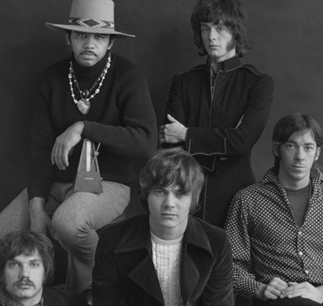
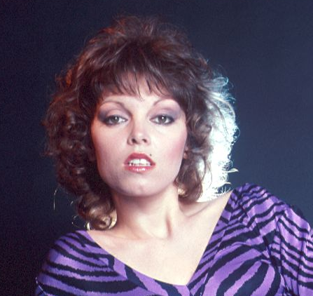
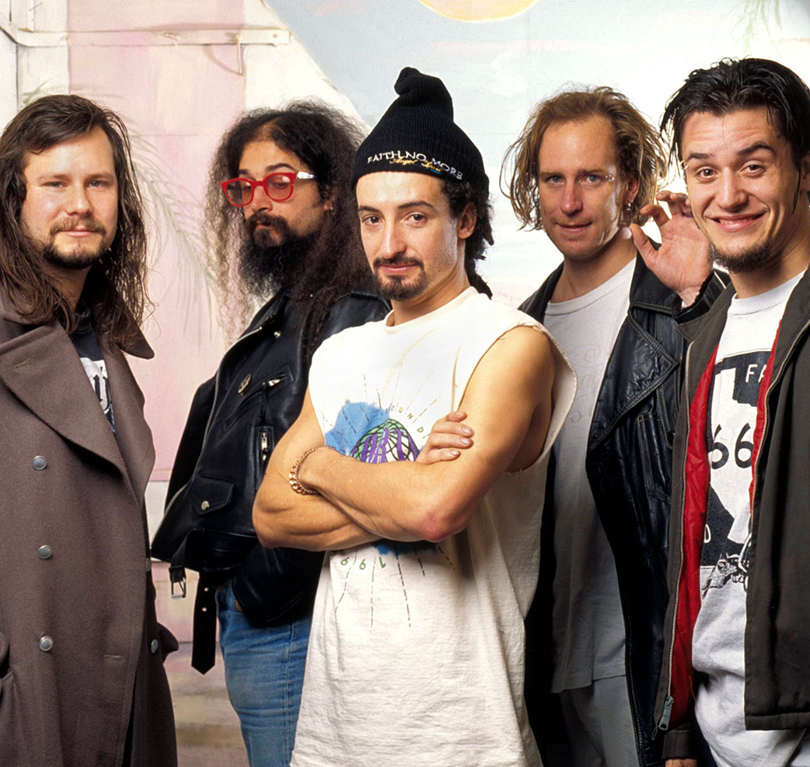
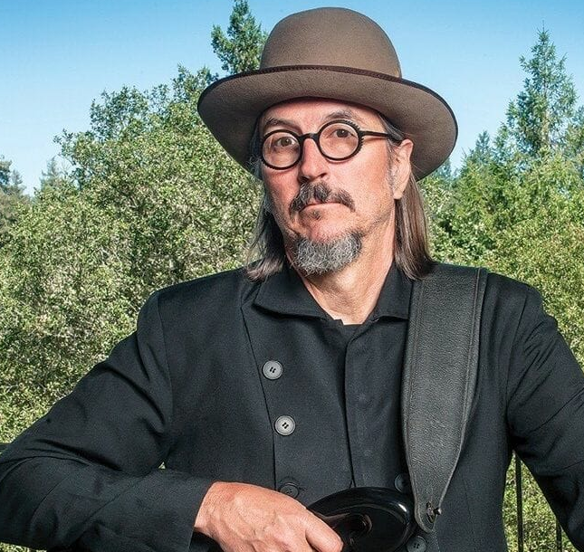
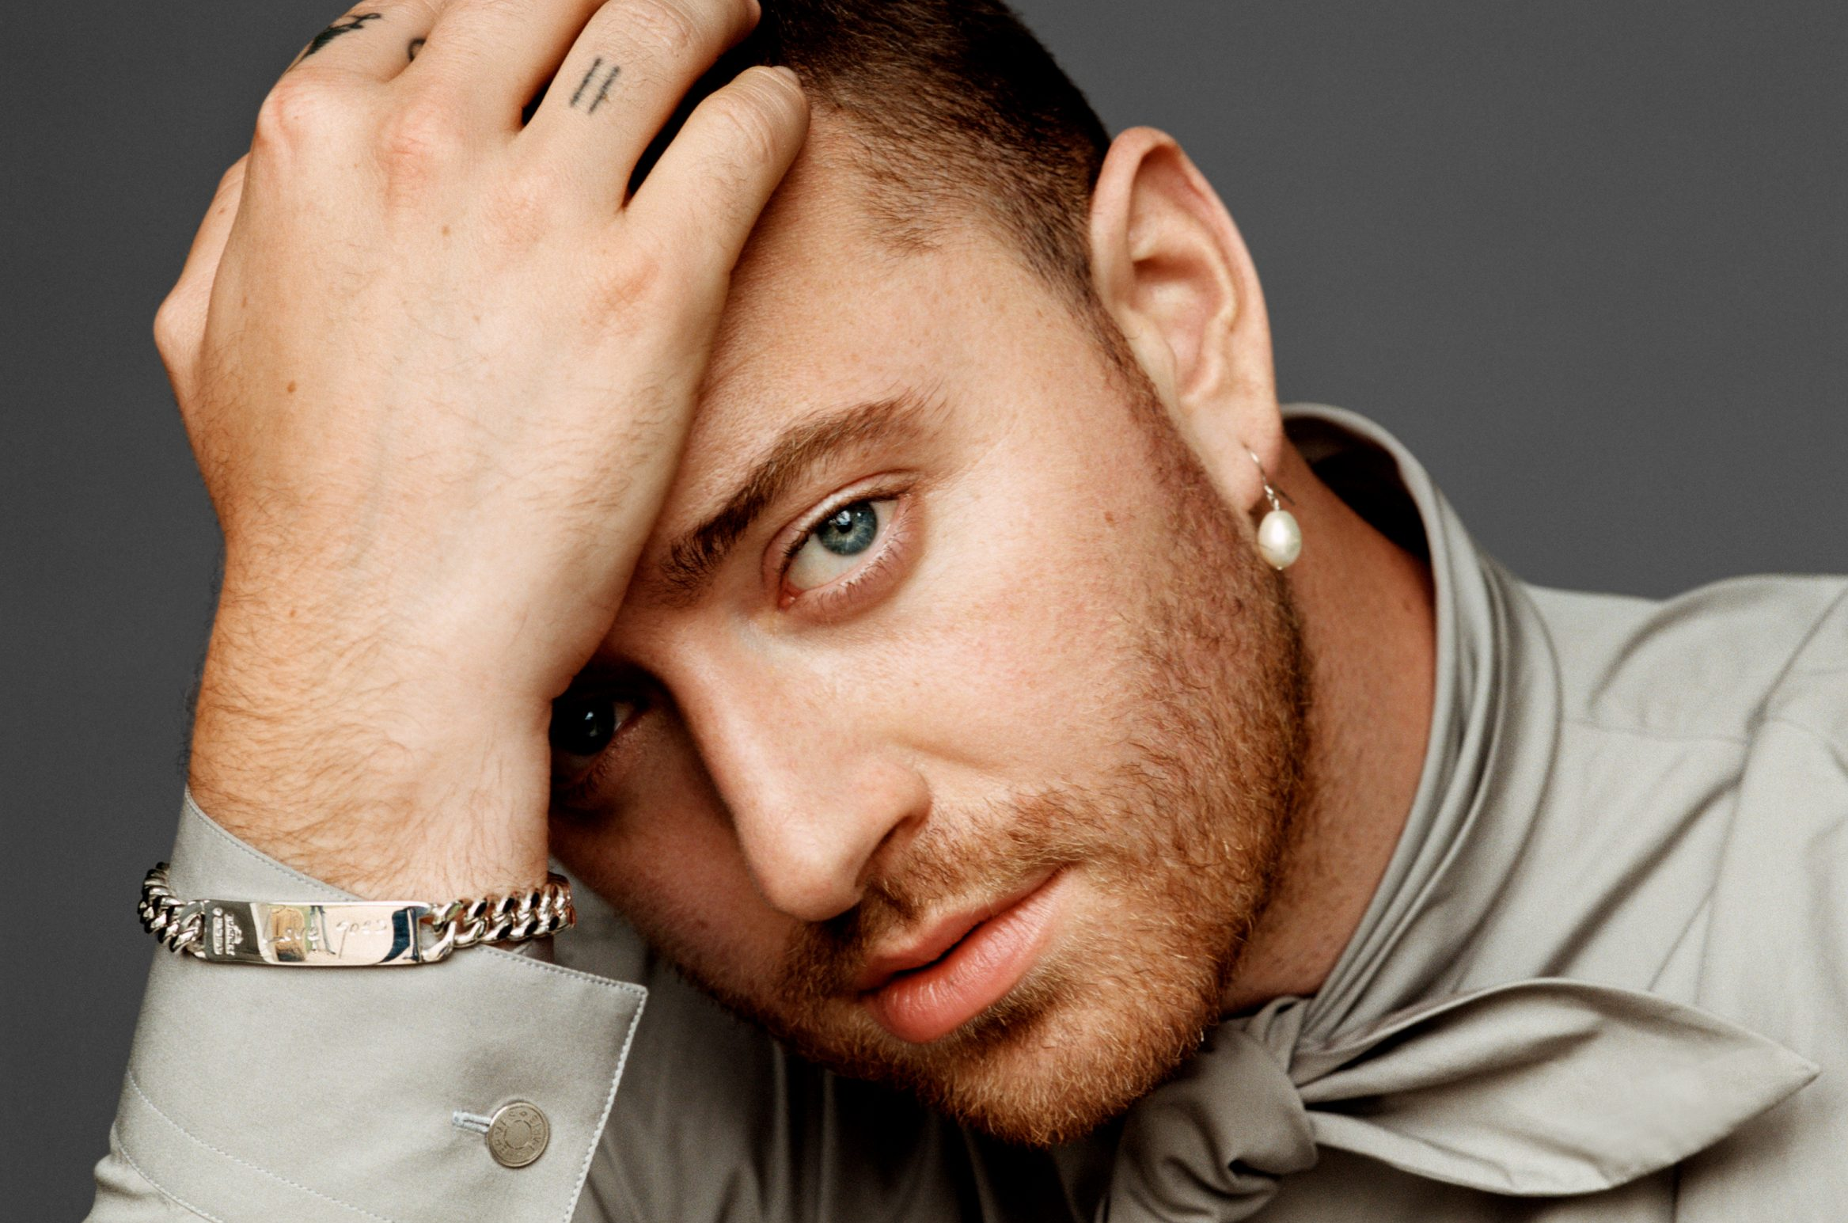
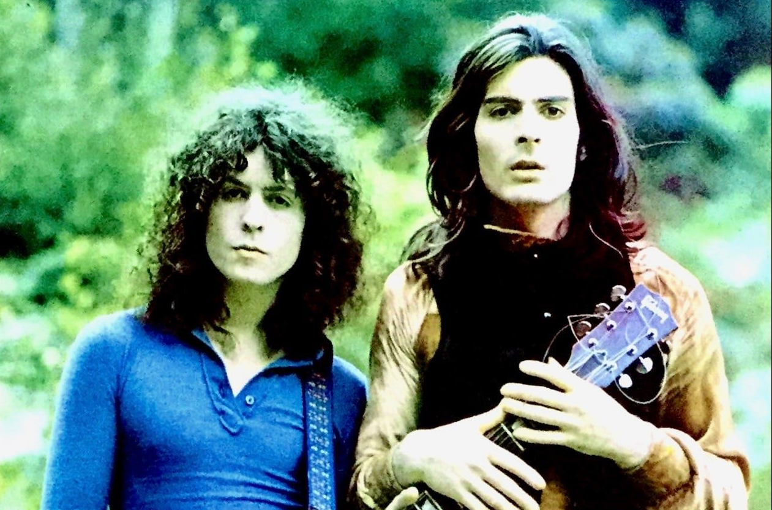
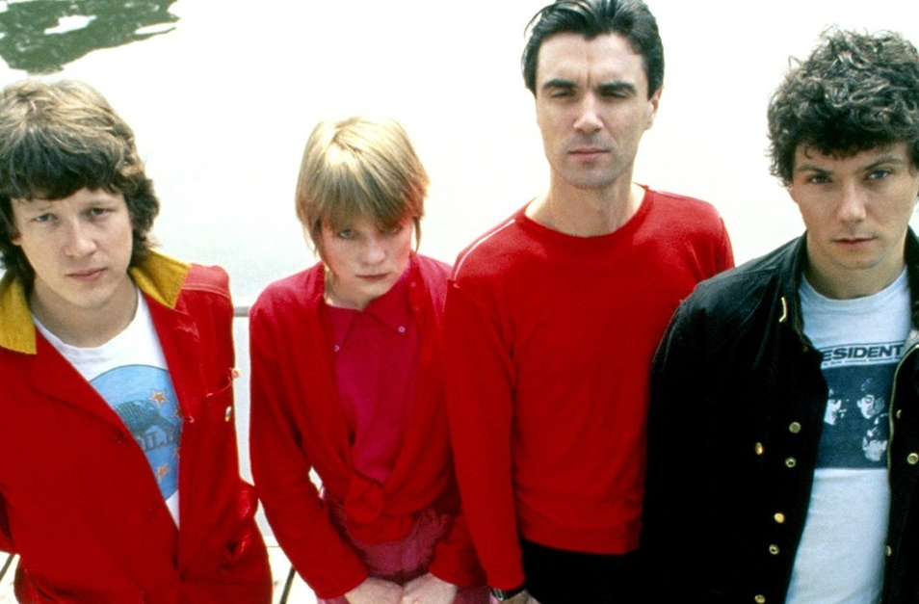
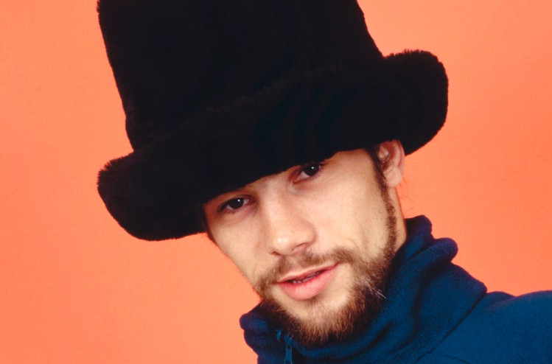
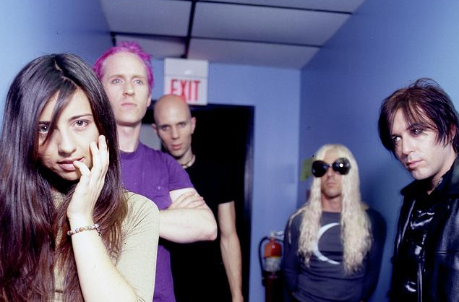
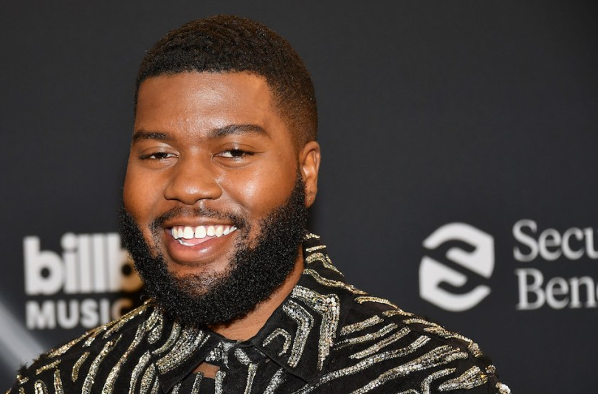
Picture Round
Instructions: Identify the artist or group on the line under each image

Slide 3
Decades In what decade was this version of the song originally released?
Billy Vera and The beaters – At This Moment (1981)
The Weeknd – Starboy (2016)
Color Me Badd – I Wanna Sex You Up (1991)
J-Kwon – Tipsy (2004)
Janis Joplin – Me and Bobby McGee (1971)
Nelly Furtado – I’m Like A Bird (2000)
Blackstreet – No Diggity (1996)
Sweet – Love Is Like Oxygen (1978)
Kenny G – Songbird (1987)
Taylor Swift – You Belong With Me (2008)
None

Slide 4
General Knowledge
Name the popular Broadway musical that tells the story about the formation, success and breakup of the 1960s rock and roll group The Four Seasons. Jersey Boys
In October of 2020 the Weeknd released a remix of the popular song In Your Eyes, which features what “smooth jazz” saxophonist who rose to fame in the 80s and became one of the best-selling artists of all time? Kenny G
From what country does the pop and dance duo Los Del Rio, of Macarena fame, originate? Spain
Name the girl group, known for hits like Don’t Cha, Stickwitu, and Buttons, that started out as a burlesque act in 1995. Pussycat Dolls
What artist came out as gay during Pride Month in 2019, while his country rap hit was enjoying a 19-week run atop the Billboard Hot 100 (its longest-running #1 song since the chart debuted in 1958) Lil Nas X (Old Town Road)
The acronym MIDI describes the communication protocol, digital interface, and electrical connectors between electronic music instruments, computers, and other related devices. What does MIDI stand for? (hint: I just read you all the answers). Musical Instrument Digital Interface
Name the the co-founder of The Smashing Pumpkins who has been the only constant member since its inception in 1988. Billy Corgan
While their fans were awaiting the release of their second album, Boys II Men recorded what ballad for the soundtrack of Eddie Murphy’s film Boomerang, which went on to spend 13 weeks at #1? End of the Road
As of 2022 Lady Gaga is the first and only artist to have two songs pass 7 million downloads, helping her to become the 18th top digital sales artist in the U.S. Name one of these two songs. Just Dance and Poker Face
With over 80 million records sold worldwide, what Can’t Get You Out of My Head singer is the highest-selling female Australian artist of all time? Kylie Minogue
Divided among 3 auditoriums, how many total seats does New York’s Carnegie Hall have? 3671

Slide 6
Steve Miller Band
Pat Benatar
Faith No More
Les Claypool
Sam Smith
T. Rex
Talking Heads
Jamiroquai
A Perfect Circle
Khalid

