Slide 1
INVESTMENT ASSIGNMENT SUBMISSION
Name: Gurpreet Singh

Slide 2
Business Objective
Sparks Fund wants to make investments in a few companies. For that, we have two minor constraints for investments:
1. We have to invest between 5 to 15 Million USD per round of investment.
2. We have to invest only in English speaking countries because of the ease of communication with the companies.
Our main objective is that we have to invest where other are investing. For that we have to analysis which type of funding is most suitable for us. Also, we have to analysis the countries and sectors where most are invested.

Slide 3
Steps of analysis
START
Load the required datasets
Make some analysis of companies and round2 dataframes.
Merge 2 dataframes
Clean the data from the merged dataframe, so that data remains consistent.
Find the best funding type.
Now, we merge the top3 countries and master frame dataframe.
Now, we have to find the best sector for investement by considering top3 english speaking countries and best funding type.
Find the top 3 english speaking countries
Now, Make some analysis of country for investment by choosing best funding type.
Now, we can find the top 3 sectors of top 3 countries of most suitable funding type.
From this dataframe we can find the number of investments and amount of investments in top3 sectors of suitable funding type.
STOP

Slide 4
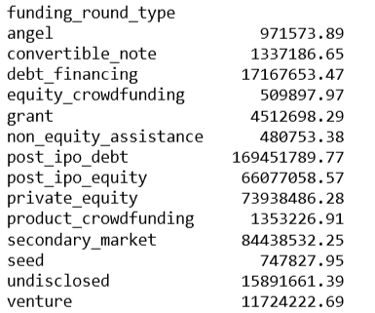
Funding Type Analysis
First We have to analysis which Funding type is most suitable for investment.
After doing some data cleaning and data analysis we found that ‘venture type’ funding type is the most suitable for investment within 5M and 15M Dollars.
We can see that venture funding type is the most suitable for funding between 5M and 15M Dollars.

Slide 5
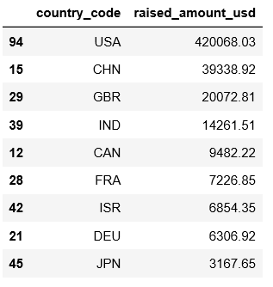
Country Analysis
After finding the best funding type for investment. Now, we have to find the top 3 countries where others are investing and where english is its official language for ease communication.
There is a dataframe which shows the investment in different countries.
But, we have to consider only top3 english speaking countries where others are investing which are
USA, GBR and IND.

Slide 6
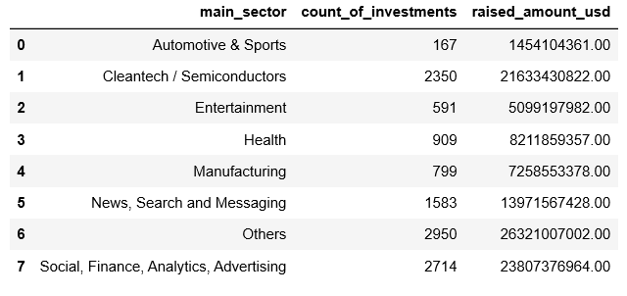
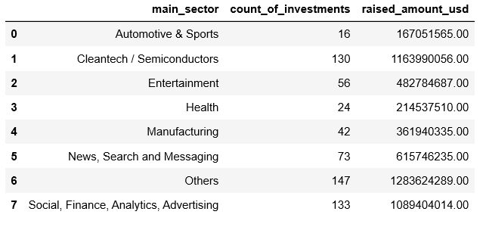
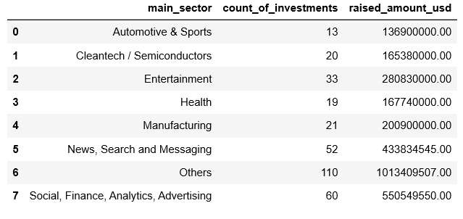
Sector Analysis
After finding the best investment type and top3 countries, now we have to find which is the best 8 main sectors for investment where other are invested.
From this dataframe, we can find out the count of investments and total amount of investment( raised amount usd )
of top3 countries in each main sectors.
Country 1( USA ) Country 2 ( GBR ) Country 3 ( IND )

Slide 7
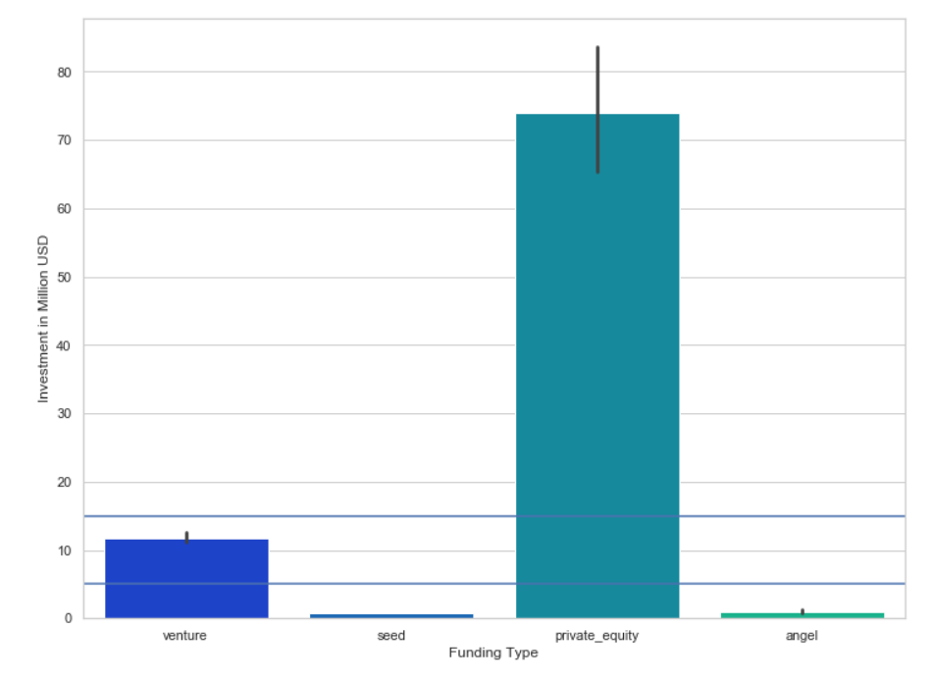
A Plot showing the fraction of total investments (globally) in venture, seed, angel and private equity and the average amount of investment in each funding type. From the plot we can see that ‘venture’ funding type is the best suited for spark funds
Plot 1

Slide 8
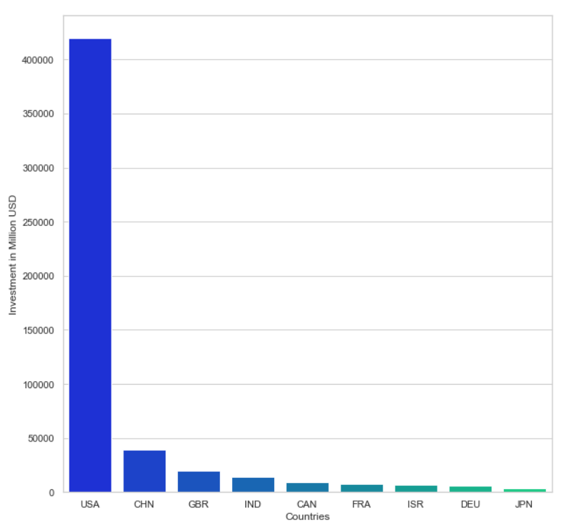
A Plot showing the top 9 countries against the total amount of investments of funding type ‘Venture’. From the plot it is very clear that USA, CHN, GBR is the top 3 countries .
Plot 2

Slide 9
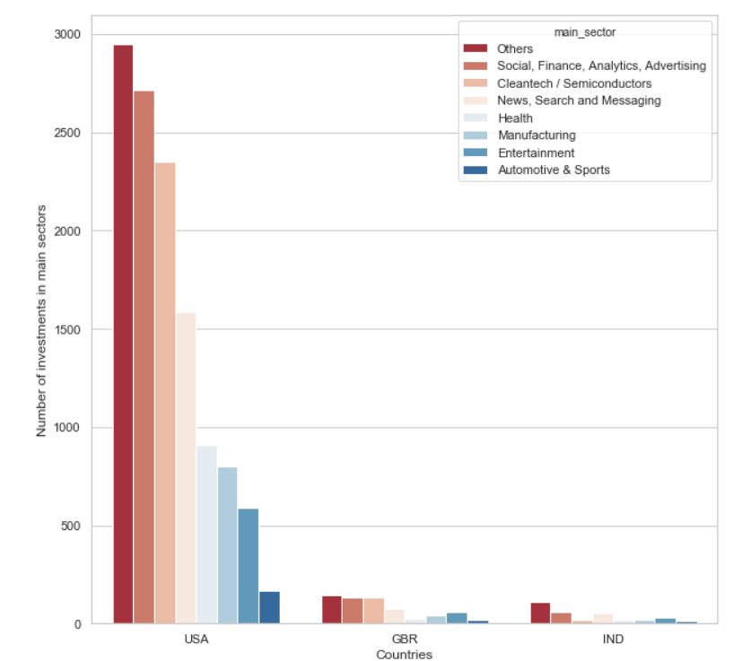
A Plot showing the number of investments in the top 3 sectors of the top 3 countries for the chosen funding type ‘venture’. From plot we can see the top 3 sectors of top 3 countries.
Plot 3

Slide 10
Conclusions
After finding the most suitable funding type, top3 countries and 8 main sectors where other are invested we can say that:
Best Funding type for investment: VENTURE
Best Country for investment: USA
Best Sector for investment: OTHERS

