Slide 1
Open Sourcing Your Enterprise
Mohammad Rezaei

Slide 2
Agenda
General Introduction
Motivation and cost/benefit criteria
Open source recipes
Measure your success

Slide 3
Levels of Participation
Consumption
Contribution
Ownership
Start with consumption and have a plan for contribution and ownership.

Slide 4
Benefits
Reduce Costs
Concentrate on your domain
Don’t reinvent the wheel.
Implement the features you need.
Interoperability
Lower legal costs – no need to review contracts
Attract and retain top development talent
Influence direction

Slide 5
Benefits
Higher quality code
Able to fix issues
Freedom from vendor lock-in
Many eyes, wide usage improves quality and security
Empower your developers
Full access to code, ease of deployment
Influence direction
Reduce rejection of proprietary code

Slide 6
Risks
License incompatibility
Litigation (patent, illegal code)
Malicious code contribution
Security/viability of old libraries
Security of unpatched libraries.

Slide 7
Culture Clash
“Can only use software with a support contract”
“Open source is lower quality than commercial software”
“Open source is not certified to work with product XYZ”

Slide 8
Motivation
2015 survey:
88% want to increase contribution
53% want to reduce employee barrier to participation
Companies contributing:
2014: 50%
2015: 63%
2016: 65%
2017: 66%

Slide 9
Motivation
30% want to make it easier for employees [‘14]
67% encourage contribution [‘16]
34% have more than 50% employees contributing [‘16]
Facebook asked their employees… “Were you aware of the open source software program at Facebook?”

Slide 10
Consumption Recipe
Sell the benefits
Establish a license policy
Mirror & filter maven and npm internally
Create a process for other intake
For large deployments, consider paid support
Post-use compliance

Slide 11
Contribution and Ownership
Three universal aspects:
Legal
Social
Technical
Understanding them makes you a better consumer!

Slide 12
Contribution Recipe
Sell the benefits
Establish training for people
Establish a registry of people/projects
Create bots for compliance/retention
Establish project approval process
Setup IP review for outgoing code
Support both BYOD and enterprise desktop

Slide 13
Legal
Review your employment agreements and copyright law
Explain the rules to your employees
Understand contribution rules versus consumption rules
4 common legal frameworks:
Copyright assignment
Contribution agreement
In == Out
In == Out with DCO

Slide 14
Social
Social pillars of open source:
Collaboration, open exchange
Meritocracy
Transparency
Freedom to tinker
Sharing and empowerment
Good citizenship
Respect the local rules

Slide 15
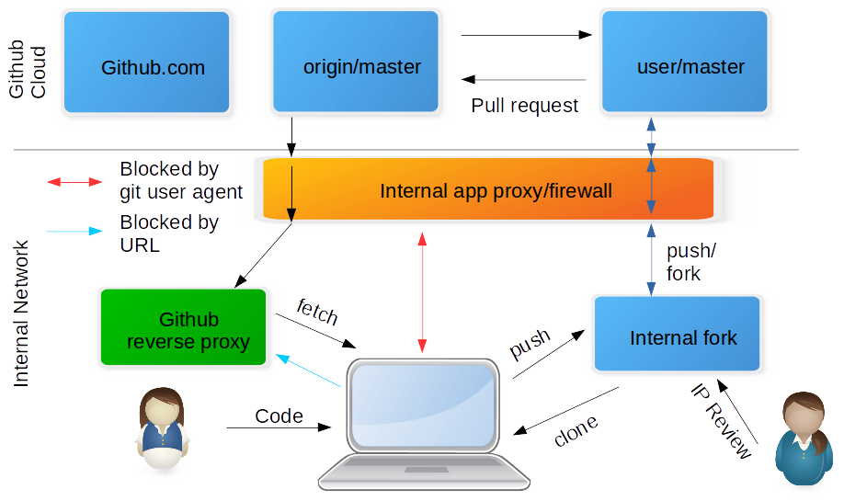
GitHub Contribution Recipe

Slide 16
3 Steps to Contribute
Get trained
Social/Legal/Reputational aspects
Approve project
Legal/Vendor review
Write code
Get IP review if not using BYOD

Slide 17
Ownership Recipe
Sell the benefits
Establish a project approval process
Establish a presence outside
Establish guidelines around responding to issues/bugs
Adopt a contribution model

Slide 18
Ownership: checkpoints
Establish a community standard
Make sure your work is done in the open
Adopt a uniform license
Adopt a contribution model
Code consistency rules
Treat the community with respect

Slide 19
Consumption Success
How long does it take between deciding to use an open source product and actual use?
How easy is it to evaluate an open source product for use?
How easy is it to keep up to date with new versions?
How many manual approvals?

Slide 20
Contribution Success
How long does it take between having a patch and having it accepted?
How many manual approvals?

Slide 21
Ownership Success
Is the ultimate source in the open?
Are discussion and decisions happening in the open?
How big is the size and breadth of the community?
What happens when a committer leaves the company?
What’s the average response time to issues?

Slide 22

Conclusion
Use these recipes as a starting point.
Keep the end goal in mind.
Bring your enterprise into the open source community: it’s good for you and it’s good for the community.

