Slide 1
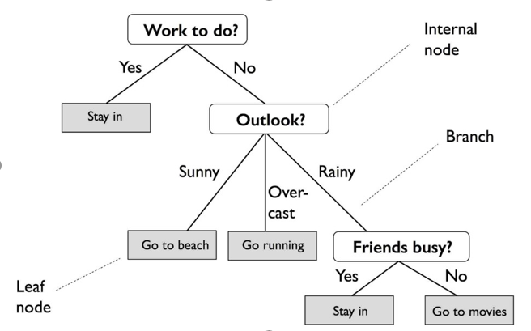
Machine Learning: Mechanics
Multiple types of ML algorithms (discussed later)
Let’s take one example: Decision Tree (supervised machine learning model)
Process of training determines the decision points
Starting from the root, the data is split on the feature that results in the greatest Information Gain (IG)
Increasing IG is roughly the decrease in the uncertainty of the result
Source: https://towardsdatascience.com
Notes:
Before you start working with data for a machine learning project, it is vital to understand what the data is, and what we want to achieve. Without it, we have no basis from which to make our decisions about what data is relevant as we clean and prepare our data.

Slide 2
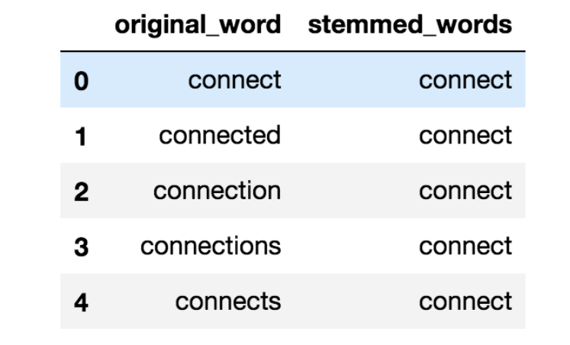
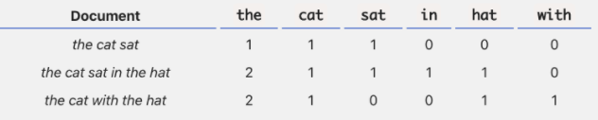
Natural Language Processing
A few key initial steps in prepping the data for NLP:
Text preprocessing (removing capitalisation. lemmatization)
Text to features (BoW, Word2Vec)
Training (Supervised/unsupervised)
Testing & refinement
To use NLP in a financial context we need a dictionary to help us identify sentiment changes at both a stock level and industry level
e.g. Loughran and McDonald (2011) Financial Dictionary
Word lemmatization
Word lemmatization
An example of Bag of Words (BoW)
Source: https://www.analyticsvidhya.com/, https://www.kdnuggets.com/
Notes:
Why NLP?
Approximately two and a half exabytes (10^18) of unstructured data are created daily on the internet
To put things into perspective, the amount of unstructured data that was created in the past two days is equivalent to the same amount of data that was created from the beginning of humankind through the end of 2003

