Slide 1
CityCollection
© Templateswise.com
Innovating Recycling

Slide 2
Who are we?
We are a seed stage startup showcasing a proprietary platform to disrupt recycling in emerging markets. Our plan is to use the connectivity provided by increasing smartphone penetration, to drive incentive driven collection

Slide 3
What is our solution?
Incentivizing users…
…Through data analytics…
…To drive efficient collection
150LKR /month is enough to engage in responsible recycling!
Custom dashboard and state-of-the-art machine learning algorithms that learns/predicts user disposal patterns
Directing logistics and connecting recyclers in the most efficient manner and connecting the main recyclers

Slide 4
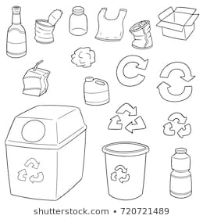
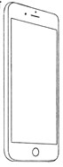
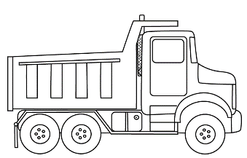
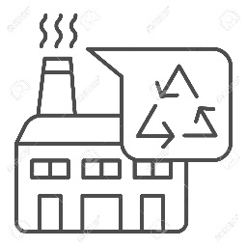
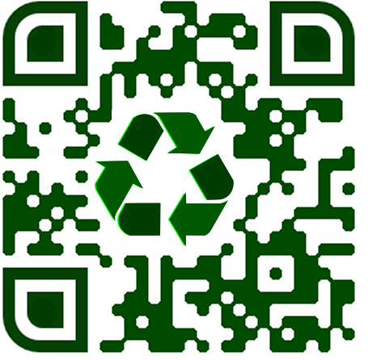
How does our platform work?
Recycling efficiency facilitator, that allows for mapping of individual contributions
Enabling incentive driven recycling through QR code ID
Data analytics enables more efficient recycling, and targeted education

Slide 5
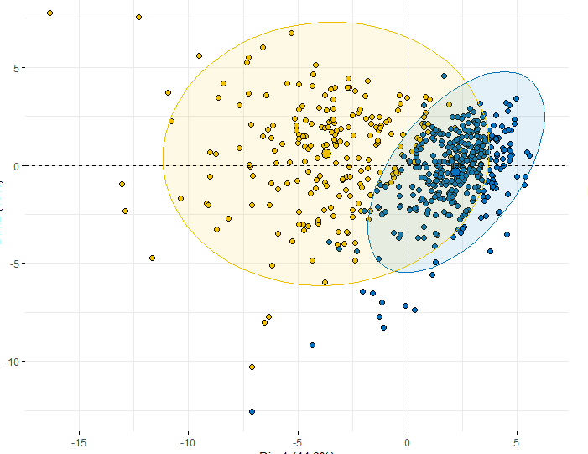
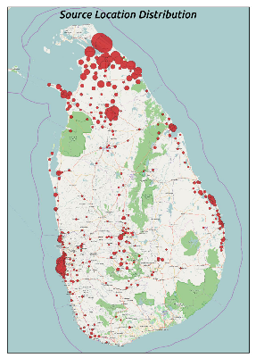
Why should we care?
Disrupting the way we recycle
Unparalleled control of logistics
Efficient and rapid user base growth, driving economies of scale
Education of public (further drive growth)
Cutting edge data analytics

Slide 6
How does our platform work?
Etc etc…

Slide 7
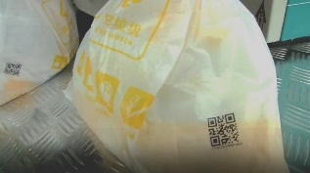

What does the platform require?
Read QR code to ID each user…
Validation @ each household collection by driver
Individual bags collected by users. Each bag has unique QR code ID
…enter #no. of items recycled. This will map to each user
Validation @ recycler

Slide 8
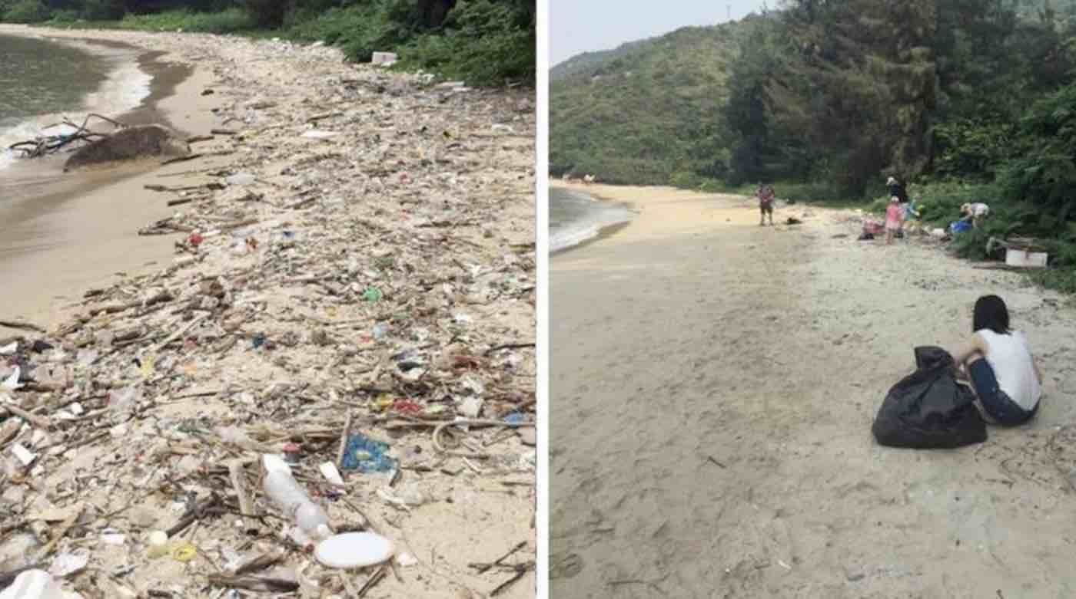
We are looking for a partner!
We are looking for a partner that will help us with a mutually beneficial relationship!
Gamika – gamikasenviratneaud@gmail.com, 0778867684
Avinath –
Ajmal –

