Slide 1
CityCollection
© Templateswise.com
Disrupting Recycling

Slide 2
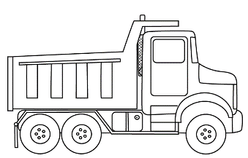
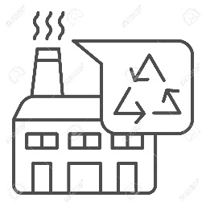

Who are we?
We are a seed stage startup building a scalable, data driven, incentivized recycling platform to cater to emerging markets. Our platform will leverage mobile apps 1. users, 2. validators, and a 3. dashboard for accessing the data driven insights.
Stage of Innovation:
CityCollection
(Us!)
Users
Enabling technology platform
Collectors
Recyclers

Slide 3

Who are we?
Gamika Seneviratne
Name
Name
Assistant Director at Acuity Knowledge partners, 5 years experience in financial analysis, data scientist, and experienced image recognition programmer. MEng in Electrical and Electronic Engineering from Imperial College London
Des
Des
Sri Lankan, Buddhist, Male
Des
Des

Slide 4
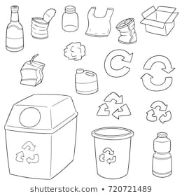
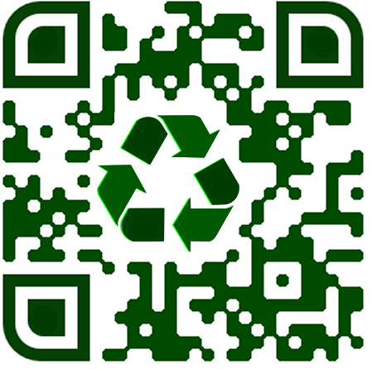
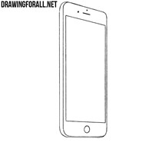
How does our platform work?
Collector collects ID recyclable…
…That recycler users
All bags have QR code that link to specific user
…That users can redeem
Collector sorts and attributes points…
Users segregate data
A recycling efficiency facilitator that allows for mapping of individual contributions, and then rewarding each person for the contribution
Incentives enabled by mapping user specific ID to garbage bags with QR codes
Data analytics combine to give more efficient sorting, recycling and targeted education

Slide 5
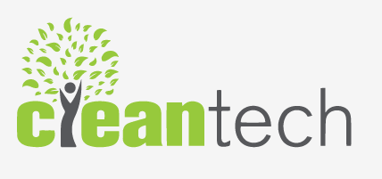
How does it benefit you?
20¢ per PET item
from recycler
5¢ per PET item rewarded for user
15¢ per PET item for Cleantech, our partner
Increased volume
Reduced sorting costs
Better route optimization
Data monopoly

Slide 6
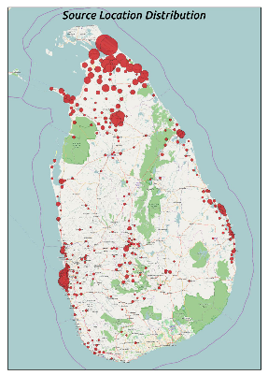
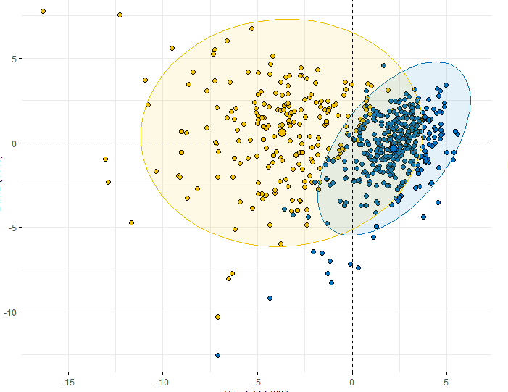
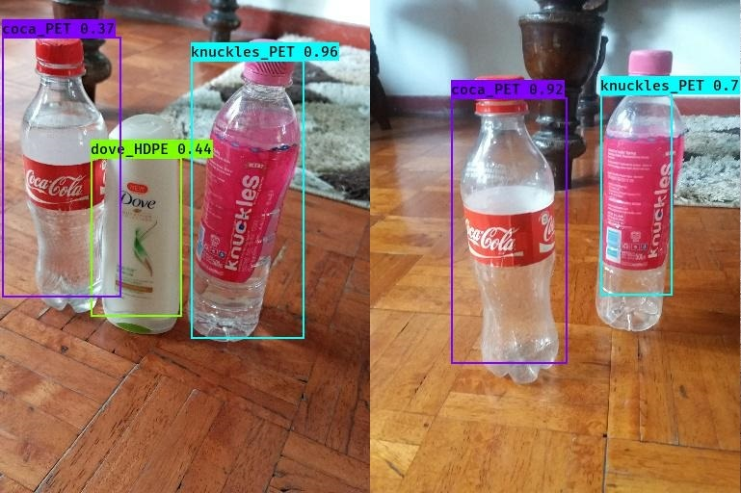
How does our platform work?
Location data
Brand data
Types data
Image data
Explain location, what we will use it for
How to track entry into water ways
Etc
Etc
Gathered for extra incentive
Sold/used for training image recognition algorithm
We already designed two models; 1. mobile capable platform image classification 2 a specific brand identification model (YOLOv3)
Actual data from 100 participants in crowdsourced data gathering initiative

Slide 7
Why does the app scale?
Incentification
Gamification
Explain…
Put a pic of the demo
Explain…
Put a pic of the demo
Education

Slide 8
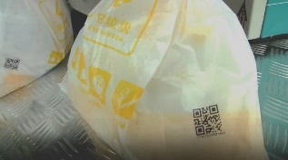

What does the platform require?
Read QR code to ID each user…
Validation @ each household collection by driver
Individual bags collected by users. Each bag has unique QR code ID
…enter #no. of items recycled. This will map to each user
Validation @ recycler

Slide 9
Problems to overcome?
Implementation Changes
Benefits
Plastic data challenge exercises
E.g.
We will provide the mobile devices for free

Slide 10
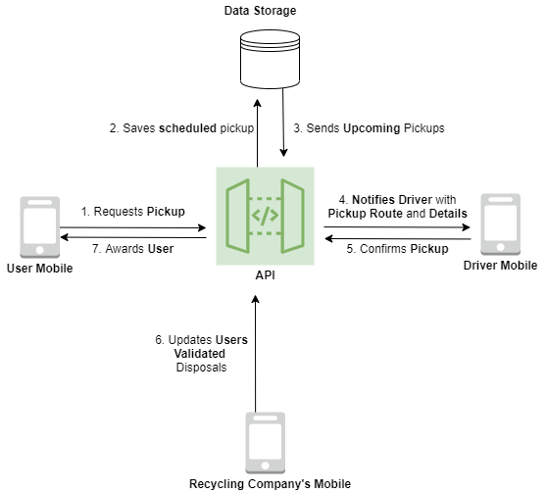
Appendix: How does our platform work?

