Slide 1
CityCollection
© Templateswise.com
Disrupting Recycling

Slide 2
Who are we?
We are a seed stage startup building a scalable, data driven, incentivized recycling platform to cater to emerging markets. Our platform will leverage mobile apps 1. users, 2. validators, and a 3. dashboard for accessing the data driven insights.
We provide the technology platform that enables EM collection authorities to efficiently collect, direct and understand recyclables. Our platform uses an incentivizing and gamification to attract and grow the users base, attribution to identify user disposal patterns, and educate the users. The gathered data will be used in the form of a dashboard also provide to the collectors for optimizing sorting costs, route optimization, and awareness raising campaigns.
>> Images?
Our stage of innovation:
Working POC, building the platform for scalability
Striking partnership deal with largest collector in Sri Lanka
Future plans:
Fully functional scalable platform powered by AWS-
Trial the solution in small districts for PET and E-waste
Strike CSR deals with major retailers

Slide 3

Who are we?
Gamika Seneviratne
Name
Name
Assistant Director at Acuity Knowledge partners, 5 years experience in financial analysis, data scientist, and experienced image recognition programmer. MEng in Electrical and Electronic Engineering from Imperial College London
Des
Des
Sri Lankan, Buddhist, Male
Des
Des

Slide 4
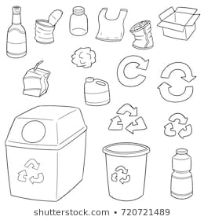
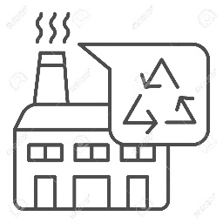
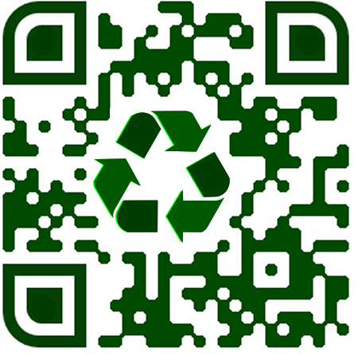
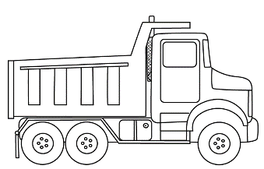
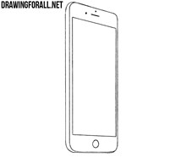
How does our platform work?
…collector collects ID recyclable…
…that recycler users
20¢ per PET…
….into bags having QR codes linked to user’s ID
…collector sorts and attributes points…
…that users can redeem
…5¢ per PET reward
Users segregate data…
…remaining 15¢ per PET
QR codes enables user validation and redemption for each contribution
Validation by the collector can be done at the user’s premise (e.g. laptops) or on premise (e.g. lot of PET bottles) via the manual sorters
Data at user level (e.g. disposal patterns, favorite brands) and at district level (types of items most thrown, proximity to water ways, etc) will be combined to drive a targeted collection and education process

Slide 5
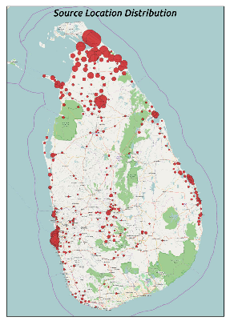
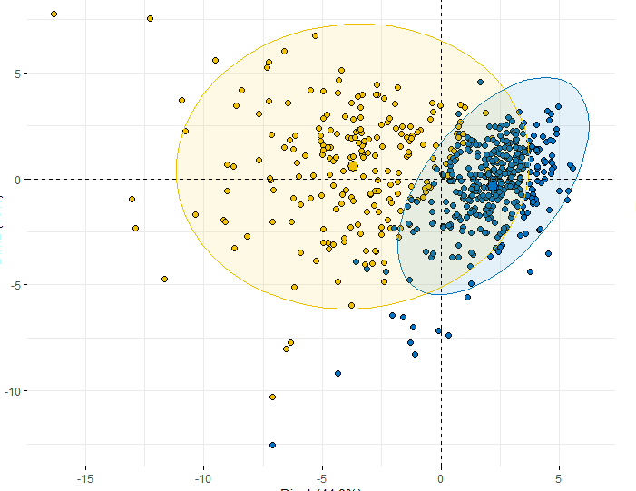
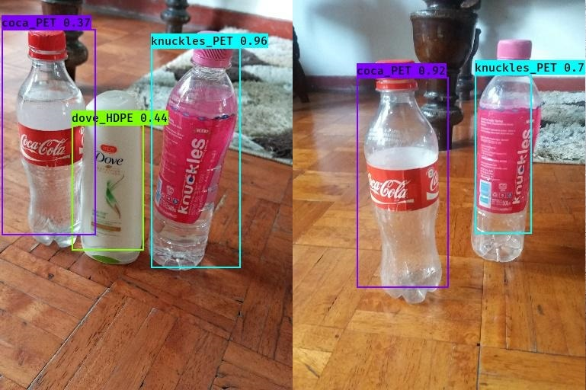
What is the data we generate?
Location data
Brand data
Types data
Image data
Explain location, what we will use it for
How to track entry into water ways
Etc
Etc
Gathered for extra incentive
Sold/used for training image recognition algorithm
We already designed two models; 1. mobile capable platform image classification 2 a specific brand identification model (YOLOv3)
Actual data from 100 participants in crowdsourced data gathering initiative

Slide 6
Why does the app scale?
Incentivizing
Gamification
Explain…
Put a pic of the demo
Explain…
Put a pic of the demo
Education

Slide 7
Challenges we address
Challenge 1 - Improved Visibility of Plastic Waste Generation and Material Flows
Challenge 2 - Optimization of Circular Supply Chains for Plastics
Tracking and understand where plastic waste comes from and where does it go? Tick
2. Better understand waste generation based on its quality (type, cleanliness, etc) and source (urban/rural, commercial/household, community-level/country-level, etc)?
3. Predict the consumer attitudes and behaviors to identify potential channels of influence on plastics?
How might we incentivize responsible for plastic use and waste management?
2. How might we enhance the visibility, connectivity, and efficiency of informal sector waste collectors and aggregators?
3. How might we improve the visibility of pricing?4. How might we better track and improve value generation across the supply chain?
*Further detail is available on our comprehensive assessment report

Slide 8
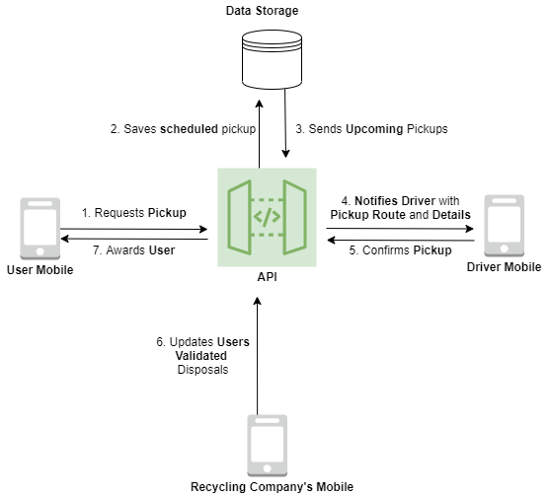
Appendix: How does our platform work?

Slide 9
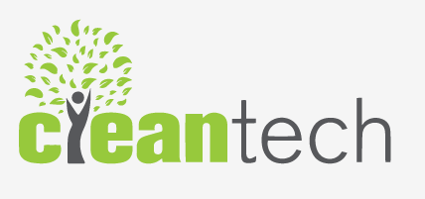
Do we need this slide?
20¢ per PET item
from recycler
5¢ per PET item rewarded for user
15¢ per PET item for Cleantech, our partner
Increased volume
Reduced sorting costs
Better route optimization
Data monopoly

