Slide 1
Regression Discontinuity Designs
April 5, 2021

Slide 2
Week 4: Regression Discontinuity Design
Evan
(Feb 15)
Kee Hyun
Xiaonan (Mar 8)
Youngjoon
(Mar 22)
Chase
(Apr 5)
Alauna, Autumn,
William (Apr 19)
Introduction to Causal Inference
DiD Methods
Fixed Effects
Instrumental Variables
Regression Discontinuity Designs
Experimental Studies
Observational Data
Binary IV
Binary/Con. IV
Binary IV

Slide 3
Agenda
Introduction to RDD concept
When to use RDD
Potential issues with RDD
Literature examples
Example code
Further learning

Slide 4
What is RDD?
RDD uses two samples, one subject to a certain treatment and the other not, to estimate two regression lines and then compares the difference
Functions like a quasi experiment
The "cutpoint" between the treatment and control groups needs to be random or "as-if" random
The method examines a given bandwidth around the cutpoints
After a regression line is fit to each group, measure the difference in the intercepts at the cutpoint
This is your estimated treatment effect
This method is most commonly used to examine close elections, but can have a variety of applications

Slide 5
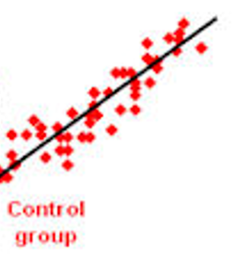
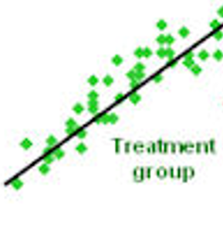
What is RDD?
An IR Example:
Having a budget surplus decreases the number of rebel fighters in conflict states, because these states are more able to acquire funds to pay soldiers.
‘Surplus’ is the statistical ‘treatment’
Budget deficit (0 or 1) acts as the cutpoint.
The amount of deficit (or surplus) acts as the x-axis, the number of rebels acts as the y-axis.
The green points are states with budget surpluses (negative deficits). The red points are states with budget deficits.
Estimated treatment effect
Number of rebels
Budget deficit

Slide 6
What is RDD?
Some points from each group may exist above or below the regression mean for the alternate group; the method is comparing the difference in regression means.
Estimated treatment effect
Number of rebels
Budget deficit

Slide 7
What is RDD?
Estimation is occurring within the “optimal bandwidth”, which may not include all values from each group.
Optimal bandwidth min
Number of rebels
Optimal bandwidth max
Budget deficit

Slide 8
What is RDD?
RDD curves can take many forms
For example;
Treatment group may be on the right
The curve could also slope negatively, or be flat
Many theoretical base models will be flat
Flat RDD is “sharp”, sloped is “fuzzy”
The treatment variable may differ from the x-axis variable
In some cases, the treatment effect may weaken the related independent variable effect
For example, shown here; states that attack civilians are shown on a scale, with the implementation of sanctions for this behavior being the cutpoint, and the x-axis showing the number of attacks
This setup is less common for observational data, difficult to establish clean cutpoints
Treatment group – international sanctions
Number of rebels
Control group
Attacks on civilians

Slide 9
What is RDD?
Another case may use a treatment effect not directly related to the other independent variable (“covariate”)
For example, we may use geographic region as the treatment effect
In this case, the method is essentially the same as estimating a binary variable coefficient into a model, and then plotting this model in comparison with a model with the variable excluded
The primary difference is the “randomness” of the treatment
Control group
Number of rebels
Treatment group – OECD Neighbor
Unemployment rate

Slide 10
When should we use RDD?
RDD is most appropriate with a binary independent variable
Even better when the variable can alternately exist in ‘degrees’ of some kind
For example, in election results: win/lose, margin of victory/loss
RDD is problematic if we are selecting the binary cutoff for a continuous variable
For example, unemployment: 10% unemployment is cutpoint
This violates the underlying logic of an RDD argument (a binary ‘treatment’) and is also susceptible to selection bias
However, it could work in the case of something with a well-accepted “cutoff”, such as a 620 FICO score

Slide 11
When should we use RDD?
The distribution of cases may limit the effectiveness or statistical significance of this method
For example, for very rare events such as conflict or coup
In practice, if the cut-off selects only a small number, then the control group may also be constrained. In the same way, using experimental data, more subjects may be sought for the control group if the treatment group takes a significant majority. However, this is usually not possible for observational data.
Estimated treatment effect
Number of rebels
Budget deficit

Slide 12
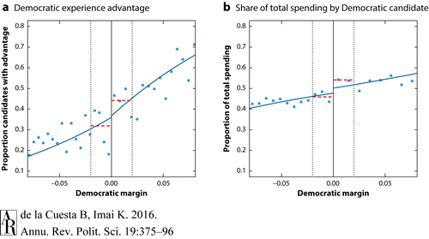
Potential Issues with RDD: Bandwidth selection
Local randomization assumption: Under the local randomization assumption, also called the as-if-random assumption, the observations below and above the discontinuity threshold, a [−0.02, 0.02] window indicated by dotted lines in this case, are assumed to be identical on average. As a result, the estimated discontinuity is based on two flat lines with no slope (red dashed lines). In contrast, under the continuity assumption, the association with the forcing variable is not assumed to be absent (blue solid lines). The two plots are based on the dataset on US House elections by Caughey & Sekhon (2011) using two pretreatment covariates: the experience advantage of the Democratic candidate (a) and the proportion of total donations given to the Democrat (b). They show that the local randomization assumption can falsely discover a discontinuity (a) or overestimate one (b).
Solution: test multiple bandwidths

Slide 13
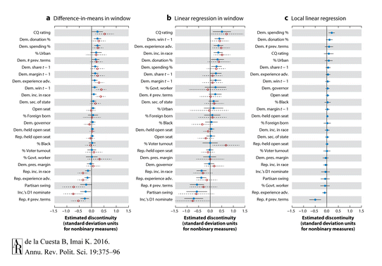
Potential Issues with RDD: Line estimation method
Figure shows a comparison of estimated discontinuities in pretreatment covariates across three methods. Solid and dashed lines in each panel represent 95% confidence intervals, not corrected for multiplicity. (a) Filled blue circles represent estimates based on the difference-in-means estimator within the 2-percentage-point window on either side of the threshold; open red circles represent estimates within the one-half-percentage-point window. Panel (b) shows the estimates based on the linear regression in the same sets of windows. Panel (c) presents the estimates based on the local linear regression proposed by Calonico et al. (2014). Abbreviations: adv., advantage; CQ, Congressional Quarterly; Dem., Democratic; govt., government; inc., incumbent; pres., president; prev., previous; Rep., Republican; sec., secretary; t, time period.
Solution: test multiple methods

Slide 14
Potential Issues with RDD
External validity and extrapolation: The design is inherently extrapolating the treatment effect along the whole line, although the estimate is being drawn only from the cutpoint
The effect could differ at other points in the line
Including covariates in the model can also complicate this issue
Solution: Include several robustness tests, estimate full lines if possible
Estimated treatment effect
Extrapolated treatment group estimate
Number of rebels
Extrapolated control group estimate
Budget deficit

Slide 15
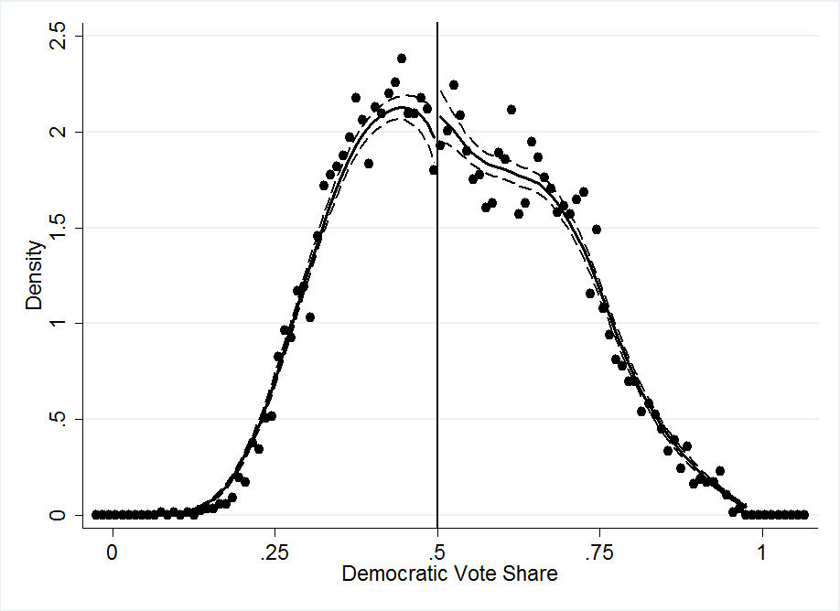
Potential Issues with RDD: Distortion at cut-point
Distribution density
Example: In State X, close elections always result in a recount, and the incumbent party usually wins (i.e. is able to manipulate) the recount
Issue: This can have implications for our theory, as the candidates in close elections are manipulating whether they are in the treatment group or not
Solution: Observation density test
See McCrary (2008)

Slide 16
Literature Example
Ventura, T. (2021). Do mayors matter? Reverse coattails on congressional elections in Brazil. Electoral Studies, 69, 102242.
Provides an example of the “close election” genre
Studies the effect of having an incumbent mayor on a parties’ regional vote performance
The effect is hypothesized to be positive

Slide 17
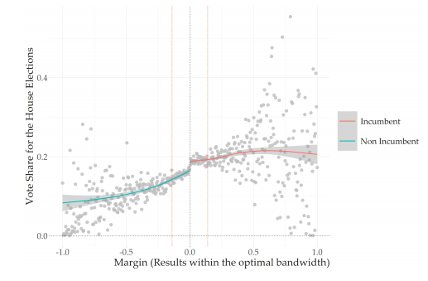
Literature Example: Primary figure
The y-axis displays the dependent variable, party’s regional vote share
The x-axis displays the independent variable, party’s mayoral election performance, with the cutpoint being win or loss and the scale showing margin of victory/defeat

Slide 18
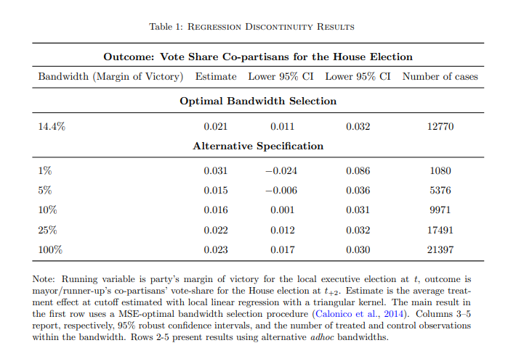
Literature Example: Primary table
Optimal bandwidth selection
Treatment effect estimate (interpreted as percentages)
Confidence interval
Sample size

Slide 19
Literature Example: Conceptual Check
This model works well because we have a clear binary variable:
Party mayoral candidate either won (1) or lost (0)
Can also be expressed as a vote margin
We have a clear theory about how this would impact the party’s vote share in the general election:
An incumbent mayor would be expected to help (“reverse coattails”)
Alternative example: If our theory was about how spending in the mayoral race would affect the party’s chances in the general, RDD would be less appropriate
There is no clear cut-point on which we could divide two regression groups

Slide 20
Code: Literature Replication (Table Results)
table<- Hmisc::latex(d_fig, file=here("outputs","table_1.tex"),
title="",
table.env=FALSE,
center="none",
col.just = c("l",rep("c",ncol(d_fig)-1)),
colheads=colnms,
booktabs = TRUE,
rowname = NULL,
caption = "\\textsc{Regression Discontinuity Results}",
n.cgroup=5,
cgroup = "\\textsc{Outcome: Vote Share Co-partisans for the House Election}")
# Definining the variables
y<- df$vs_party_fed
r <- 100*df$vote_margin_share
band <- list("opt", 1,5,10, 25, 100)
# Model local linear
res <- sim_rd(y=y, x=100*df$vote_margin_share,
vary = band, p=1)
# Selecting the Results
d_fig <- map_df(res, extract)
# Table 1 ------------------------------------------------------
d_fig %<>% mutate_if(is.numeric, round, digits=3) %<>%
mutate(h=paste(c(1, 5, 10, 14.4, 25, 100),"\\%", sep="")) # add by hand the optimal value label
colnms = c("Bandwidth (Margin of Victory)", "Estimate", "Lower 95\\% CI",
"Lower 95\\% CI","Number of cases")
Primary RDD package required: ‘rdrobust’
Also requires several other packages
Define variables and cut-point needed for model
Run model (d_fig) using sim_rd function
Create a formatted Latex table using the model
Link to full replication code

Slide 21
Code: Literature Replication (Figure)
# Treatment -----------------------------------------------------------
d$treat <- ifelse(d$vote_margin_share <0, "Non Incumbent", "Incumbent")
df <- d
# Figure 2 ----------------------------------------------------------------
cut <- cut(df$vote_margin_share,500, include.lowest = TRUE)
tmp <- aggregate(y, by=list(cut = cut), FUN=mean, na.rm=T)
tmp1 <- aggregate((df$vote_margin_share), by=list(cut = cut), FUN=mean, na.rm=T)
data <- data.frame(margin = tmp1$x, y = tmp$x)
ggplot() +
geom_point(data = data[data$margin <0 ,], aes(margin, y),na.rm=T,size=3, color = 'gray', alpha=.8) +
geom_point(data = data[data$margin >0 ,], aes(margin, y),na.rm=T,size=3, color = 'gray', alpha=.8) +
stat_smooth(data = df,
aes(vote_margin_share, vs_party_fed, group=treat, color=treat)) +
geom_hline(yintercept=0, linetype="dotted") +
xlab("Margin (Results within the optimal bandwidth)") +
geom_vline(xintercept=0, linetype="dotted") +
ylab("Vote Share for the House Elections") +
scale_color_discrete(name="") +
geom_vline(xintercept=-0.14, linetype="F1", color="tomato2", alpha=.5) +
geom_vline(xintercept=0.14, linetype="F1", color="tomato2", alpha=.5)
Primary package required: ggplot
Also requires several other packages
Establishment of binary variable and cutpoint
Establish group designations
Construction of the figure (ggplot)
Link to full replication code

Slide 22
Code: General Example (Table Results)
library(rdd)
bw <- with(RD_data, IKbandwidth(R, Y, cutpoint = 0))
rdd_simple <- RDestimate(Y ~ R, data = RD_data, cutpoint = 0, bw = bw)
summary(rdd_simple)
##
## Call:
## RDestimate(formula = Y ~ R, data = RD_data, cutpoint = 0, bw = bw)
##
## Type:
## sharp
##
## Estimates:
## Bandwidth Observations Estimate Std. Error z value Pr(>|z|)
## LATE 1.0894 1177 0.3035 0.11323 2.680 0.007355 **
## Half-BW 0.5447 611 0.2308 0.15471 1.492 0.135722
## Double-BW 2.1787 1832 0.2699 0.08968 3.010 0.002613 **
## ---
## Signif. codes: 0 '***' 0.001 '**' 0.01 '*' 0.05 '.' 0.1 ' ' 1
##
## F-statistics:
## F Num. DoF Denom. DoF p
## LATE 37.73 3 1173 0.000e+00
## Half-BW 12.64 3 607 1.006e-07
## Double-BW 104.74 3 1828 0.000e+00
Another code option is ‘rdd’
Establishment of the cutpoint
Construction of model
Call model results
Tutorial

Slide 23
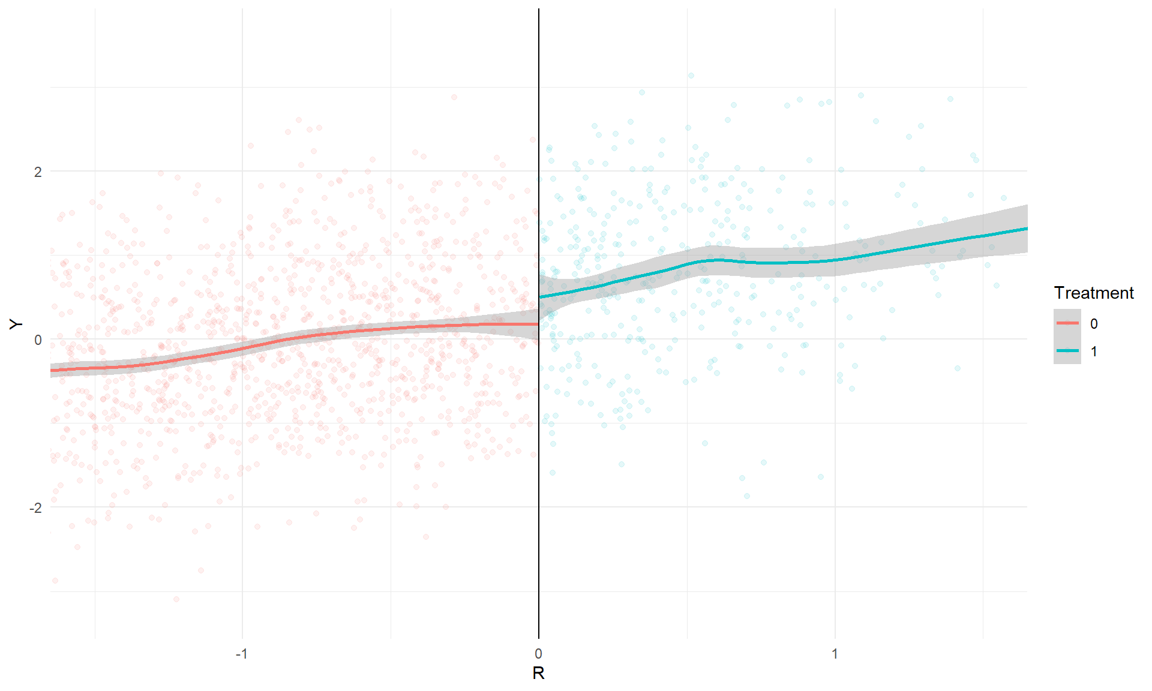
Code: General Example (Figure)
Use ggplot to create RDD figure
Uses example data from literature paper
Figure itself can be found here: Tutorial
## `geom_smooth()` using formula 'y ~ x’
ggplot() +
geom_point(data = data[data$margin <0 ,], aes(margin, y),na.rm=T,size=3, color = 'gray', alpha=.8) +
geom_point(data = data[data$margin >0 ,], aes(margin, y),na.rm=T,size=3, color = 'gray', alpha=.8) +
geom_smooth(data = df,
aes(vote_margin_share, vs_party_fed, group=treat, color=treat))

Slide 24
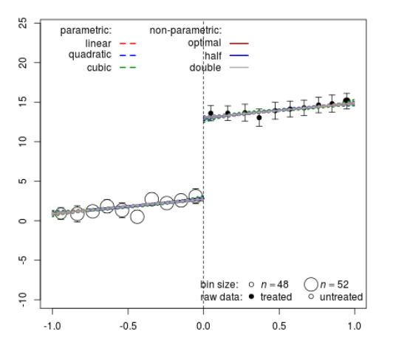
Code: General Example 2 (Figure)
Another simple example using the rdd package instead of ggplot
Function utilized is plot.RD
Tutorial
dat <- data.frame(x = runif(1000, -1, 1), cov = rnorm(1000))
dat$tr <- as.integer(dat$x >= 0)
dat$y <- 3 + 2 * dat$x + 3 * dat$cov + 10 * (dat$x >= 0) + rnorm(1000)
rd <- rd_est(y ~ x + tr | cov, data = dat, cutpoint = 0, t.design = "geq")
plot(rd)

Slide 25
For further learning
1. Imbens and Lemieux 2008 – General methods article on the use of the RDD method with observational data
2. Gelman and Imbens 2019 – Discusses the degree of line fit, recommends linear or other low-order line fits
3. Keele and Titiunik 2015 – Examines geographic boundaries as random cutpoints in constructing natural experiments
4. de la Cuesta and Imai 2016 – Annual Review article discussing close election application
Another great RDD source for R (and conceptual): https://rpubs.com/cuborican/RDD

Slide 26
Summary
RDD examines two groups, one exposed to a treatment and the other not, to estimate an effect of that treatment
The method is “native” to the experimental world, but here we apply it to observational data
RDD is a good way to examine binary independent variables that can also vary in degrees
It can also be used as a way to examine “natural experiments”
Key points of concern come around the assumptions made for the cutpoint , the optimal bandwidths, and the line estimation method
The most common application looks at election data

Slide 27
References
De la Cuesta, B., & Imai, K. (2016). Misunderstandings about the regression discontinuity design in the study of close elections. Annual Review of Political Science, 19, 375-396.
Gelman, A., & Imbens, G. (2019). Why high-order polynomials should not be used in regression discontinuity designs. Journal of Business & Economic Statistics, 37(3), 447-456.
Imbens, G. W., & Lemieux, T. (2008). Regression discontinuity designs: A guide to practice. Journal of econometrics, 142(2), 615-635.
Keele, L. J., & Titiunik, R. (2015). Geographic boundaries as regression discontinuities. Political Analysis, 23(1), 127-155.
Lee, D. S., & Lemieux, T. (2010). Regression discontinuity designs in economics. Journal of economic literature, 48(2), 281-355.
McCrary (2008). "Manipulation of the Running Variable in the Regression Discontinuity Design: A Density Test". Journal of Econometrics. 142 (2): 698–714.
Ventura, T. (2021). Do mayors matter? Reverse coattails on congressional elections in Brazil. Electoral Studies, 69, 102242.
Note: Special thanks to Evan Jones and Tiago Ventura for assistance with this presentation

