Slide 1
Home Automation System using Arduino
by
Sachin Gupta
Prathamesh khandare
Vishal Shah

Slide 2
What is Home Automation?
Home automation is building automation for a home, called a smart home or smart house. A home automation system will control lighting, climate, entertainment systems, and appliances. It may also include home security such as access control and alarm systems .When connected with the Internet, home devices are an important constituent of the Internet of Things.
Lighting, appliances, electrical outlets, heating and cooling systems– are hooked up to a bluetoothly controllable network.
Home Automation gives you access to control devices in your home from a mobile device

Slide 3
Introduction
There is an increasing demand for smart homes, where appliances react automatically to changing environmental conditions and can be easily controlled through one common device.
This project presents a possible solution whereby the user controls devices by using their existing mobile phone ,where control is communicated to the Microcontroller from a mobile phone through its Bluetooth interface.
The aim of this project is to design a circuit such that one can control home or industrial appliances using the help of Bluetooth.
Using Bluetooth to control appliances reduces human efforts without compromising on efficiency. It also saves time.
This circuit can be operated up to a distance of 5-10 meters depending upon the Bluetooth which we use.
Provide improved convenience, comfort, energy, efficiency and security

Slide 4
Motivation
Our motivation of this project is “DIGITAL INDIA” concept. We thought that we
should make some contribution for this movement called “DIGITAL INDIA”. Home Automation is a technology which has great scope in future, In this technology we can use light whenever u wont.
In the “Digital India” Electricity saving is important topic in that world now. IN
INDIA also more Electricity are wasting.
We can use this system to classroom. Even in city homes also use this system to save lights energy.

Slide 5
Hardware requirements
Arduino Micro
Bluetooth Module HC-05
Relay Module
PIR Module
Arduino IDE
Software requirements

Slide 6
Arduino Micro

Slide 8
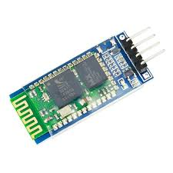
Bluetooth Module (HC-06)
For the communication between mobile phone and Arduino Bluetooth module(HC-06) is used.
This Bluetooth module can easily achieve serial wireless data transmission. Its operating frequency is among the most popular 2.4GHz ISM frequency band (i.e. Industrial, scientific and medical).
It adopts Bluetooth 2.0+EDR standard. In Bluetooth 2.0, signal transmit time of different devices stands at a 0.5 seconds interval so that the workload of Bluetooth chip can be reduced substantially and more sleeping time can be saved for Bluetooth.
This module is set with serial interface, which is easy to use and simplifies the overall design/development cycle.

Slide 9
Specification
Bluetooth protocol: Bluetooth 2.0+ EDR standard
USB protocol: USB v1.1/2.0
Operating frequency: 2.4GHz ISM frequency band
Modulation mode: Gauss frequency Shift Keying
Transmission speed: 2.1Mbps(Max)/160 kbps(Asynchronous)； 1Mbps/1Mbps(Synchronous)
Safety feature: Authentication and encryption
Supported configuration: Bluetooth serial port (major and minor)
Supply Voltage: +3.3 VDC 50mA
Operating temperature: -20 to 55℃
Size: 36.5*16mm
Weight: 4g

Slide 10
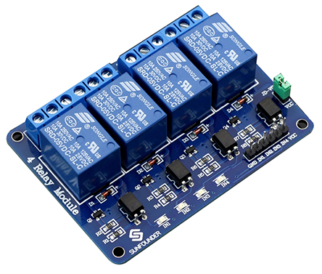
Relay Module
Relay is basically an electromagnetic switch which can be turn on and off by an applying the voltage across its contacts.
Relays are used where it is necessary to control a circuit by a low-power signal.
Relays protect electrical circuits from overload or fault.
In this project used a 5V 4-channel relay.

Slide 11
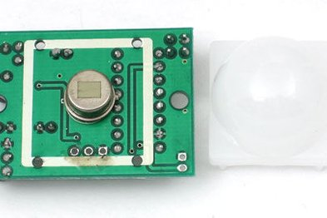
PIR Module
PIR sensors allow you to sense motion, almost always used to detect whether a human has moved in or out of the sensors range.
They are small, inexpensive, low-power, easy to use and don't wear out. For that reason they are commonly found in appliances and gadgets used in homes or businesses.
They are often referred to as PIR, "Passive Infrared", "Pyroelectric", or "IR motion" sensors.

Slide 12
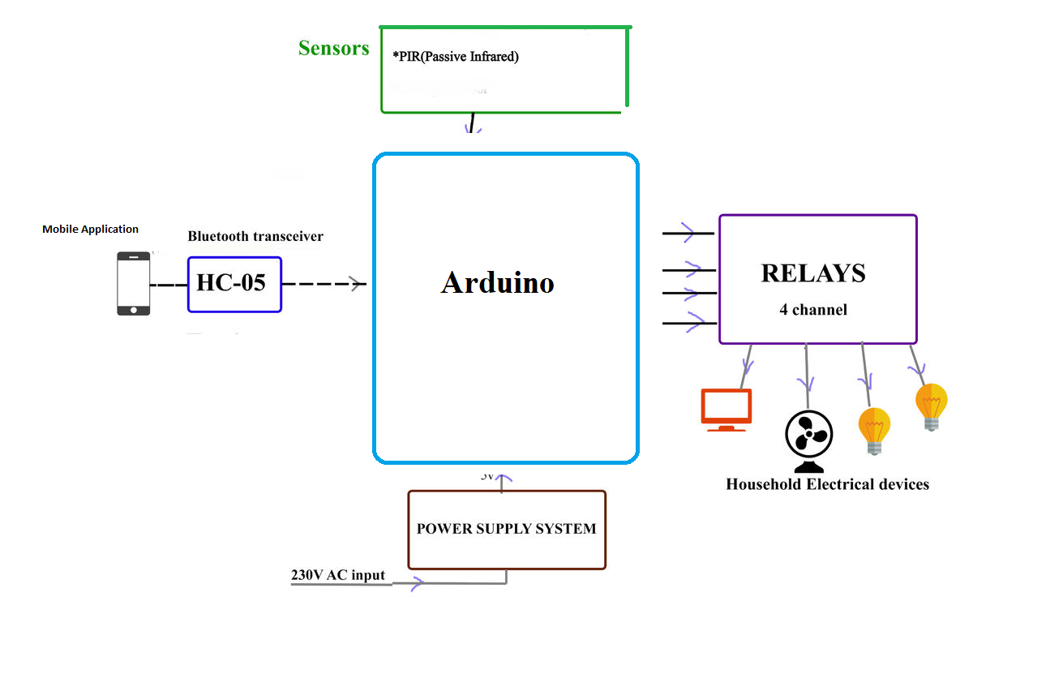
Overview of the Home Automation System

Slide 13
Working Principle
First Bluetooth module connected to the phone by the Bluetooth.
Bluetooth phone already have a application to provide the interference between mobile and the Bluetooth module.
By using the application ,the mobile send the command signal to microcontroller by the Bluetooth.
Bluetooth and relay IC is connect to the microcontroller by its pins.
The relay is connected to the load by its pins.
When microcontroller receives the command from mobile ,it operate the load.

Slide 14
Advantages
Quick response is achieved.
Easy to maintain and repair.
Design is efficient and low cost.
Power consumption is low.
Controlling electrical devices wirelessly
Saves electricity.
We can control appliances from any place round the room.

Slide 15
Disadvantages
This system is not capable of displaying the feed back status of the devices being operated.
Number of electrical appliances that can be controlled by this circuit is limited.
Bluetooth is used in this home automation system, which have a range of 10 to 20 meters so the control cannot be achieved from outside this range.

Slide 16
Applications
Yet there is an increasing demand for smart homes, where appliances react automatically to changing environmental conditions and can be easily controlled through one common device.
This wireless technology is especially useful in home environment, where there exists hardly any infrastructure to interconnect intelligent appliances.

Slide 17
References
https://www.elementzonline.com
https://www.instructables.com
https://www.slideshare.net

Slide 18
THANK YOU

