Slide 1
Home Automation System using Arduino
by
Sachin Gupta
Prathamesh khandare
Vishal Shah

Slide 2
What is Home Automation?
Home automation is building automation for a home, called a smart home or smart house. A home automation system will control lighting, climate, entertainment systems, and appliances. It may also include home security such as access control and alarm systems .When connected with the Internet, home devices are an important constituent of the Internet of Things.
Lighting, appliances, electrical outlets, heating and cooling systems– are hooked up to a bluetoothly controllable network.
Home Automation gives you access to control devices in your home from a mobile device

Slide 3
Introduction
There is an increasing demand for smart homes, where appliances react automatically to changing environmental conditions and can be easily controlled through one common device.
This project presents a possible solution whereby the user controls devices by using their existing mobile phone ,where control is communicated to the Microcontroller from a mobile phone through its Bluetooth interface.
The aim of this project is to design a circuit such that one can control home or industrial appliances using the help of Bluetooth.
Using Bluetooth to control appliances reduces human efforts without compromising on efficiency. It also saves time.
This circuit can be operated up to a distance of 5-10 meters depending upon the Bluetooth which we use.
Provide improved convenience, comfort, energy, efficiency and security

Slide 4
Motivation
Our motivation of this project is “DIGITAL INDIA” concept. We thought that we
should make some contribution for this movement called “DIGITAL INDIA”. Home Automation is a technology which has great scope in future, In this technology we can use light whenever u wont.
In the “Digital India” Electricity saving is important topic in that world now. IN
INDIA also more Electricity are wasting.
We can use this system to classroom. Even in city homes also use this system to save lights energy.

Slide 5
Hardware requirements
Arduino uno
Bluetooth Module HC-05
Relay Module
PIR Module
Wires
12v power supply
Arduino IDE
Software requirements

Slide 6
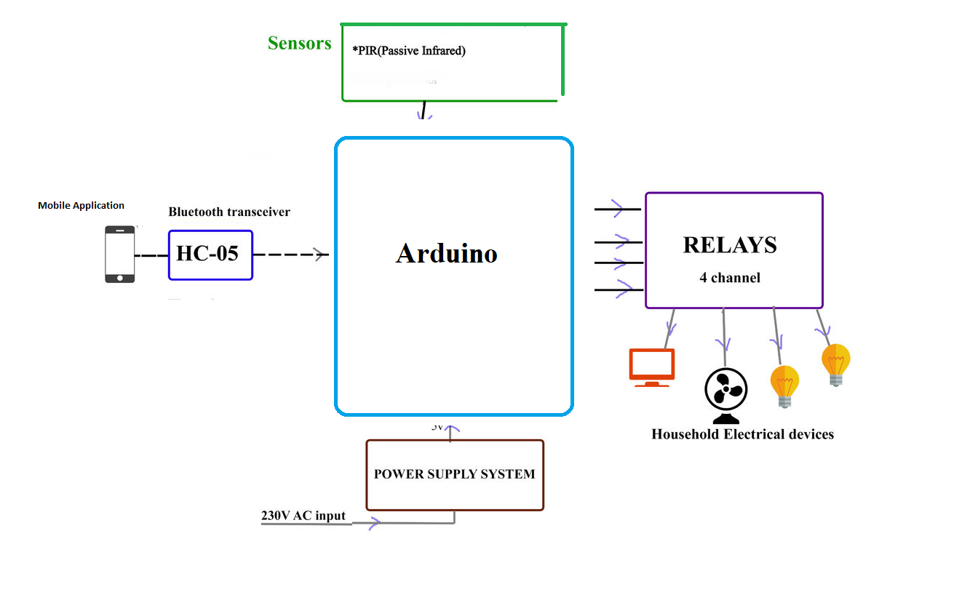
Overview of the Home Automation System

Slide 7
Circuit Design
The circuit design of Home Automation based on Arduino and Bluetooth is very simple and is explained below.
The Bluetooth module has 4 – pins: VCC, TX, RX and GND. VCC and GND are connected to 5V and ground from Arduino UNO. The Bluetooth module works on 3.3V and it has an on board 5V to 3.3V regulator.
The TX and RX pins of the Bluetooth module must be connected to RX and TX pins of the Arduino. In Arduino UNO, we are defining pins 2 and 4 as RX and TX using software. Hence, TX of Bluetooth is connected to pin 4 of Arduino.
But when connecting RX of Bluetooth to TX of Arduino (or any microcontroller as a matter of fact), we need to be careful as the pin can tolerate only 3.3V. But the voltage from TX or Arduino will be 5V.
So, a voltage divider network consisting of 10K and 20K resistors are used to reduce the voltage to 3.3V approximately.
Note: Any combination of resistors can be used to bring down the voltage to approximately 3.3V.
The next step is to connect the digital I/O pins of the Arduino to input of the relay board.
More detailed information about Arduino Bluetooth Interface and Arduino Relay Control.

Slide 8
Working Principle
A simple home automation project using Arduino UNO, Bluetooth module and a smartphone. The aim of this project is to control different home appliances using a smartphone. The working of the project is explained here.
When the power is turned on, the connection LED on the Bluetooth module starts blinking. We need to start the “Bluetooth Controller” app in our smartphone and get connected to the Bluetooth module. If the pairing is successful, the LED becomes stable.
Now, in the app, we need to set different keys for different loads and their corresponding value that must be transmitted when that key is pressed. The following image shows a set of keys to control 4 loads and an additional key to turn off all the loads.
Then we are ready to control the loads. When a key is pressed in the smartphone, the Bluetooth module receives the corresponding data and intern transmits that data to Arduino
For example, if we press “LOAD 2 ON”, then the data received by the Bluetooth module is “2”.
This data i.e. “2” is transmitted to Arduino. Arduino then compares the received data with the data written in the sketch and accordingly turns on the load 2. The similar action can be applicable to other keys and loads.
Using this type of connection, we can control i.e. turn on or off different home electrical appliances using our smartphones.
Caution: We should be very careful when using a relay with AC mains.

Slide 9
Advantages
Quick response is achieved.
Easy to maintain and repair.
Design is efficient and low cost.
Power consumption is low.
Controlling electrical devices wirelessly
Saves electricity.
We can control appliances from any place round the room.

Slide 10
Disadvantages
This system is not capable of displaying the feed back status of the devices being operated.
Number of electrical appliances that can be controlled by this circuit is limited.
Bluetooth is used in this home automation system, which have a range of 10 to 20 meters so the control cannot be achieved from outside this range.

Slide 11
Applications
Yet there is an increasing demand for smart homes, where appliances react automatically to changing environmental conditions and can be easily controlled through one common device.
This wireless technology is especially useful in home environment, where there exists hardly any infrastructure to interconnect intelligent appliances.
Using this project, we can turn on or off appliances remotely i.e. using a phone or tablet.
The project can be further expanded to a smart home automation system by including some sensors like light sensors, temperature sensors, safety sensors etc. and automatically adjust different parameters like room lighting, air conditioning (room temperature), door locks etc. and transmit the information to our phone.
Additionally, we can connect to internet and control the home from remote location over internet and also monitor the safety.

Slide 12
References
https://www.elementzonline.com
https://www.instructables.com
https://www.slideshare.net

Slide 13
THANK YOU

