Slide 1


Slide 2
Chapter 10: Application Layer
Introduction to Networks v6.0
Notes:
Cisco Networking Academy Program
Introduction to Networks v6.0
Chapter 10: Application Layer

Slide 3
Chapter 10 - Sections & Objectives
10.0 Introduction
10.1 Application Layer Protocols
Explain how the functions of the application layer, session layer, and presentation layer work together to provide network services to end user applications.
Explain how common application layer protocols interact with end user applications.
10.2 Well-Known Application layer Protocols and Services
Explain how web and email protocols operate.
Explain how the IP addressing protocols operate.
Explain how file transfer protocols operate.
10.3 Summary
Notes:
3

Slide 4
10.1 Application Layer Protocols
Notes:
Cisco Networking Academy Program
Introduction to Networks v6.0
Chapter 10: Application Layer

Slide 5
Application Layer Protocols Application, Presentation, Session
Application Layer
Closest to the end user.
Application layer protocols help exchange data between programs running on the source and destination hosts.
The TCP/IP application layer performs the functions of the upper three layers of the OSI model.
Common application layer protocols include: HTTP, FTP, TFTP, DNS.
Presentation and Session Layer
Format data, compress and encrypt data
Common standards for video include QuickTime and Motion Picture Experts Group (MPEG).
Common graphic image formats are: GIF, JPEG and PNG
The session layer creates and maintains dialogs between source and destination applications.
The session layer handles the exchange of information to initiate dialogs, keep them active, and to restart sessions that are disrupted or idle.
Notes:
10.1 – Application Layer Protocols
10.1.1 – Application, Presentation, Session

Slide 6
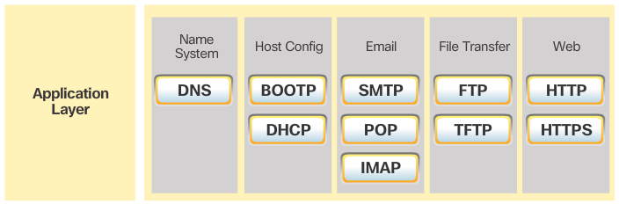
Application Layer Protocols Application, Presentation, Session (Cont.)
TCP/IP Application Layer Protocols
TCP/IP application protocols specify the format and control information necessary for common Internet functions.
Application layer protocols must be implemented in both the source and destination devices.
Application layer protocols implemented on the source and destination host must be compatible to allow communication.
Notes:
10.1 – Application Layer Protocols
10.1.1 – Application, Presentation, Session (Cont.)

Slide 7
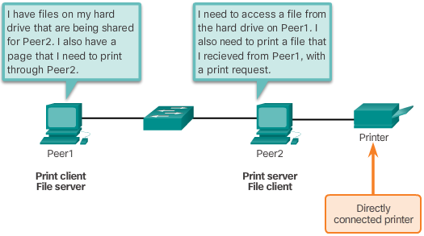
Application Layer Protocols How Application Protocols Interact with End-User Applications
Client-Server Model
Clients request information while servers provide it.
Client and server processes are considered to be in the application layer.
The contents of the data exchange will depend of the application in use.
Email is an example of a Client-Server interaction.
Peer-to-Peer Networks
Data is accessed without the use of a dedicated server.
Two or more computers can be connected to a P2P network to share resources.
Every connected end device (a peer) can function as both a server and a client.
The roles of client and server are set on a per-request basis.
Notes:
10.1 – Application Layer Protocols
10.1.2 – How Application Protocols Interact with End-User Applications

Slide 8
Application Layer Protocols How Application Protocols Interact with End-User Applications (Cont.)
Peer-to-Peer Applications
Some P2P applications use a hybrid system, where resource sharing is decentralized.
Indexes that point to resource locations are stored in a centralized directory.
In a hybrid system, each peer accesses an index server to get the location of a resource stored on another peer.
Common P2P Applications
Common P2P networks include: eDonkey, G2, BitTorrent.
Many P2P applications allow users to share pieces of many files with each other at the same time.
A small torrent file contains information about the location of other users and tracker computers.
Trackers are computers keeping track of the files hosted by users.
This technology is called BitTorrent. There are many BitTorrent clients, including BitTorrent, uTorrent, Frostwire, and qBittorrent.
Notes:
10.1 – Application Layer Protocols
10.1.2 – How Application Protocols Interact with End-User Applications (Cont.)

Slide 9
10.2 Well-Known Application Layer Protocols and Services
Notes:
Cisco Networking Academy Program
Introduction to Networks v6.0
Chapter 10: Application Layer

Slide 10
Well-Known Application Layer Protocols and Services Web and Email Protocols
Hypertext transfer Protocol and Hypertext Markup Language
A URL is a reference to a web server.
URLs and URIs are the names most people associate with web addresses.
URLs contain the protocol, the server name and the requested filename.
Using DNS, the server name portion of the URL is then translated to the associated IP address before the server can be contacted.
HTTP and HTTPS
The browser sends a GET request to the server’s IP address and asks for the index.html file.
The server sends the requested file to the client.
The index.html was specified in the URL and contains the HTML code for this web page.
The browser processes the HTML code and formats the page for the browser window based on the code in the file.
HTTP Is not secure. Messages can be intercepted.
HTTPS uses authentication and encryption to secure data.
Notes:
10.2 – Well-Known Application Layer Protocols and Services
10.2.1 – Web and Email Protocols

Slide 11
Well-Known Application Layer Protocols and Services Web and Email Protocols (Cont.)
Email Protocols
Email is a store-and-forward method of sending, storing, and retrieving electronic messages.
Email messages are stored on mail servers.
Email clients communicate with mail servers to send and receive email.
Mail servers communicate with other mail servers to transport messages from one domain to another.
Email relies on three separate protocols for operation: SMTP,POP and IMAP.
SMTP Operation
SMTP message formats require a message header and body.
The header must have a properly formatted recipient email address and a sender address.
An SMTP client sends an email by connecting to a SMTP server on port 25.
The server receives the message and stores it in a local mailbox or relays the message to another mail server.
Users use email clients to retrieve messages stored on the server.
Notes:
10.2 – Well-Known Application Layer Protocols and Services
10.2.1 – Web and Email Protocols (Cont.)

Slide 12
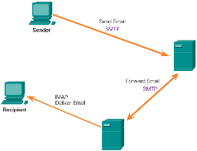
Well-Known Application Layer Protocols and Services Web and Email Protocols (Cont.)
POP Operation
Messages are downloaded from the server to the client.
Email clients direct their POP requests to mail servers on port TCP 110.
POP allows for email messages to be downloaded to the client’s device (computer or phone) and removed from the server.
A downloaded message resides on the device that triggered the download.
IMAP Protocols
IMAP is another protocol used to retrieve email messages.
Allows for messages to be displayed to the user rather than downloaded.
The original messages reside on the server until manually deleted by the user.
Users view copies of the messages in their email client software.
Support folder hierarchy to organize and store mail.
When a user decides to delete a message, the server synchronizes that action and deletes the message from the server.
Notes:
10.2 – Well-Known Application Layer Protocols and Services
10.2.1 – Web and Email Protocols (Cont.)

Slide 13
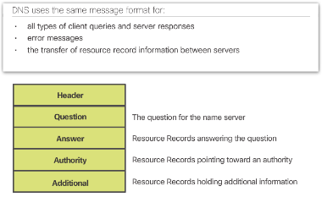
Well-Known Application Layer Protocols and Services IP Addressing Services
Domain Name Service
IP addresses are not easy to memorize.
Domain names make server addresses more user-friendly.
Computers still need the actual numeric address before they can communicate.
The DNS protocol allows for the dynamic translation of a domain name into the associated IP address.
DNS Message Format
Common DNS records are A, NS, AAAA and MX.
DNS servers search its own records first, relaying the client’s request to other servers if it can’t resolve the request.
The response is then forwarded to the client.
The client often stores previous name resolutions. Use the ipconfig /displaydns to list cached DNS entries on Windows.
Notes:
10.2 – Well-Known Application Layer Protocols and Services
10.2.2 – IP Addressing Services

Slide 14
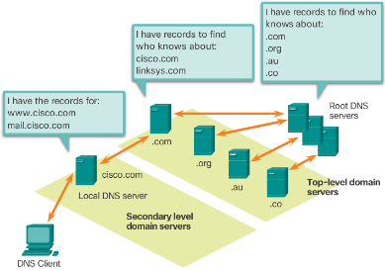
Well-Known Application Layer Protocols and Services IP Addressing Services (Cont.)
DNS Hierarchy
The DNS protocol uses a hierarchical system.
The naming structure is broken down into small, manageable zones.
Each DNS server is only responsible for managing name-to-IP mappings for a small portion of the DNS structure.
Requests for zones not stored in a specific DNS server are forwarded to other servers for translation.
Top-level domains represent either the type of domain or the country of origin. Examples of top-level domains are .com, .org, .au and .co
The nslookup Command
Use nslookup to place DNS queries.
Useful for DNS troubleshooting.
Notes:
10.2 – Well-Known Application Layer Protocols and Services
10.2.2 – IP Addressing Services (Cont.)

Slide 15
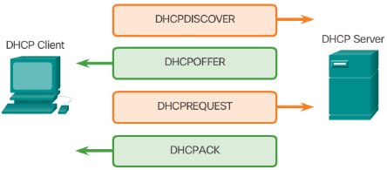
Well-Known Application Layer Protocols and Services IP Addressing Services (Cont.)
Dynamic Host Configuration Protocol
Computers need network IP information to communicate over a network.
IP information include host and gateway addresses, mask, and DNS server.
DHCP allows for automated and scalable distribution of IP information.
DHCP-distributed addresses are leased for a set period of time.
Addresses are returned to the pool for reuse when no longer in use.
DHCP supports IPv4 and DHCPv6 supports IPv6.
DHCP Operation
The client broadcasts a DHCPDISCOVER.
A DHCP server replies with DHCPOFFER.
The client sends a DHCPREQUEST message to the server it wants to use (in case of multiple offers).
A client may also request an address previously been allocated by the server.
The server returns a DHCPACK to confirm the lease has been finalized.
Notes:
10.2 – Well-Known Application Layer Protocols and Services
10.2.2 – IP Addressing Services (Cont.)

Slide 16
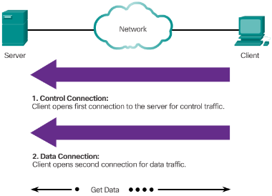
Well-Known Application Layer Protocols and Services File Sharing Services
File Transfer Protocol
FTP was developed to allow the transfer of files over the network.
An FTP client is an application that runs on a client computer used to push and pull data from an FTP server.
FTP requires two connections between the client and the server: one connection for commands and replies and another connection for the actual file transfer.
The client initiates and establishes the first connection to the server for control traffic on TCP port 21.
The client then establishes the second connection to the server for the actual data transfer on TCP port 20.
The client can download (pull) data from the server or upload (push) data to the server.
Notes:
10.2 – Well-Known Application Layer Protocols and Services
10.2.3 – File Sharing Services

Slide 17
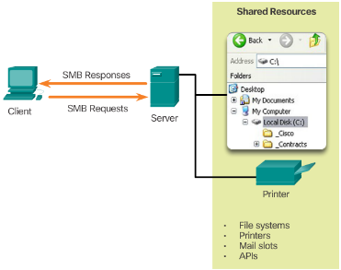
Well-Known Application Layer Protocols and Services File Sharing Services (Cont.)
Server Message Block
SMB is a client/server file sharing protocol.
All SMB messages share a common format.
SMB file-sharing and print services have become the mainstay of Windows networking.
Microsoft products now support TCP/IP protocols to directly support SMB resource sharing.
After the connection is established, the user of the client can access the resources on the server as if the resource is local to the client host.
The Mac, LINUX, and UNIX operating systems have their own implementation of SMB.
Notes:
10.2 – Well-Known Application Layer Protocols and Services
10.2.3 – File Sharing Services (Cont.)

Slide 18
10.3 Summary
Notes:
Cisco Networking Academy Program
Introduction to Networks v6.0
Chapter 10: Application Layer

Slide 19
Chapter Summary Summary
Explain the operation of the application layer in providing support to end-user applications.
Explain how well-known TCP/IP application layer protocols and services operate.
Notes:
9.3.1 - Summary

Slide 20
Chapter 10 New Terms and Commands
Hypertext Transfer Protocol (HTTP)
File Transfer Protocol (FTP)
Trivial File Transfer Protocol (TFTP)
Internet Message Access Protocol (IMAP)
Domain Name System (DNS)
Simple Mail Transport Protocol (SMTP)
Post Office Protocol (POP)
Dynamic Host Configuration Protocol (DHCP)
QuickTime and Motion Picture Experts Group (MPEG)
Graphics Interchange Format (GIF)
Joint Photographic Experts Group (JPEG)
Portable Network Graphics (PNG)
BOOTP
HTTPS
Client-server model
Peer-to-peer network (P2P)
P2P networks
P2P applications
Gnutella protocol
BitTorrent
Uniform Resource Locator (URL)
Uniform Resource Identifier (URIs)
Get
Post
Put
HTTP Secure (HTTPS)
Secure Socket Layer (SSL)
Simple Mail Transfer Protocol (SMTP)
Post Office Protocol (POP)
Notes:
New Terms and Commands

Slide 21
Chapter 10 New Terms and Commands
IMAP
Port 25 (SMTP)
TCP Port 110 (POP)
Domain name
DNS Protocol
Record types: A, NS, AAAA, MX
ipconfig /displaydns
Top-level domains are: .com, .org, .au, .co
10.2.2.4
Nslookup
10.2.2.5
Dynamic Host Configuration Protocol (DHCP) for IPv4
DHCPv6
10.2.2.6
DHCP Discover
DHCP Offer
DHCP Request
DHCP Acknowledgement
DHCP Negative Acknowledgement
DHCPv6: SOLICIT, ADVERTISE, INFORMATION REQUEST, and REPLY
10.2.3.1
FTP daemon (FTPd)
10.2.3.2
Server Message Block (SMB)
Notes:
New Terms and Commands

Slide 23


