Slide 1


Slide 2
Chapter 6: Network Layer
Introduction to Networks v6.0
Notes:
Cisco Networking Academy Program
Introduction to Networks v6.0
Chapter 6: Network Layer

Slide 3
Chapter 6 - Sections & Objectives
6.1 Network Layer Protocols
Describe the purpose of the network layer in data communication.
Explain why the IPv4 protocol requires other layers to provide reliability.
Explain the role of the major header fields in the IPv4 and IPv6 packet.
6.2 Routing
Explain how a host device uses routing tables to direct packets to itself, a local destination, or a default gateway.
Compare a host routing table to a routing table in a router.
6.3 Routers
Describe the common components and interfaces of a router.
Describe the boot-up process of a Cisco IOS router.
6.4 Configure a Cisco Router
Configure initial settings on a Cisco IOS router.
Configure two active interfaces on a Cisco IOS router.
Configure devices to use the default gateway.
Notes:
3

Slide 4
6.1 Network Layer Protocols
Notes:
Cisco Networking Academy Program
Introduction to Networks v6.0
Chapter 6: Network Layer

Slide 5
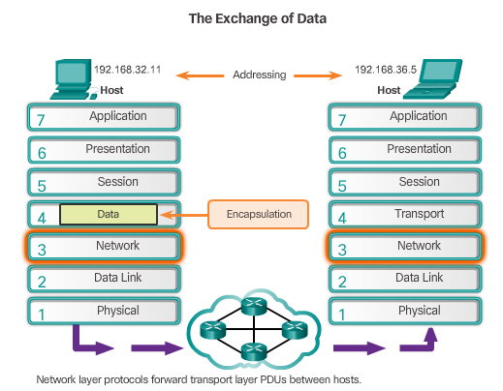
Network Layer Protocols Network Layer in Communications
The Network Layer
End to End Transport processes
Addressing end devices
Encapsulation
Routing
De-encapsulating
Network Layer Protocols
IPv4
IPv6
Notes:
6.1 – Network Layer Protocols
6.1.1 – Network Layer in Communications

Slide 6
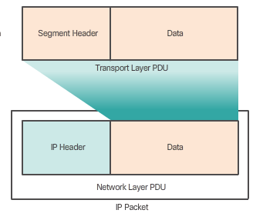
Network Layer Protocols Characteristics of the IP Protocol
Encapsulating IP
Segments are encapsulated into IP packets for transmission.
The network layer adds a header so packets can be routed to the destination.
IP - Connectionless
Sender doesn’t know if the receiver is listening or the message arrived on time.
Receiver doesn’t know data is coming.
IP – Best Effort Delivery
No guarantees of delivery are made.
IP – Media Independent
IP can travel over different types of media.
Notes:
6.1 – Network Layer Protocols
6.1.2 – Characteristics of the IP Protocol

Slide 7
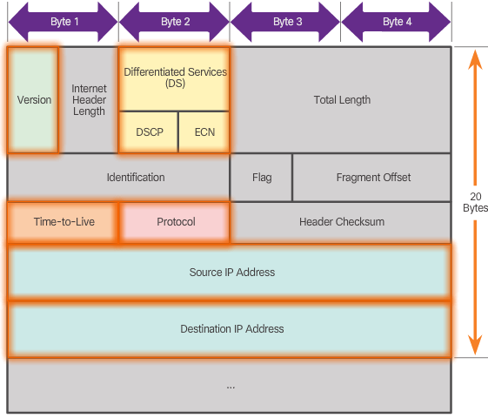
Network Layer Protocols IPv4 Packet
IPv4 Packet Header
Version = 0100
DS = Packet Priority
TTL = Limits life of Packet
Protocol = Upper layer protocol such as TCP
Source IP Address = source of packet
Destination IP Address = destination of packet
Notes:
6.1 – Network Layer Protocols
6.1.3 - IPv4 Packet

Slide 8
Network Layer Protocols IPv6 Packet
Limitations of IPv4
IP address depletion
Internet routing table expansion
Lack of end-to-end connectivity
Introducing IPv6
Increased address space
Improved packet handling
Eliminates the need for NAT
EncapsulatingIPv6
Simplified header format
No checksum process requirement
More efficient Options Header mechanism
Flow Label field makes it more efficient.
IPv6 Packet Header
xx
Notes:
6.1 – Network Layer Protocols
6.1.4 – IPv6 Packet

Slide 9
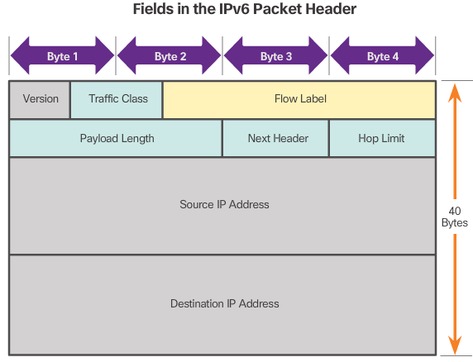
Network Layer Protocols IPv6 Packet (Cont.)
IPv6 Packet Header
xx
Version = 0110
Traffic Class = Priority
Flow Label = same flow will receive same handling
Payload Length = same as total length
Next Header = Layer 4 Protocol
Hop Limit = Replaces TTL field
Notes:
6.1 – Network Layer Protocols
6.1.4 – IPv6 Packet (Cont.)

Slide 10
6.2 Routing
Notes:
Cisco Networking Academy Program
Introduction to Networks v6.0
Chapter 6: Network Layer

Slide 11
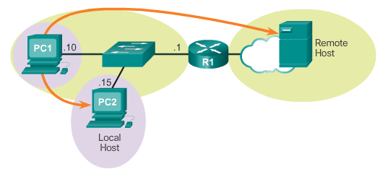
Routing How a Host Routes
Host Forwarding Decision
Three types of destination: itself, local host, remote host.
Default Gateway
Routes traffic to other networks
Has a local IP address in the same address range as other hosts on the network
Can take data in and forward data out
Using the Default Gateway
Hosts will use the default gateway when sending packets to remote networks.
Host Routing Tables
Use the netstat –r command to display the
host routing table on a Windows machine.
Notes:
6.2 – Routing
6.2.1 – How a Host Routes

Slide 12
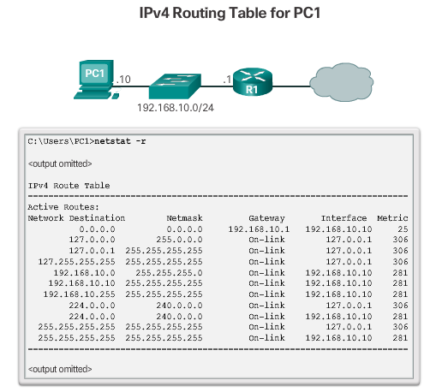
Routing How a Host Routes (Cont.)
Notes:
6.2 – Routing
6.2.1 – How a Host Routes (Cont.)

Slide 13
How a Host Routes Router Routing Tables
Router Packet Forwarding Decision
Routers and hosts forward packets in a similar fashion.
The main difference is that routers have more interfaces while hosts often have only one.
Devices on directly connected networks can be reached directly.
Devices on remote networks are reached through gateway.
IPv4 Router Routing Table
The router routing table stores network routes the router knows about.
Use the show ip route command to display the routing table on a Cisco router.
The router routing table also has information on: how the route was learned, its trustworthiness and rating.
It also contains which interface to use to reach that specifc destination.
Directly Connected Routing Table Entries
C - Identifies a directly-connected network, automatically created when an interface is configured with an IP address and activated.
L - Identifies that this is a local interface. This is the IPv4 address of the interface on the router.
Remote Network Routing Table Entries
Xx
Next-Hop Address
xx
Notes:
6.2 – Routing
6.2.2 – Router Routing Tables

Slide 14
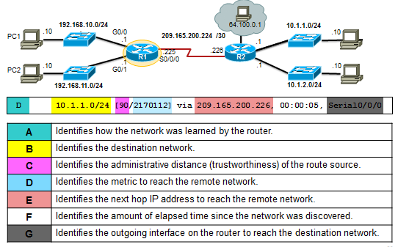
How a Host Routes Router Routing Tables (Cont.)
Remote Network Routing Table Entries
Remote destinations can’t be reached directly.
Remote routes contain the address of the intermediate network device to be used to reach the destination.
Next-Hop Address
Next-Hop address is the address of the intermediate device used to reach a specifc remote destination.
Notes:
6.2 – Routing
6.2.2 – Router Routing Tables (Cont.)

Slide 15
6.3 Routers
Notes:
Cisco Networking Academy Program
Introduction to Networks v6.0
Chapter 6: Network Layer

Slide 16
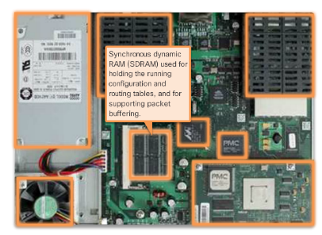
Routers Anatomy of a Router
A Router is a Computer
Routers have CPU, memory and I/O devices
Cisco routers use IOS as their operating system.
Router Memory
Just as a computer, routers have memory.
Routers contain RAM, ROM, NVRAM and Flash memory.
Inside a Router
Routers have the same general structure.
Connect to a Router
Routers have may ports to support connections.
LAN and WAN Interfaces
Routers have LAN and WAN ports.
Different models ship with different ports.
Ethernet is very common on different router
models.
Notes:
6.3 – Routers
6.3.1 – Anatomy of a Router

Slide 17
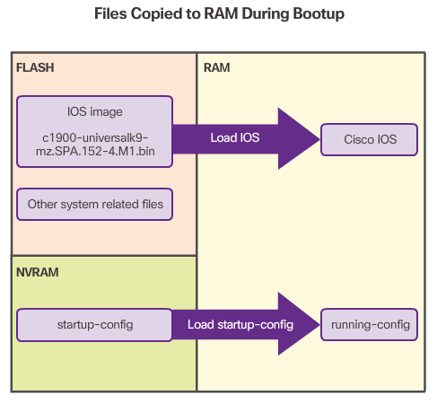
Routers Anatomy of a Router
Bootset Files
IOS image file, stored in the Flash, contains the IOS.
The Flash also stores other system files.
The NVRAM stores configuration parameters.
Router Bootup Process
Perform the POST and load the bootstrap program.
Locate and load the Cisco IOS software.
Locate and load the startup configuration file or enter setup mode
Show Version Output
The show version command is very useful.
It provides information on the amounts of memory installed, what IOS images was loaded during boot and more.
Notes:
6.3 – Routers
6.3.2 – Router Boot-up

Slide 18
6.4 Configuring a Cisco Router
Notes:
Cisco Networking Academy Program
Introduction to Networks v6.0
Chapter 6: Network Layer

Slide 19
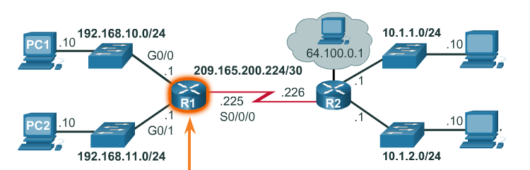
Configure a Cisco Router Configure Initial Settings
Basic Switch Configuration Steps
Configure device name
Secure EXEC mode
Secure VTY lines
Secure privilege EXEC mode
Secure all passwords
Provide legal notification
Configure the management SVI
Save the configuration
Basic Router Configuration Steps
Configure device name
Secure EXEC mode
Secure VTY lines
Secure privilege EXEC mode
Secure all passwords
Provide legal notification
Configure the management SVI
Save the configuration
Notes:
6.4 – Configure a Cisco Router
6.4.1 – Configure Initial Settings

Slide 20
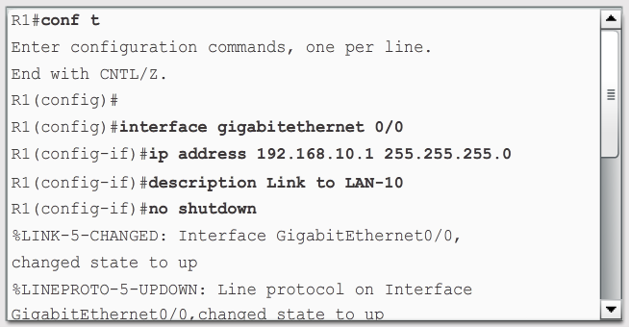
Configure a Cisco Router Configure Interfaces
Configure Router Interfaces
Enter the interface sub-configuration mode.
Add a description to the Interface (optional)
Configure an IPv4 or IPv6 address.
Activate the interface with a no shutdown command
Verify Interface Configuration
show ip route - Displays the contents of the IPv4 routing table stored in RAM.
show interfaces - Displays statistics for all interfaces on the device.
show ip interface - Displays the IPv4 statistics for all interfaces on a router.
Notes:
6.4 – Configure a Cisco Router
6.4.2 – Configure Interfaces

Slide 21
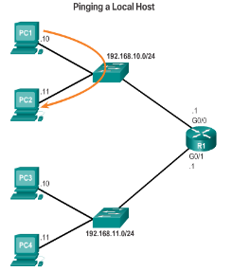
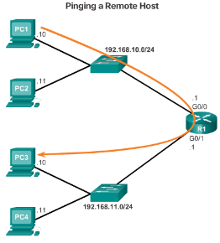
Configure a Cisco Router Configure the Default Gateway
Default Gateway for a Host
Default Gateway for a Switch
A default gateway is required for remote network communication.
If a switch is to be managed via its VTY lines, it needs a default gateway.
Use the ip default-gateway command to configure the default gateway for a switch.
Notes:
6.4 – Configure a Cisco Router
6.4.3 – Configure the Default Gateway

Slide 22
6.5 Chapter Summary
Notes:
Cisco Networking Academy Program
Introduction to Networks v6.0
Chapter 6: Network Layer

Slide 23
Chapter Summary Summary
Explain how network layer protocols and services support communications across data networks.
Explain how routers enable end-to-end connectivity in a small to medium-sized business network.
Explain how devices route traffic in a small to medium-sized business network.
Configure a router with basic configurations.
Notes:
6.5.1 - Summary

Slide 24
Section 6.1 New Terms and Commands
encapsulation
routing
de-encapsulation
data
packet
frame
Internet Protocol Version 4 (IPv4)
Internet Protocol Version 6 (IPv6)
Network Layer PDU = IP Packet
Transport Layer PDu
Segment Header
IP Header
Auxiliary port (AUX)
connectionless
best effort delivery
media independent
Connectionless
unreliable
maximum transmission unit (MTU)
Version
Differentiated Services (DS)
Time-to-Live (TTL)
Internet Control Message Protocol (ICMP)
data payload
Identification, Flags, Fragment Offset fields
keyword
Network Address Translation (NAT)
Traffic Class
Flow Label
Payload Length
Next Header
Hop Limit
local host
remote host
default gateway
Notes:
New Terms and Commands

Slide 25
Section 6.2 New Terms and Commands
netstat –r
route print
interface list
IPv4 Route Table
IPv6 Route Table
directly-connected routes
remote routes
default route
show ip route
route source
destination network
outgoing interface
administrative distance
metric
next-hop
route timestamp
branch routers
WAN routers
service provider routers
Notes:
New Terms and Commands

Slide 26
Section 6.3 New Terms and Commands
Power-on-self-test POST
RAM
ROM
NVRAM
Flash
Synchronous dynamic RAM (SDRAM)
WIC
high-speed WIC (HWIC)
ROMMON
Advanced Integration Module (AIM)
Enhanced high-speed WAN interface card (eHWIC)
Serial module
Ethernet interfaces
Auxiliary (AUX) RJ-45 port
In-band router interfaces
Console
Out-of-band
Secure Shell (SSH)
Telnet
startup-config
running-config
bootstrap program
Trivial File Transport Protocol (TFTP)
setup mode
show version
Notes:
New Terms and Commands

Slide 27
Section 6.4 New Terms and Commands
interface type-and-number
ip address ipv4-address subnet-mask
description description-text
no shutdown
show ip interface brief
ping ip address
show ip route
show interfaces
show ip interface brief
ip default-gateway ip-address
Notes:
New Terms and Commands

Slide 29


