Slide 1

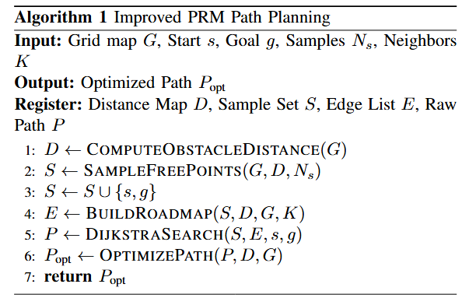
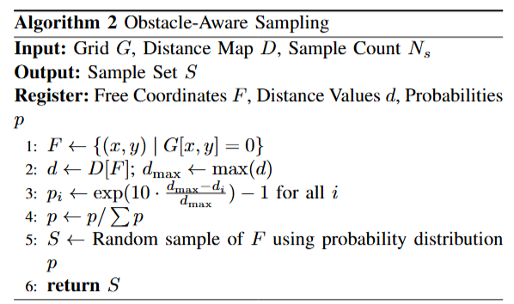
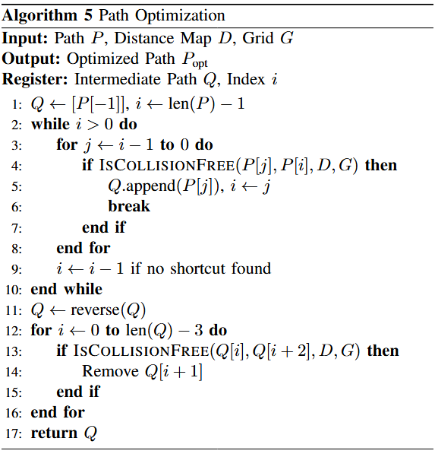
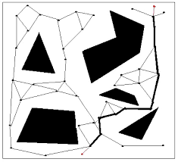
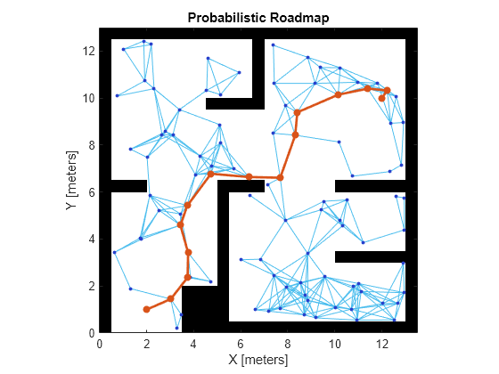
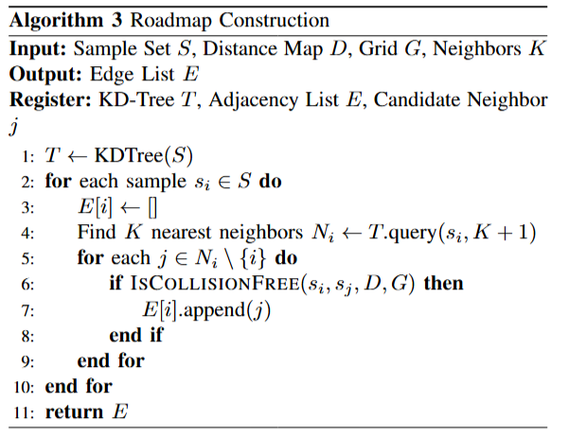
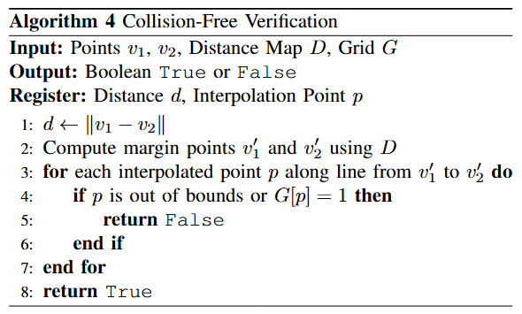
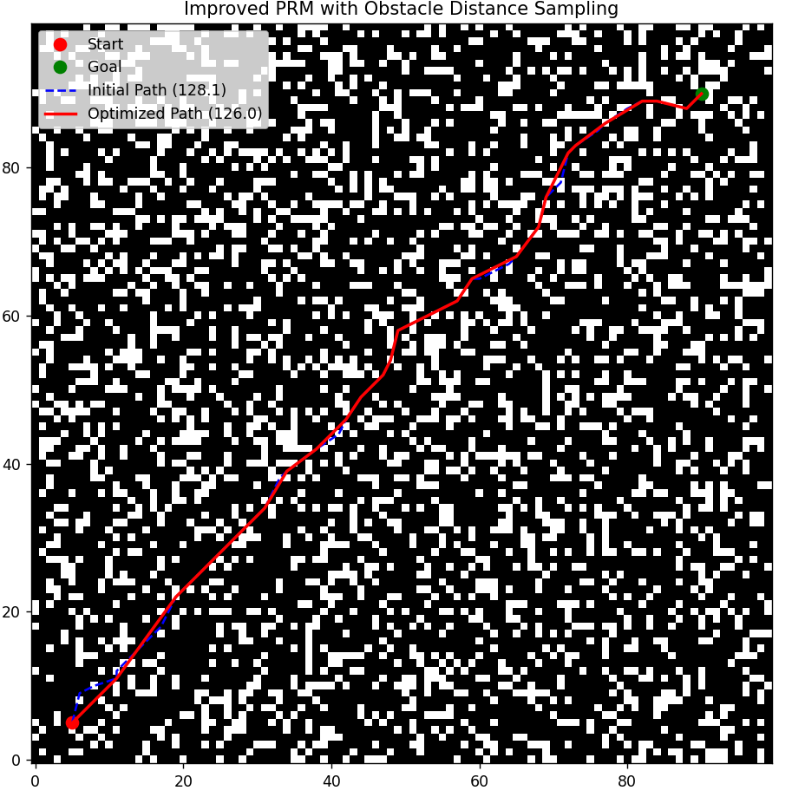
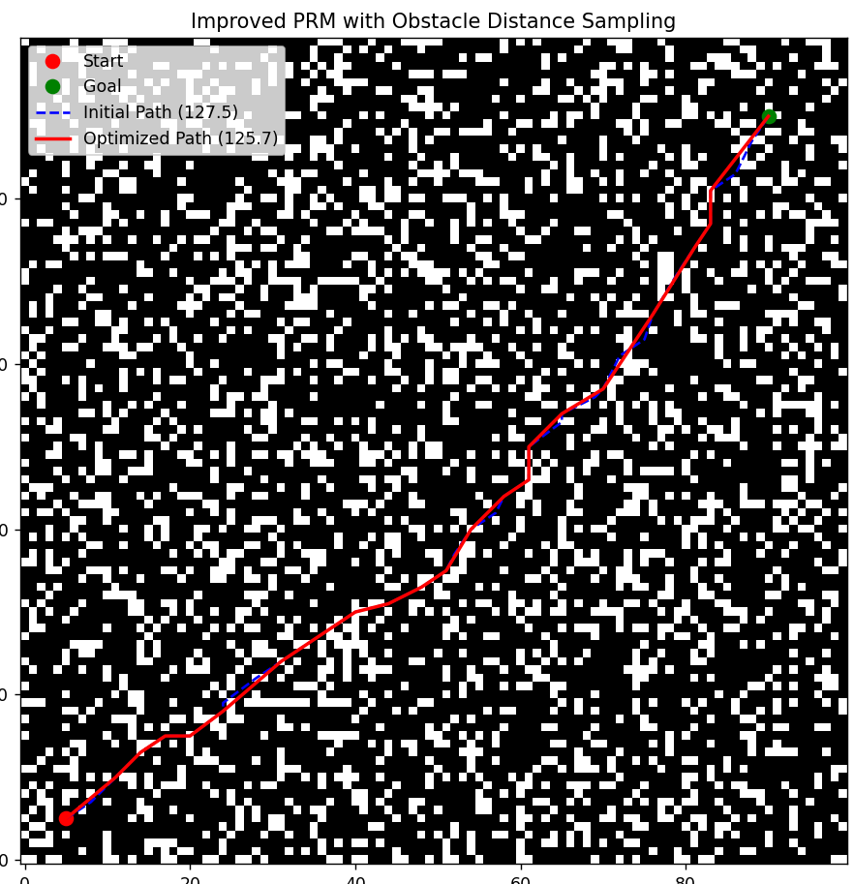
Improved probabilistic roadmap method based on obstacle distance sampling
Bhandekar Abhinay|| Gonthina Sai Sriram|| S V S Aditya ||
International Institute of Information Technology , Naya Raipur
INTRODUCTION
METHODOLOGY
CONCLUSIONS
Path planning is crucial in robotics, especially in complex environments. PRM (Probabilistic Roadmap Method) is a scalable solution for such spaces, but it often struggles in narrow regions due to random sampling, leading to low success rates and inefficient paths.
Improved Probabilistic Roadmap Method (PRM) • Probabilistic Roadmap Method (PRM) is a graph-based path planning technique that constructs a roadmap of feasible paths using randomly sampled points. • The improved PRM introduces Obstacle Distance Sampling (ODS), where the sampling probability is influenced by the distance to the nearest obstacle. • This ensures more efficient and purposeful sampling in free space, improving the likelihood of finding a valid and optimal path.
• The roadmap is built using K-Nearest Neighbors (KNN) and validated with obstacle-aware collision checks, enhancing the connectivity of the graph. • A modified Dijkstra’s algorithm is used to find the shortest path, followed by a triangle inequality and binary smoothing optimization for refining the path. • This method achieves high success rates even in complex environments with dense obstacles, outperforming traditional PRM in planning efficiency.
This paper presented an improved PRM algorithm that integrates obstacle distance-based sampling, collision detection, and path optimization. The method effectively increases success rates in narrow areas, reduces runtime, and improves path quality. Experiments demonstrate that it outperforms traditional and other enhanced PRM variants.
Advantages
Higher success rate in narrow spaces Obstacle-distance-guided sampling increases the probability of selecting points in tight regions, improving path-finding success.
Improved sampling efficiency Concentrating samples near obstacle boundaries leads to a more informative and connected roadmap with fewer nodes.
Faster collision detection The obstacle distance-based criteria help avoid unnecessary collision checks, reducing runtime during roadmap construction.
Shorter and smoother paths Use of triangle inequality and dichotomy ensures final paths are not only valid but also optimized for distance and smoothness.
Consistent performance across different sample sizes The algorithm remains efficient and effective even as the number of sample points increases, scaling well with computational resources.
Disadvantages
Preprocessing overhead for distance matrix Calculating the obstacle distance matrix (DFSO) introduces an initial computational cost before sampling.
Sensitivity to distance function accuracy The algorithm's performance is reliant on precise computation of distances between free space points and obstacles.
Increased algorithm complexity Compared to classic PRM, the integration of advanced sampling, collision detection, and path optimization steps makes the implementation more complex.
The improved PRM algorithm introduces obstacle-distance-based sampling to concentrate points near narrow regions, enhancing connectivity. A collision detection strategy using obstacle distances reduces redundant checks and speeds up roadmap construction. Finally, path optimization using triangle inequality and dichotomy refines the path for smoothness and minimal cost.
RESULTS
The proposed algorithm was tested against Random Sampling PRM, MSAPRM, and Gaussian PRM on a narrow environment map. It achieved the highest success rate, the shortest path lengths, and the fastest computation times across various sample sizes. Especially with 300 samples, it reduced path cost by over 30% and improved speed by up to 43%, demonstrating its efficiency and reliability in complex scenarios.
OBJECTIVES
REFERENCES
Improve Path Planning in Complex Environments To develop a more effective solution for path planning in high-dimensional and cluttered spaces where conventional algorithms like PRM often struggle due to randomness and inefficiency.
Enhance Sampling Efficiency in PRM To refine the sampling strategy of the Probabilistic Roadmap Method in order to address the limitations in narrow passages, thereby increasing the success rate and reducing the time to generate feasible paths.
Generate Smoother and More Optimal Paths To produce paths that are not only collision-free but also shorter, smoother, and more suitable for real-world robotic navigation applications.
Benchmark and Evaluate Performance To simulate and compare the proposed enhanced PRM method with the standard PRM, using performance metrics such as path length, computation time, and success rate.
Xiong, Y., Wang, C., Li, B., & Wu, S. (2024, May). Improved probabilistic roadmap method based on obstacle distance sampling. In 2024 36th Chinese Control and Decision Conference (CCDC) (pp. 5554-5559). IEEE.
ACKNOWLEDGEMENTS
Guided by- Dr. Shailesh Khapre
2000 Sampling Points
1000 Sampling Points

