Slide 1

Vel Tech Rangarajan Dr. Sagunthala R&D Institute of Science and Technology
School of Computing
Department of Computer Science and Engineering
10211CS224 / FULL STACK APPLICATION DEVELOPMENT (JAVA)
END SEMESTER PROJECT REVIEW
Date: 06-05-2026
JOB PORTAL MANAGEMENT SYSTEM
SDG: SDG 8 – Economic Growth
Presented By:
Gowtham Sai Garnepudi – VTU28790 – 23UECS2007.
Courses Handling Faculty:
Dr. NATTESHAN. N.V.S

Slide 2
INTRODUCTION
The rapid growth of job seekers and companies has made manual hiring
Processes inefficient and time-consuming.
Many candidates struggle to find suitable jobs, while employers face difficulty
in identifying the right talent.
1
2
It reduces time, effort, and cost involved in job searching and hiring.
The system has strong real-world relevance as online job portals are widely used
in modern recruitment.
It improves accessibility by allowing users to apply for jobs anytime and from
anywhere.
The Job Portal Management System connects job seekers and recruiters efficiently
through a digital interface.
It provides features like job posting, resume submission, application tracking,
and user management.
3
4
5
6
7
8
9

Slide 3
PROBLEM STATEMENT
1
In many organizations, recruitment processes are still partially manual and
inefficient.
Job seekers face difficulty in finding relevant job opportunities in one place.
Employers struggle to manage large volumes of applications effectively.
Existing systems may lack proper automation, filtering, and tracking features.
This leads to delays, data mismanagement, and poor communication between
users.
There is a need for a centralized and automated system to handle recruitment
activities.
The system should improve accuracy, reduce time, and enhance user experience.
2
3
4
5
6
7
8
9

Slide 4
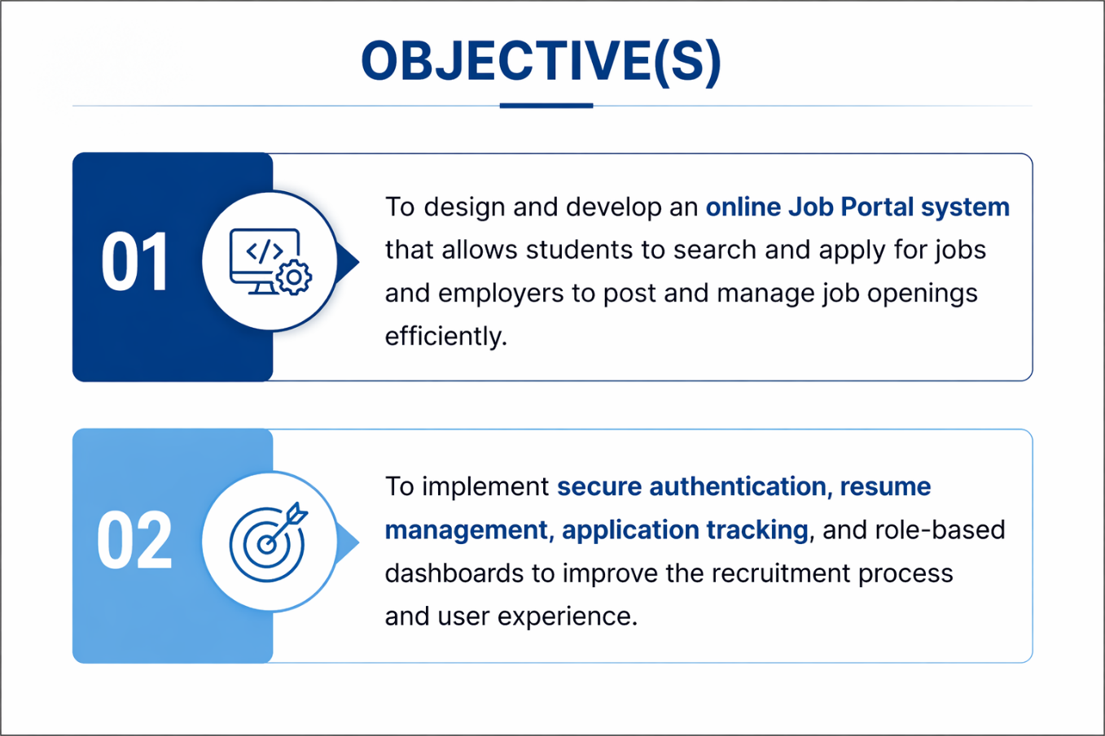
OBJECTIVES
1
• Develop a centralized job portal connecting job seekers and employers
• Automate job posting, applications, and tracking process
• Improve accuracy & efficiency by reducing manual work
• Provide a user-friendly and interactive interface
• Enable advanced search & filtering for better job matching
• Ensure secure data management (authentication & protection)
• Support real-time notifications (Email / SMS / OTP)
• Maintain high scalability & system performance
• Provide analytics & reporting for recruiters
• Reduce time, cost, and effort in recruitment
2
3
4
5
6
7
8
9

Slide 5
PROPOSED SYSTEM
The system provides a centralized online platform for job seekers and
employers to interact.
It automates job posting, application submission, and candidate
management processes.
Advanced search and filtering options help job seekers find relevant
opportunities quickly.
Employers can efficiently screen and shortlist candidates using organized
data.
The system reduces manual work, saving time and minimizing human errors.
Real-time notifications improve communication between job seekers and
recruiters.
Secure data handling ensures privacy and reliability of user information.
1
2
3
4
5
6
7
8
9

Slide 6
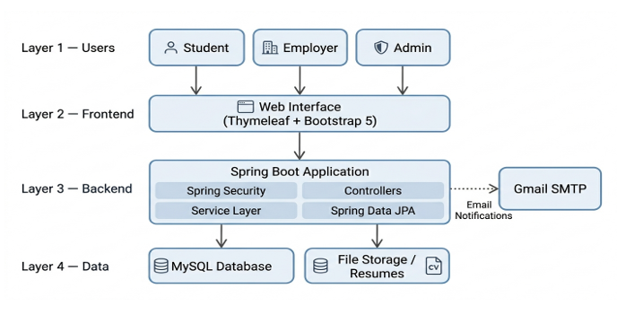
PROPOSED SYSTEM ARCHITECTURE
1
2
3
4
5
    Input : User details, job postings, resumes, and login data are entered into the system.
    Processing : The system validates data, matches jobs with candidates, and manages applications.
    Database : All user, job, and application data are securely stored and managed.
    Output : Users receive job listings, application status, notifications, and reports.
6
7
8
9

Slide 7
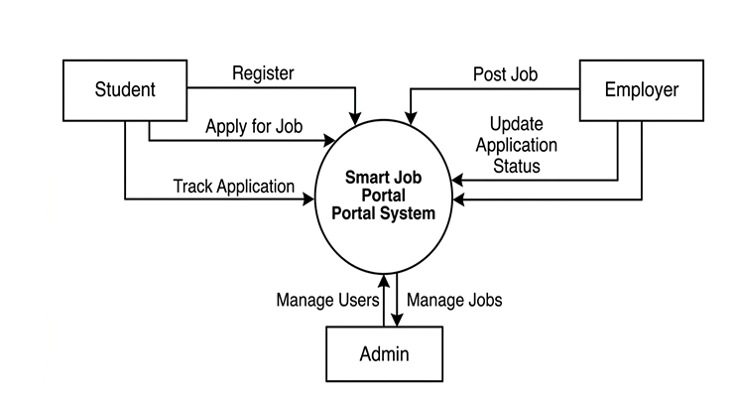
WORKFLOW
Dataflow Diagram:
1
2
3
4
5
6
7
8
9

Slide 8
TECHNOLOGIES USED
Frontend:
HTML, CSS, JavaScript (with Bootstrap for responsive design)
Backend:
Java (Servlets/JSP) or Python (Django/Flask)
Database:
MySQL
Third-Party API:
Email API (for notifications), SMS/OTP API (for verification)
Tools:
VS Code / Eclipse, Git.
Hardware/Software Requirements:
1
2
3
4
5
6
7
8
Operating System: Windows/Linux
Web Browser: Chrome/Edge
9

Slide 9
MODULE DESCRIPTION
Module 1: User Management
Handles registration and login for job seekers and employers, along with profile creation and secure authentication.
Module 2: Job Management
Allows employers to post, update, and manage job listings, including job descriptions, requirements, and deadlines.
Module 3: Application Management
Enables job seekers to apply for jobs and allows employers to view, filter, and shortlist applications.
Module 4: Search & Recommendation
Provides advanced search and filtering options, and suggests relevant jobs to users based on their profile.
Module 5: Reporting & Analytics
Generates reports on job postings, applications, and hiring trends for better decision-making.
1
2
3
4
5
6
7
8
9

Slide 10
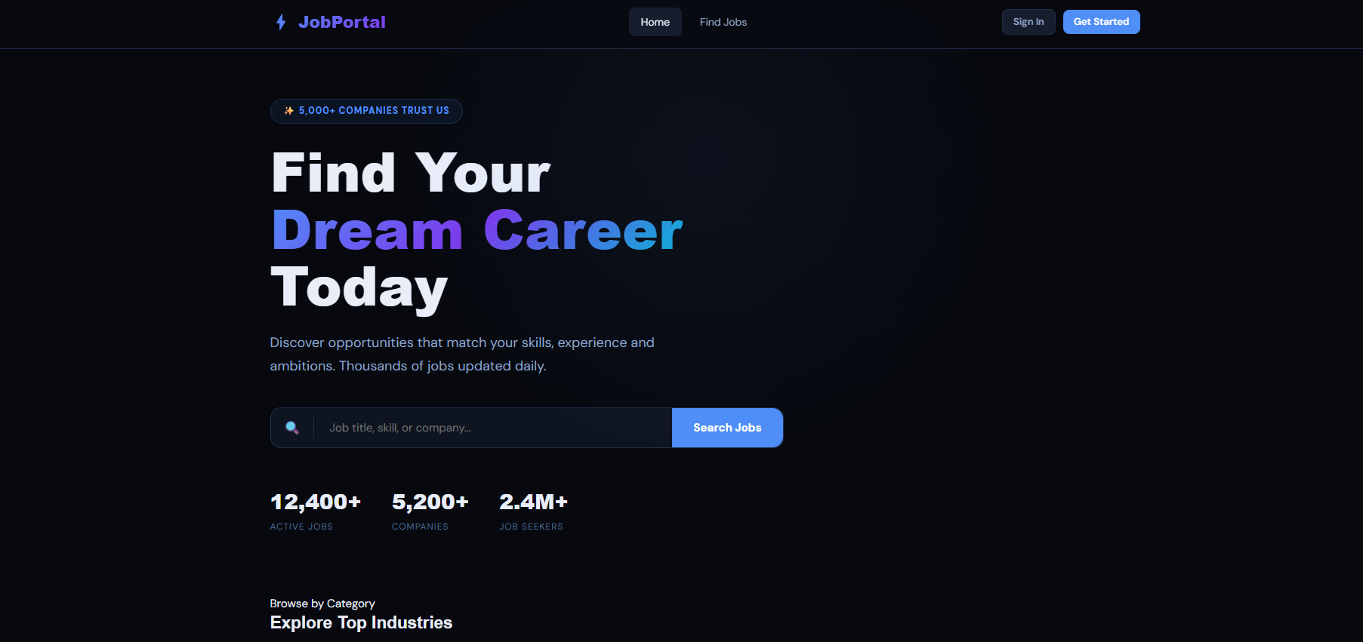
IMPLEMENTATION SCREENSHOTS
Home page :
1
2
3
4
5
6
7
8(A)
The homepage provides a modern and visually appealing interface for users.
It highlights the main goal: “Find Your Dream Career Today”, attracting job seekers.
Displays key statistics like active jobs, companies, and job seekers to build trust.
Provides easy navigation options such as Home, Find Jobs, Sign In, and Get Started.
9

Slide 11
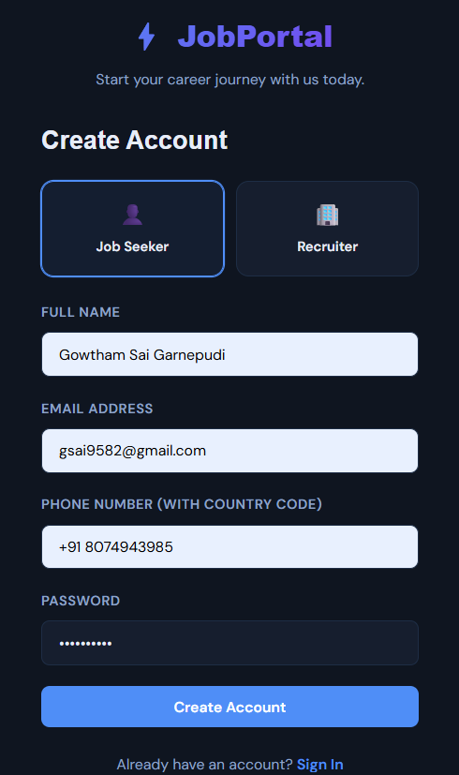
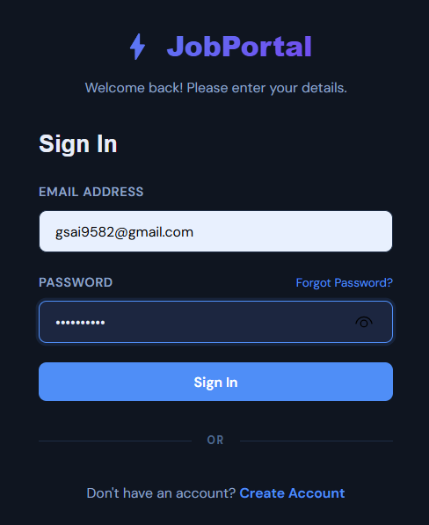
IMPLEMENTATION SCREENSHOTS
Admin Login Page
User Login Page
1
• User selects Job Seeker / Recruiter
• Enter Name, Email, Phone, Password
• Simple & secure signup form
• Supports OTP/verification
• Clean & user-friendly design
• Option to login if account exists
• Enter Email & Password
• Secure user authentication
• Forgot Password option available
• Quick & easy login process
• Redirect to dashboard after login
• Option to create new account
2
3
4
5
6
7
8(B)
9

Slide 12
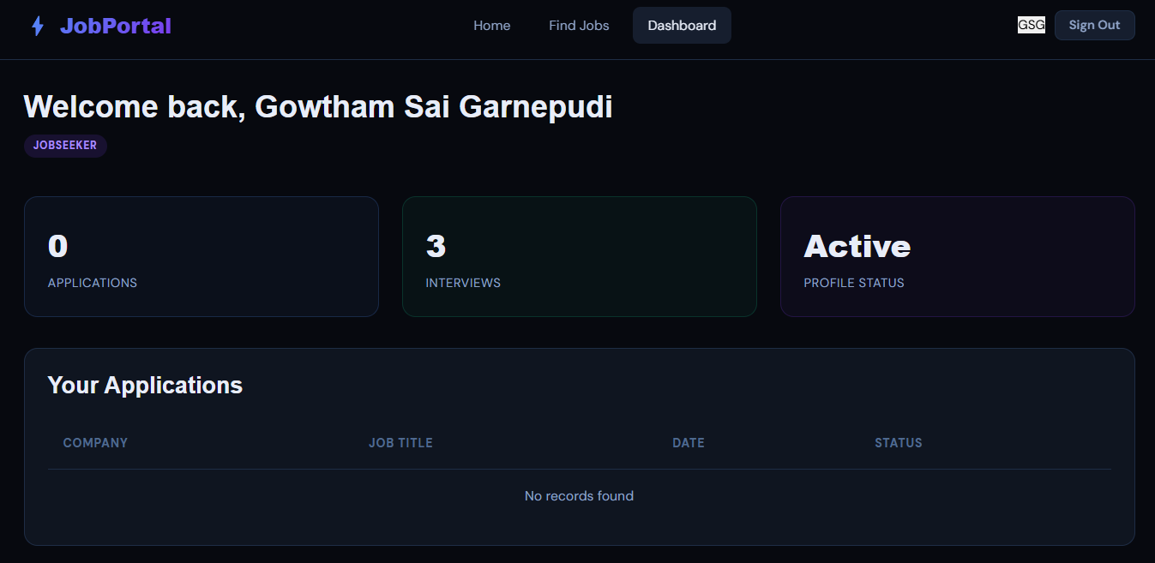
IMPLEMENTATION SCREENSHOTS
Module 1:
1
2
3
4
5
6
7
8(C)
9

Slide 13
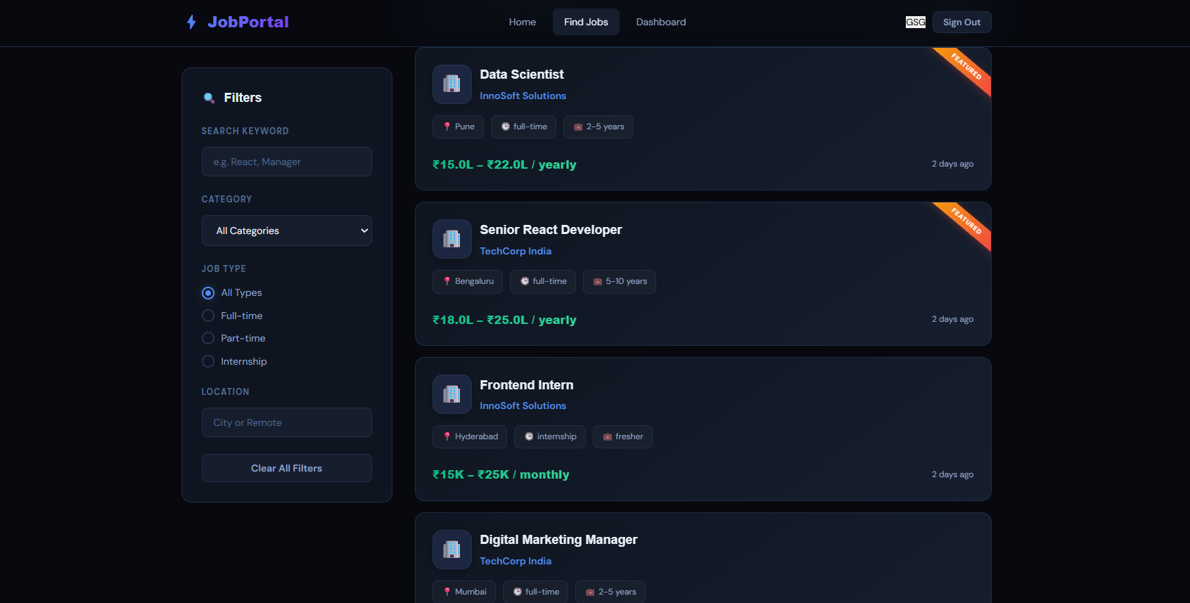
IMPLEMENTATION SCREENSHOTS
Module 2 :
1
2
3
4
5
6
7
8(C)
9

Slide 14
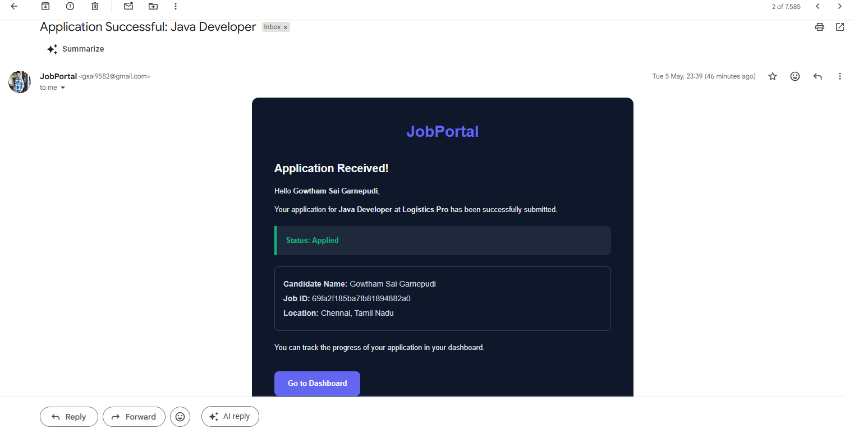
IMPLEMENTATION SCREENSHOTS
Innovative Module:
1
Sends automated emails for registration, job updates, and alerts
Provides application confirmation with details & tracking link
Enables real-time communication between users and the system
2
3
4
5
6
7
8(C)
9

Slide 15
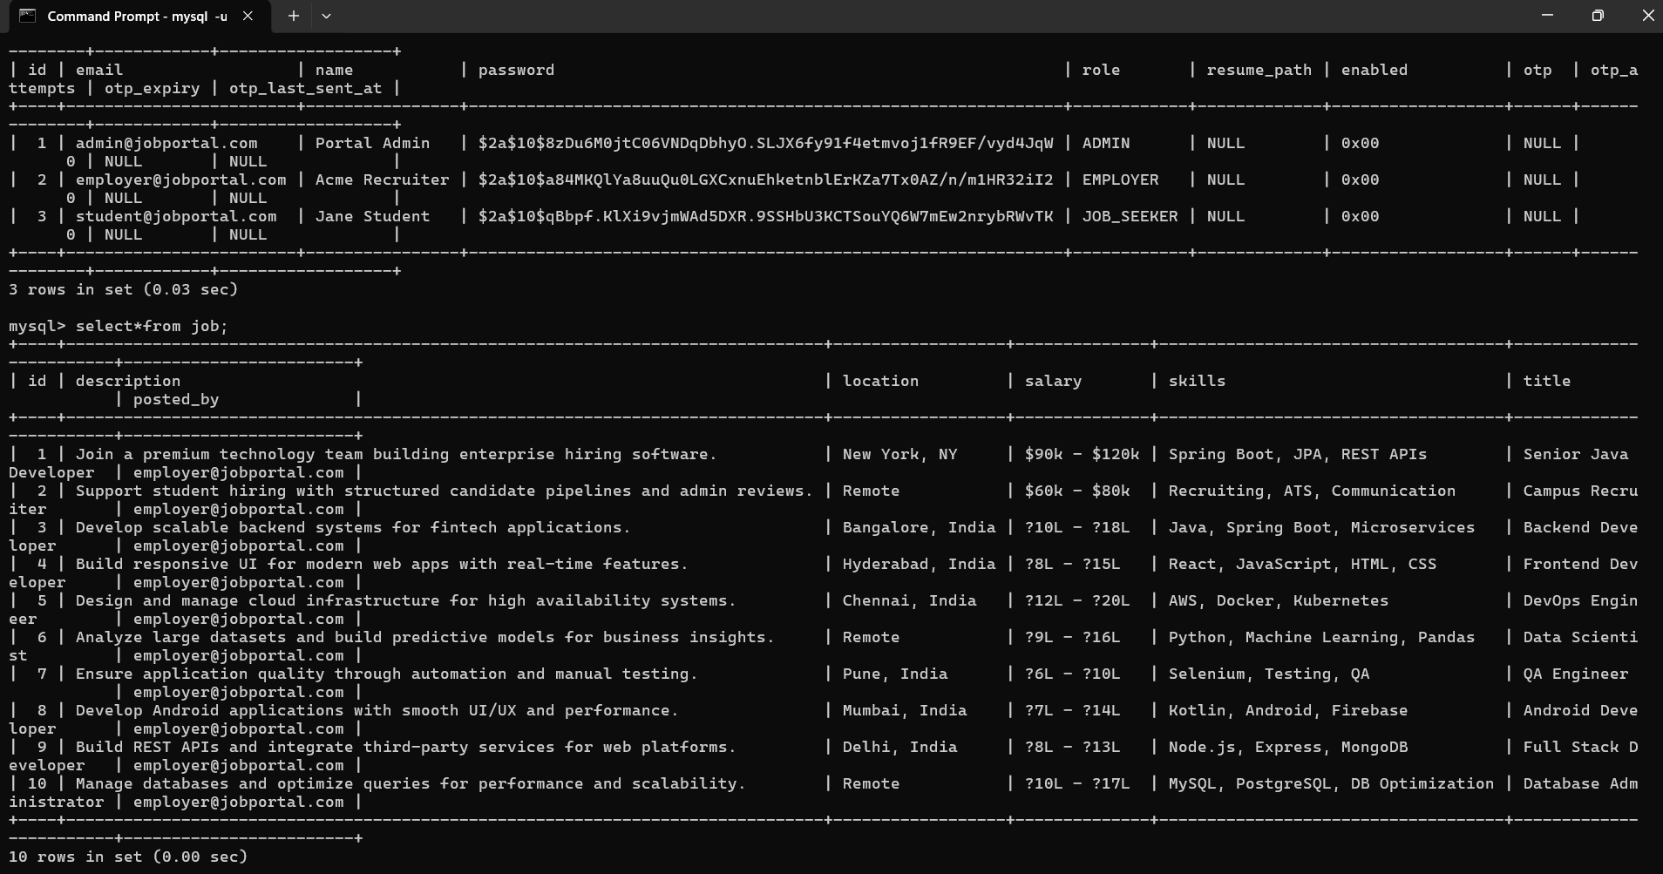
IMPLEMENTATION SCREENSHOTS
Database:
1
2
• Stores user, job, and application data securely
• Maintains tables like users, jobs, applications, OTP
• Enables fast data retrieval and updates
• Supports authentication and role management
• Ensures data integrity and reliability
3
4
5
6
7
8(C)
9

Slide 16
ADVANTAGES & LIMITATIONS
Advantages:
Provides a centralized platform for job seekers and employers.
Reduces time and effort in the recruitment process.
Easy access to job opportunities from anywhere at any time.
Improves accuracy and minimizes manual errors.
Enables quick communication through notifications and updates.
Efficient management of applications and candidate data.
Limitations:
Requires internet connectivity to access the system.
Risk of fake job postings or profiles if not properly verified.
Data security and privacy concerns if not well protected.
Initial setup and maintenance cost can be high.
May require regular updates and technical support.
1
2
3
4
5
6
7
8
9

Slide 17
Thank you

