Slide 1

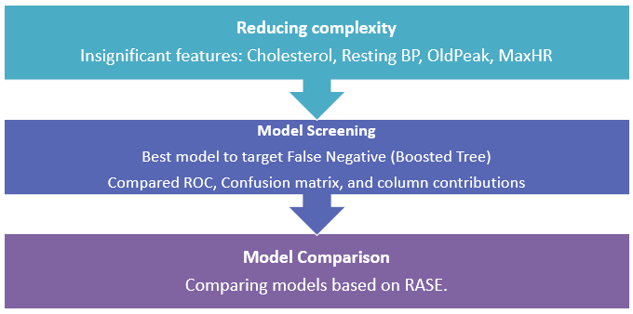
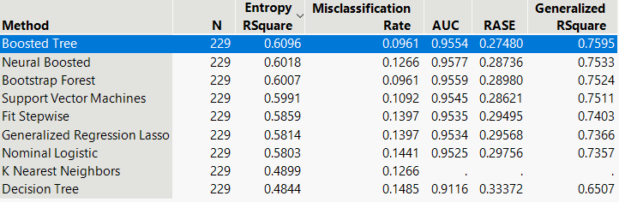
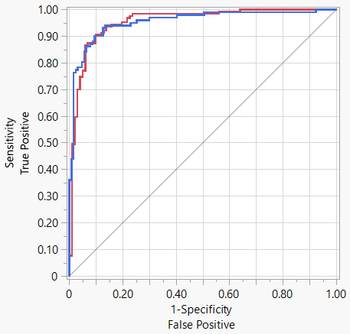
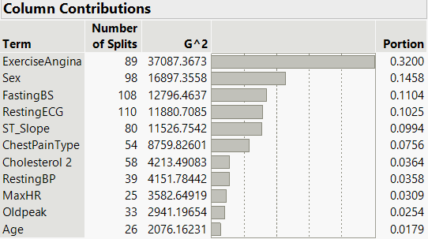
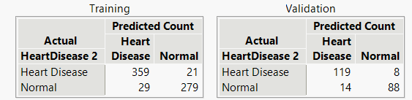
Improved Heart Failure Prediction using Model Screening platform
Introduction Methodology
The data set included 918 participants from different countries and 11 factors associated with heart failure, such as age, sex, blood pressure, blood glucose.
Performed pre-processing of data by exploring null values and outliers. Further, performed Exploratory Data Analysis to understand the importance and relationship of each feature in relation to heart failure.
To build the model, we incorporated the following JMP-16 capabilities in our methodology.
Model Screening: An efficient platform for simultaneously fitting, comparing, exploring, selecting, and then deploying the best predictive model.
Model Comparison: Enables easy to compare and select the best-performing predictive model.
Dashboards: Efficient way to better represent EDA concisely also it can be run anytime as new data is available.
Cardiovascular disease is the number one cause of death globally, claiming an estimated 17.9 million lives in 2019, accounting for 32% of all deaths worldwide that year.^{【1】}
Developed a classification model for classifying Heart disease. Leveraged predictions using Model Screening, Model Comparison, and Dashboard feature in JMP 16.
The model output will help in understanding the importance of factors leading to heart disease and the probability of developing heart disease under certain conditions.
Objective:
To build the best model and also to find factors that are leading to heart failure.
Results
Chosen model with the least number of False Positives (9) as the cost is high.
Accuracy achieved is 90.6%, with an AUC of 95.5.
Exercise Angina, Sex, FastingBS, Resting ECG, ST_slope,ChestpainType contribute more than 75% to heart failure.
Cholesterol, RestingBP, MaxHR, Oldpeak, and Age contribute least to our target.
These least predictors are shown statistically insignificant in our logistic regression, so they can be omitted to reduce the complexity of the model
Conclusions References & Acknowledgements
Using a model screening platform, we explored the best predictive model for heart failure prediction.
Leveraged the JMP 16 dashboard utility to develop an interactive platform that outputs the probability of heart failure based on input parameters.
[1] https://www.who.int/news-room/fact-sheets/detail/cardiovascular-diseases-(cvds)#:~:text=Cardiovascular%20diseases%20(CVDs)%20are%20the,%2D%20and%20middle%2Dincome%20countries.
Notes:
Single sided poster!

Slide 2
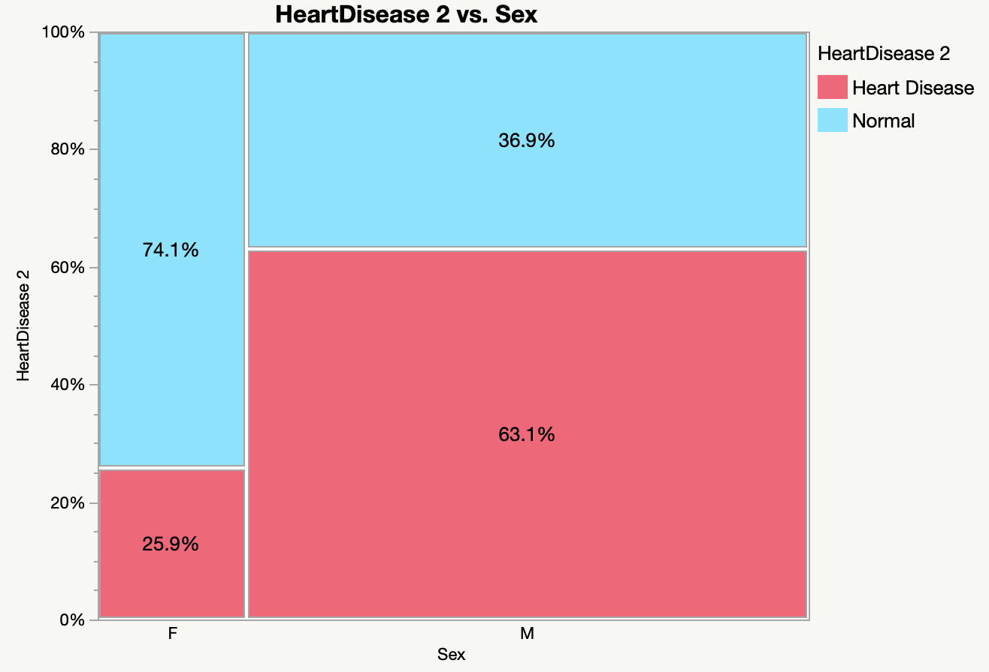
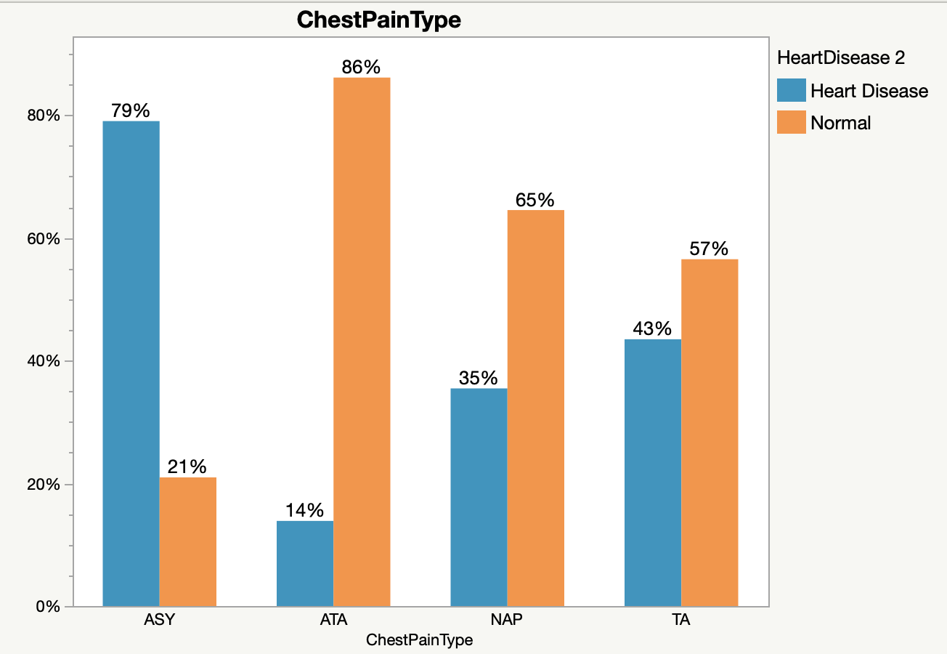
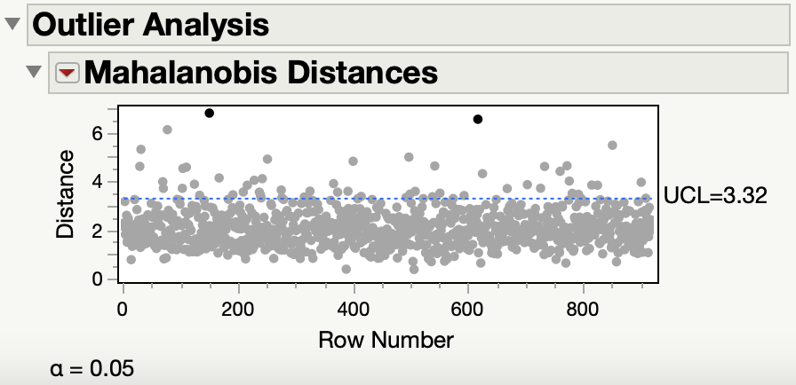
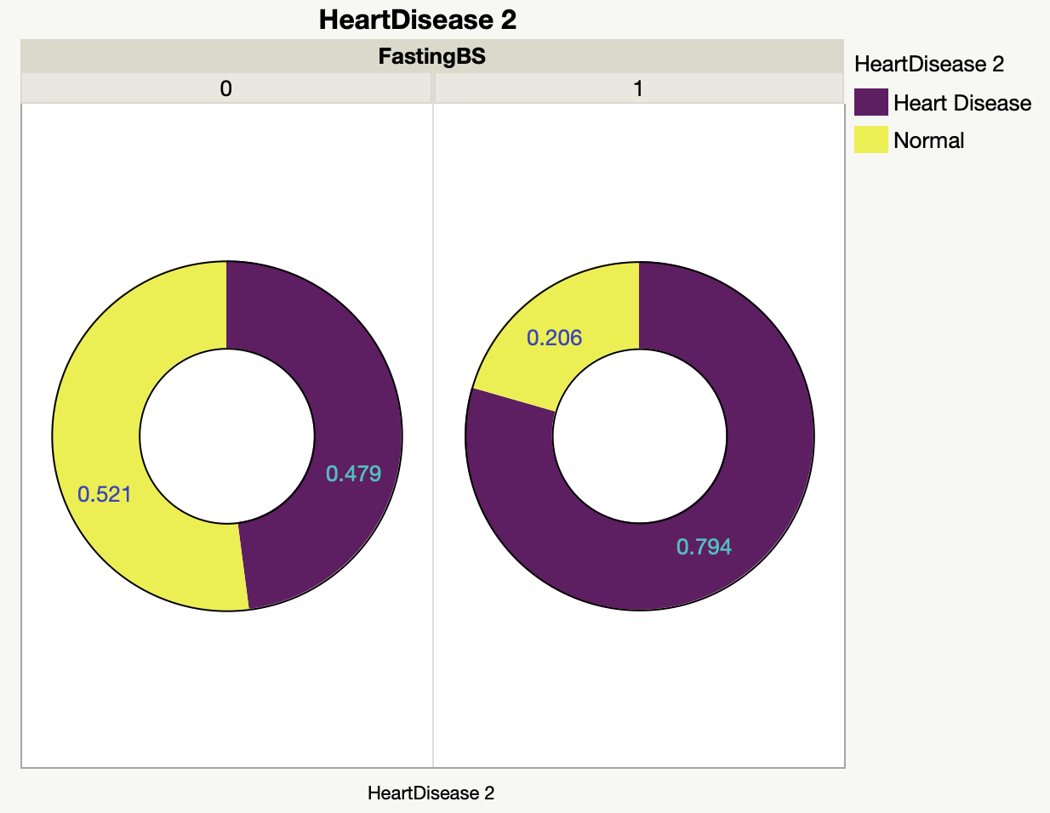
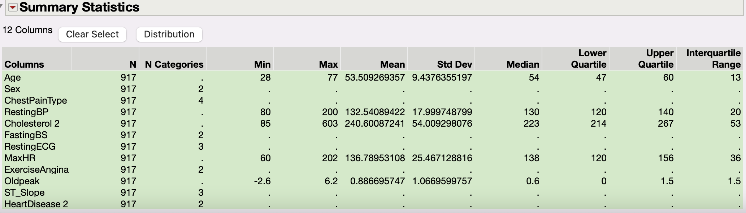
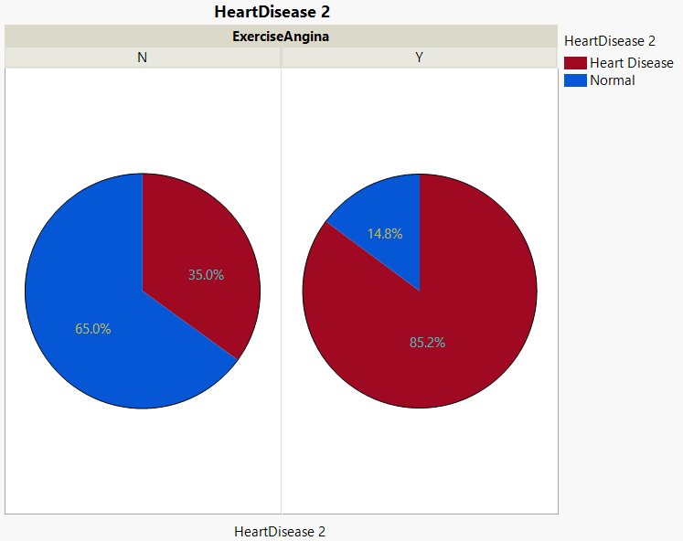
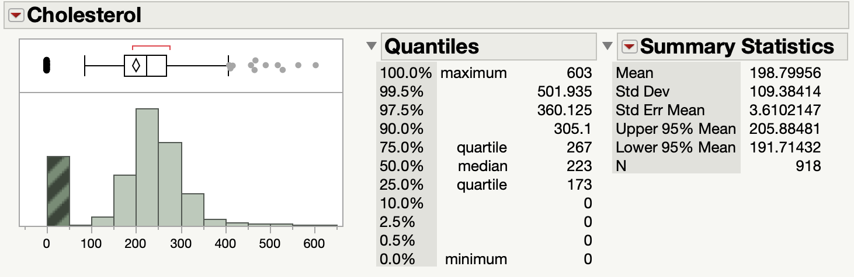
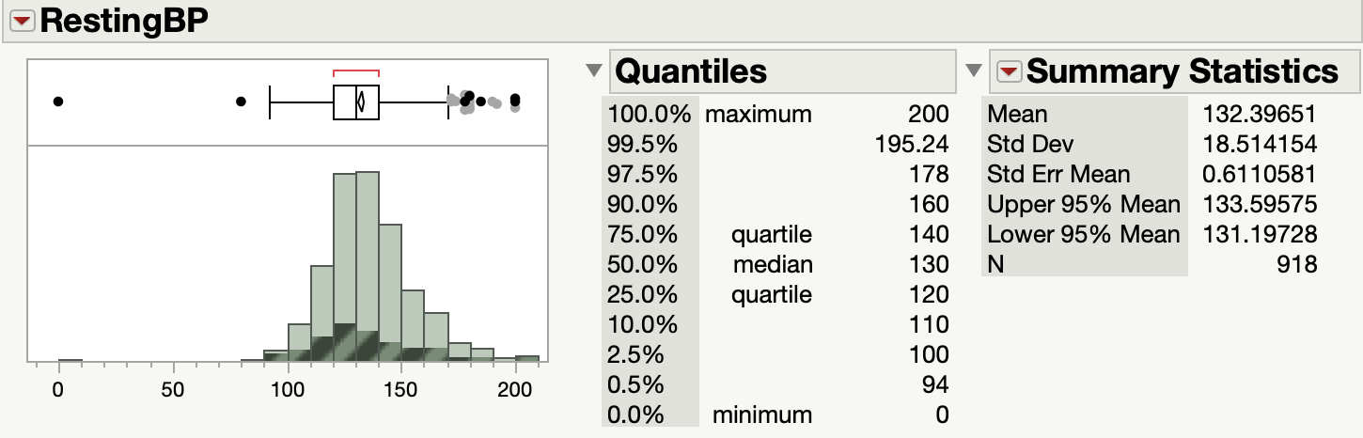
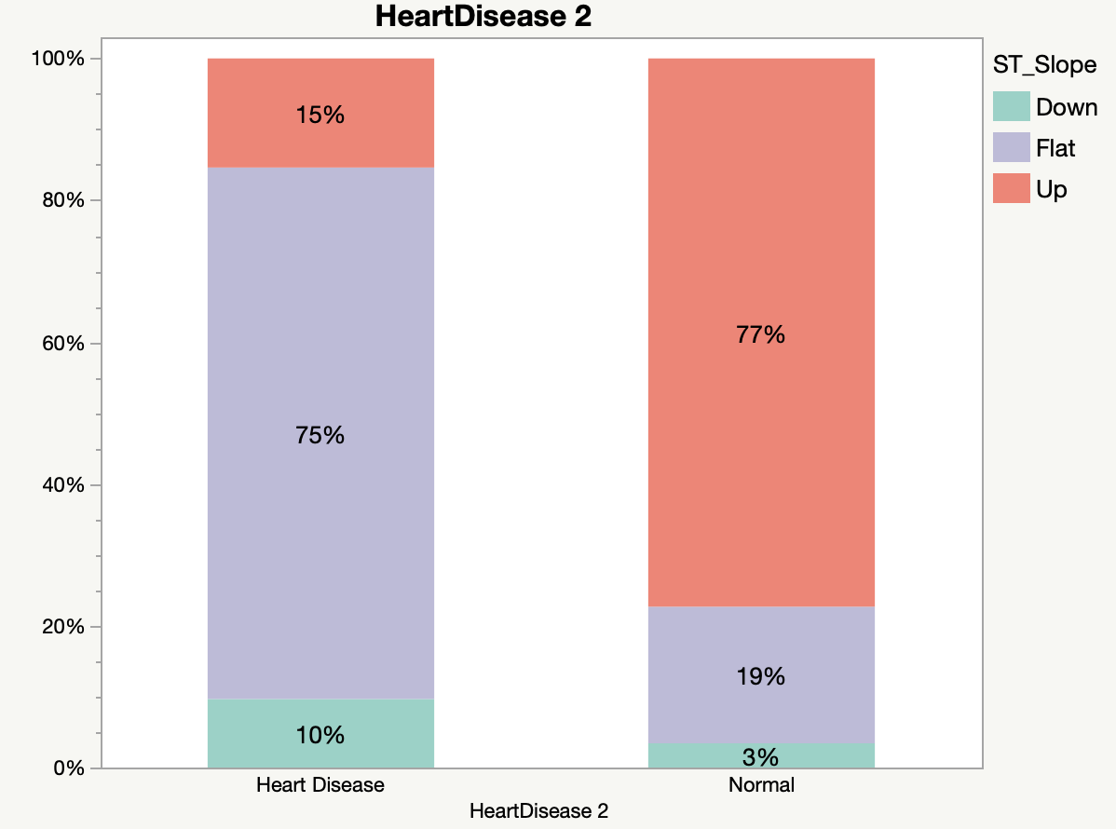
Pre-processing & Exploratory Data Analysis
Exploring Outliers
Exploratory Data Analysis
While exploring the outliers, we identified some patients have higher values on some tests. Since the dataset reflected the actual physical condition of the patient, we decided not to exclude or impute these values.
Gender is an important
element since men who
suffer from heart disease
are twice as likely as
women.
ASY is shown to be the most dangerous type of chest pain as it has the highest incident rate of heart disease.
Missing Values
Blood sugar also has a big impact on heart disease because diabetic have a higher risk of heart disease.
The ST slope of the electrocardiogram after exercise is also a relatively clear judgment basis. A flat slope means higher risk.
Blood sugar also has a big impact on heart disease because diabetics have a higher risk of heart disease.
Resting BP: exclude the row
Cholesterol: replaced by median

Slide 3
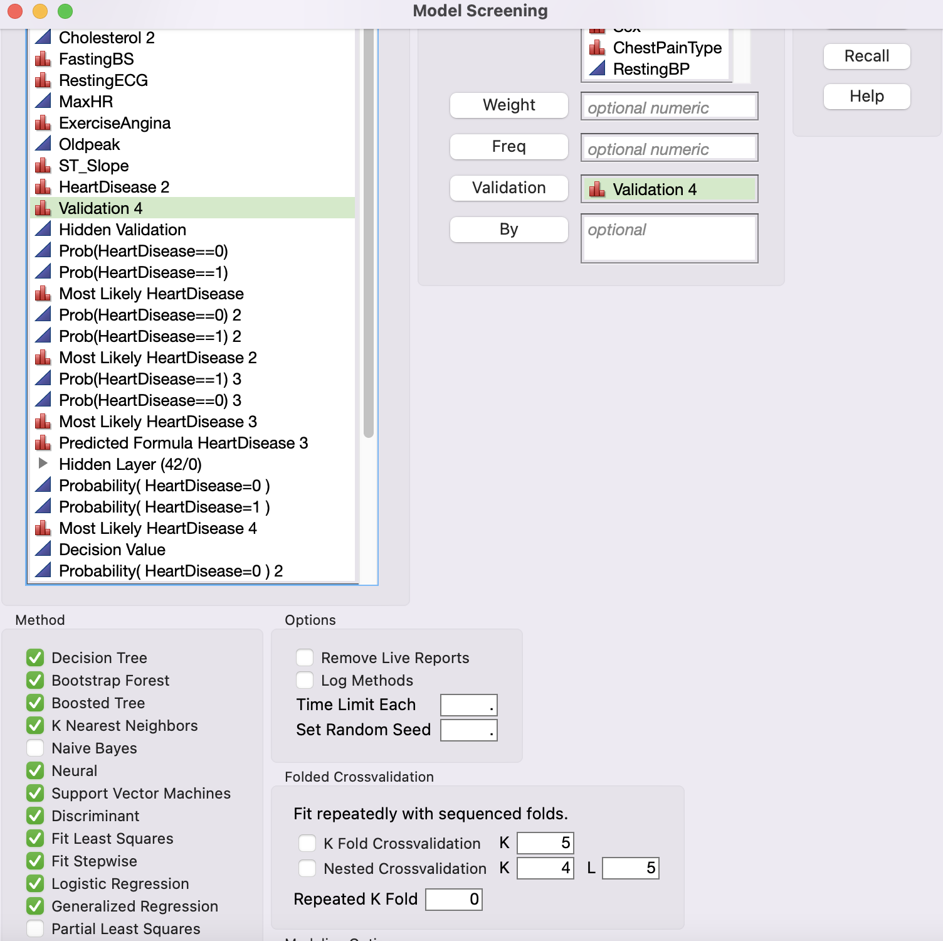
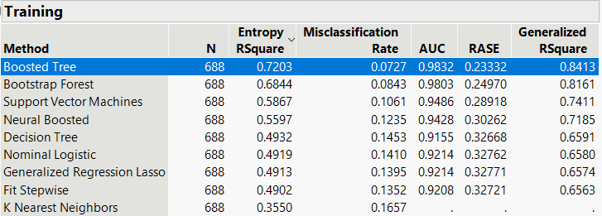
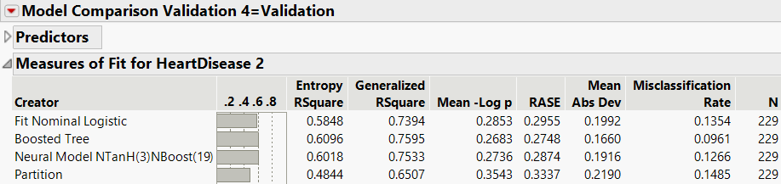
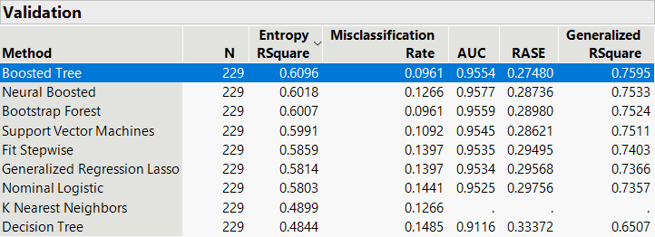
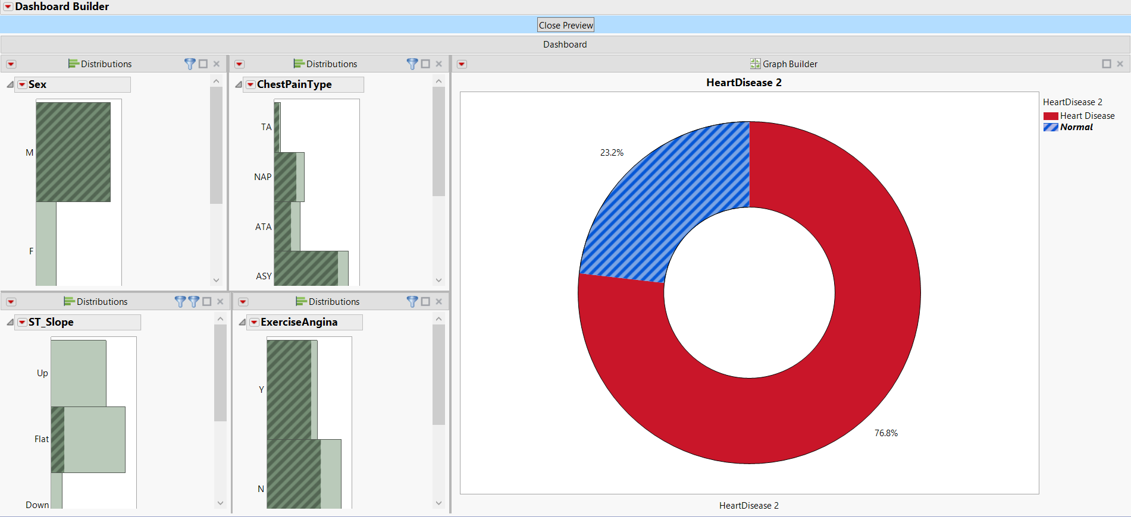
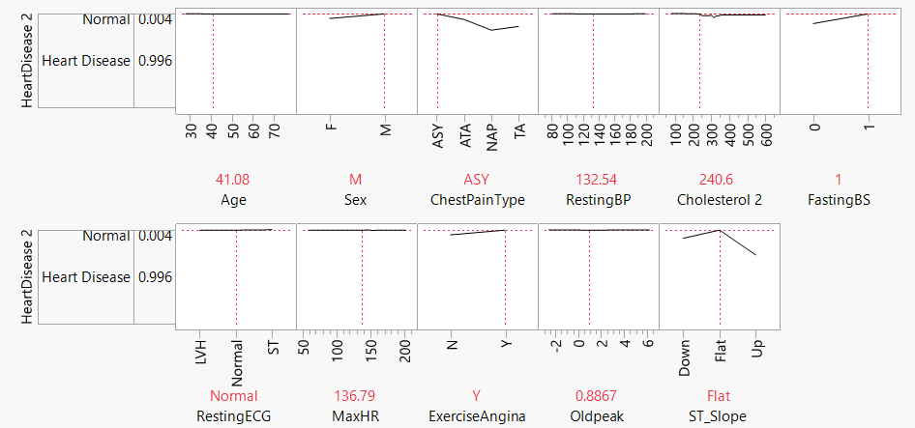
Model Screening & Comparision
Model Screening
Model Comparison
Dashboard
Using the profiler feature in JMP-16, we can predict heart risk of a new patient based on inputting his vitals like Age, chest pain, etc.
We noticed Male Diabetic with a flat pattern in ECG is shown to be more prone to a heart attack.

Slide 4
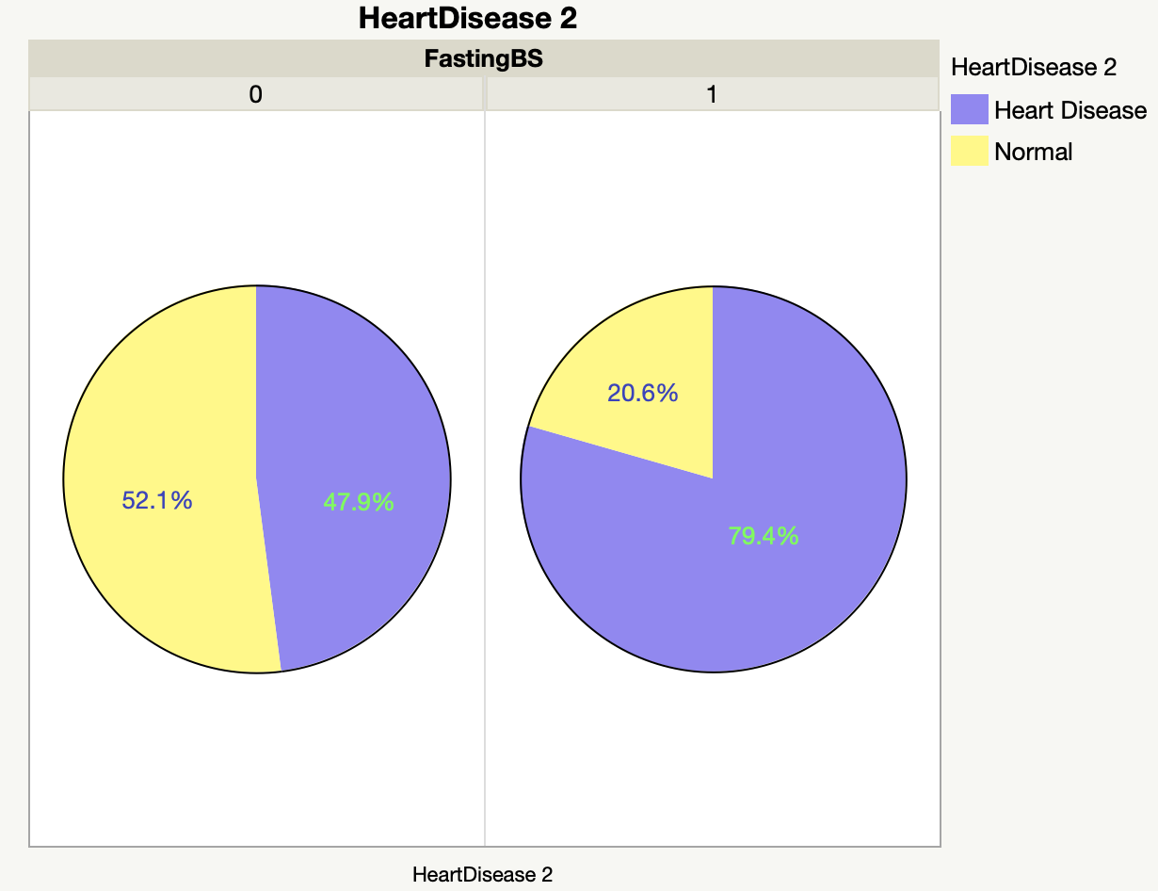
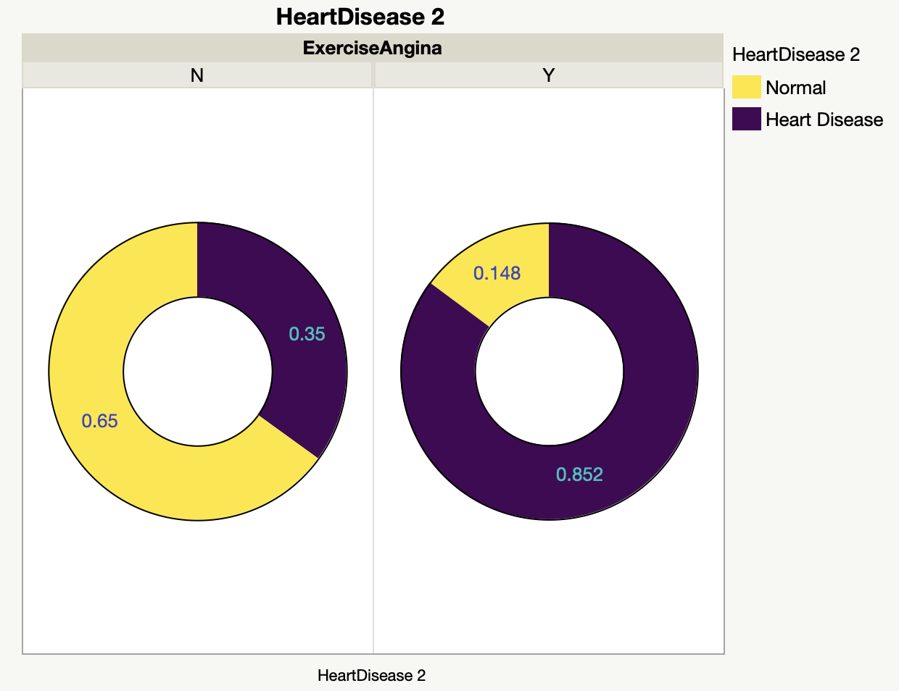
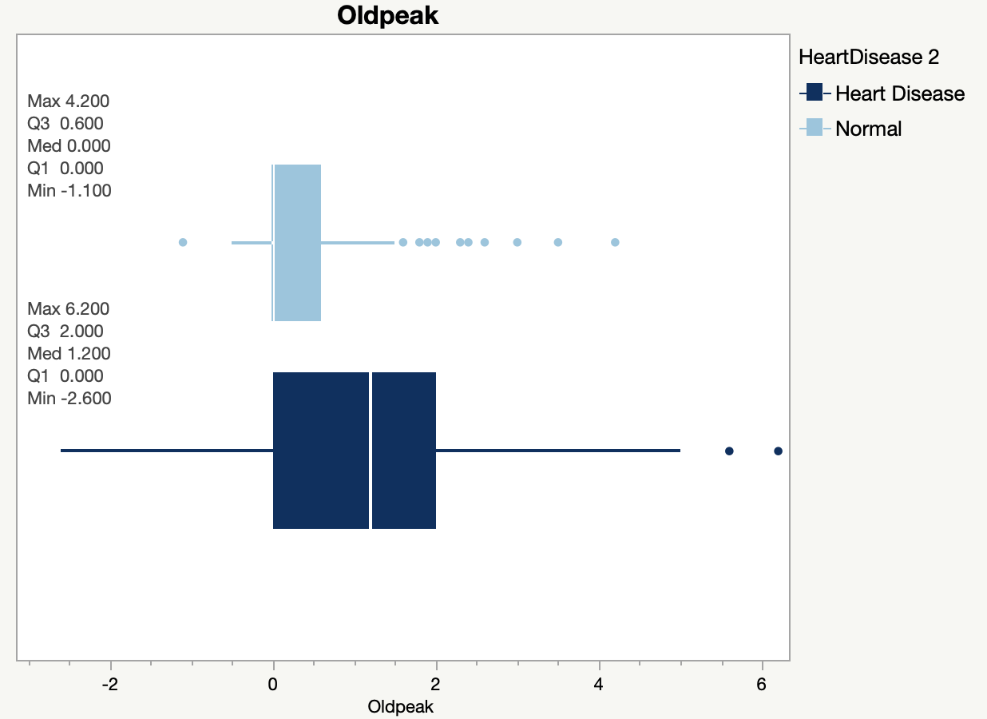
Appendix-EDA
Gender
Chest Pain
FastingBS
ST-slope
Exercise Angina
Oldpeak

