Slide 1

THEME: Customer Retention
Kangaroo House Insurance
Team: Data Pirates
Sai Jahnavi Gamalapati
Kavya Sree Peta
Sai Kumar Bysani
Praneetha V C
1

Slide 2

Contents
Problem Statement
Data Pre-processing
Feature Engineering
Exploratory Data Analysis
Modeling
Results
Recommendations
Conclusion
Q n A
2

Slide 3

Problem Statement
3

Slide 4

Kangaroo - House Insurance American Company is concerned about the company’s retention rates and wants to know what is causing policy cancellation and retain existing customers.
The aim of this project is to create a retention model to identify policies that will be renewed or canceled before the end of the term and understand what variables are most influential in causing a policy cancellation.

Slide 5
Data Description
5

Slide 6
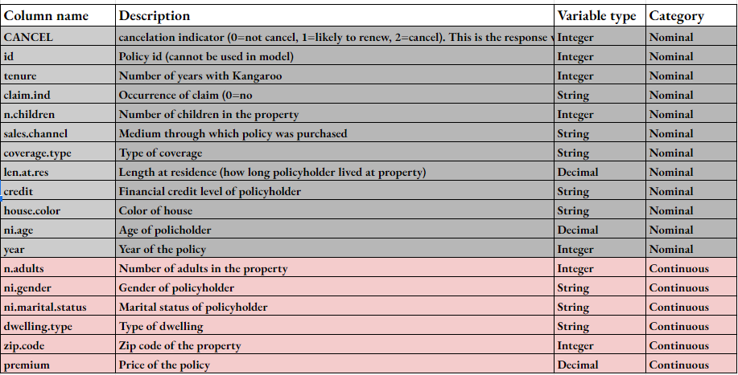

Slide 7
Data Pre-Processing
7

Slide 8
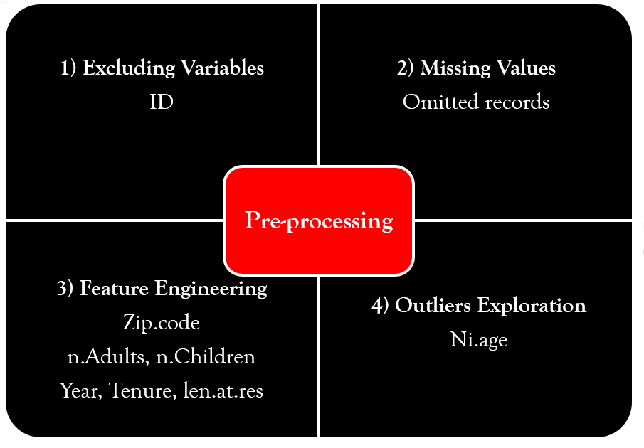
-1 removal

Slide 9
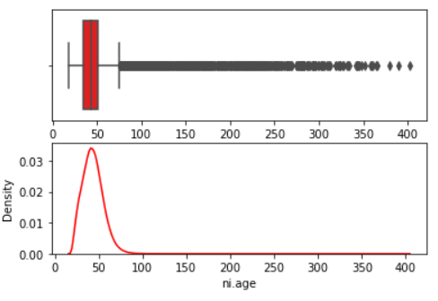
Outliers in ni.age

Slide 10
Feature Engineering
10

Slide 11
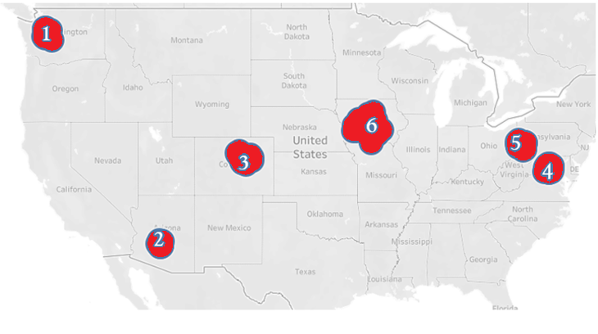
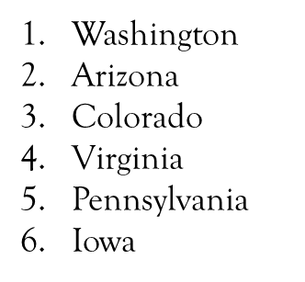
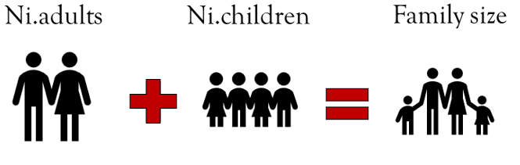
“Zipcode” into Zones
Years Remaining
Years_left = 2022 – “Year”
Years Remaining = “Tenure” – Years_left
Family size

Slide 12
Exploratory Data Analysis
12

Slide 13
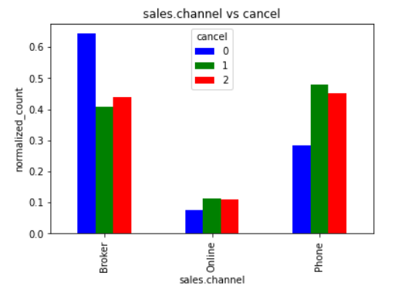
Sales. channel vs cancel
If sales.channel is through “Broker”, it is seen that there is a higher chance of continuing insurance than by other means.
Phone, Online modes are showing higher incidents of not proceeding with the policy
13

Slide 14
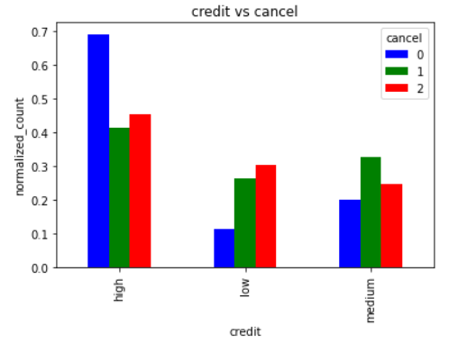
Credit vs cancel
A high credit scorer is most likely to continue the policy than others.
There are higher chances of convincing the medium credit scorers from canceling the plan.
14

Slide 15
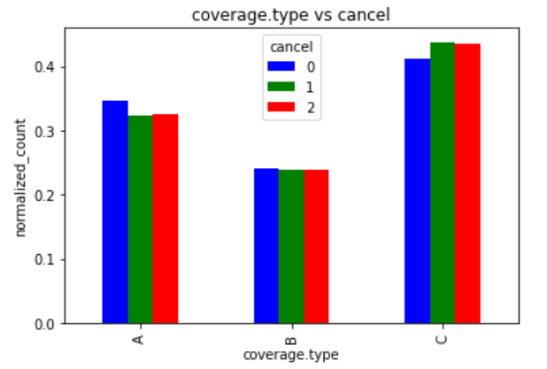
Coverage.type vs cancel
Coverage A (covering damage to the house) holders are most likely to continue the policy than Coverage C (personal property)
15

Slide 16
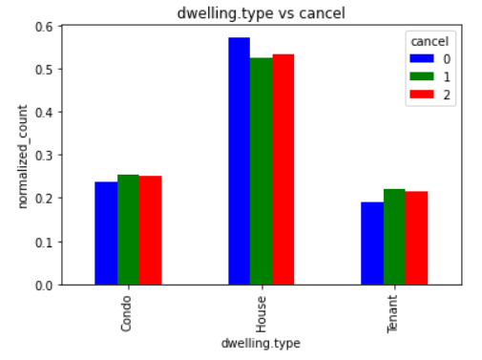
Dwelling.type vs cancel
Consumers with “House” dwelling.type are most likely to continue the House Insurance premium plan than the others.
16

Slide 17
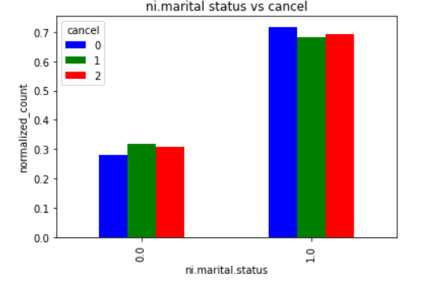
Ni.marital_status vs cancel
Married policyholders are most likely to continue the policy than unmarried holders.
17

Slide 18
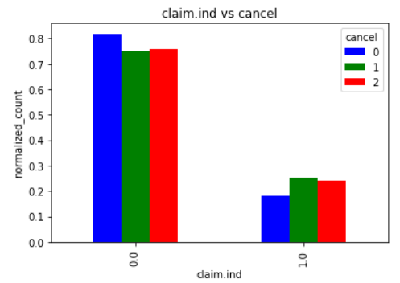
Claim.ind vs cancel
Policy holders without claims are most likely to continue the policy.
18

Slide 19
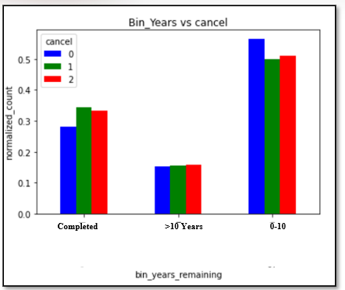
Years remaining vs cancel
Insurance holders in Years remaining ranging from 1-10 years (short-term) are more likely to continue the policy than completed and long-term users.
19

Slide 20
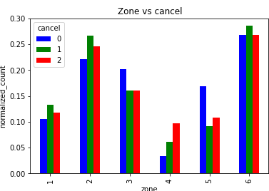
Zone vs cancel
Zone-4 (Virginia) policyholders are mostly canceling policies.
Policy holders from Arizona, Washington, and Iowa can be convinced from cancelling.
ZONE KEY
20

Slide 21
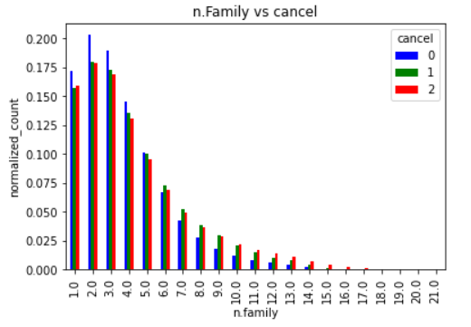
Family size vs cancel
Small family-size <=5 are tending to continue the policy.
Family-size of 6 to 9 can be convinced to continue the policy, whereas if the family size is >=9, they tend towards canceling their plan.
21

Slide 22
Modeling
22

Slide 23
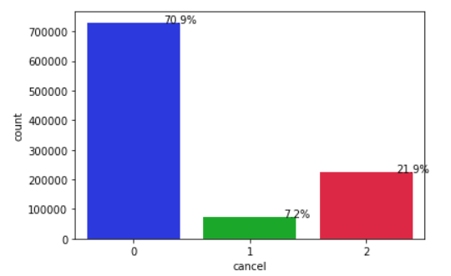
Class Imbalance
Class imbalance is 70.9%, 7.2%, 21.9%
Training-Val split is 80%-20%
Oversampling algorithms like SMOTE are not showing improvement in predictions
23

Slide 24
Evaluation Metrics
Precision is preferred over the False Positive rate for imbalanced data since the FPR can be misleading or uninformative as a number of 0s are more in the data.
The focus is to improve the precision of 1’s and 2’s predictions.
24

Slide 25
Modelling Techniques
Logistic Regression with ALL features
XGBoost Tree
Logistic Regression with statistically significant features
25

Slide 26
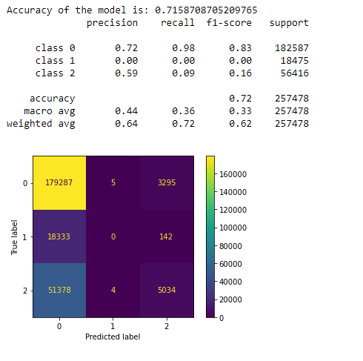
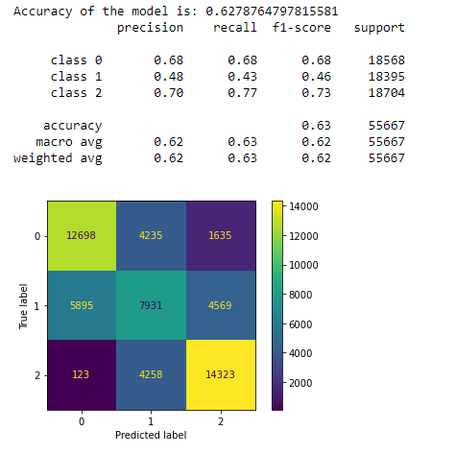
Logistic Regression (Baseline)
GridSearch on class balance weight parameters
(1/70,1/7,1/20)
Removed irreverent features like
→ni. gender
→coverage.type
→dwelling.type}
Above predictors are in poor relation to our target variable
Before tuning
After tuning
26

Slide 27
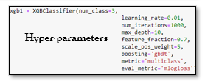
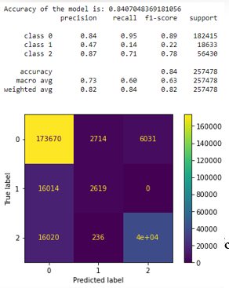
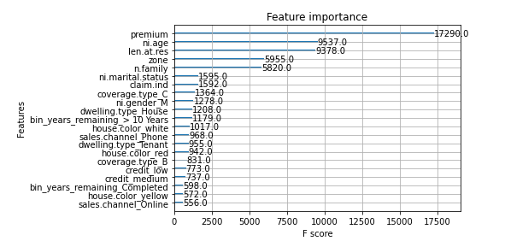
XGBoost
Confusion Matrix
We are seeing high precision for classes 0 and 2, however, the recall on class-1 has dropped significantly which means there are a higher number of False negatives. This can be attributed to highly skewed data.
27

Slide 28
Model Averaging
Decent predictions of 1’s (TPR) can be seen in the logistic classifier compared to XGBoost.
To further improve the predictions of 1, with probabilities from logistic regression classifier and XGBoost, average model has been computed.
With this, the accuracy achieved is 0.72, with class-1 precision, recall (0.46,0.40)
28

Slide 29
Recommendations
29

Slide 30
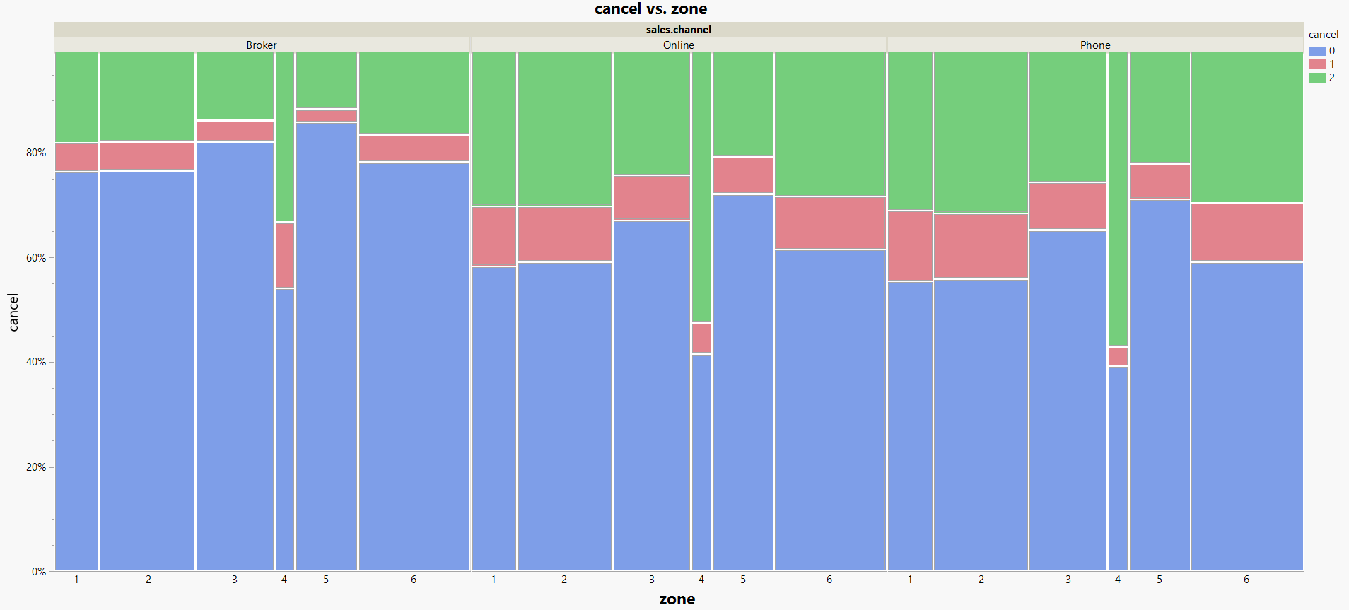
Suggestions to improve Zone - 4
In Virginia (Zone-4) where cancellations are more, we are observing that most of the sales communication is made via Online and Phone.
We can look to employing more in-person sales agents who might win customers in the company's favor of retention of customers
30

Slide 31
No. | Implementation | Values
1 | Success rate of Virginia (Broker, Online, Phone) | (54%,41%,39%)
2 | Households in Virginia (ref-1) | 3184121
3 | Percentage of towns in Virginia based on Zipcode | 26%
4 | Required households in Virginia | 827871
5 | Number of Customers who have already taken plan | 51313
6 | Number of people that does not have Kangaroo Auto Insurance | 776558
7 | Assuming 15% of them require an insurance plan | 116483
8 | Number of Customers a sales agent can handle | 100
9 | Number of sales agents required | 1164
10 | Pay per hour for a sales agent | 15$
11 | Total Investment per hour | 17460$
12 | Mean Premium in Virginia | 899.83$
13 | Success Rate of Broker | 54%
14 | Number of New Customers they will be getting | 62901
15 | Total sales for the new customers per month | 56.6M$
31

Slide 32
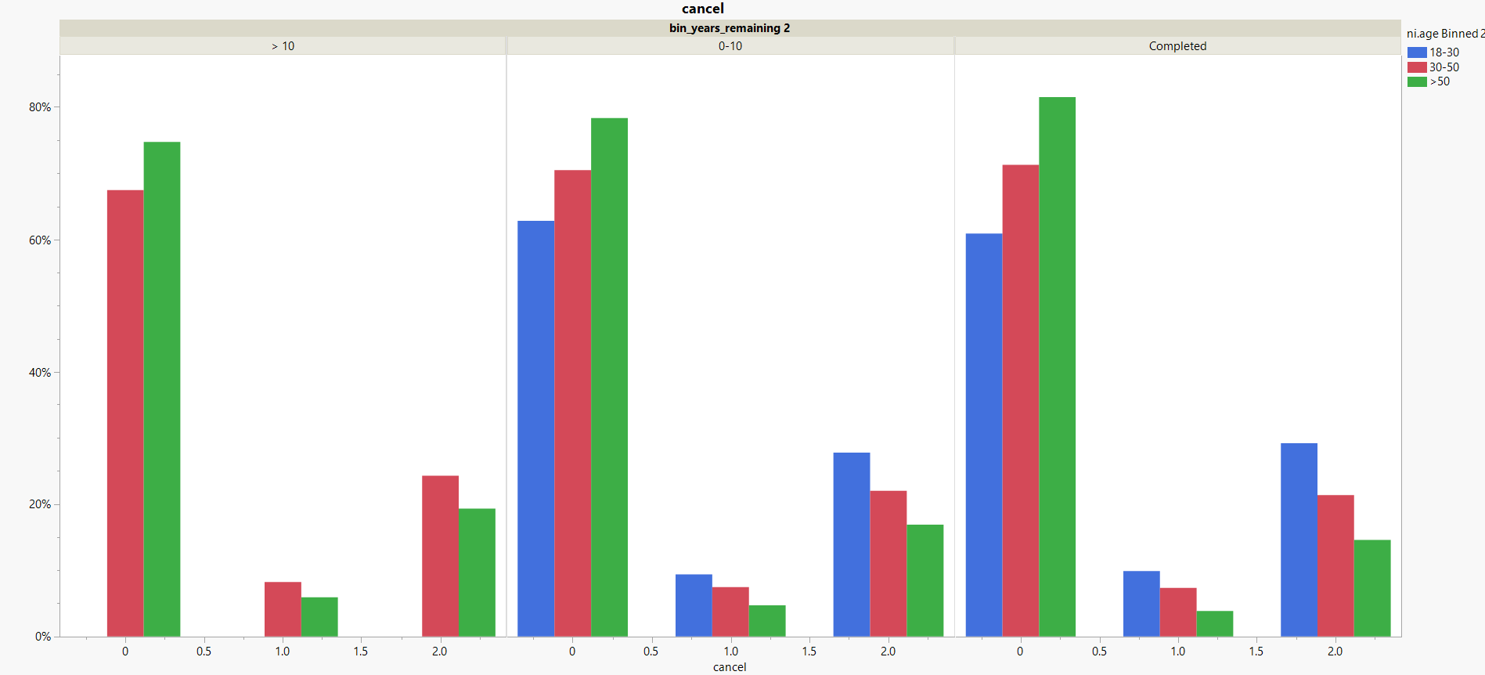
Targeting Younger population
For completed (-10 to 0), most of those who haven’t renewed the plan are aged 18-30. For the age group (0-10), most of those who have canceled are in the age group 18-30.
Insights:
Offering additional coverage top-up at reasonable rates might work in the company's favor.
Marketing the target age group customers to emphasize on the fact that low premiums are associated with the newly constructed homes, which are preferable for investment. Rather than the old ones, which tend to get problems with age and have higher premiums too.
32

Slide 33
Implementation benefits
Implementation | Values
% of adult's contributing to kangaroo industry | 13.81%
% of adults tending to cancel policy | 43.5%
The homeownership rate among Americans under 35 years (ref-2) | 37.8%
Total adults (1:1 male) | 4620550
The number of adults with credit scores >680 is (24%) (ref-3) | 1136655.3
The number of Homeownership of adult households is (37.8%) | 429655.7
For analysis’ sake, we have chosen the entire adult population households are taking policy from kangaroo. Actual values may vary
No of adults cancelling policy (43.5%) | 185611
No of adults continuing policy (56.5%) | 244044.43
In our analysis, we found 899 is the mean premium ranging from (620-1200) for the 18-30 population
Sales from the adult population per month with 890 premium (total - canceled) | $219M
Sales from adult population with premium 620 and expecting at least 10% turnout with reduction in premium (total_updated_canceled) | $266M
% increase in sales | 21.4%
33

Slide 34
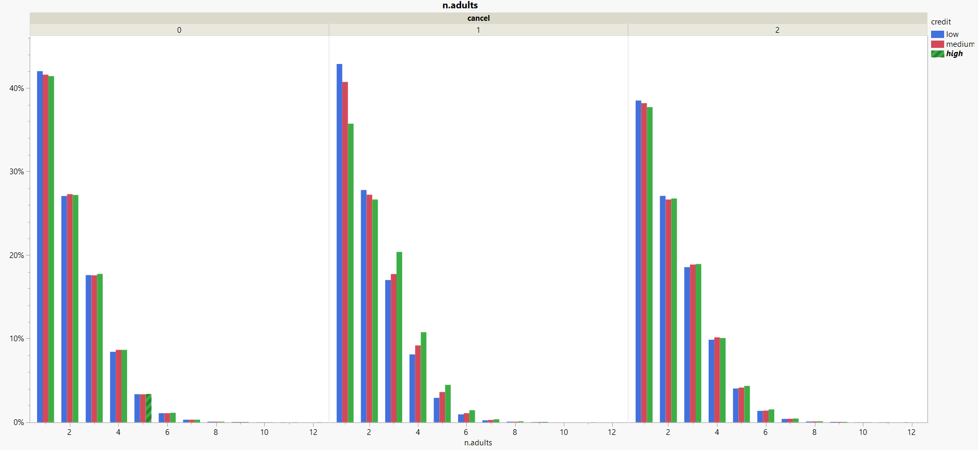
Targeting Skeptical Customers
Families with three or more adults can be convinced to renew the plan, as most of them have a “High Credit Score”.
There is no notable trend observed for cancelled and continuing customers.
34

Slide 35
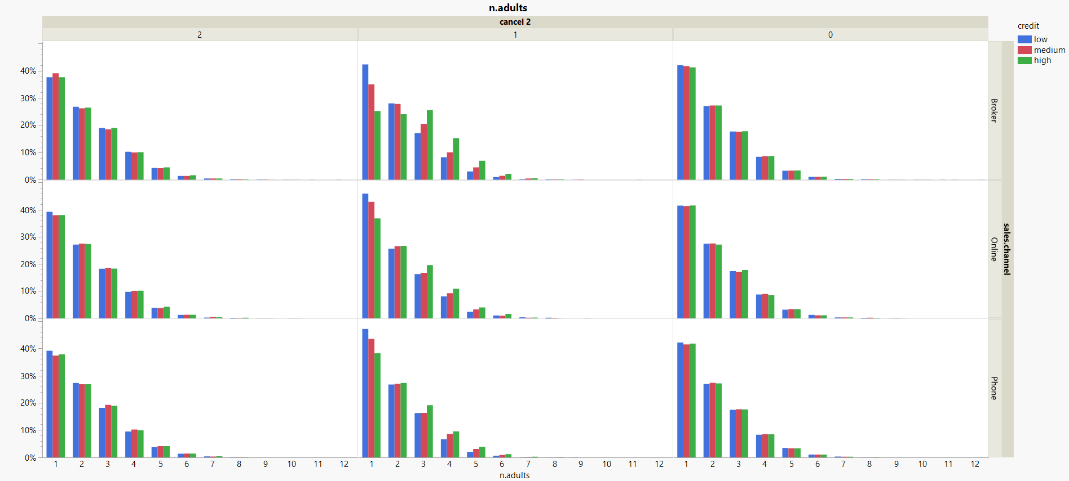
Analysis with sales.channel
When the mode of communication is phone, most customers are unable to take a decision.
For customers with low credit scores, they are also skeptical
35

Slide 36
Implementation
CASE 1: Improving Website
Giving some attractive offers to these customers and referral bonus might convince them to continue.
CASE 2: Hiring Sales Agents
Assigning a group of sales agents to these customers might convince them to further continue.
Success Rate | 54%
Number of Customers that can be convinced | 2200
Mean premium | 899$
Revenue that can be generated per month | 1.97M$
36

Slide 37
Conclusion
37

Slide 38
Factors leading to policy cancellations
Credit Score
Sales. channel
Age of customer
Tenure remaining
Location
Claim history
Family Size
38

Slide 39
References
https://www.census.gov/quickfacts/VA (ref-1)
https://www.statista.com/statistics/1036066/homeownership-rate-by-age-usa/ (ref-2)
https://www.experian.com/blogs/ask-experian/what-is-the-average-credit-score-in-the-u-s/ (ref-3)
38

Slide 40

Thank You
39

