Slide 1

An Explainable AI Framework for Analysis of X-Ray Polarimetry Data from XPoSat
Under the Guidance of
Ms. Soujanya
Team No.: 17
G Sai Saatvik — 23BD1A058M
R Srihitha — 23BD1A059M
N Shruthi — 23BD1A059B
K Rajkumar — 24BD5A0530

Slide 2
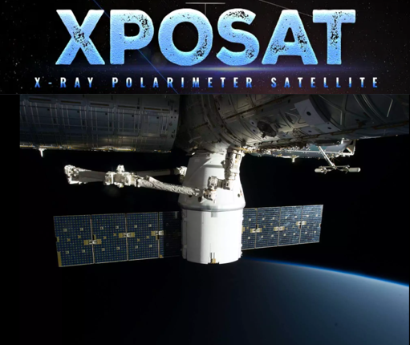
OBJECTIVES
ABSTRACT
XPoSat’s POLIX payload records polarization-sensitive scattering information across multiple Level-2 FITS products. The proposed study aims to transform exposure, energy–azimuth, timing, detector-balance and source-azimuth behaviour into interpretable features for unsupervised observation screening when trusted anomaly labels are unavailable. Product-aware explanations will connect unusualness to original FITS products, while WeightedRoll and blank-sky comparison remain an independent physical diagnostic. The expected contribution is a traceable workflow for expert prioritization—not source classification. Statistical unusualness is not a discovery, and calibrated polarization degree or official sky polarization angle is outside the present claim without validated background treatment and mission calibration.
Introduction about XPOSAT and POLIX:
XPoSat is India's first dedicated X-ray polarimetry mission developed by ISRO to study the polarization properties of cosmic X-ray sources. The POLIX instrument generates Level-2 scientific data that require complex manual analysis. This project proposes an Explainable Artificial Intelligence (XAI) framework to automatically analyze POLIX data by extracting scientific features and applying unsupervised machine learning techniques for anomaly detection.
Understand POLIX Level-2 products.
Screen observations without trusted labels.
Explain feature- and product-level evidence.
Keep modulation as a separate diagnostic.

Slide 3
INTRODUCTION
X-Ray Astronomy
X-Ray Polarization
Imaging, spectroscopy and timing locate, characterize and track energetic sources, but may leave source geometry under-constrained.
Linear polarization adds degree and orientation information related to emission asymmetry, magnetic-field structure and scattering geometry.
INTRODUCTION
XPoSat / POLIX
Project Motivation
XPoSat carries POLIX for 8–30 keV polarimetry and XSPECT for 0.8–15 keV spectroscopy and timing. POLIX uses a central beryllium scatterer, four proportional counters and 48 anode cells.
One POLIX observation spans heterogeneous FITS products. Manual comparison is repetitive; labels are unavailable; and a score must remain traceable to scientific evidence.
The project proposes observation-level screening—not source classification—while preserving the distinction between statistical unusualness and calibrated polarimetric inference.
INTRODUCTION SUMMARY

Slide 4
Why X-Ray Astronomy Needs Polarization
Compact objects, accretion flows, shocks and hot plasmas release large amounts of energy in X-rays.
IMAGING
Where is the emission?
Spatial structure and source location
SPECTROSCOPY
What energies are present?
Composition, temperature and continuum shape
TIMING
How does it change?
Variability, periodicity and transient behaviour
↓
These observables can leave source geometry degenerate. Polarization adds orientation, magnetic-field order and scattering geometry.

Slide 5
POLIX Converts Scattering into Modulation
CROSS-SECTIONAL VIEW
Counter 1
DOCUMENTED DETECTOR FACTS
Incident X-rays enter along the instrument axis into the central scatterer.
• Four position-sensitive proportional counters
• 48 anode cells in total
• Thomson-scattering sensitivity
• Polarization produces a preferred azimuthal count pattern
↖ ↗
↙ ↘
Central
beryllium
scatterer
Counter 4
Counter 2
Counter 3
The modulation pattern is evidence from which polarization information may be inferred after background treatment and calibration.

Slide 6
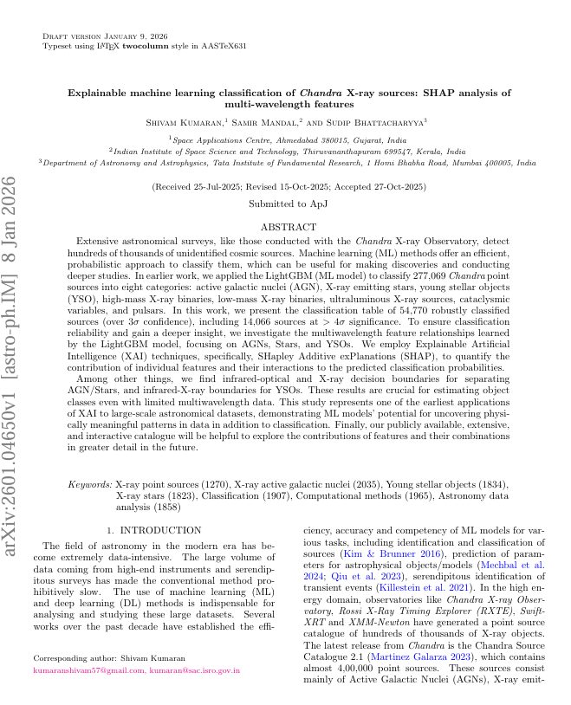
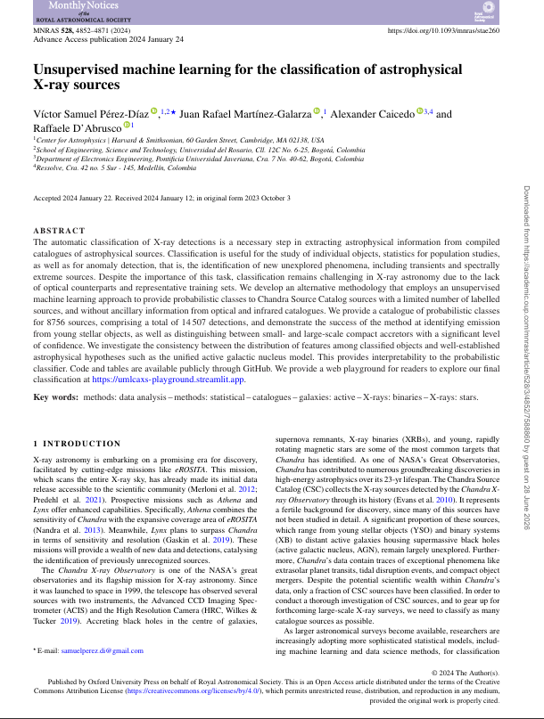
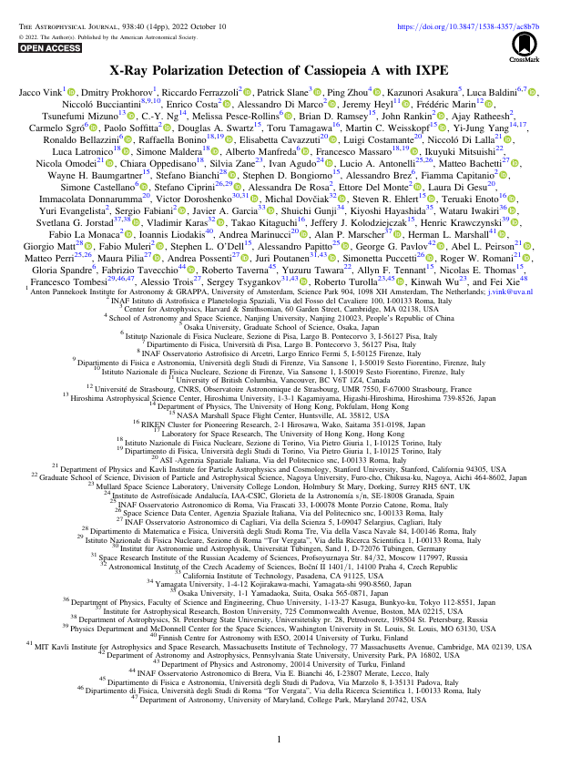
BASE PAPERS
Explainable Machine Learning Classification of Chandra X-ray Sources
Unsupervised Machine Learning for the Classification of Astrophysical X-ray Sources
X-Ray Polarization Detection of Cassiopeia A with IXPE
Initial interpretability influence Initial unsupervised-learning influence

Slide 7
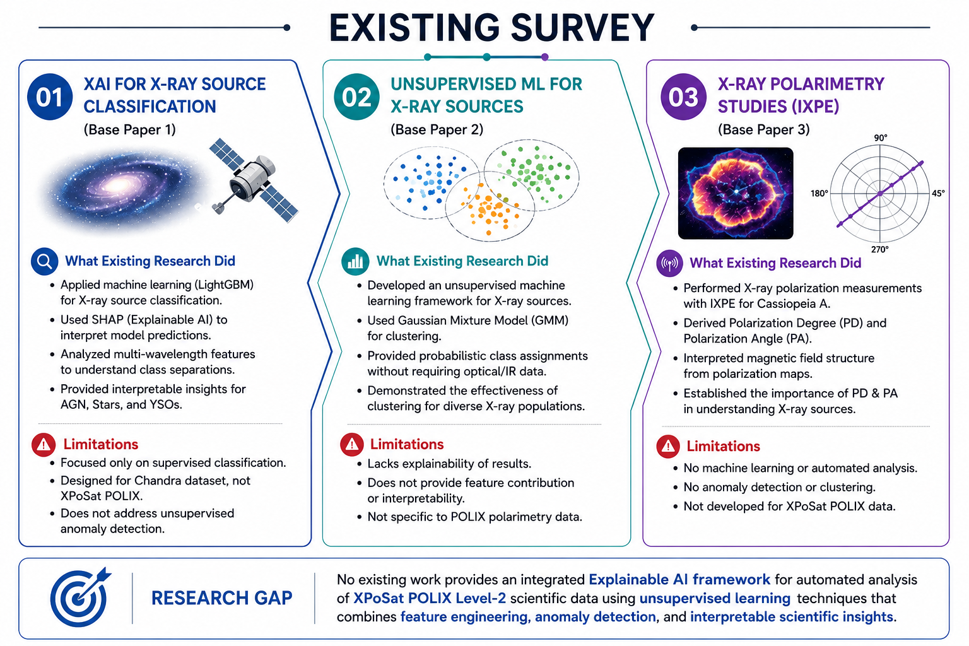
Existing System

Slide 8
BASE-PAPER INTERPRETATION
Unsupervised Machine Learning for the Classification of Astrophysical X-ray Sources
ADAPTED: learning when labels are weak or unavailable.
NOT ADOPTED: source-class probabilities; our output is observation unusualness.
X-Ray Polarization Detection of Cassiopeia A with IXPE
IXPE detection of Cassiopeia A polarization demonstrates how calibrated polarimetry constrains magnetic structure.
ROLE: physical-science foundation—not a POLIX ML base paper and not transferable calibration.
Explainable Machine Learning Classification of Chandra X-ray Sources
Supervised LightGBM classification of Chandra sources with SHAP explanations.
ADAPTED: scientific interpretability and feature attribution.
NOT ADOPTED: classification labels, LightGBM and SHAP as the project method.
CURRENT FOUNDATION
No single paper covers the project. The defensible base-source set combines the POLIX Level-2 handbook, Isolation Forest, anomaly-explanation literature and Stokes-based polarimetry. The three papers above remain valuable influences with clearly limited roles.

Slide 9
LITERATURE SURVEY
X-Ray Astronomy
X-Ray Polarimetry
X-ray astronomy studies high-energy cosmic sources using space-based observatories, providing valuable insights into extreme astrophysical phenomena.
Polarimetry measures the polarization properties of X-rays, such as Polarization Degree (PD) and Polarization Angle (PA), to understand the physical characteristics of celestial objects.
LITERATURE SURVEY
Machine Learning
Explainable AI (XAI)
Machine learning techniques are
increasingly used to automate feature extraction, pattern recognition, and anomaly detection in large astronomical datasets.
Explainable AI improves the transparency
of AI models by providing interpretable explanations, enabling researchers to
better understand and trust model predictions.
Existing research demonstrates the growing application of X-ray polarimetry, machine learning, and Explainable AI in astronomical data analysis. These advancements provide a strong foundation for developing intelligent and interpretable scientific analysis frameworks.
LITERATURE SUMMARY

Slide 10
EXISTING SYSTEM
Manual Product Review
Mission Products & Utilities
Researchers inspect separate exposure, light-curve, azimuthal, detector-wise and modulation products with domain knowledge.
Official Level-2 products preserve instrument semantics and provide the starting point for valid scientific analysis.
EXISTING SYSTEM
Target-Specific Studies
General ML / XAI
Published polarimetry analyses focus on individual sources, calibrated missions and source-specific physical questions.
Generic PCA, clustering, anomaly detection and explanation methods are available, but do not encode POLIX product meaning automatically.
Current practice is scientifically established and expert controlled, but multi-file archive screening remains repetitive and weakly integrated with explainable anomaly ranking.
EXISTING-SYSTEM SUMMARY

Slide 11
ADVANTAGES OF EXISTING SYSTEM
Explainable Machine Learning Classification of Chandra X-ray Sources: SHAP Analysis of Multi-Wavelength Features
Explainable AI using SHAP
Accurate X-ray source classification
Interpretable feature analysis.
Unsupervised Machine Learning for the Classification of Astrophysical X-ray Sources
No labeled data required.
Detects hidden data patterns.
Efficient clustering of X-ray sources
X-Ray Polarization Detection of Cassiopeia A with IXPE
Accurate polarization measurement.
Reliable PD & PA estimation.
Better understanding of magnetic fields

Slide 12
EXISTING SYSTEM — LIMITATIONS
REPETITIVE MULTI-FILE REVIEW
One observation spans several products
Archive-level comparison is time-consuming
Analyst workflows may vary
UNLABELLED AND OPAQUE SCREENING
Trusted anomaly labels are unavailable
Generic scores may lack product meaning
Small datasets can produce unstable rankings
PHYSICAL-CALIBRATION DEPENDENCE
Statistical anomaly is not polarization
WeightedRoll includes source and background
Final PD/PA needs valid calibration

Slide 13
Research Problem, Aim and Objectives
FORMAL PROBLEM
AIM
How can multiple POLIX Level-2 products be analysed automatically, without trusted anomaly labels, to identify unusual observations and explain the responsible features/products—while keeping physical modulation evidence separate and presenting results for researcher review?
The project aims to develop an explainable, unsupervised framework for screening POLIX Level-2 observations and supporting cautious, traceable scientific interpretation.
PROPOSED OBJECTIVES
1 Study XPoSat/POLIX and Level-2 FITS structure
2 Define scientifically meaningful features
3 Compare source and blank-sky observations
4 Apply PCA and clustering where justified
5 Rank unusual observations with unsupervised detection
6 Explain evidence at feature and product level
7 Treat WeightedRoll as an independent diagnostic
8 Provide an accessible researcher-oriented interface

Slide 14
ADVANTAGES OF PROPOSED SYSTEM
Multi-Product
Screening
Prioritize
Observations
Product-Aware
Evidence
Physical
Diagnostic
Reproducible
Workflow
1. Multi-Product Screening
Combines interpretable summaries from related Level-2 products instead of examining each file in isolation.
2. Observation Prioritization
Ranks observations for expert review without requiring trusted anomaly labels or source classes.
3. Product-Aware Evidence
Connects unusualness to contributing features, measurement meaning and original FITS product families.
4. Independent Physical Check
Keeps WeightedRoll and blank-sky modulation evidence separate from the primary anomaly features.
5. Reproducible & Extensible
Supports versioned feature definitions and future observations, calibration releases and expert feedback.

Slide 15
DISADVANTAGES / EXPECTED LIMITATIONS
Missing products, exposure irregularities or detector effects can influence features. Data-quality context must be reported with every score.
A small archive and absent anomaly labels limit conventional validation. Rankings may change with new observations, features or parameters.
Data Quality & Exposure
Small Unlabelled Dataset
Calibration Dependence
WeightedRoll contains source and background contributions. Final calibrated PD and official PA remain outside the present claim.
Expert
Validation
Unsupervised unusualness does not establish causality or discovery. Domain experts remain responsible for scientific follow-up.

Slide 16
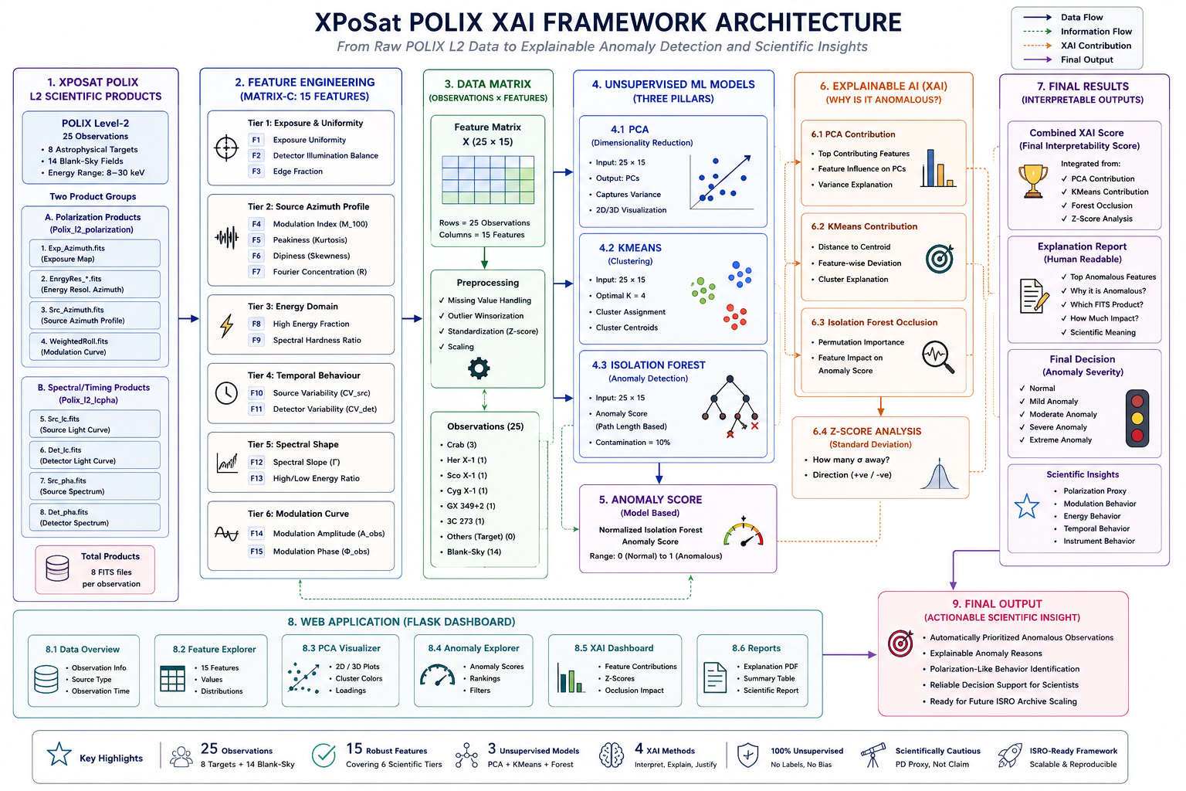

Slide 17
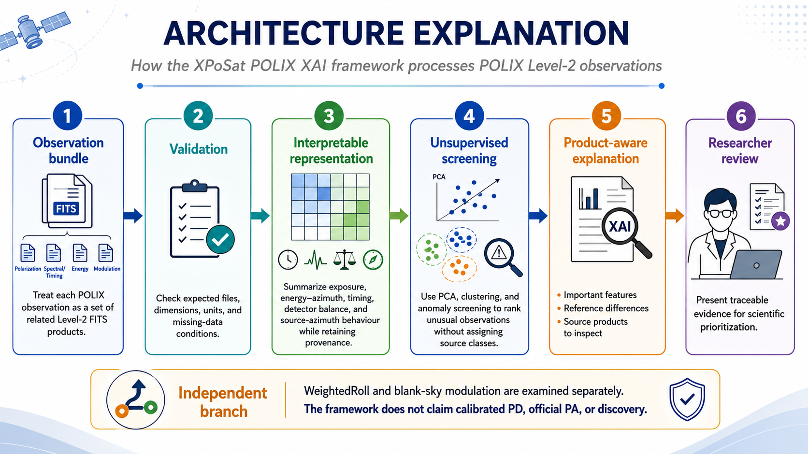
ARCHITECTURE EXPLANATION

Slide 18
Explainability Must Preserve Scientific Meaning
EVIDENCE PATH A — STATISTICAL SCREENING
EVIDENCE PATH B — PHYSICAL DIAGNOSTIC
Interpretable Level-2 features
↓
Unsupervised observation score
↓
Feature deviation + product provenance
↓
Researcher review
WeightedRoll source + background
↓
Raw / fitted modulation amplitude and phase
↓
Blank-sky comparison + response calibration
↓
Only then: calibrated PD / official PA
Scientific XAI must show what differed, in which original product, relative to what reference, and with what uncertainty.
SHAP and LightGBM are literature references—not methods claimed for the evolved framework. Attribution is not causality, especially in a small dataset.

Slide 19
Research Gap and Proposed Position
WELL ESTABLISHED
LIMITED WORK IDENTIFIED
PROPOSED POSITION
• X-ray polarization constrains geometry and magnetic/scattering structure
• POLIX Level-2 products have defined scientific meanings
• Unsupervised methods can prioritize unusual observations
• Explanations need contextual evidence
A directly comparable framework was not identified that integrates:
• multiple POLIX Level-2 products
• interpretable feature engineering
• unsupervised observation screening
• product-aware explanations
• blank-sky-referenced modulation diagnostics
The proposed study intends to investigate a researcher-facing screening framework that keeps two questions separate:
1. Is this observation statistically unusual?
2. Does independent modulation evidence justify further polarimetric interpretation?
Claim boundaries: anomaly ≠ discovery • fitted phase ≠ official PA • no calibrated PD without official calibration • expert validation remains essential

