Slide 1

An Explainable AI Framework for Analysis of
X-Ray Polarimetry Data from XPoSat
Project Stage-I — Review 1
Under the Guidance of
Ms. Soujanya
Team No.: 17
G Sai Saatvik — 23BD1A058M
R Srihitha — 23BD1A059M
N Shruthi — 23BD1A059B
K Rajkumar — 24BD5A0530
Notes:
[Sources]
- C:\Users\Saatvik\Downloads\Sample Template_ppt.pptx — college-supplied visual template and institutional branding.
- Project title supplied by the user; wording preserved exactly.

Slide 2
Review-I Scope and Abstract
PROPOSED RESEARCH
REVIEW-I FOCUS
X-ray polarimetry adds directional information that imaging, spectroscopy and timing may not fully provide. XPoSat’s POLIX payload records polarization-sensitive azimuthal scattering in the 8–30 keV band and distributes several heterogeneous Level-2 FITS products for each observation. The proposed study aims to represent scientifically meaningful behaviour across these products, screen observations without trusted anomaly labels, and explain unusual scores at both feature and product level. A separate WeightedRoll-based modulation diagnostic is intended to support cautious physical interpretation against blank-sky behaviour. The expected contribution is a traceable researcher-oriented screening framework. Its central limitation is that statistical unusualness and fitted modulation are not equivalent to a calibrated polarization degree, an official sky polarization angle, or an astrophysical discovery.
1 Introduction
2 Literature Survey
High-level base-paper context and proposed direction are included only to support these two sections.
Excluded: architecture • implementation • model results • website/testing
Notes:
[Sources]
- Indian Space Research Organisation, “XPoSat: India’s X-Ray Polarimetry Mission,” 2023, https://www.isro.gov.in/ISRO_EN/XPoSat_X-Ray_Polarimetry_Mission.html.
- N. Anand, K. Rikame, and K. Roy, XPoSat-POLIX User Handbook: User Guide for Scientific Data Analysis Level2, version 1.0, 2025.
- D:\polix_xai_webapp\PS1_Review1_Introduction_Literature_Survey.md — reviewed Review-I abstract and scope.

Slide 3
Why X-Ray Astronomy Needs Polarization
Compact objects, accretion flows, shocks and hot plasmas release large amounts of energy in X-rays.
IMAGING
Where is the emission?
Spatial structure and source location
SPECTROSCOPY
What energies are present?
Composition, temperature and continuum shape
TIMING
How does it change?
Variability, periodicity and transient behaviour
↓
These observables can leave source geometry degenerate. Polarization adds orientation, magnetic-field order and scattering geometry.
Notes:
[Sources]
- M. C. Weisskopf et al., “An overview of the performance and scientific results from the Chandra X-Ray Observatory,” PASP, 2002, https://doi.org/10.1086/338108.
- S. Fabiani, “Instrumentation and future missions in the upcoming era of X-ray polarimetry,” Galaxies, 2018, https://doi.org/10.3390/galaxies6020054.

Slide 4
What X-Ray Polarization Measures
CORE CONCEPTS
AZIMUTHAL MODULATION
Linear polarization
Preferred orientation of the electric-field oscillation.
Polarization degree (PD)
Fraction of the detected signal associated with linear polarization.
Polarization angle (PA)
Orientation of the polarization direction, defined only after instrument and sky-coordinate conventions are applied.
N(φ) = A [1 + μ cos 2(φ − φ₀)]
Azimuthal scattering angle φ
Modulation carries information about emission geometry, magnetic fields and scattering media—but calibration and background treatment are required for PD/PA.
Notes:
[Sources]
- S. Fabiani, “Instrumentation and future missions in the upcoming era of X-ray polarimetry,” Galaxies, 2018, https://doi.org/10.3390/galaxies6020054.
- F. Kislat et al., “Analyzing the data from X-ray polarimeters with Stokes parameters,” Astroparticle Physics, 2015, https://doi.org/10.1016/j.astropartphys.2015.02.007.

Slide 5
Mission Capabilities Must Not Be Conflated
Mission / payload
Primary capability
Verified band
Context for this study
Chandra
High-resolution X-ray imaging and spectroscopy
Instrument-dependent
Context only; not a polarimetry mission
IXPE
Dedicated imaging X-ray polarimetry
2–8 keV
Calibrated imaging-polarimetry literature
XPoSat
Indian mission carrying POLIX and XSPECT
Two payload bands
Mission platform for the proposed study
POLIX
Medium-energy X-ray polarimetry
8–30 keV
Primary Level-2 data scope
XSPECT
X-ray spectroscopy and timing
0.8–15 keV
Complementary; not primary scope
Quality-control check: Chandra is presented as an imaging/spectroscopy observatory—not as a polarimetry mission.
Notes:
[Sources]
- Indian Space Research Organisation, “XPoSat: India’s X-Ray Polarimetry Mission,” 2023, https://www.isro.gov.in/ISRO_EN/XPoSat_X-Ray_Polarimetry_Mission.html.
- M. C. Weisskopf et al., Chandra overview, PASP, 2002, https://doi.org/10.1086/338108.
- M. C. Weisskopf et al., “The Imaging X-Ray Polarimetry Explorer (IXPE): Pre-Launch,” JATIS, 2022, https://doi.org/10.1117/1.JATIS.8.2.026002.
- H. Saini, K. V. Madhu, and R. Karidhal, XPoSat mission analysis, Experimental Astronomy, 2025, https://doi.org/10.1007/s10686-025-09988-6.

Slide 6
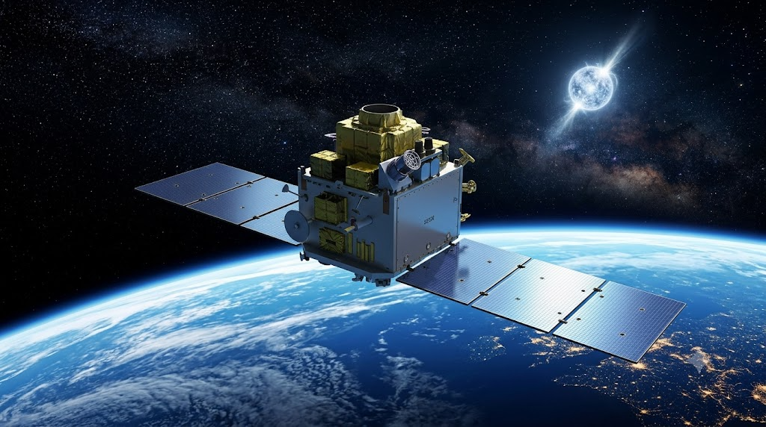
XPoSat Adds Indian X-Ray Polarimetry
MISSION PURPOSE
• India’s first dedicated X-ray polarimetry mission
• Launched on 1 January 2024 aboard PSLV-C58
• Designed to combine medium-energy polarimetry with simultaneous spectroscopic and timing context
• Extends India’s space-astronomy capability into polarization-sensitive observation
POLIX | 8–30 keV
Polarimetry
XSPECT | 0.8–15 keV
Spectroscopy and timing
Notes:
[Sources]
- Indian Space Research Organisation, “XPoSat: India’s X-Ray Polarimetry Mission,” 2023, https://www.isro.gov.in/ISRO_EN/XPoSat_X-Ray_Polarimetry_Mission.html.
- H. Saini, K. V. Madhu, and R. Karidhal, XPoSat mission analysis, Experimental Astronomy, 2025, https://doi.org/10.1007/s10686-025-09988-6.
- Visual reused from C:\Users\Saatvik\Downloads\XPoSat_POLIX_XAI_Presentation (1).pptx, embedded media image2.png. Original asset provenance was not independently established; used only because the user supplied it for reuse.

Slide 7
POLIX Converts Scattering into Modulation
CROSS-SECTIONAL VIEW
Counter 1
DOCUMENTED DETECTOR FACTS
Incident X-rays enter along the instrument axis into the central scatterer.
• Four position-sensitive proportional counters
• 48 anode cells in total
• Thomson-scattering sensitivity
• Polarization produces a preferred azimuthal count pattern
↖ ↗
↙ ↘
Central
beryllium
scatterer
Counter 4
Counter 2
Counter 3
The modulation pattern is evidence from which polarization information may be inferred after background treatment and calibration.
Notes:
[Sources]
- N. Anand, K. Rikame, and K. Roy, XPoSat-POLIX User Handbook: User Guide for Scientific Data Analysis Level2, version 1.0, 2025 — central beryllium scatterer, four proportional counters, 48 anode cells, Thomson-scattering operation.
- Indian Space Research Organisation, XPoSat mission page, https://www.isro.gov.in/ISRO_EN/XPoSat_X-Ray_Polarimetry_Mission.html.

Slide 8
One Observation Spans Multiple Products
Exposure products
Good-time and exposure context
Energy–azimuth products
Count distribution across energy and azimuth
Source azimuthal profiles
Observation-level angular behaviour
Source light curves
Temporal variability
Detector-wise light curves / spectra
Balance and detector-specific behaviour
WeightedRoll modulation
Physical-diagnostic product; source and background contributions
WeightedRoll is not presented as fully background-corrected.
One observation must be interpreted across several heterogeneous products; unusual behaviour may arise from exposure, energy, timing, detector balance or azimuth.
Notes:
[Sources]
- N. Anand, K. Rikame, and K. Roy, XPoSat-POLIX User Handbook: User Guide for Scientific Data Analysis Level2, version 1.0, 2025 — Level-2 product families and WeightedRoll source/background content.
- D:\polix_xai_webapp\PS1_Review1_Citation_Audit.md — verified claim-to-source mapping for Level-2 product descriptions.

Slide 9
Research Problem, Aim and Objectives
FORMAL PROBLEM
AIM
How can multiple POLIX Level-2 products be analysed automatically, without trusted anomaly labels, to identify unusual observations and explain the responsible features/products—while keeping physical modulation evidence separate and presenting results for researcher review?
The project aims to develop an explainable, unsupervised framework for screening POLIX Level-2 observations and supporting cautious, traceable scientific interpretation.
PROPOSED OBJECTIVES
1 Study XPoSat/POLIX and Level-2 FITS structure
2 Define scientifically meaningful features
3 Compare source and blank-sky observations
4 Apply PCA and clustering where justified
5 Rank unusual observations with unsupervised detection
6 Explain evidence at feature and product level
7 Treat WeightedRoll as an independent diagnostic
8 Provide an accessible researcher-oriented interface
Notes:
[Sources]
- D:\polix_xai_webapp\PS1_Review1_Introduction_Literature_Survey.md, Sections 1.7–1.11 — reviewed motivation, formal problem, aim, objectives and scope.
- V. Yepmo, G. Smits, and O. Pivert, “Anomaly explanation: A review,” Data & Knowledge Engineering, 2022, https://doi.org/10.1016/j.datak.2021.101946.
- M. Lochner and B. A. Bassett, “Astronomaly,” Astronomy and Computing, 2021, https://doi.org/10.1016/j.ascom.2021.100481.

Slide 10
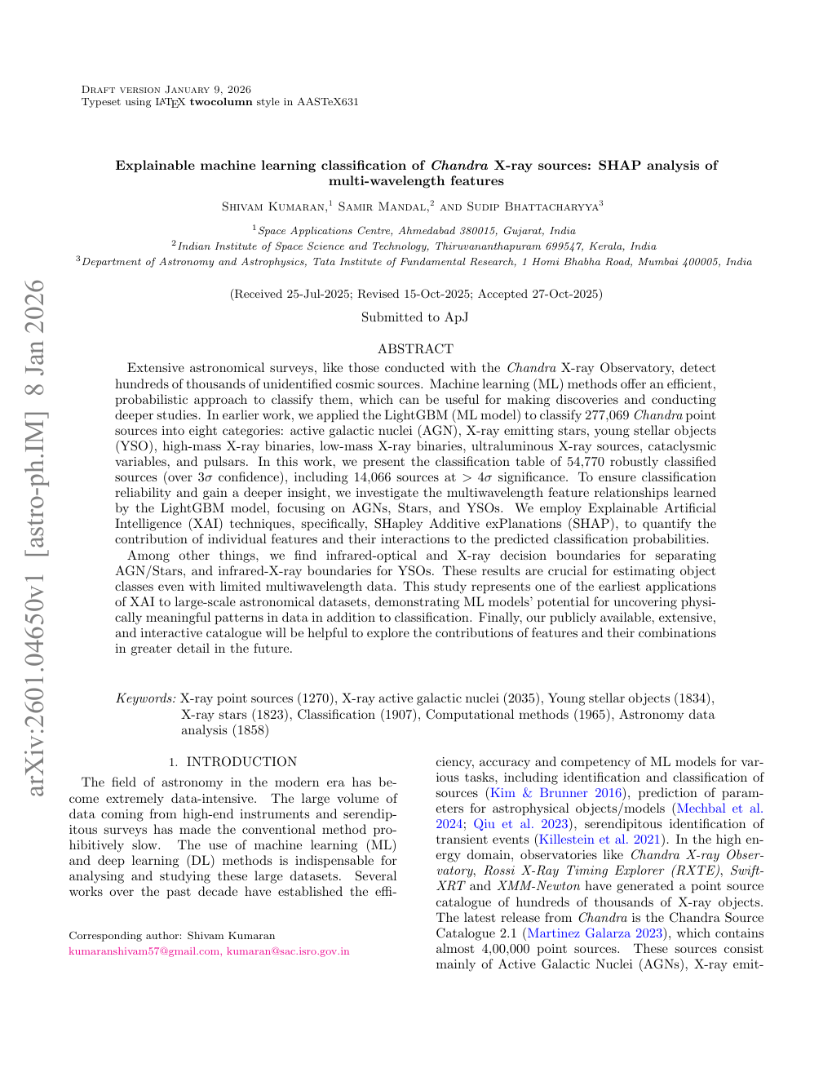
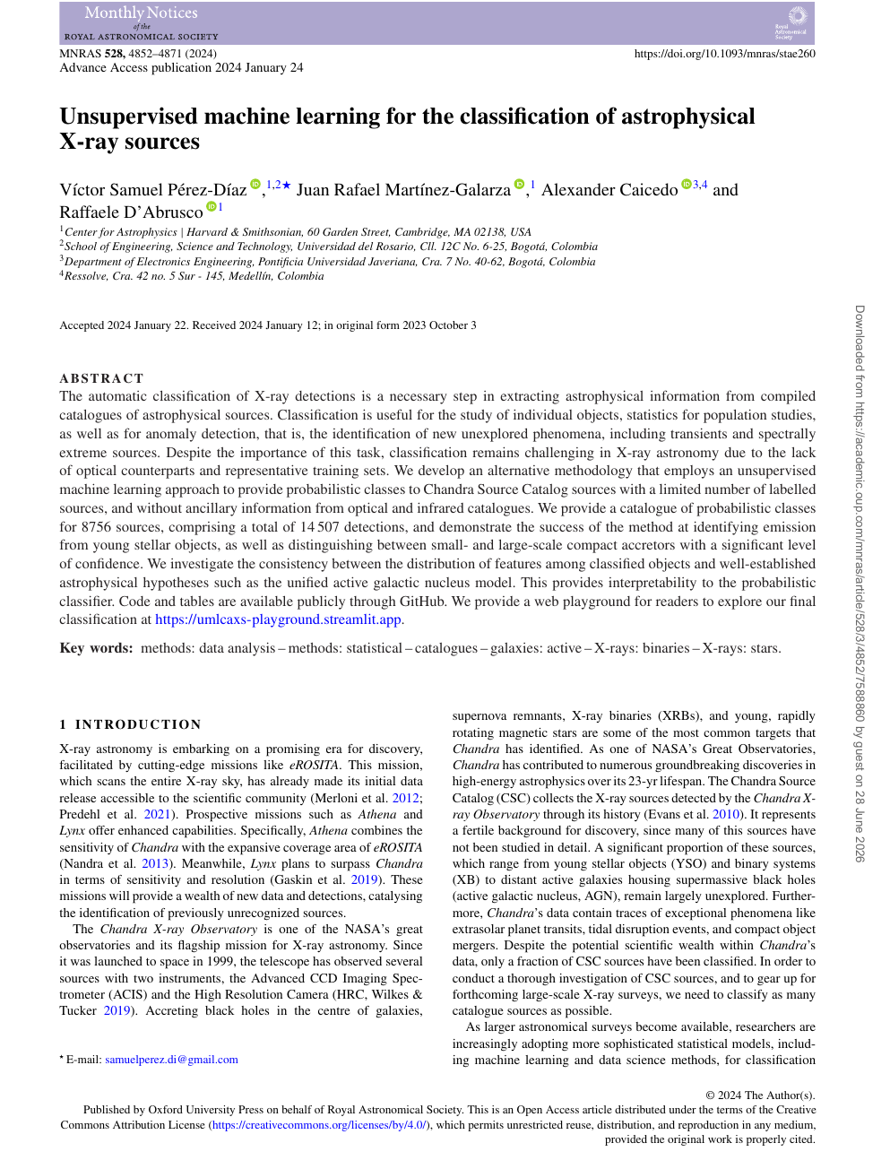
Early Base Papers Shaped the Question
ORIGINAL STARTING REFERENCES
WHAT WAS ADAPTED
• Astronomy can benefit from automated analysis of high-dimensional X-ray data
• Interpretability is necessary for scientific trust
• Unsupervised feature-space structure is useful when labels are limited
• Results must be checked against astrophysical expectations
WHAT THE PROJECT DOES NOT ADOPT
No source classification • no LightGBM • no SHAP • no class probabilities. The proposed task is observation-level anomaly screening across POLIX products.
Kumaran et al. (2026 preprint)
Explainable Chandra source classification
Pérez-Díaz et al. (2024)
Unsupervised Chandra source classification
Notes:
[Sources]
- S. Kumaran, S. Mandal, and S. Bhattacharyya, “Explainable machine learning classification of Chandra X-ray sources: SHAP analysis of multi-wavelength features,” arXiv:2601.04650, 2026, https://doi.org/10.48550/arXiv.2601.04650. Local file: C:\Users\Saatvik\Downloads\basepaper.pdf.
- V. S. Pérez-Díaz et al., “Unsupervised machine learning for the classification of astrophysical X-ray sources,” MNRAS, 2024, https://doi.org/10.1093/mnras/stae260. Local file: C:\Users\Saatvik\Downloads\stae260.pdf.
- Interpretation explicitly requested by the user: both papers influenced ideas, but classification, LightGBM and SHAP are not the methods used by the evolved project.

Slide 11
The Evolved Study Needs a Base-Source Set
No single paper covers the evolved problem; the proposed study therefore uses a four-part base-source set.
1
Mission and data
POLIX Level-2 User Handbook (2025)
Authoritative product semantics, detector facts and processing limits
2
Physical analysis
Kislat et al. (2015)
Stokes Q/U, background treatment and calibrated-polarization boundaries
3
Unsupervised ML
Liu, Ting and Zhou (2008)
Isolation Forest for ranking unusual multivariate observations
4
Explainability
Yepmo, Smits and Pivert (2022)
Anomaly-explanation taxonomy and contextual evidence
Notes:
[Sources]
- N. Anand, K. Rikame, and K. Roy, XPoSat-POLIX User Handbook, version 1.0, 2025.
- F. Kislat et al., “Analyzing the data from X-ray polarimeters with Stokes parameters,” 2015, https://doi.org/10.1016/j.astropartphys.2015.02.007.
- F. T. Liu, K. M. Ting, and Z.-H. Zhou, “Isolation Forest,” ICDM 2008, https://doi.org/10.1109/ICDM.2008.17.
- V. Yepmo, G. Smits, and O. Pivert, “Anomaly explanation: A review,” 2022, https://doi.org/10.1016/j.datak.2021.101946.

Slide 12
Polarimetry Literature Defines the Physics
FOUNDATIONS
MISSIONS
SOURCE STUDIES
Fabiani (2018)
Reviews X-ray polarimeter types and science drivers.
Kislat et al. (2015)
Provides Stokes-based treatment of azimuthal events and background.
Implication
Raw modulation is not yet calibrated PD/PA.
Chandra
Imaging and spectroscopy context.
IXPE
Dedicated 2–8 keV imaging polarimetry.
XPoSat / POLIX / XSPECT
Distinct Indian polarimetry and spectro-temporal roles.
Implication
Instrument responses are not interchangeable.
Crab
Spatial and pulse-phase structure.
Cyg X-1
Polarization constrains disk–jet geometry.
Her X-1
Phase-resolved polarization constrains pulsar geometry.
Implication
Energy, phase and source state matter.
Source-specific calibrated results motivate features and checks; they cannot be transferred directly to a POLIX anomaly score.
Notes:
[Sources]
- S. Fabiani, X-ray polarimetry instrumentation review, 2018, https://doi.org/10.3390/galaxies6020054.
- F. Kislat et al., Stokes analysis, 2015, https://doi.org/10.1016/j.astropartphys.2015.02.007.
- M. C. Weisskopf et al., Chandra overview, 2002, https://doi.org/10.1086/338108.
- M. C. Weisskopf et al., IXPE pre-launch, 2022, https://doi.org/10.1117/1.JATIS.8.2.026002.
- N. Bucciantini et al., Crab polarimetry, 2023, https://doi.org/10.1038/s41550-023-01936-8.
- H. Krawczynski et al., Cygnus X-1 polarimetry, 2022, https://doi.org/10.1126/science.add5399.
- V. Doroshenko et al., Her X-1 geometry, 2022, https://doi.org/10.1038/s41550-022-01799-5.

Slide 13
Astronomy ML Supports Unlabelled Screening
Study / method
Problem and data
Useful idea
Limitation for POLIX
Pérez-Díaz et al. (2024)
Chandra catalogue source classification
Unsupervised feature-space structure with few labels
Still assigns source classes; different objective and data model
PCA — Pearson (1901)
Correlated multivariate variables
Compact view of variance and redundancy
Variance is not physical importance; small-sample loadings may shift
KMeans — MacQueen (1967)
Exploratory grouping
Checks whether observations form broad similarity groups
Requires k and scaling; clusters do not prove physical classes
Isolation Forest — Liu et al. (2008)
Unlabelled anomaly ranking
Isolation-based screening without normal-density modelling
Scores depend on sample, features and randomization
Astronomaly — Lochner & Bassett (2021)
Human-guided archive anomaly search
Expert review and extensible ranking workflow
Does not encode POLIX products or calibration semantics
Literature supports screening and prioritization—not automatic scientific discovery.
Notes:
[Sources]
- V. S. Pérez-Díaz et al., “Unsupervised machine learning for the classification of astrophysical X-ray sources,” MNRAS, 2024, https://doi.org/10.1093/mnras/stae260.
- K. Pearson, “On lines and planes of closest fit to systems of points in space,” 1901, https://doi.org/10.1080/14786440109462720.
- J. B. MacQueen, “Some methods for classification and analysis of multivariate observations,” 1967.
- F. T. Liu et al., “Isolation Forest,” ICDM 2008, https://doi.org/10.1109/ICDM.2008.17.
- M. Lochner and B. A. Bassett, “Astronomaly,” 2021, https://doi.org/10.1016/j.ascom.2021.100481.
- D. Baron and D. Poznanski, “The weirdest SDSS galaxies,” MNRAS, 2017, https://doi.org/10.1093/mnras/stw3021.

Slide 14
Explainability Must Preserve Scientific Meaning
EVIDENCE PATH A — STATISTICAL SCREENING
EVIDENCE PATH B — PHYSICAL DIAGNOSTIC
Interpretable Level-2 features
↓
Unsupervised observation score
↓
Feature deviation + product provenance
↓
Researcher review
WeightedRoll source + background
↓
Raw / fitted modulation amplitude and phase
↓
Blank-sky comparison + response calibration
↓
Only then: calibrated PD / official PA
Scientific XAI must show what differed, in which original product, relative to what reference, and with what uncertainty.
SHAP and LightGBM are literature references—not methods claimed for the evolved framework. Attribution is not causality, especially in a small dataset.
Notes:
[Sources]
- V. Yepmo, G. Smits, and O. Pivert, “Anomaly explanation: A review,” 2022, https://doi.org/10.1016/j.datak.2021.101946.
- S. M. Lundberg and S.-I. Lee, “A unified approach to interpreting model predictions,” NeurIPS, 2017.
- F. Kislat et al., Stokes analysis and background handling, 2015, https://doi.org/10.1016/j.astropartphys.2015.02.007.
- POLIX Level-2 User Handbook, version 1.0, 2025 — WeightedRoll contains source and background contributions.

Slide 15
Research Gap and Proposed Position
WELL ESTABLISHED
LIMITED WORK IDENTIFIED
PROPOSED POSITION
• X-ray polarization constrains geometry and magnetic/scattering structure
• POLIX Level-2 products have defined scientific meanings
• Unsupervised methods can prioritize unusual observations
• Explanations need contextual evidence
A directly comparable framework was not identified that integrates:
• multiple POLIX Level-2 products
• interpretable feature engineering
• unsupervised observation screening
• product-aware explanations
• blank-sky-referenced modulation diagnostics
The proposed study intends to investigate a researcher-facing screening framework that keeps two questions separate:
1. Is this observation statistically unusual?
2. Does independent modulation evidence justify further polarimetric interpretation?
Claim boundaries: anomaly ≠ discovery • fitted phase ≠ official PA • no calibrated PD without official calibration • expert validation remains essential
Notes:
[Sources]
- D:\polix_xai_webapp\PS1_Review1_Literature_Comparison_Table.md — thematic synthesis and final research-gap statement.
- D:\polix_xai_webapp\PS1_Review1_Introduction_Literature_Survey.md, Sections 3.8–3.10 — reviewed literature synthesis, cautious gap wording and Review-I positioning.
- Gap wording is intentionally cautious: “limited published work was identified,” not “no work exists.”

Slide 16
References — Missions and Polarimetry
[1] ISRO, “XPoSat: India’s X-Ray Polarimetry Mission,” 2023.
[2] N. Anand, K. Rikame and K. Roy, XPoSat-POLIX User Handbook: Level2, V1.0, 2025.
[3] H. Saini, K. V. Madhu and R. Karidhal, “Mission analysis, design and operations plan of XPoSat,” Experimental Astronomy, 2025, doi:10.1007/s10686-025-09988-6.
[4] M. C. Weisskopf et al., “An overview of the performance and scientific results from Chandra,” PASP, 2002, doi:10.1086/338108.
[5] M. C. Weisskopf et al., “IXPE: Pre-Launch,” JATIS, 2022, doi:10.1117/1.JATIS.8.2.026002.
[6] S. Fabiani, “Instrumentation and future missions in the upcoming era of X-ray polarimetry,” Galaxies, 2018, doi:10.3390/galaxies6020054.
[7] F. Kislat et al., “Analyzing the data from X-ray polarimeters with Stokes parameters,” Astroparticle Physics, 2015, doi:10.1016/j.astropartphys.2015.02.007.
[8] V. Doroshenko et al., “Determination of X-ray pulsar geometry with IXPE polarimetry,” Nature Astronomy, 2022, doi:10.1038/s41550-022-01799-5.
[9] H. Krawczynski et al., “Polarized x-rays constrain the disk-jet geometry in Cygnus X-1,” Science, 2022, doi:10.1126/science.add5399.
[10] N. Bucciantini et al., “Simultaneous space and phase resolved X-ray polarimetry of the Crab pulsar and nebula,” Nature Astronomy, 2023, doi:10.1038/s41550-023-01936-8.
Notes:
[Sources]
- Reference details reproduced from D:\polix_xai_webapp\PS1_Review1_Introduction_Literature_Survey.md and its citation audit.
- Official mission page: https://www.isro.gov.in/ISRO_EN/XPoSat_X-Ray_Polarimetry_Mission.html.
- All DOI values visible on the slide were verified in the reviewed source files.

Slide 17
References — Machine Learning and XAI
[11] K. Pearson, “On lines and planes of closest fit to systems of points in space,” Philosophical Magazine, 1901, doi:10.1080/14786440109462720.
[12] J. B. MacQueen, “Some methods for classification and analysis of multivariate observations,” Proc. 5th Berkeley Symposium, 1967.
[13] F. T. Liu, K. M. Ting and Z.-H. Zhou, “Isolation Forest,” ICDM, 2008, doi:10.1109/ICDM.2008.17.
[14] D. Baron and D. Poznanski, “The weirdest SDSS galaxies,” MNRAS, 2017, doi:10.1093/mnras/stw3021.
[15] M. Lochner and B. A. Bassett, “Astronomaly,” Astronomy and Computing, 2021, doi:10.1016/j.ascom.2021.100481.
[16] V. Yepmo, G. Smits and O. Pivert, “Anomaly explanation: A review,” Data & Knowledge Engineering, 2022, doi:10.1016/j.datak.2021.101946.
[17] S. M. Lundberg and S.-I. Lee, “A unified approach to interpreting model predictions,” NeurIPS, 2017.
[18] V. S. Pérez-Díaz et al., “Unsupervised machine learning for the classification of astrophysical X-ray sources,” MNRAS, 2024, doi:10.1093/mnras/stae260.
[19] S. Kumaran, S. Mandal and S. Bhattacharyya, “Explainable machine learning classification of Chandra X-ray sources,” arXiv preprint, 2026, doi:10.48550/arXiv.2601.04650.
Review-I conclusion: the literature supports a scientifically cautious investigation of explainable, unsupervised POLIX observation screening—without importing classification claims or presenting final project results.
Notes:
[Sources]
- Reference details reproduced from D:\polix_xai_webapp\PS1_Review1_Introduction_Literature_Survey.md plus the two user-supplied Chandra papers.
- Pérez-Díaz et al. local file: C:\Users\Saatvik\Downloads\stae260.pdf.
- Kumaran et al. local file: C:\Users\Saatvik\Downloads\basepaper.pdf.

