Slide 1
Qubit-Efficient Hybrid Quantum Reinforcement Learning for Scalable Vehicle Routing
(Batch No: CBIT/IT/2025-26/IT1/118)
Under the Guidance of:
Dr. T. Satyanarayana Murthy
Associate Professor, IT, CBIT
Presented by :
G. Sai Varshini, 160122737006
V. Akshitha, 160122737027
Chaitanyya Pratap Agarwal, 160122737034

Slide 2
Qubit-Efficient Hybrid Quantum Reinforcement Learning for Scalable Vehicle Routing
(Batch No: CBIT/IT/2025-26/IT1/118)
Under the Guidance of:
Dr. T. Satyanarayana Murthy
Associate Professor, IT, CBIT
Presented by :
G. Sai Varshini, 160122737006
V. Akshitha, 160122737027
Chaitanyya Pratap Agarwal, 160122737034

Slide 3
AGENDA
Abstract
​Problem Statement
Objectives
Literature Review
Existing Idea
Proposed Methodology
Results
​References

Slide 4
Abstract
The Vehicle Routing Problem (VRP) is a central challenge in logistics, known for its NP-hard complexity and focus on optimizing delivery networks. Traditional methods for solving VRP demand significant computational power, lack scalability as the number of routes increases, and are static—requiring full prior knowledge of customer demands and traffic conditions. Quantum algorithms such as the Quantum Approximate Optimization Algorithm (QAOA) and Grover-based methods have been explored to tackle these challenges. However, Grover’s algorithm, though offering a quadratic speed-up, suffers from practical limitations like long quantum circuits, the need for reprogramming for each instance, and incompatibility with noisy, near-term quantum devices.
To address these constraints, Quantum Reinforcement Learning (QRL) is proposed as a dynamic, sequential decision-making framework for VRP. In QRL, a quantum-enhanced agent interacts with its environment, where vehicle states, customer demands, and traffic conditions are encoded into quantum circuits. Through superposition, the agent explores a vast solution space and refines its policy toward near-optimal routing strategies, guided by rewards. Despite challenges such as complex quantum state encoding and hybrid quantum-classical training, QRL enables real-time adaptability to new delivery requests or disruptions and generalization of learned policies across different VRP instances. This makes QRL a scalable, flexible, and near-term feasible approach that bridges learning and optimization, paving the way for intelligent, self-improving logistics systems capable of evolving with real-world uncertainty.

Slide 5
Literature Review
On solving the Vehicle Routing Problem (VRP) using quantum computing has explored various algorithms aimed at improving scalability, adaptability, and efficiency. Early studies used Quantum Annealing (QA) on D-Wave systems to map small VRP instances, demonstrating feasibility but facing hardware and scalability limits. Later, QAOA-based approaches achieved competitive results on small datasets but were constrained by circuit depth, noise, and parameter sensitivity. Hybrid methods such as Hybrid Quantum Tabu Search (HQTS) and Column Generation-based QAOA improved convergence and resource efficiency but relied heavily on fine-tuned parameters. Other works involving Quantum Walk Optimization (QWOA) and Quantum Machine Learning (QML)—like Quantum Neural Networks (QNNs) and Quantum Support Vector Machines (QSVMs)—showed potential but struggled with noise resilience and limited scalability. Overall, while QA, QAOA, and hybrid techniques advanced quantum optimization, most still treat VRP as a static problem. This limitation has motivated the development of Quantum Reinforcement Learning (QRL), which introduces adaptivity, feedback, and reusability, enabling dynamic optimization and generalization across diverse routing environments.
https://docs.google.com/document/d/1ewo188PYPoNUoSJzKUjSzUI0dWPJSsM3p2jmygZglFQ/edit?tab=t.0

Slide 6
Problem Statement
The Vehicle Routing Problem (VRP) is NP-hard, where vehicles must serve customers with minimum travel cost under capacity and time constraints. Classical heuristics struggle with scalability, while quantum approaches provide promising alternatives.
Project Objectives & Plan
Develop a Quantum Reinforcement Learning (QRL) framework to solve the Vehicle Routing Problem (VRP) efficiently.
Overcome the limitations of static quantum algorithms like Grover’s and QAOA by introducing adaptive learning.
Use quantum superposition for faster exploration and real-time adaptability to changing demands and traffic.
Ensure scalability, flexibility, and reusability across different VRP scenarios.
Conduct a literature review, implement Grover Adaptive Search (GAS) as a baseline, and design a QRL agent using hybrid quantum-classical training.
Test, compare, and analyze the performance of QRL vs. GAS based on efficiency, scalability and adaptability.
Conclude with future improvements for real-world quantum logistics applications.

Slide 7
PROPOSED METHODOLOGY
Hybrid Architecture A quantum-classical reinforcement learning model combining classical embeddings (for vehicles and customers) with quantum circuits to make routing decisions in the Vehicle Routing Problem (VRP).
Classical Embedding + Attention Classical neural layers encode vehicle and customer states. An attention mechanism ranks unvisited customers based on relevance to each vehicle, enabling targeted exploration.
Quantum Decision Module Encodes attention-informed embeddings into a 6-qubit quantum circuit using RY, RX, and RZ gates with CNOT entanglement. Pauli-Z measurements yield probabilistic scores for each action.Learning and Action Selection
Training: Uses REINFORCE algorithm with stochastic sampling to promote exploration.
Testing: Greedy selection based on highest probability.Updates involve backpropagation (classical) and parameter-shift rule (quantum).
Efficient use of limited qubits, scalable to multiple vehicles/customers. The quantum module encourages diverse route exploration, while classical attention narrows focus—achieving both adaptability and route optimization.

Slide 8
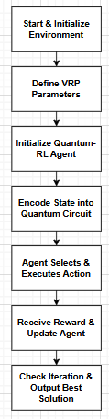
Our Methodology

Slide 9
IMPROVEMENTS
After implementing Grover Adaptive Search (GAS), it was observed that the algorithm performed efficiently for small VRP instances but failed to scale for larger problems.
Scalability limitation: GAS became unstable or crashed beyond ~15 cities due to exponential state growth and high RAM usage.
Reusability issue: GAS had to recompute from scratch for every new instance, offering no learning or adaptability.
Runtime limitation: Execution time increased rapidly as the number of cities or vehicles grew, making it impractical for larger datasets.
To address these issues, Quantum Reinforcement Learning (QRL) was proposed as an improved approach.
QRL learns the best routes through training instead of checking every possible solution.
Once trained, the same QRL model can efficiently handle new or similar VRP instances without retraining from scratch.
Instead of repeatedly searching from scratch like GAS, QRL learns once and then solves problems quickly and more efficiently.

Slide 10
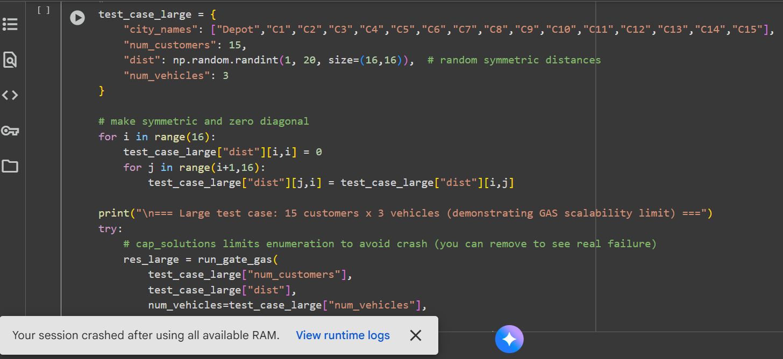
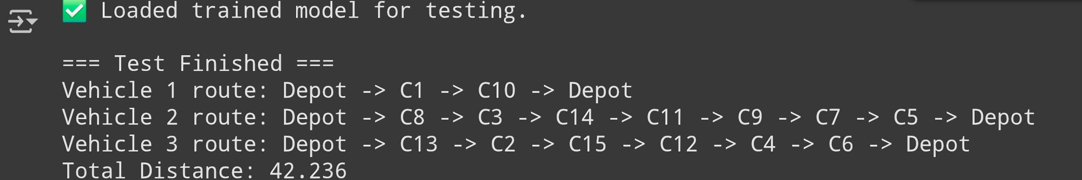
Results
Fig.2 figure showing the output of qrl the same 15 cities used in GAS approach, hence practically proving scalability when comapred to GAS approach.
Fig. 1 Runtime crash in Google Colab during execution of the Grover Adaptive Search (GAS) algorithm for a 15-city Vehicle Routing Problem, caused by exhaustion of available RAM.

Slide 11
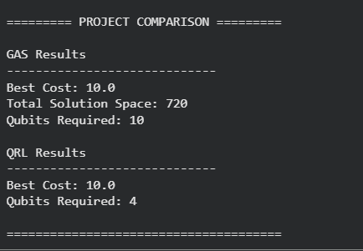
Results
The figure compares GAS and QRL for a 5-city, 2-vehicle VRP instance. GAS evaluates the complete solution space, while QRL is trained for 200 cities and then tested on the same configuration. Both methods achieve the optimal cost of 10, with QRL using fewer qubits, demonstrating improved quantum resource efficiency.

Slide 12
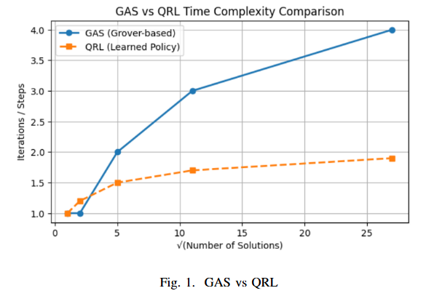

Slide 13
Project Requisites:
Technology Stack Datasets
Programming Language : Python
Core Libraries/Frameworks :
Qiskit / PennyLane (for quantum circuits & implementation)
NumPy, SciPy (for matrix ops and simulation support)
Matplotlib (for plotting results & learning curves)
Dataset | Domain | Size / Scale | Purpose
Synthetic VRP Instances | VRP Optimization | 5-200 nodes, 1-20 vehicles | To benchmark QRL for solving VRP

Slide 14
References
Rosendo, B. (2025). Quantum-enabled routing optimization for transportation efficiency. IEEE Computing in Science & Engineering. – Survey on QA/QAOA for VRP efficiency.
Fitzek, D. et al. (2024). Heterogeneous VRP on a Quantum Computer. Scientific Reports. – QAOA mapping of HVRP up to 21 qubits.
Holliday, J.B. et al. (2025). Advanced Quantum Annealing for VRP with Time Windows. arXiv/IEEE submission. – Hybrid QA + CQM with heuristic repair.
Xie, N. et al. (2023). Feasibility-Preserved QAOA for CVRP. arXiv preprint. – Constraint-aware QAOA encoding for CVRP.
Huang, W. et al. (2025). Hybrid QAOAnsatz with Column Generation for CVRP. arXiv preprint. – Hybrid QAOA with fewer qubits and faster convergence.

Slide 15
THANK YOU
QUERIES?
Batch No: CBIT/IT/2025-26/IT1/118
G. Sai Varshini , 160122737006
V. Akshitha , 160122737027
Chaitanyya Pratap Agarwal, 160122737034

