Slide 1

Applied Data Science
Coursera – Capstone Project

Slide 2
Goal
Explore a geographical location using FOUR SQUARE API
Using pandas to explore the available datasets
Use data visualization techniques to show the result

Slide 3
Problem Statement
Customer is planning to open a new restaurant in United States. They don’t have a clear picture of where to open and how to choose a city for the new restaurant.
Goal of the customer is to open a new restaurant in a “Good populated” environment.
In order to be safe, it is expected to have a low crime rate in the chosen location.
Explore the chosen city for current available restaurants.

Slide 4
Data Sets
Crime Rate records as per FBI Report
https://ucr.fbi.gov/crime-in-the-u.s/2015/crime-in-the-u.s.-2015
Four Square API – Explore by Restaurants
https://api.foursquare.com/v2/venues/search?
search_query = 'Restaurant'
radius = 1000

Slide 5
Analysis Method
Select the top 10 cities based on population
Map the crime rate with respect to the cities.
Select the right city with low crime rate and good enough population.

Slide 6
Explore the chosen place
Using Four Square API explore the chosen city with nearby restaurants.
Visualize the restaurant locations.

Slide 7
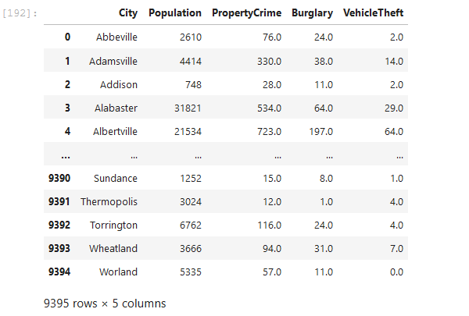
Crime Data – Raw Output
Displaying only the columns of interest

Slide 8
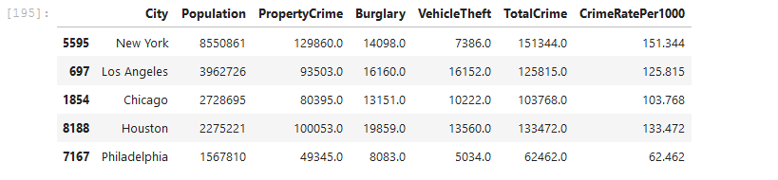
Consolidated Crime Rate Output
We will use the Population & CrimeRatePer1000 columns for visualizing the output.
Before visualizing, lets normalize the ‘Population’ column with its “mean” value, for better visual output.

Slide 9
Data Clean Up
Fill “NaN” values with “0” – As they cannot be used for representation.
Arrange the columns based on “Population” (Descending order)
Choose the top 10 cities with highest population
Map the top cities with population against the crime rate per 1000

Slide 10
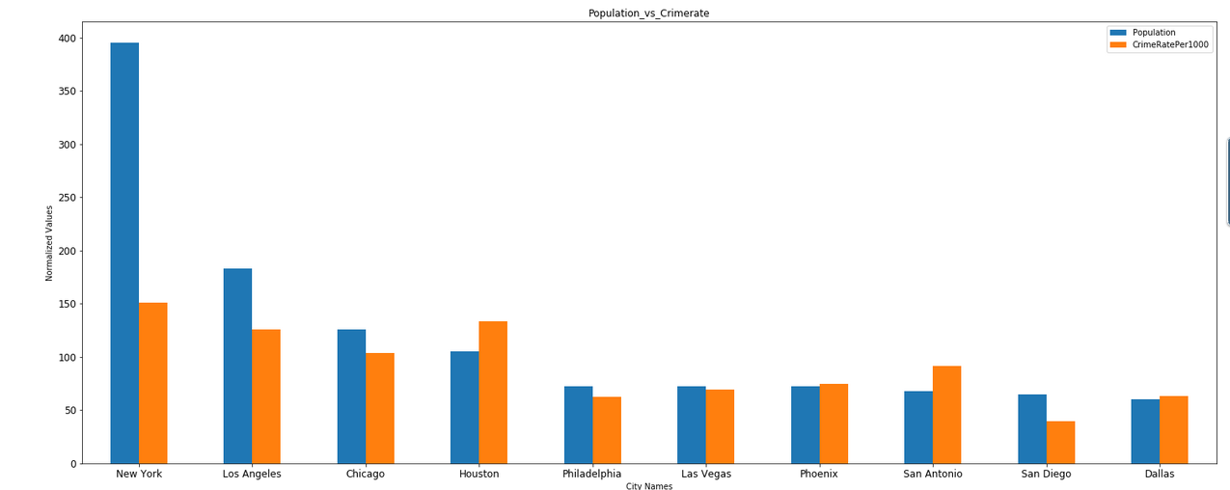
Data Visualization

Slide 11
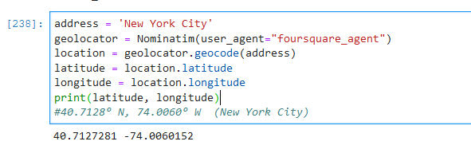
Exploring a specific location
We will analyze the restaurants with respect to this location.

Slide 12
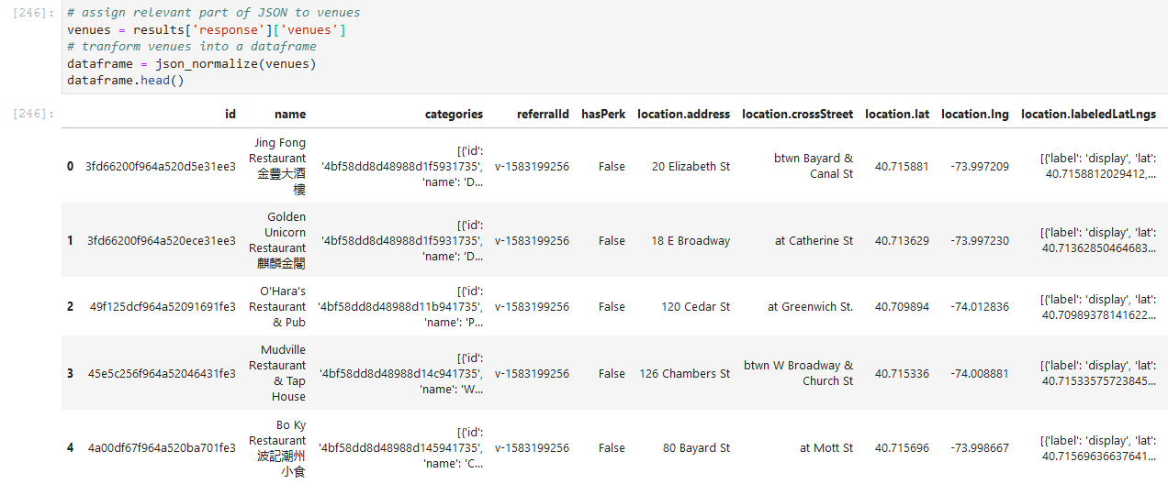
Restaurants in 1000m radius

Slide 13
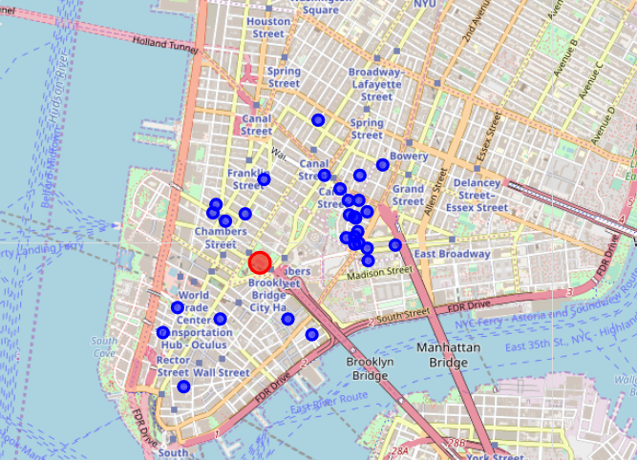
Visualizing the cleaned-up data
Total of 30 restaurants are located near the chosen location.
Customer can visualize the output and then select their strategic location.

