Slide 1

Applied Data Science
Coursera – Capstone Project

Slide 2
Goal
Explore a geographical location using FOUR SQUARE API
Using pandas to explore the available datasets
Use data visualization techniques to show the result

Slide 3
Problem Statement
Customer is planning to open a new restaurant in United States. They don’t have a clear picture of where to open and how to choose a city for the new restaurant.
Goal of the customer is to open a new restaurant in a “Good populated” environment.
In order to be safe, it is expected to have a low crime rate in the chosen location.
Explore the chosen city for current available restaurants.

Slide 4
Data Sets
Crime Rate records as per FBI Report
https://ucr.fbi.gov/crime-in-the-u.s/2015/crime-in-the-u.s.-2015
Four Square API – Explore by Restaurants
https://api.foursquare.com/v2/venues/search?
search_query = 'Restaurant'
radius = 1000

Slide 5
Analysis Method
Clean the data by filtering out unwanted columns and filling up “NaN” values.
Normalize the values so that it can be visually represented in the similar scale.
Arrange the columns based on “Population” (Descending order)
Map the top cities with population against the crime rate per 1000
Map the crime rate with respect to the cities.
Choose the top 10 cities with highest population
Select the right city with low crime rate and good enough population.

Slide 6
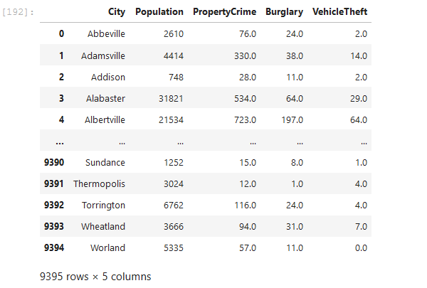
Crime Data – Raw Output
Displaying only the columns of interest

Slide 7
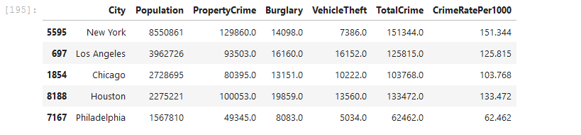
Consolidated Crime Rate Output
We will use the Population & CrimeRatePer1000 columns for visualizing the output.
Before visualizing, lets normalize the ‘Population’ column with its “mean” value, for better visual output.

Slide 8
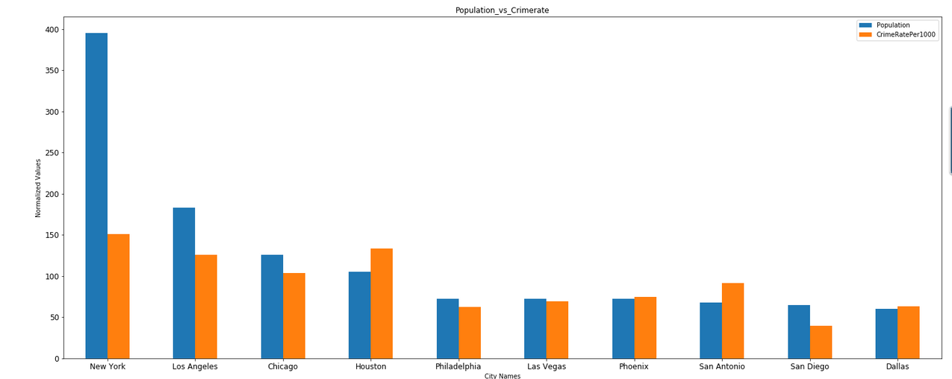
Data Visualization

Slide 9
Explore the chosen place
Using Four Square API explore the chosen city with nearby restaurants.
Visualize the restaurant locations.

Slide 10
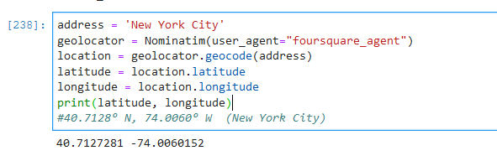
Exploring a specific location
We will analyze the restaurants with respect to this location.

Slide 11
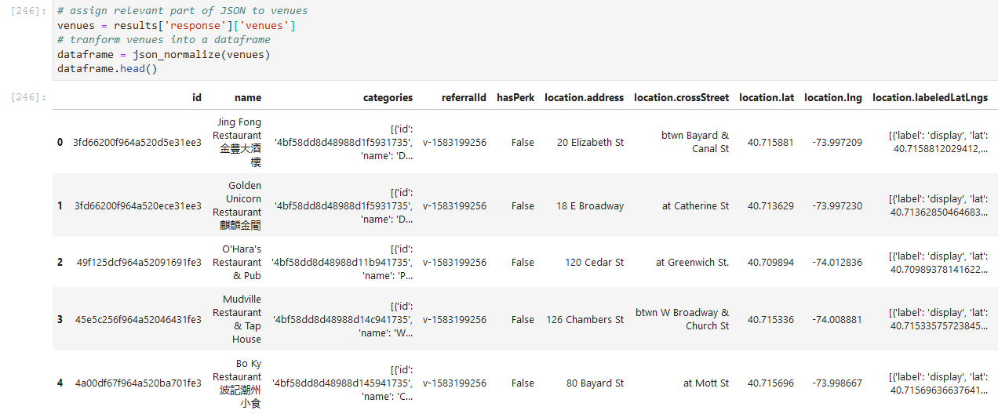
Restaurants in 1000m radius

Slide 12
Clean the data
Choose the specific columns of the JSON data
Id
Name
Category
Create a map around the chosen “Latitude , Longitude” and place the “Restaurant Results” on map

Slide 13
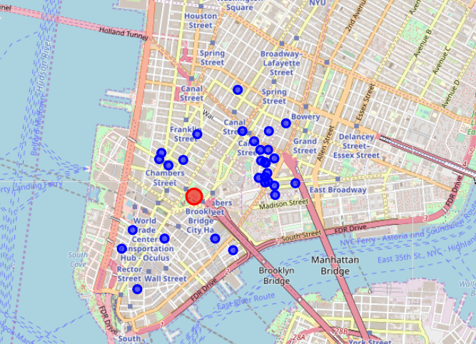
Visualizing the cleaned-up data
Total of 30 restaurants are located near the chosen location.
Customer can visualize the output and then select their strategic location.

Slide 14
Conclusion
Based on the analysis it looks like “New York City” population tops the list.
With respect to the “No of reported crimes” in “New York City” and its “Population” crime rate seems to be lesser compared to other cities.
Customer can choose “New York City” as their new venue location.
We have identified the “Densely populated” restaurant locations in “New York City” via map.
Customer can use this map to locate their strategic location.

Slide 15
Future Scope
Collect more info on the different categories of restaurant in the “New York Location”
Identify the most famous / trending restaurant category in the “New York Location”
Based on the “Visual Output” identify a location to open a new restaurant where it doesn’t exist now near the “Trending Places”

