Slide 1
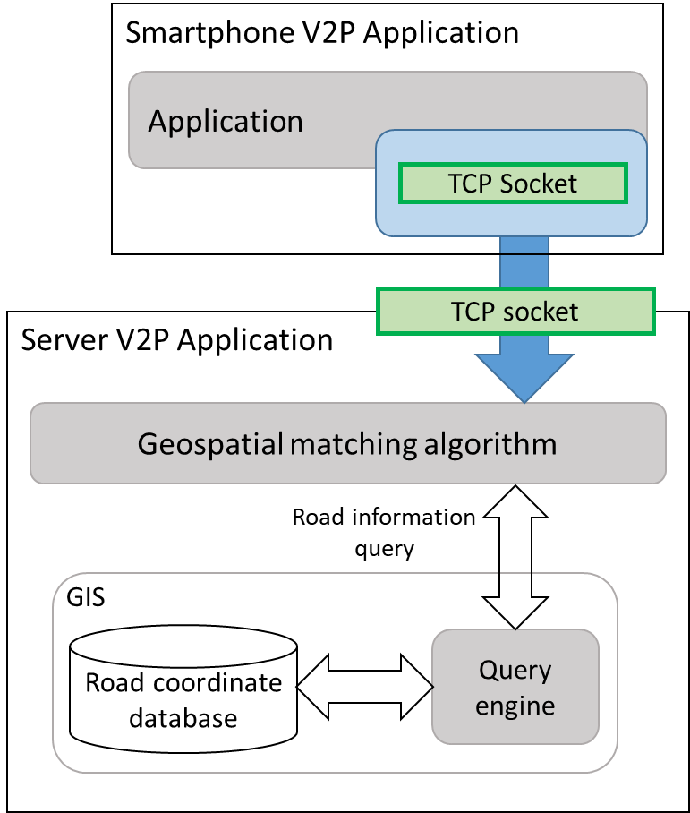

Slide 2
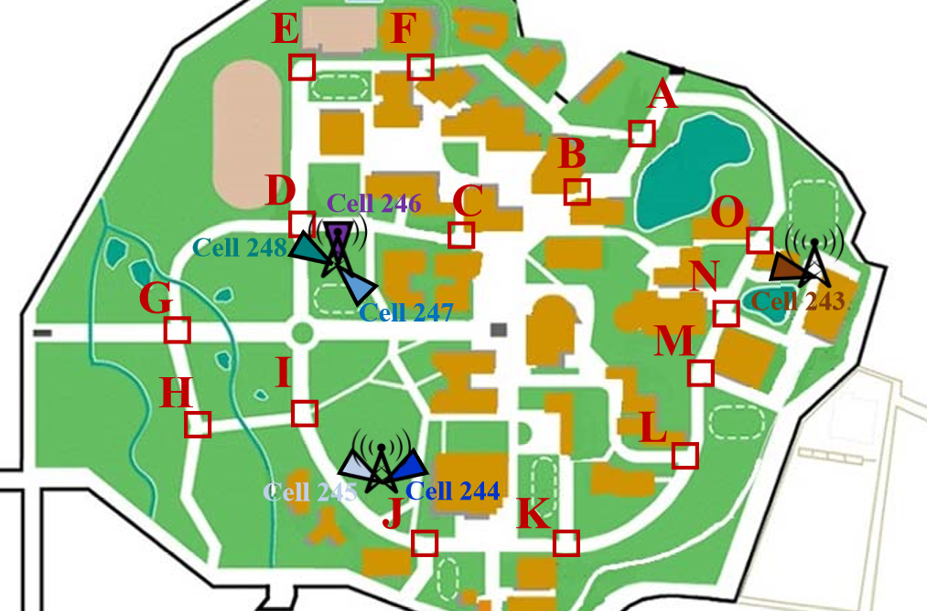
Performance Evaluation
 | Hit-Miss ratio
A -> D | 83 %
D -> A | 86 %
E -> I | 94 %
I ->E | 91 %
N -> J | 91 % &
J -> N | 90 %

Slide 3
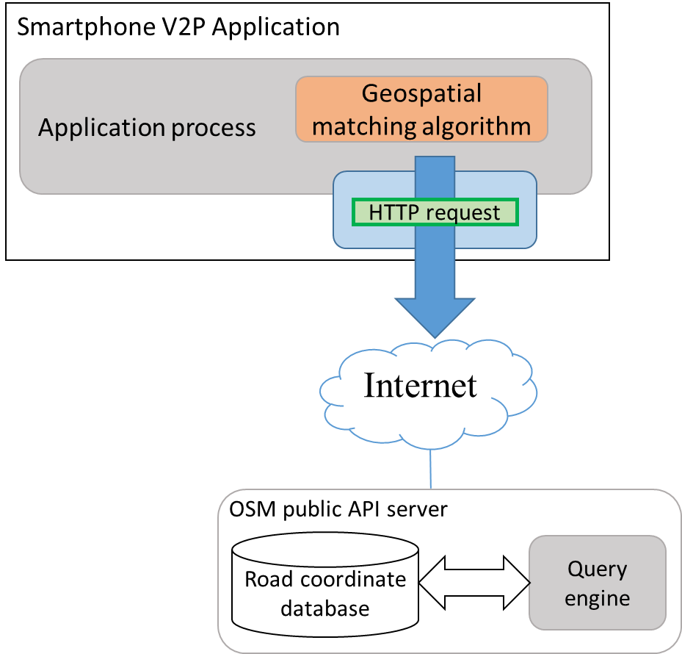
Performance Evaluation
Two test cases:

Slide 4
Performance Evaluation
Smartphone sends 400 coordinates updates.
Send to Cache server and public API server.
 | Cache database server |  | Public API server
 | Average (ms) | MAX (ms) | Average (ms) | MAX (ms)
Test 1 | 181.004 | 761 | 840 | 3990
Test 2 | 171.27 | 1360 | 637.14 | 1417
Test 3 | 162.82 | 612 | 662.718 | 2305
Test 4 | 170.852 | 764 | 963.118 | 764
Test 5 | 162.324 | 667 | 945.812 | 4321

