Slide 1



SIA - ACROW Final Project
Analysis and ML Forecasting - Final Presentation for Amit
Team: ACROW Supply Chain

Slide 2
Goal
Deliver a production-ready forecasting module for supply chain demand planning.
Show measurable accuracy improvement versus moving average baseline.
Secure Data Science and AI Diploma approval for the team.

Slide 3
Problem Statement
Supply orders and demand are volatile and intermittent across 1000+ SKUs.
Current planning relies on simple benchmarks that cause stockouts and excess inventory.
Need automated, accurate forecasts per SKU to reduce cost and improve service.

Slide 4
Data Overview
SOs dataset includes order lines, booked dates, quantities, amounts, country, system, factory, cell.
Time range: multi-year monthly data; many SKUs have intermittent demand.
Quality checks applied: missing SKUs, missing dates, split quantities detection.

Slide 5
Approach
Advanced preprocessing: cleaning, split quantity aggregation, dimensional views.
Run 15+ models per SKU: intermittent methods, statistical, ML, deep learning, custom growth model.
Model selection using rolling-window error metrics and benchmark moving averages.

Slide 6
Models Tried
Intermittent: Croston, SBA, TSB, ADIDA, IETS.
Statistical: ARIMA, Holt-Winters, Prophet enhanced.
ML and DL: LightGBM, LSTM; plus Intelligent Growth and ensembles.

Slide 7
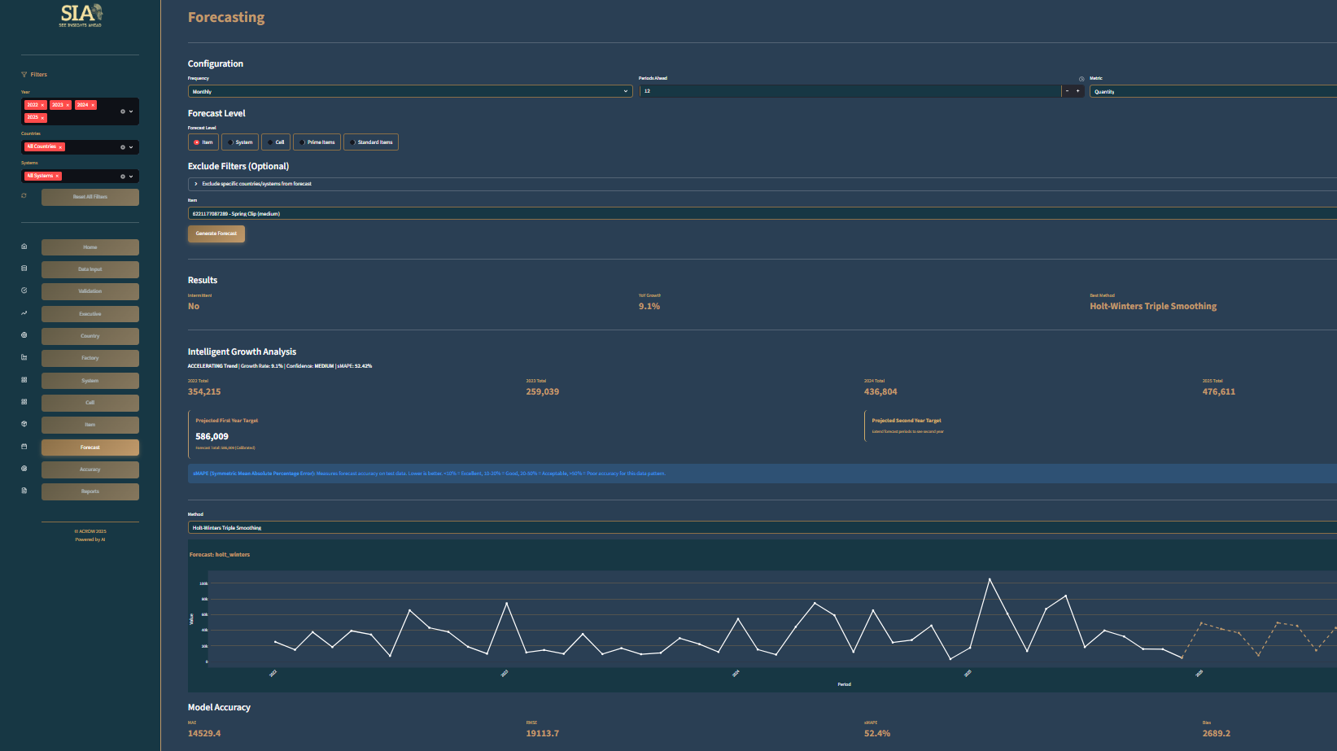

Slide 8
Evaluation and Key Results
Metrics: MAE, RMSE, sMAPE, MASE, Bias, Score.
Best model chosen per SKU using rolling evaluation up to forecast point.
Initial run shows improvement over benchmark for prioritized SKUs (high volume).
Include concrete numbers and charts in the final slides.

Slide 9
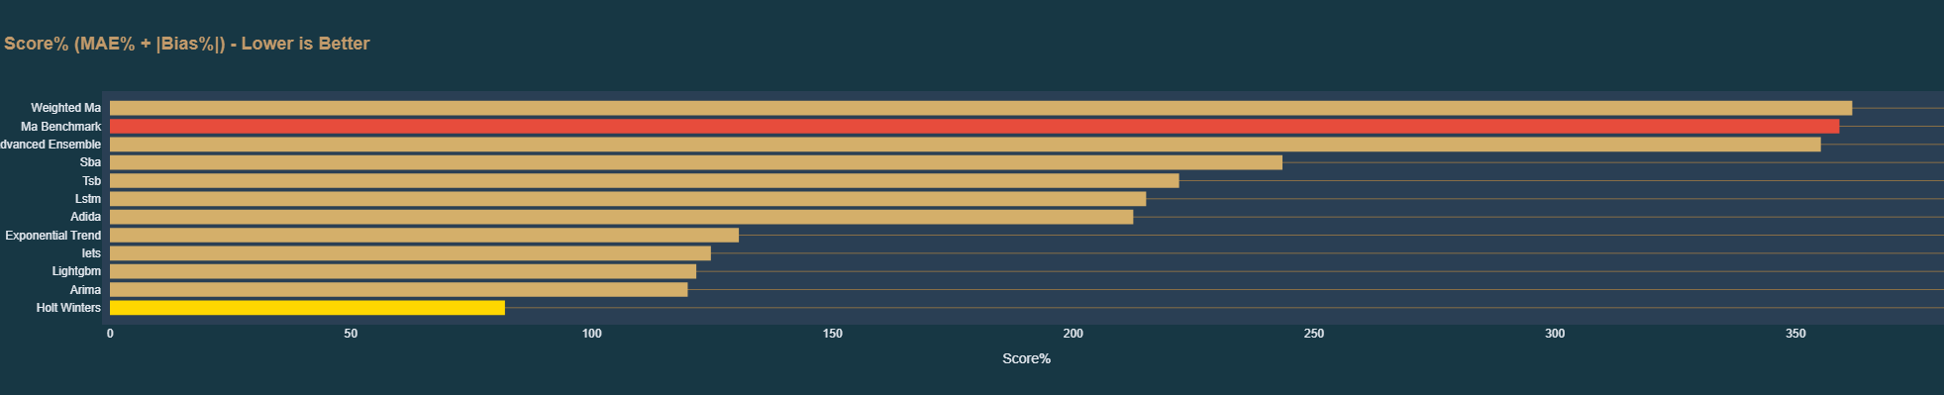
Top Insights
Using the selected SIA model we reduce forecast error vs the 3-period moving average baseline by large margins. Key impact metrics below.

Slide 10
Thank You
Questions?
Contact: ACROW, Planning Team
Prepared for: Amit - Review and diploma Project

