Slide 1
Python

Slide 2
Python Software Required
Create Venv
Python
Anaconda navigator
VsCode
Github

Slide 3
How To Use Jupyter Notebook
Select cell + press b => create Cell below your Cell
Select cell + press x => delete Cell above your Cell
Select cell + press c => copy your Cell
Select cell + press v => past your Cell

Slide 4
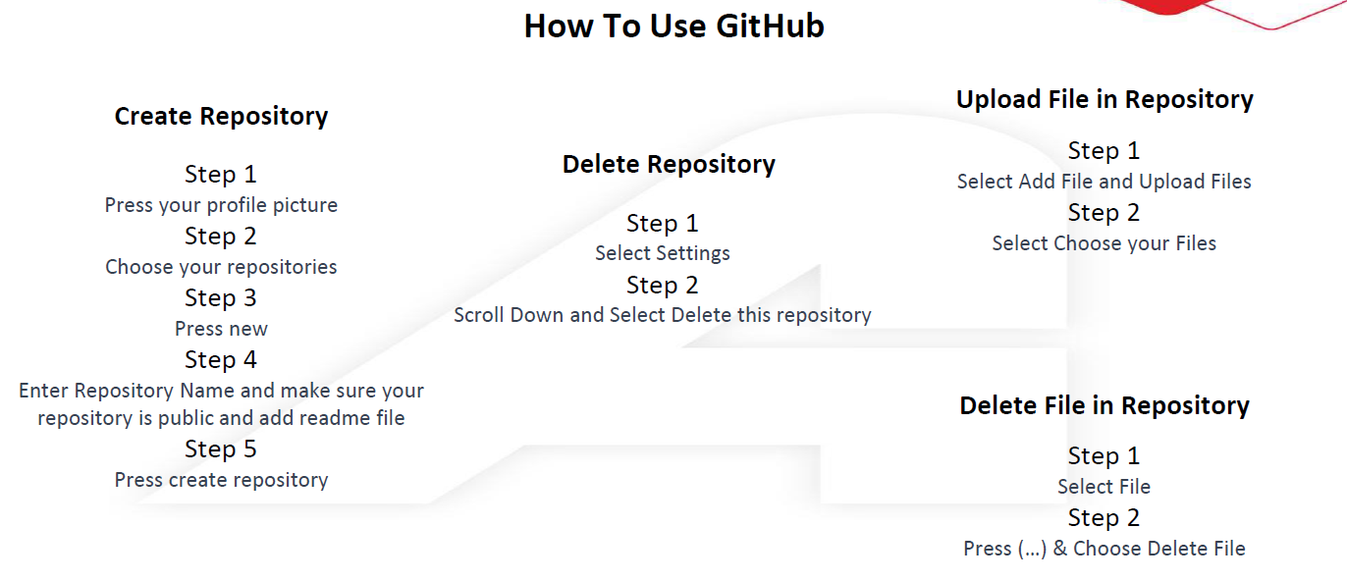

Slide 5
Introduction to python

Slide 6
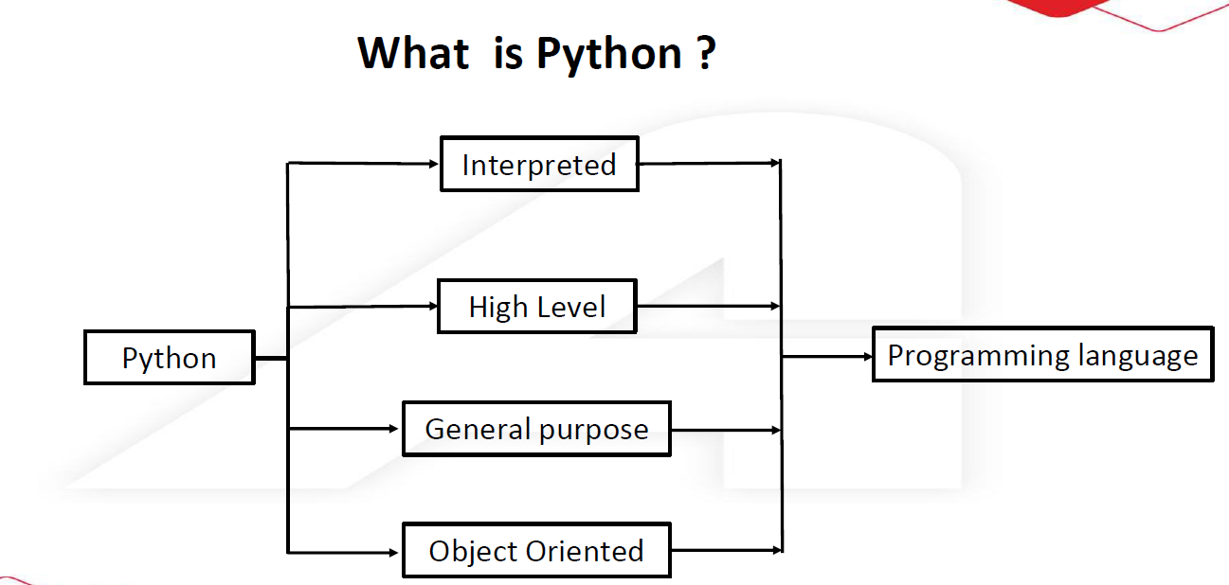

Slide 7
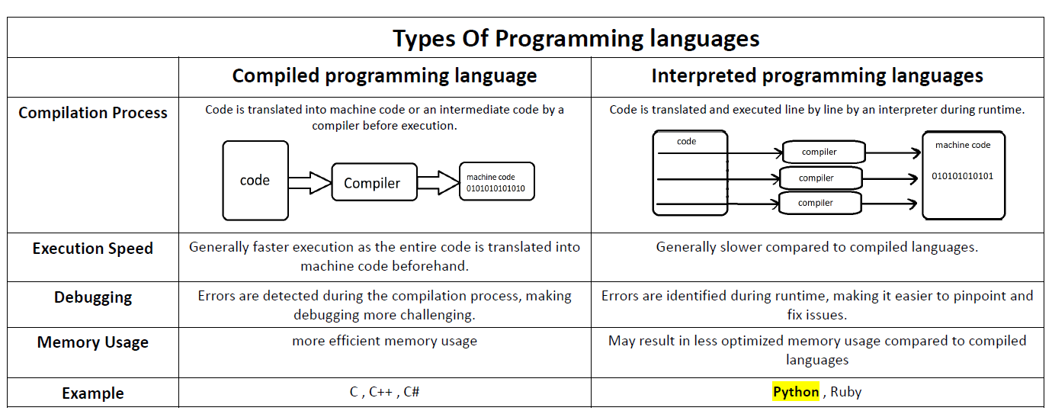

Slide 8
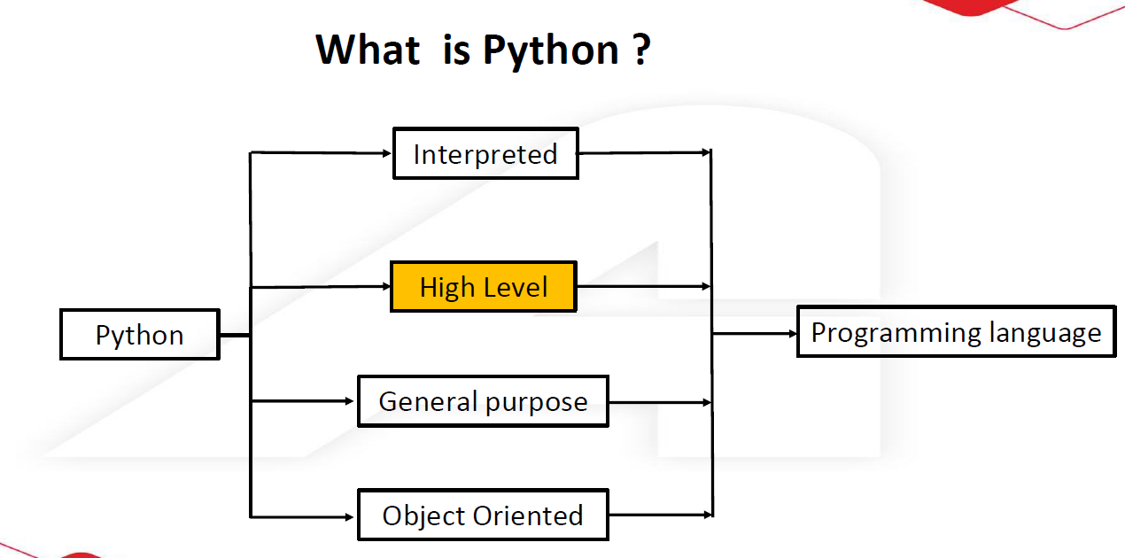

Slide 9
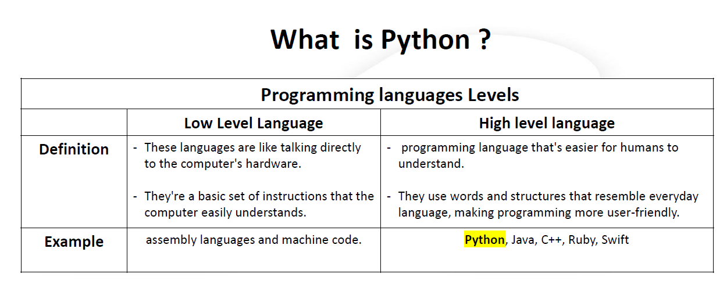

Slide 10
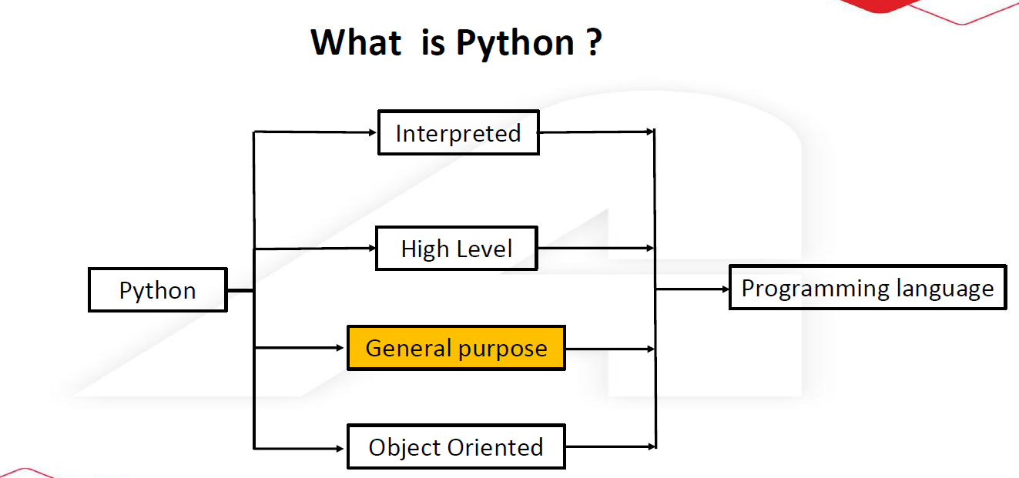

Slide 11
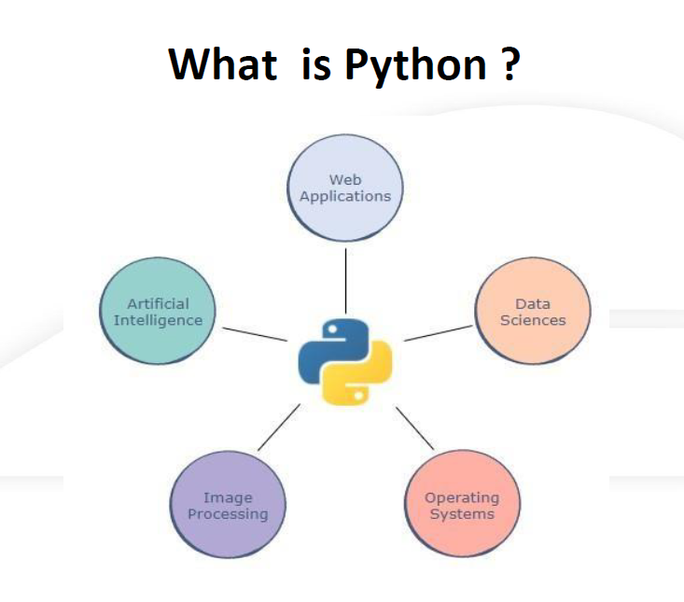
Agentic
Generative AI

Slide 12
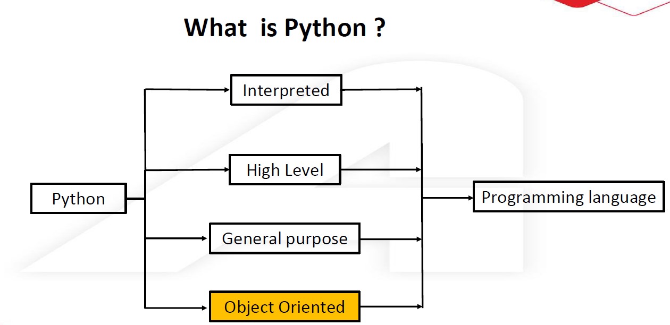

Slide 13
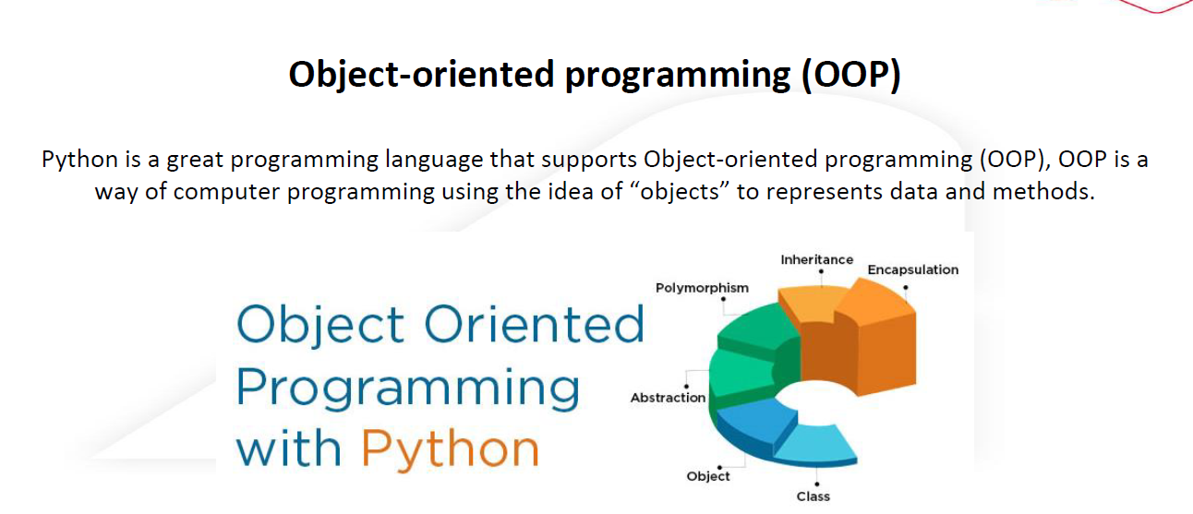

Slide 14
Python Basics

Slide 15
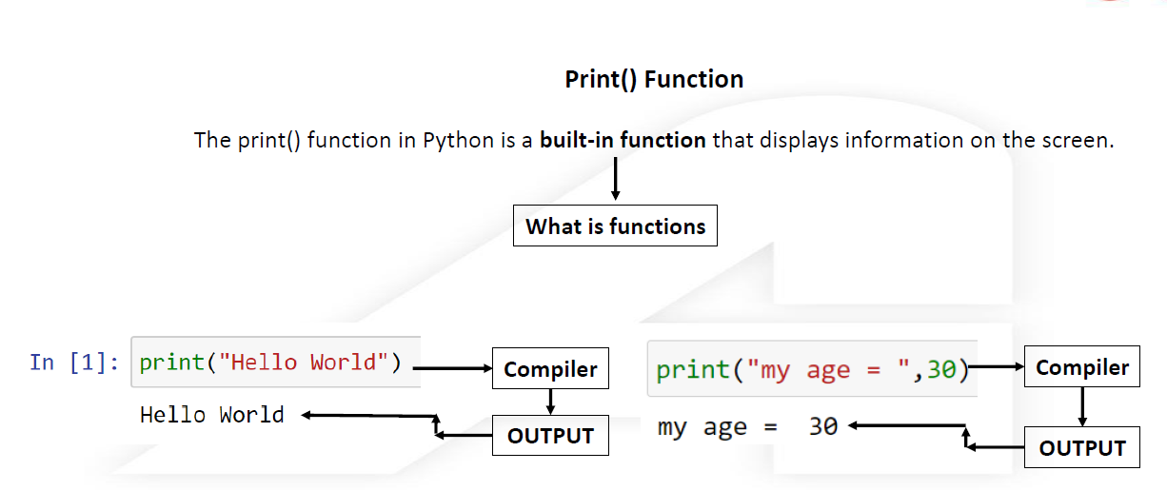

Slide 16
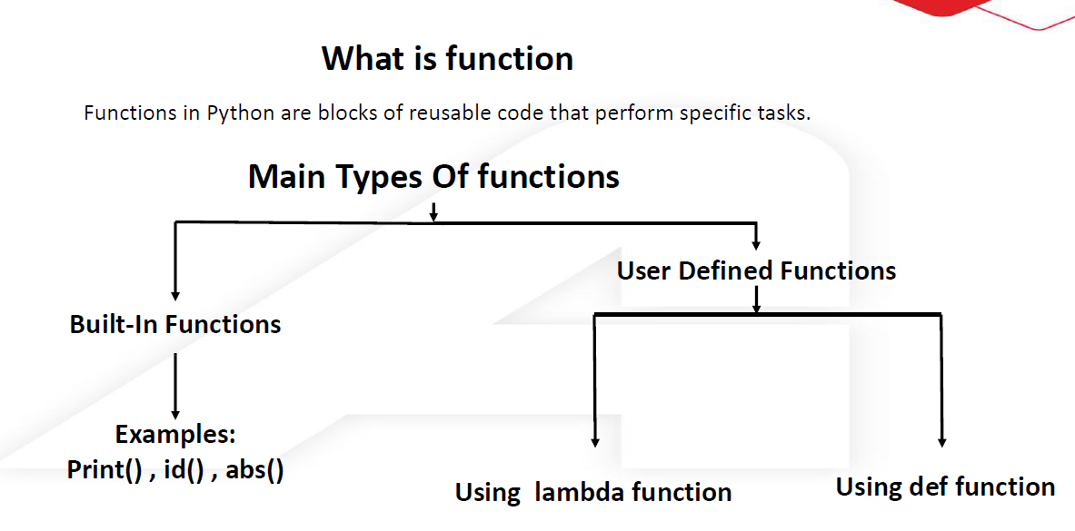

Slide 17
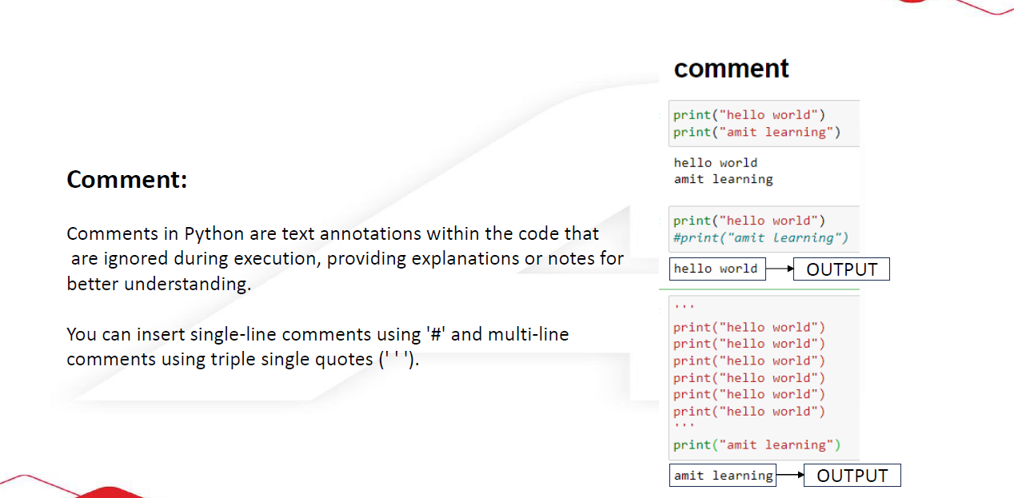

Slide 18
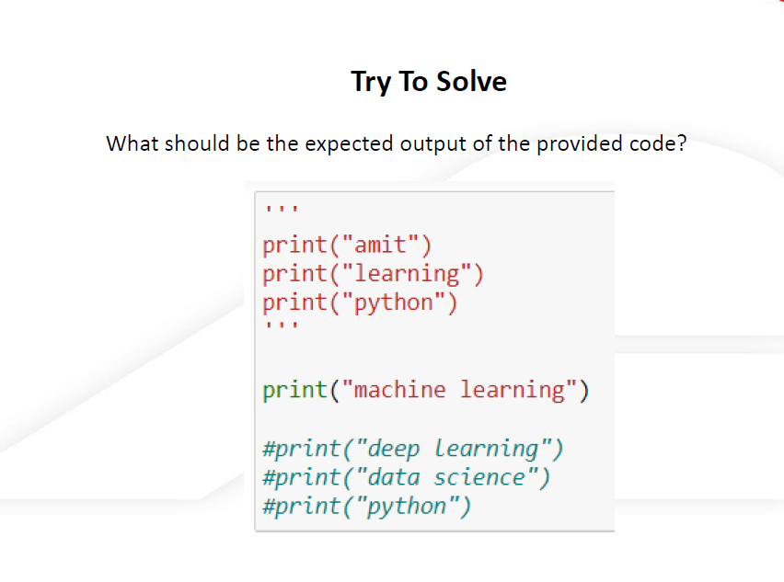

Slide 19
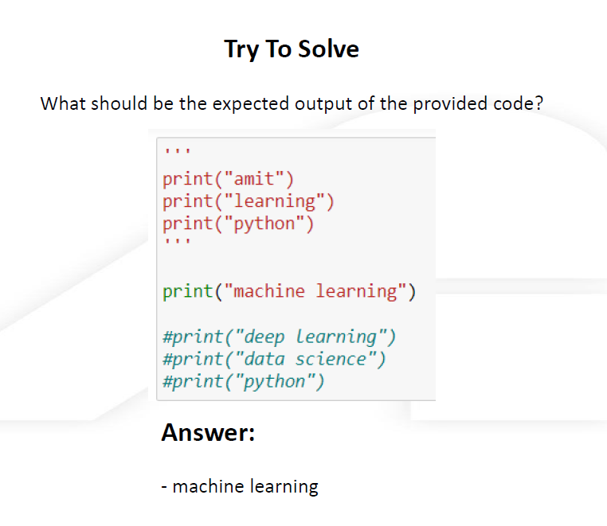

Slide 20
Python Variables

Slide 21
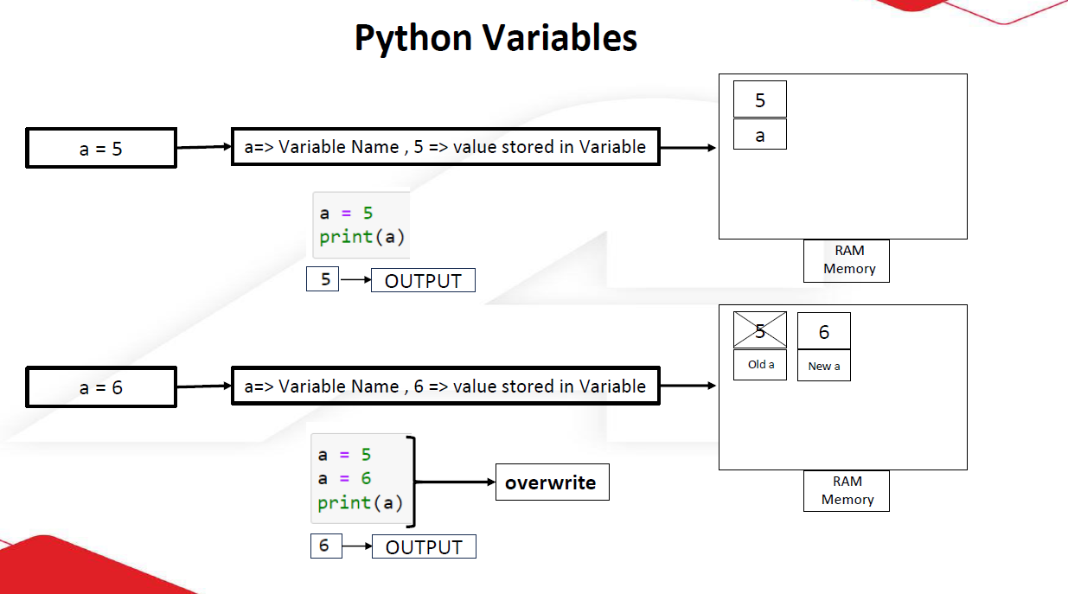

Slide 22
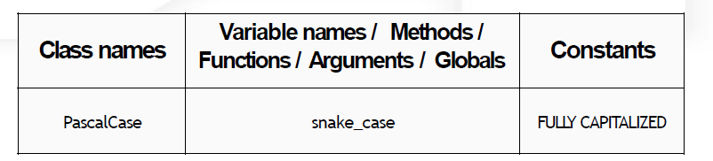
PYTHON IDENTIFIERS
1. Python identifiers are user-defined names for variables, functions, classes, or objects in code.
2. Guidelines for creating identifiers include using letters (uppercase and lowercase), numbers, and underscores.
3. Special characters and operators are not allowed in identifiers.
4. Identifiers should not begin with a number, and certain keywords are reserved and cannot be used as standalone identifiers.
5. Meaningful names for identifiers are encouraged.
6. Python is case-sensitive, distinguishing between uppercase and lowercase identifiers.
7. Avoid using 'l', 'I', or 'O' as single-character variable names due to potential font-related confusion.

Slide 23
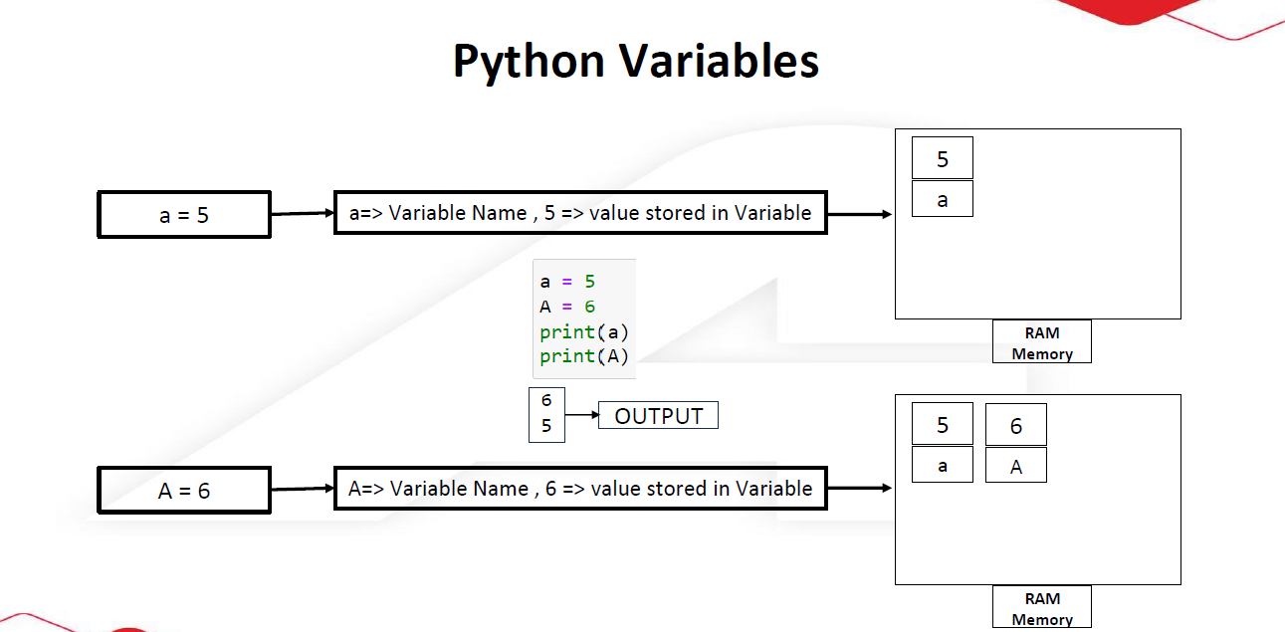

Slide 24
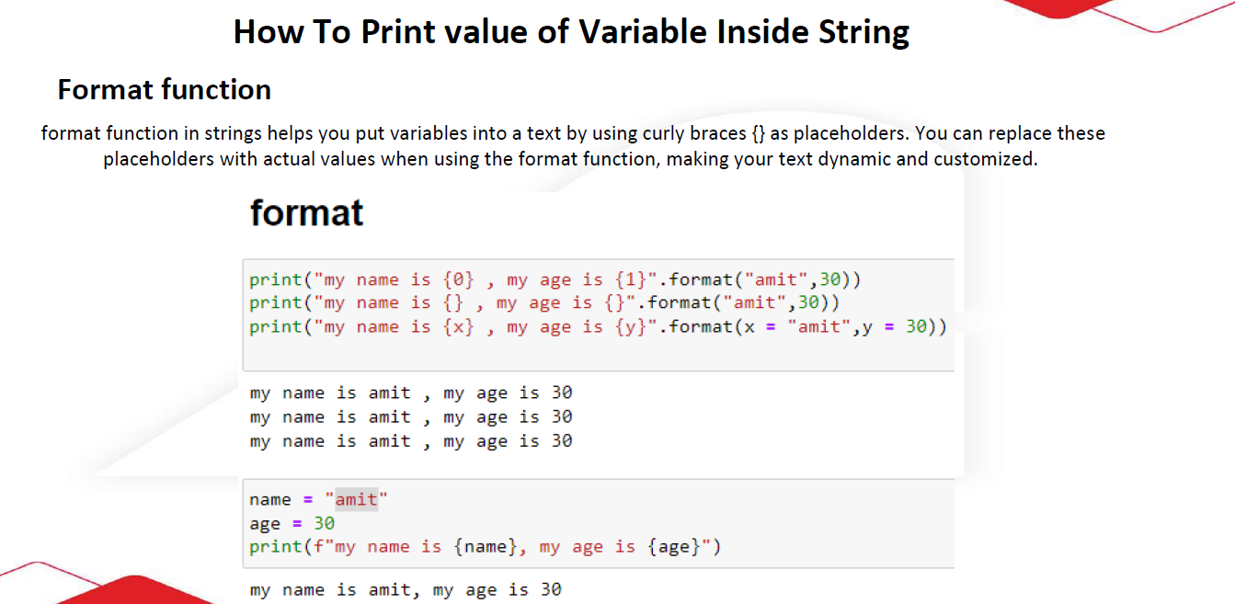

Slide 25
Try To Solve
Create a Python script to display personalized information. Utilize variables to store the user's name, age, and the name of the course they are learning. Dynamically generate a message that includes this information and print the result. Ensure clarity in your code implementation without relying on user input.
Expected Output:
My name is {your_name}, and I am {your_age} years old. I am engaged in learning {course_name}.

Slide 26
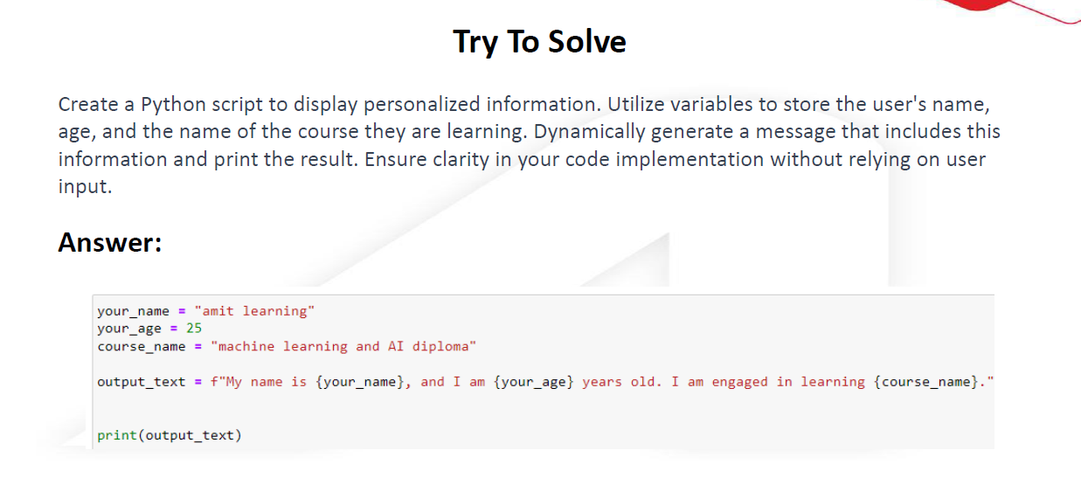

Slide 27
Python Data Types

Slide 28
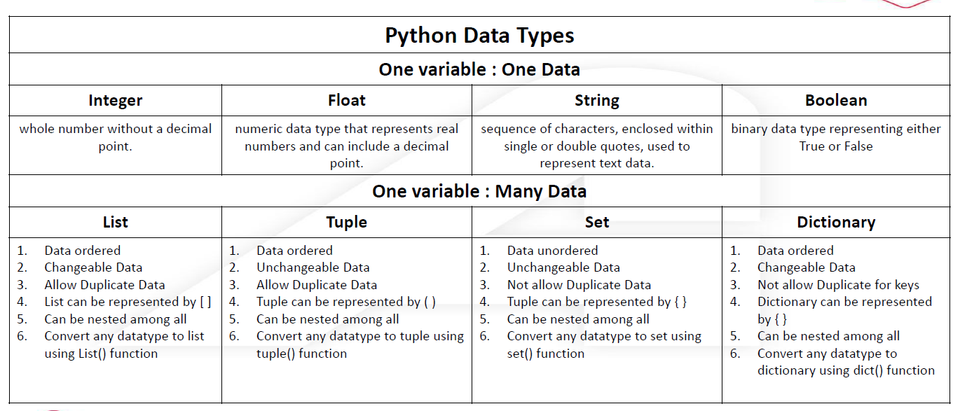

Slide 29
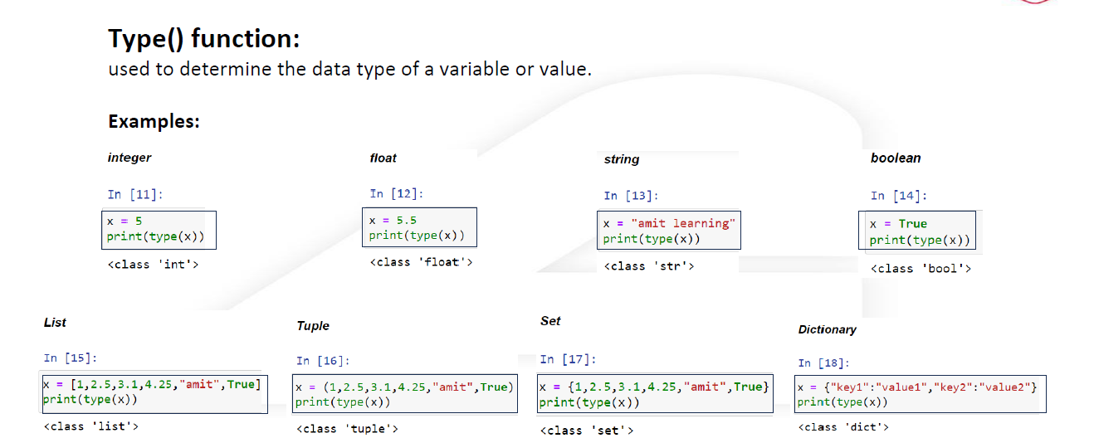

Slide 30
String

Slide 31
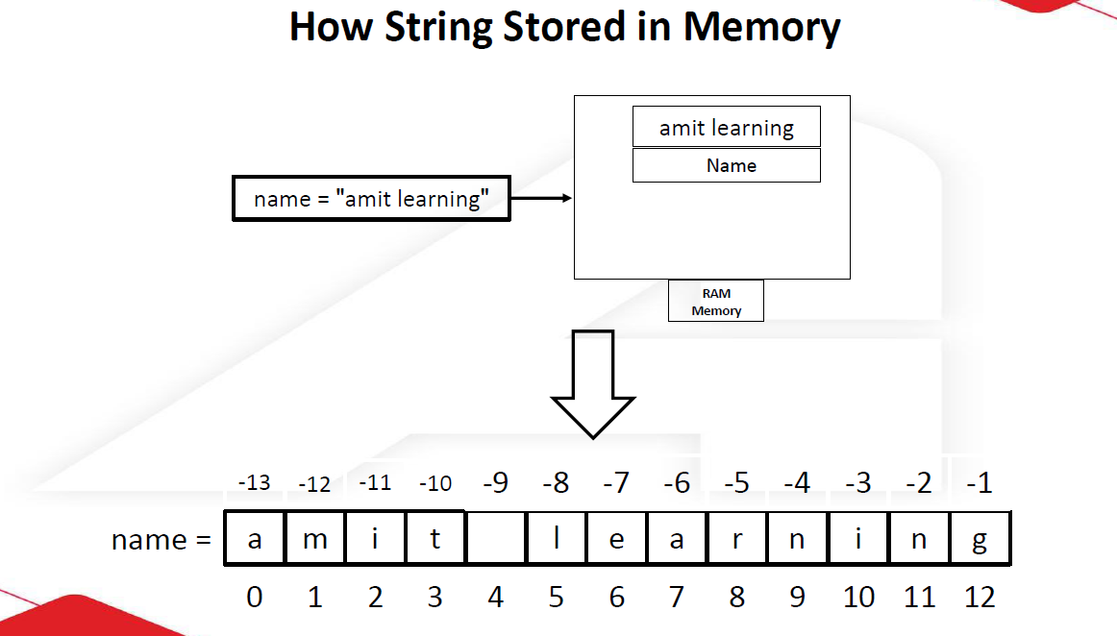

Slide 32
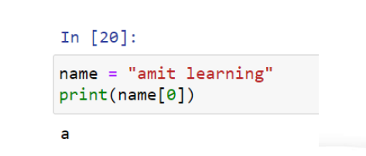
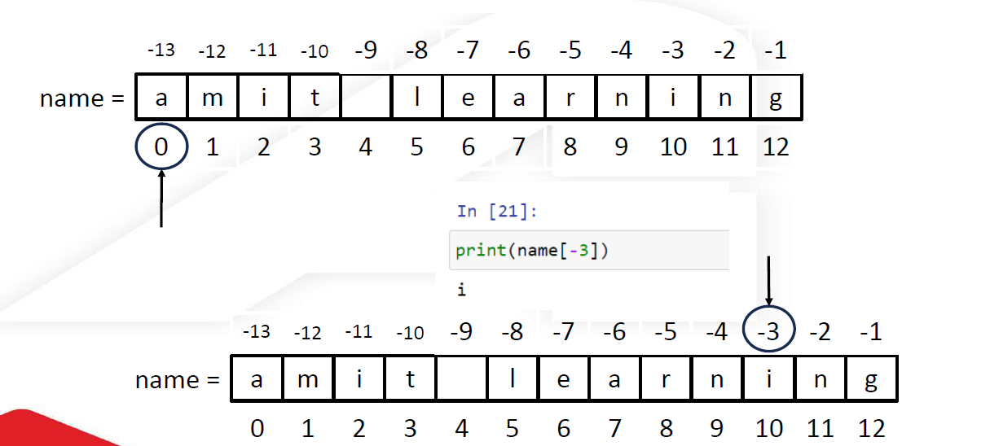

Slide 33
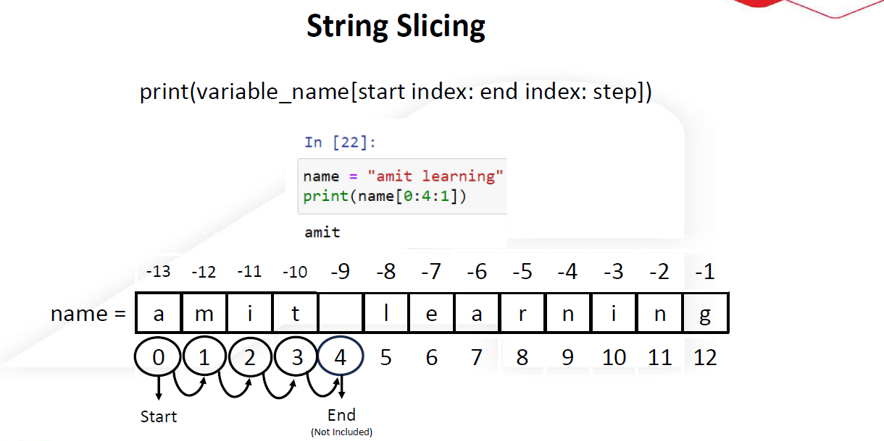

Slide 34
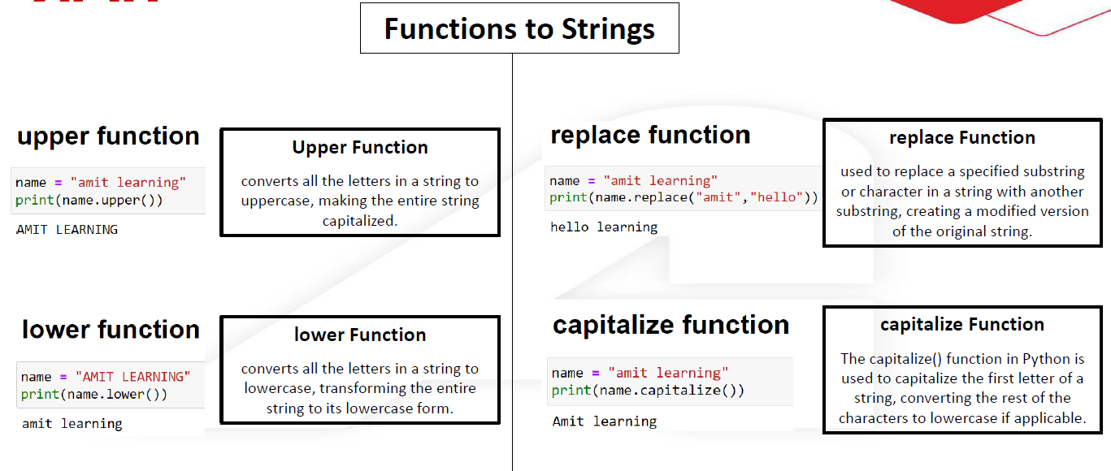

Slide 35
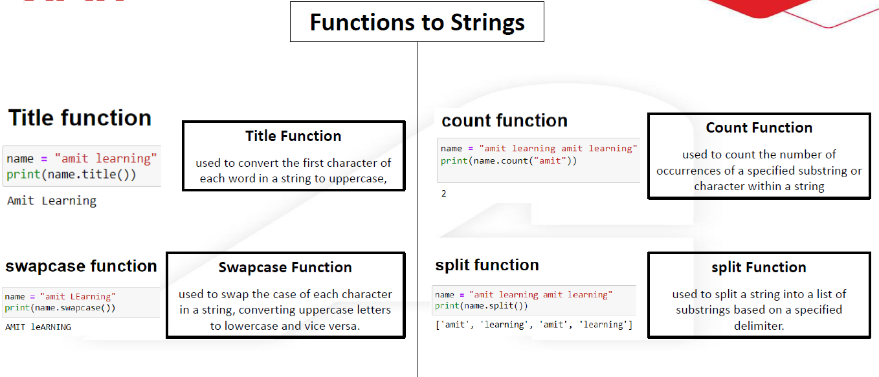

Slide 36
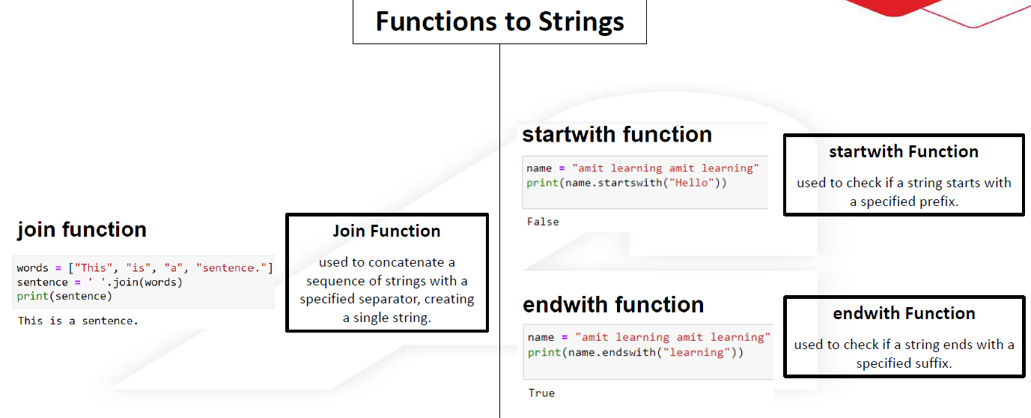

Slide 37
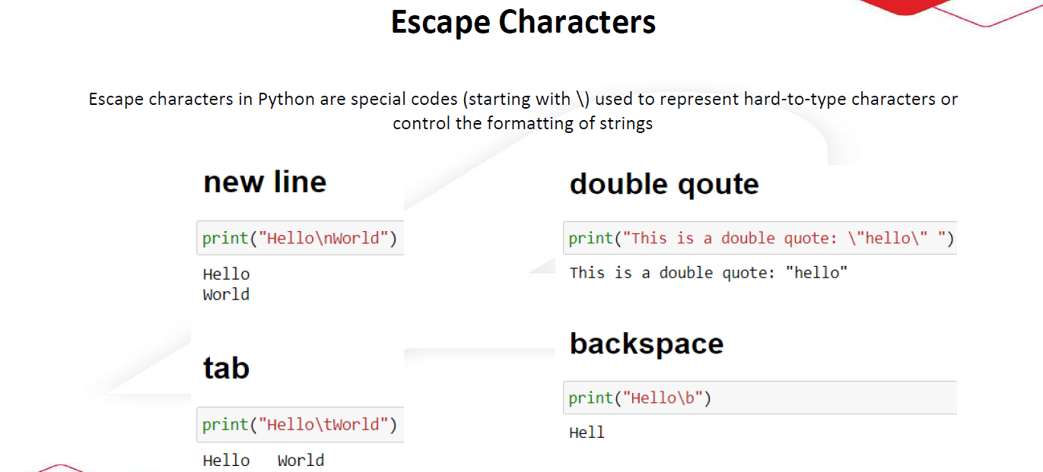

Slide 38
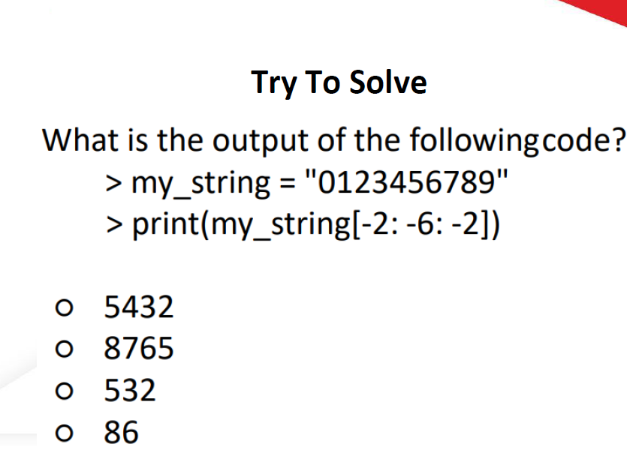

Slide 39
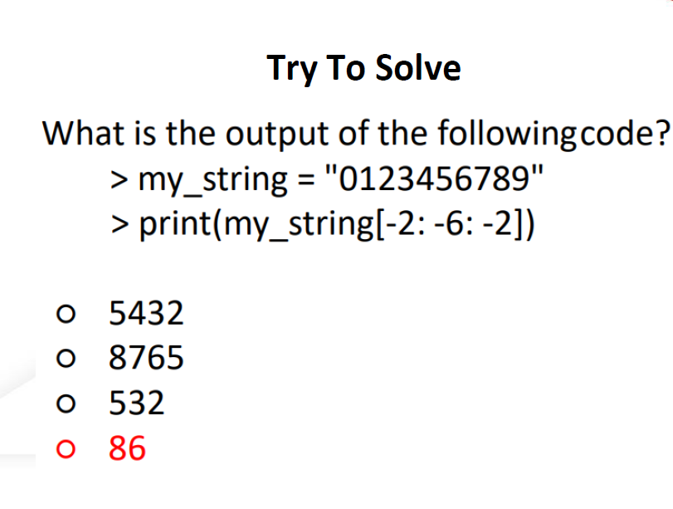

Slide 40
Assignment

Slide 41
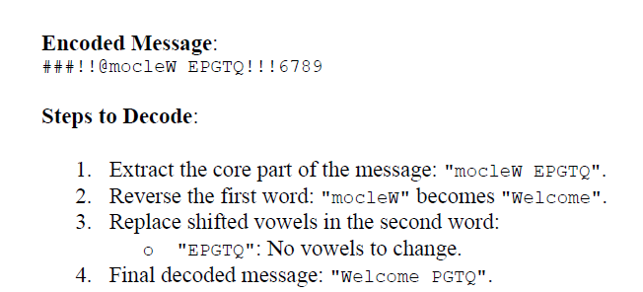

Slide 42
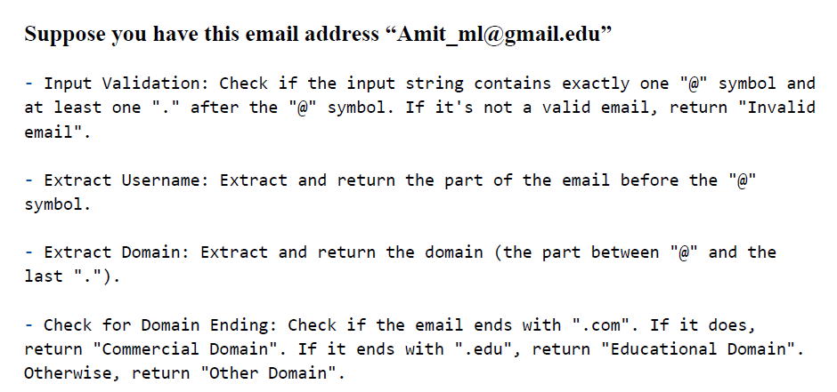

Slide 43

Thank you

