Slide 1

StaRtistics introduction to statistics

Slide 2
Class II

Slide 3
(non) Parametric

Slide 4
Non-parametric tests
In stats there are some tests that are non-parametric, by this statisticians mean that the test does not require assuming a specific model or distribution for your data
These are sometimes referred to as non-distributional tests
These tests are used when you do not want to assume a specific distribution (e.g., violation), or do not know the distribution of your data

Slide 5
Non-parametric tests
Non-distributional tests
You can make many of the common statistics non-distributional by a technique in statistics called permutations
e.g., t-tests, ANOVA/regression, etc
Let us take the t-test as an example

Slide 6
Non-parametric t-tests
Regular t-tests assume your data is normally distributed
There is a non-parametric equivalent of a t-test called the permutation t-test. This test works on the premise that you can observe a null distribution from your own data by randomly permuting groups.
Reminder: a null distribution is the distribution when the null hypothesis is true

Slide 7
permutations
Group A Group B
Permutations build a null distribution of data based on your observations under the assumption that randomly shuffling your data will void the effect of interest. Thus, you can measure how surprising the effect you observe is given your data based on the computed null distribution
A
B
Permute data
A
B

Slide 8
permutations
Group A Group B
A
B
This technique is very similar to bootstrapping without replacement (i.e., no duplicate observations).
Permute data
A
B

Slide 9
permutations
Group A Group B
A
B
Permute data
A
B

Slide 10
Bootstrapping
A very similar concept in statistics is the idea of bootstrapping to get a measure of uncertainty around an estimate (e.g., CI)
Bootstrapping is like permutations in that they resample your data, however bootstrapping requires replacement
It is often used to calculate the error associated to an estimate, effect, or performance of an algorithm and allows you to know if one given data point is driving the effect you see

Slide 11
Bootstrapping
Bootstrapping is like permutations in that they resample your data, however bootstrapping requires replacement
A
B1
B2
B3
Avg _{obs}
Avg _{b1}
Avg _{b2}
Avg _{b3}

Slide 12
Bootstrapping
The computed Avg for each bootstrap will allow you to get an idea of what range of values you could expect given your data
A
B1
B2
B3
Avg _{obs}
Avg _{b1}
Avg _{b2}
Avg _{b3}

Slide 13
Analysis of Variance

Slide 14
ANOVA
Analysis of Variance is a linear model to test if there is a difference between two or more means (i.e., groups sometimes called levels)
Let us start with a one-way ANOVA

Slide 15
ANOVA
One-way ANOVA (i.e., one FACTOR)
Test the difference between groups (levels). It answers the question:
Are the group means spread out much more than what you’d expect if you had sampled all the groups from the same distribution?

Slide 16

ANOVA
Are the group means spread out much more than what you’d expect if you had sampled all the groups from the same distribution?
$H_{0}:a_{1}= a_{2} =$ $a_{3}$= $…a_{n} |$ $H_{1}:a_{1}≠ a_{2} ≠$ $a_{3}≠…a_{n}$

Slide 17
ANOVA
Assumptions of a One-way ANOVA:
Normality of data
Homogeneity of variances (all variances are born equal)
Independent samples

Slide 18
ANOVA
Normality of data
Can test this by visualizing your data / residuals (see regression) or by a Shapiro-Wilk test

Slide 19
ANOVA
Homogeneity of variances
Also called homoscedasticity can be assessed visually or with a Bartlett test (see code)
This is a more ’serious’ assumption to break when running an ANOVA

Slide 20
ANOVA
Independence
We assume our observations are independent of one another. This may be broken when the observations are taken from the same subject (repeated measures) or when dependent variables are correlated (see regressions)

Slide 21
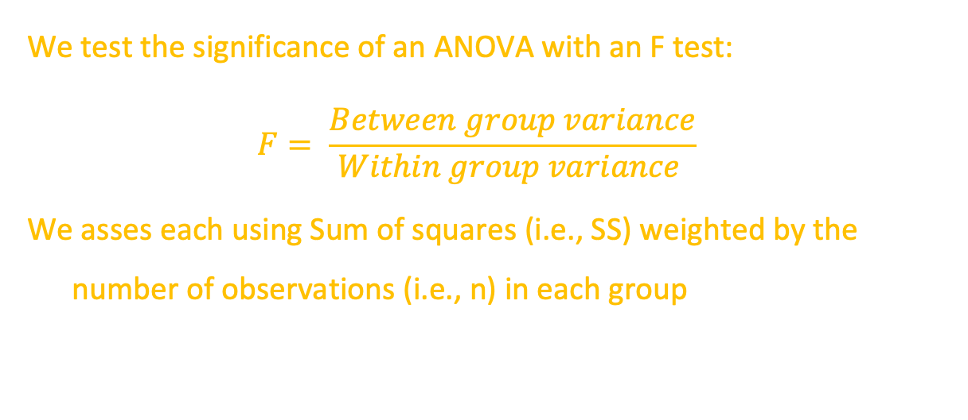
ANOVA
We test the significance of an ANOVA with an F test:
$$F= \frac{Between group variance}{Within group variance }$$
We asses each using Sum of squares (i.e., SS) weighted by the number of observations (i.e., n) in each group

Slide 22
ANOVA
Between-group SS
How spread apart are your group means
Within-group SS
How spread apart is each distribution
*** Note we always normalize these by their degrees of freedom
*** See code for visual depiction of an example with three means

Slide 23
ANOVA
How is a One-way ANOVA different from a t-test:
T-tests are used to test the difference between TWO means whereas ANOVAs test the difference between two or more means

Slide 24
ANOVA
How is a One-way ANOVA different from a t-test:
They both test slightly different questions: t-tests tells you if TWO means are different whereas an ANOVA will tell you if there are mean differences but NOT WHICH means are different

Slide 25
ANOVA
The ANOVA can be generalized to test multiple dependent variables like the Two-way ANOVA
With multiple factors / DV you can test interactions in what we call a ‘crossed’ model where every group A co-occurs with every group B

Slide 26
ANOVA
Factor / DV A
Factor / DV B
Group / Level 1A
Group / Level 2A
Group / Level 3A
Mariah
Halloween
Jlo
Halloween
Lady Gaga
Halloween
Group / Level 1B
Mariah
Christmas
Jlo
Christmas
Lady Gaga
Christmas
Group / Level 2B

Slide 27
ANOVA
Post-hoc testing:
After you are certain that the means differ, what next? Sometimes you need to do additional tests, and sometimes you don’t. This all depends on your underlying question!!!

Slide 28
ANOVA
Post-hoc testing: NOT ALWAYS NECESSARY
In some cases, we just care that the means of our groups are different and not which differ from one another. When we have two groups, we know that they are different, no additional test is needed.

Slide 29
ANCOVA
There are many iterations of an ANOVA including the analysis of covariance!
Here we test the INDEPENDENT effect of dependent variables (factors) regardless of COVARIATES of no interest (referred to as nuisance variables)
*** we will cover this idea in more detail in the regression slides!

Slide 30
Linear regression

Slide 31
What is a regression?

Slide 32
To put it simply a regression is a set of statistical tools used to describe and quantify the relationship between dependent and independent variables

Slide 33
Dependent variables (y) are the outcomes we wish to predict based on independent variables

Slide 34
Independent variables (x) are the covariates/ predictors / features we think change the value of the outcome variable in a quantifiable way

Slide 35
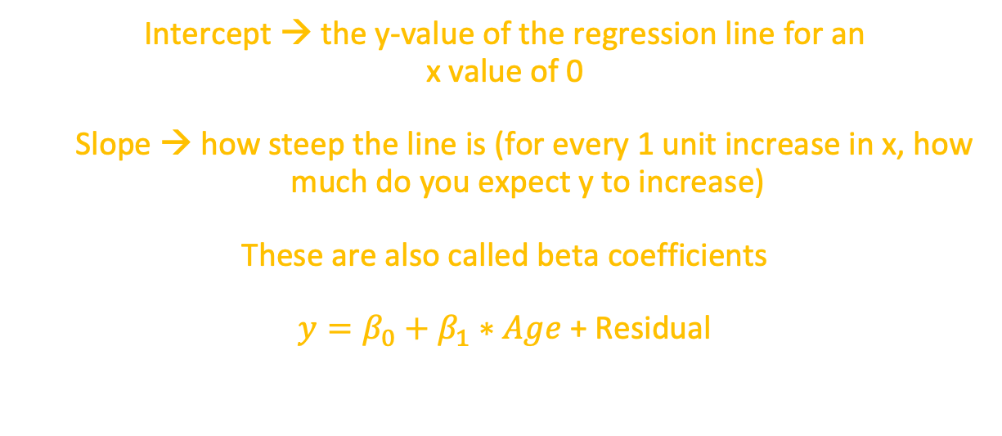
Linear Regression Models
Intercept → the y-value of the regression line for an
x value of 0
Slope → how steep the line is (for every 1 unit increase in x, how much do you expect y to increase)
These are also called beta coefficients
$y=β_{0}+β_{1}∗Age$ + Residual

Slide 36
Linear Regression Models
MAKE EXAMPLE PLOT USING OUR DATA

Slide 37
Statistical twins
ANOVAs and Linear regressions are not so different from one another… they are a LOT alike! In fact ANOVAs are a special case of a regression where all variables are categorical
Let us explore how they are two sides of the same coin:

Slide 38
Statistical twins
If you run a one-way ANOVA and a regression, you will notice that the ‘cell’ means or group means are in fact the same as the coefficients (i.e., effects) of a regression when you consider the intercept. See code for example
*** Note that the way you code your data will affect how you interpret the results! See next class for details.

