Slide 1
(sta)R(tistics)
Class 7: Visualization

Slide 2
Questions?
Do you have any lingering questions about Bayesian statistics?

Slide 3
Today we will learn...
Why would you make plots in R
How to make basic plots:
plot types
customization
How to make specialized plots
heatmaps
UpSet plots
How to save plots well
visualization file formats
Patchwork

Slide 4
Plotting in R
It’s free
It’s versatile
It’s reusable
It’s customizable
It can be used for big data
It is a transferrable skill in high demand
It will make you feel like a magician
Because R developers are literal jokers (ggdogs, ggcats, ggbernie, gglime)

Slide 5
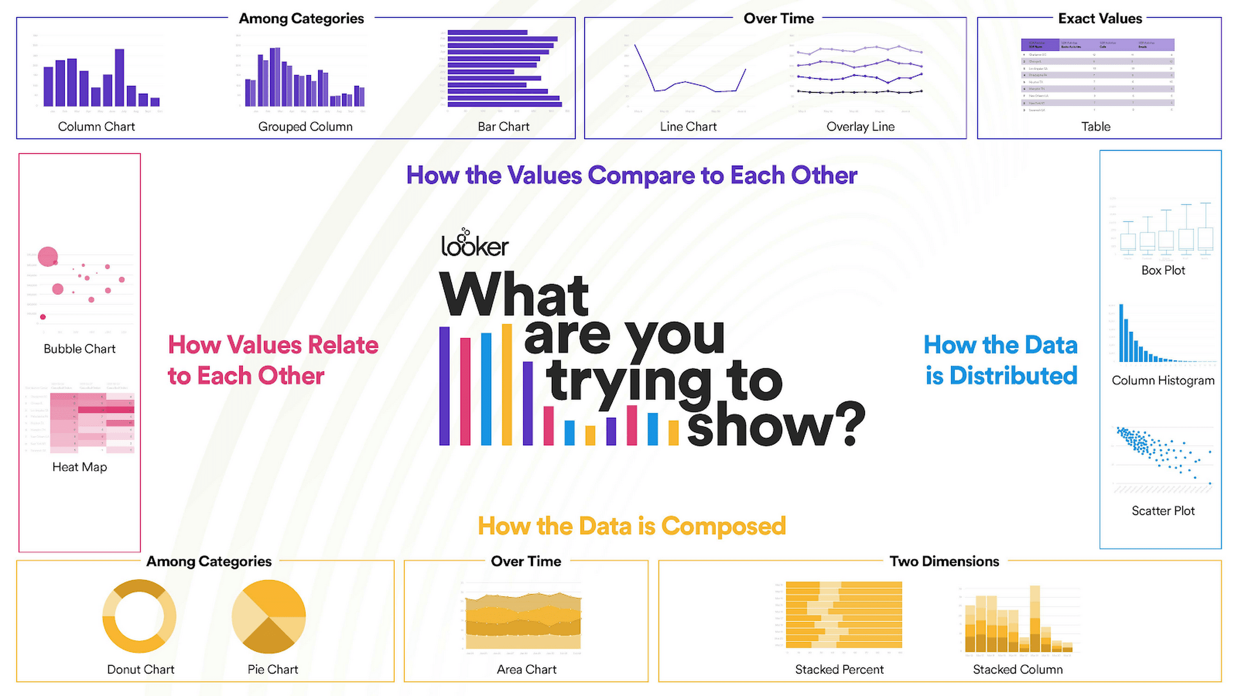
Types of plots
https://cloud.google.com/blog/products/data-analytics/different-types-graphs-charts-uses

Slide 6
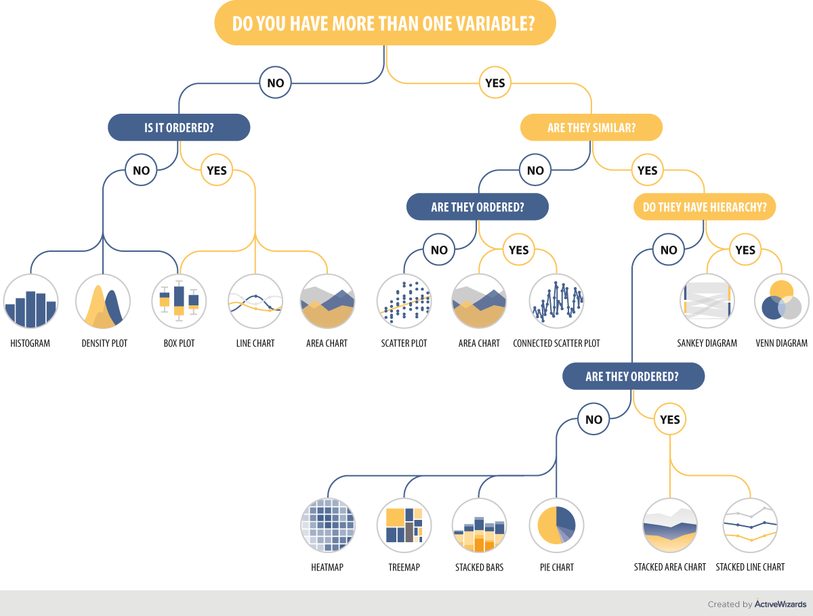
Types of plots
https://www.kdnuggets.com/2019/03/how-choose-right-chart-type.html

Slide 7
Anatomy of a plot
Title and labels
Font and size
Axes
X-axis and Y-axis
Categorial or continuous
Scale
Units
Legend
Shapes, colors, shading
Measure of data distribution
Error bars
Individual points
Statistical results
Significance symbols
Values
Pesarico et al. 2019

Slide 8
Anatomy of a plot
Title and labels
Font and size
Axes
X-axis and Y-axis
Categorial or continuous
Scale
Units
Legend
Shapes, colors, shading
Measure of data distribution
Error bars
Individual points
Statistical results
Significance symbols
Values
Seney et al. 2018

Slide 9
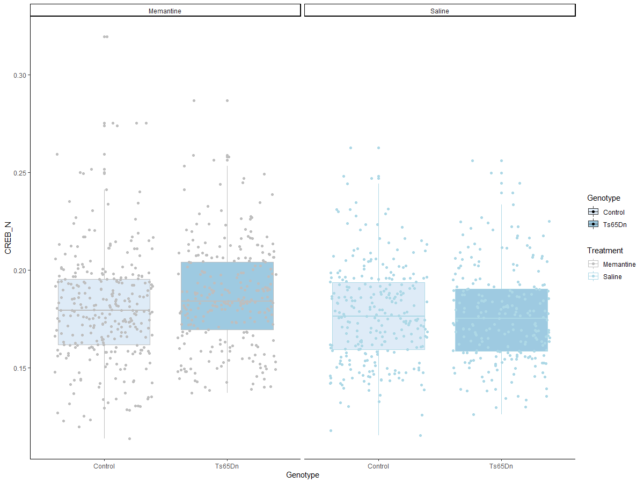
ggplot2: Boxplots

Slide 10
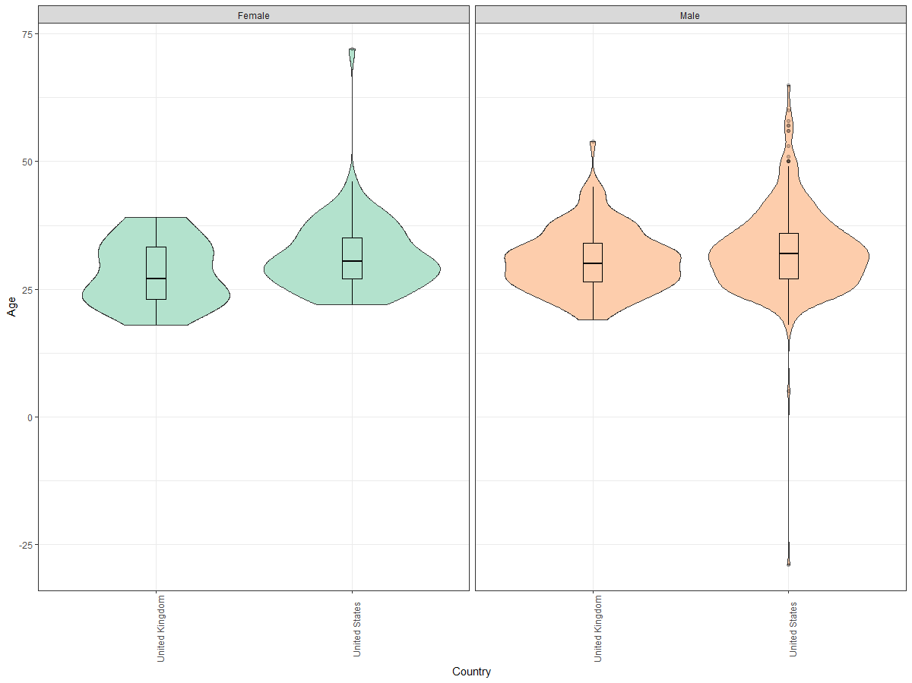
ggplot2: Violin Plots

Slide 11
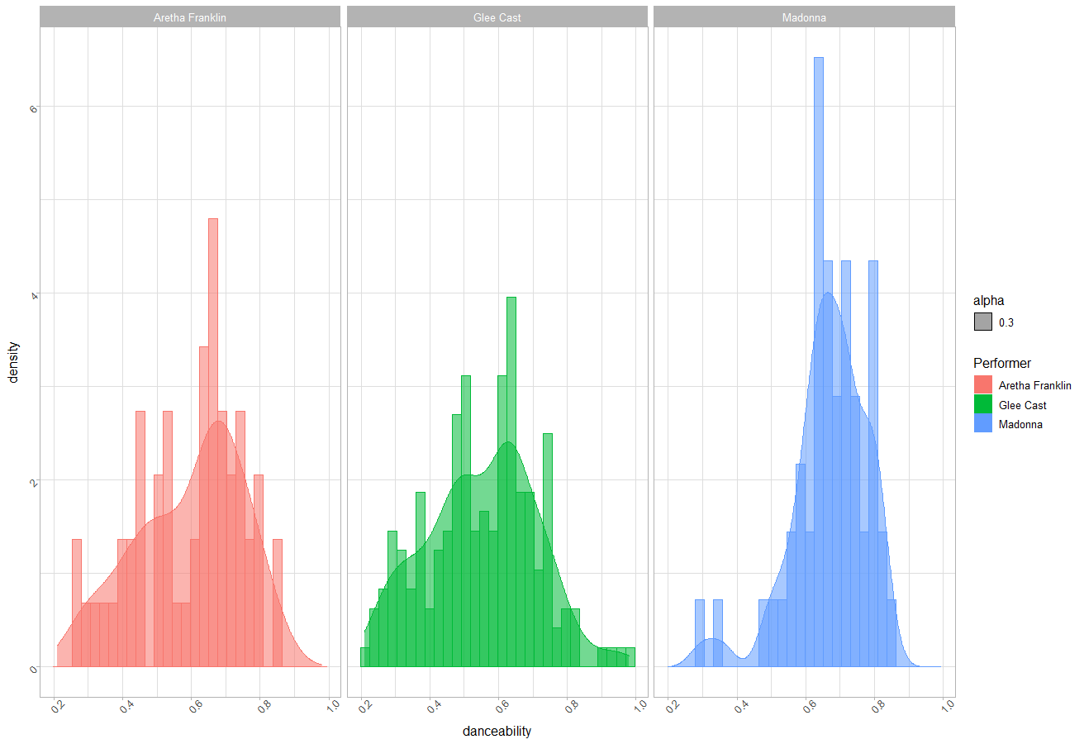
ggplot2: Density Plots

Slide 12
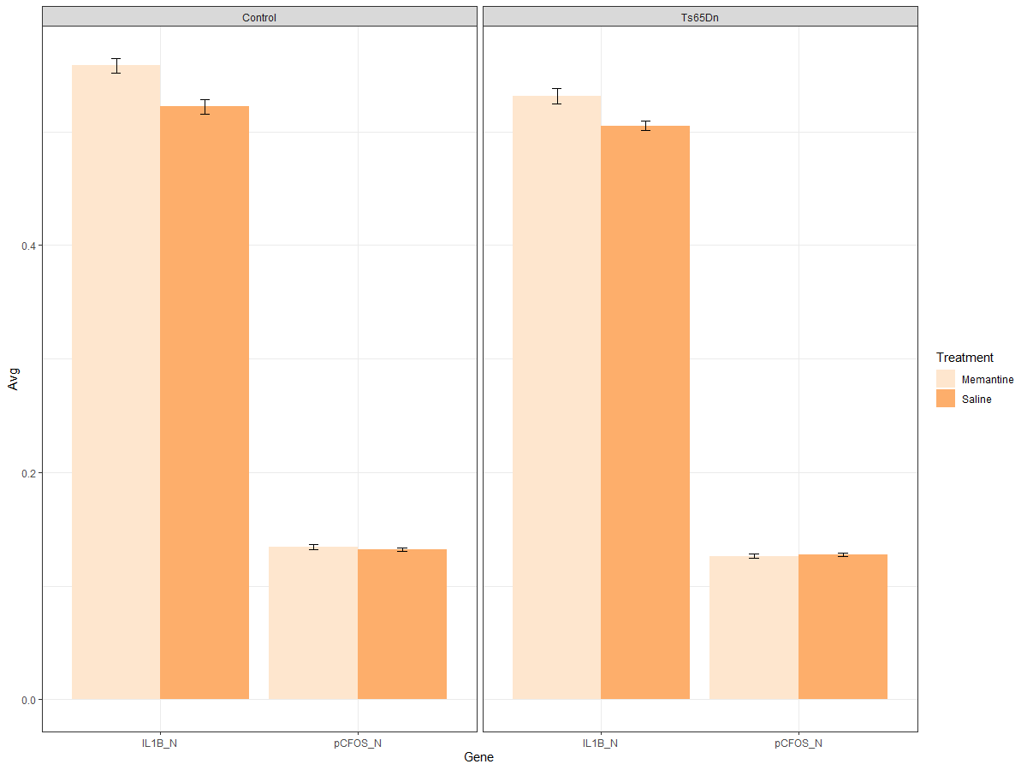
ggplot2: Barplots, Error Bars, Significance stars

Slide 13
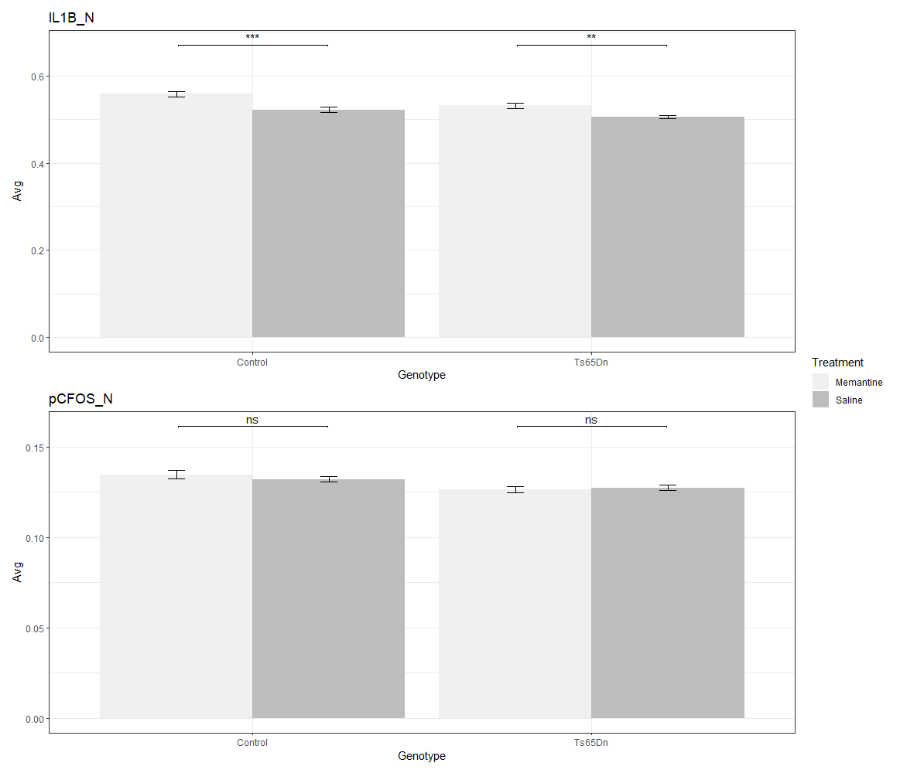
Combining plots: patchwork

Slide 14
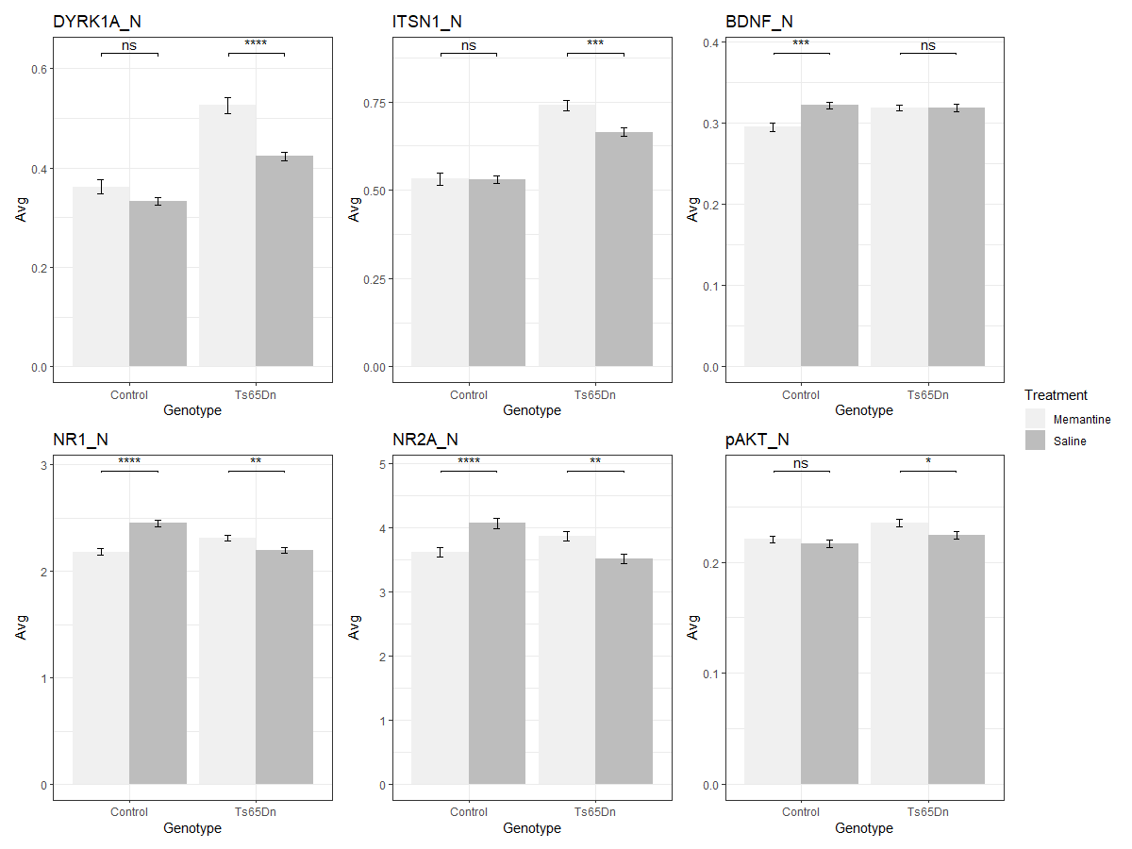
Plotting in a loop or within lapply

Slide 15
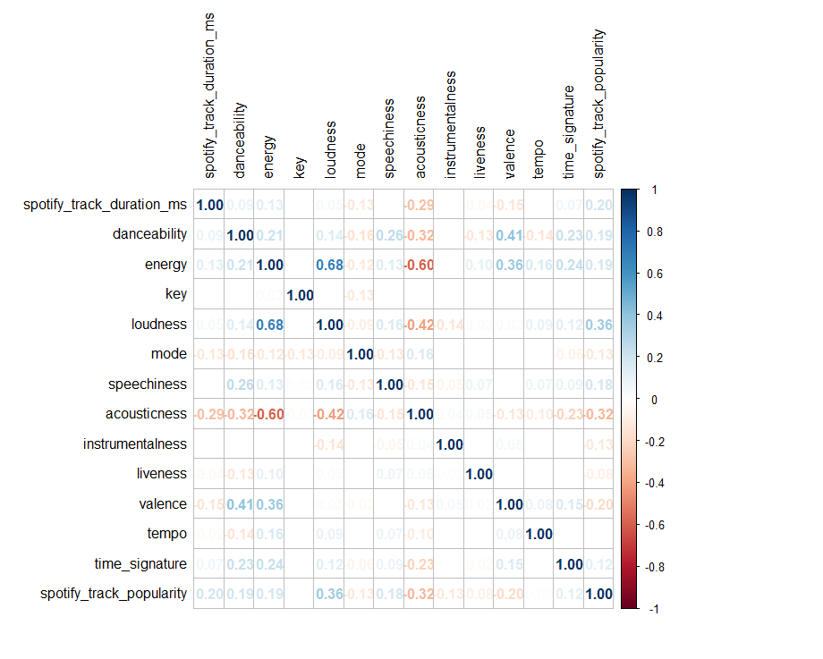
“Heatmaps” - corrplot

Slide 16
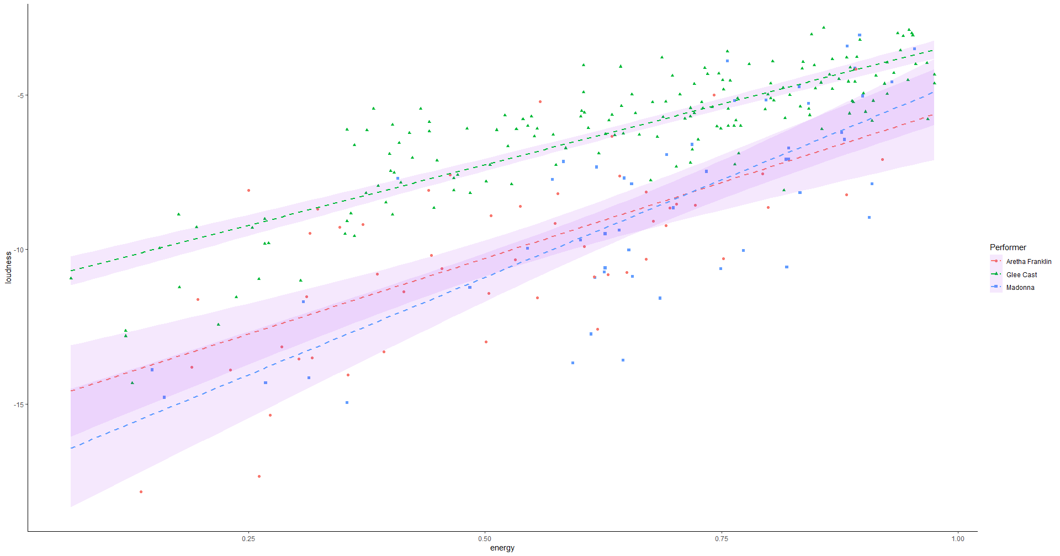
ggplot2: Scatterplots and Fitted Curves

Slide 17
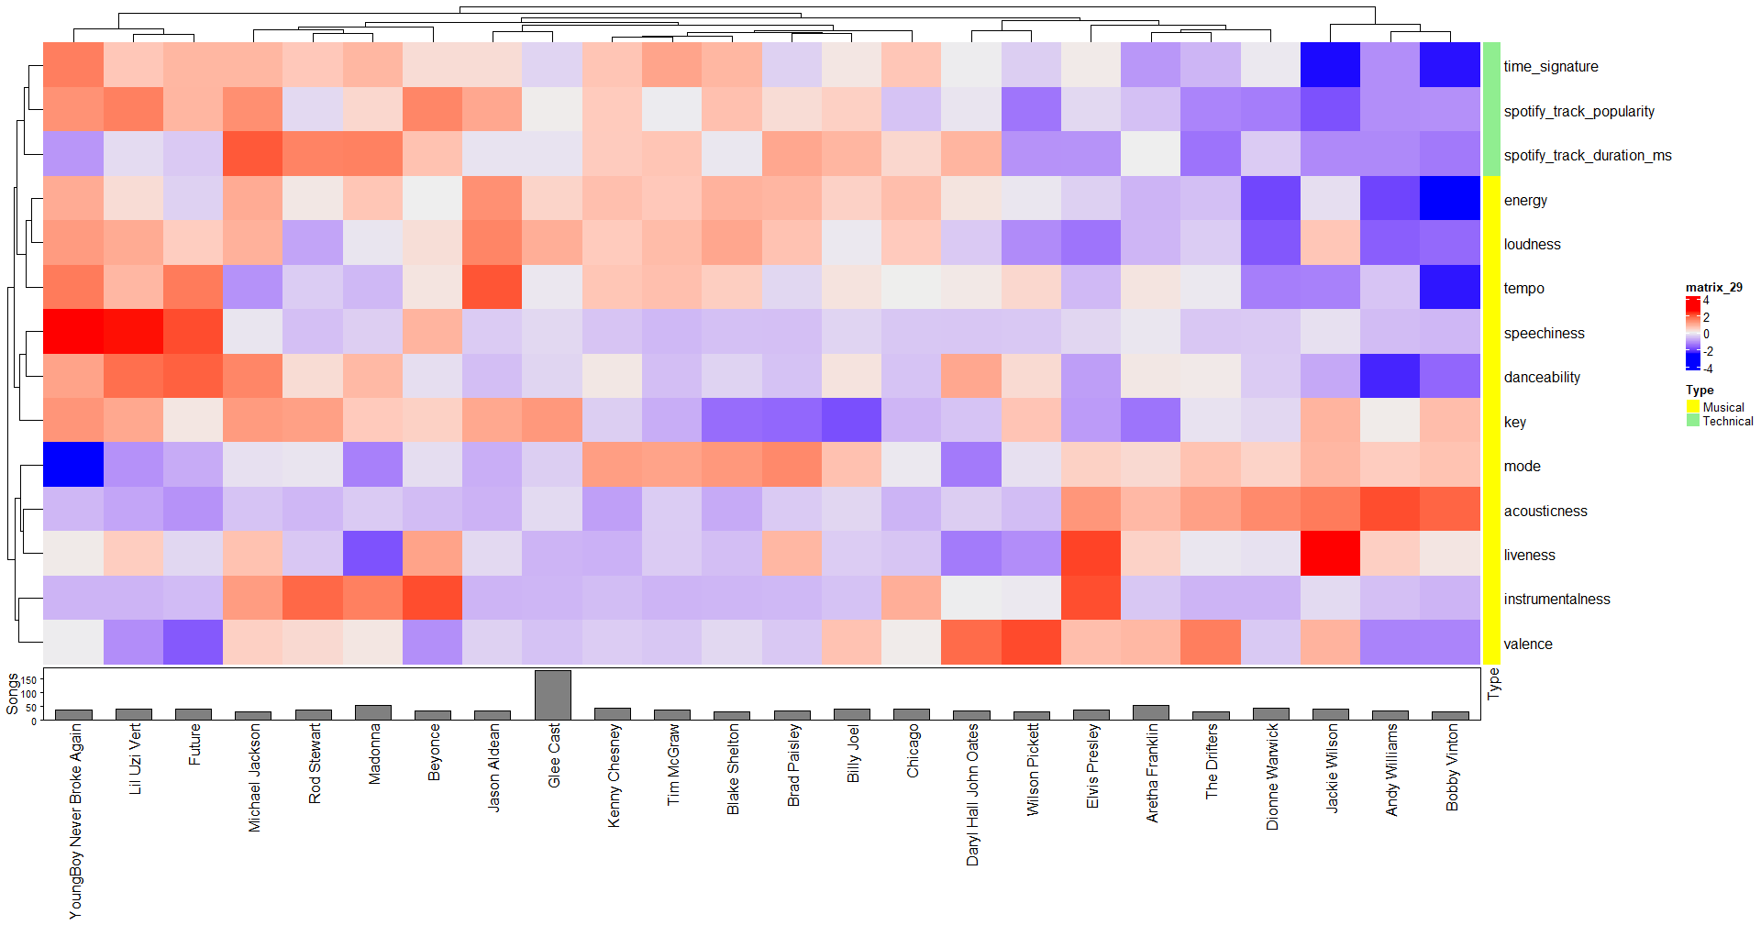
Heatmaps - ComplexHeatmap

Slide 18
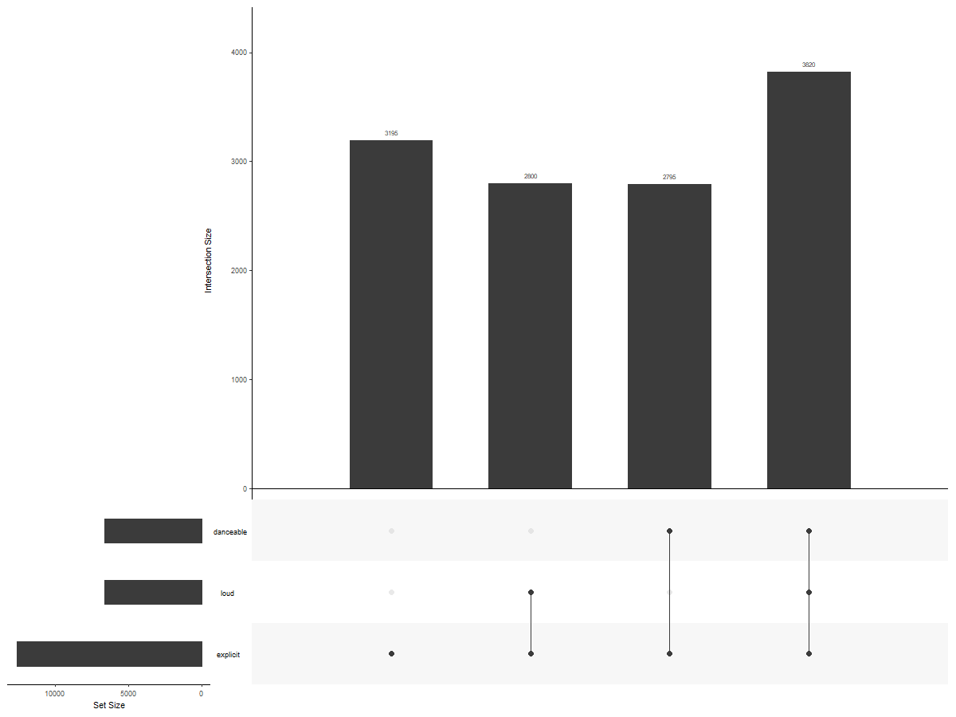
UpSet Plots for Overlaps

Slide 19
Saving plots: File formats
PNG or JPG
PDF
SVG
ggsave
Warning: Never try to save an R Workspace in which you have created a lot of plot objects!

Slide 20
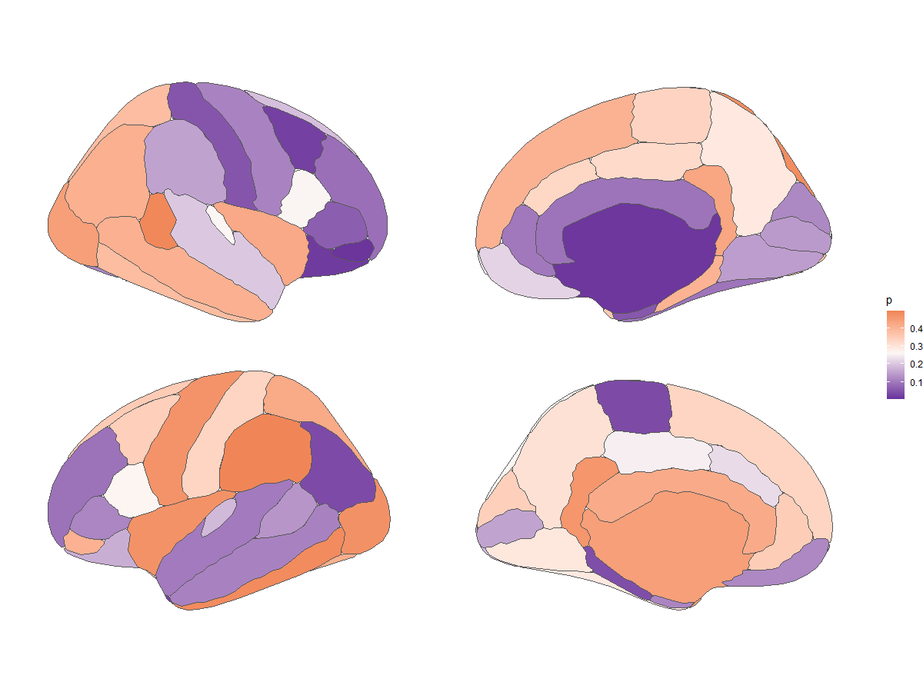
Visualizing Brain Imaging data

Slide 21
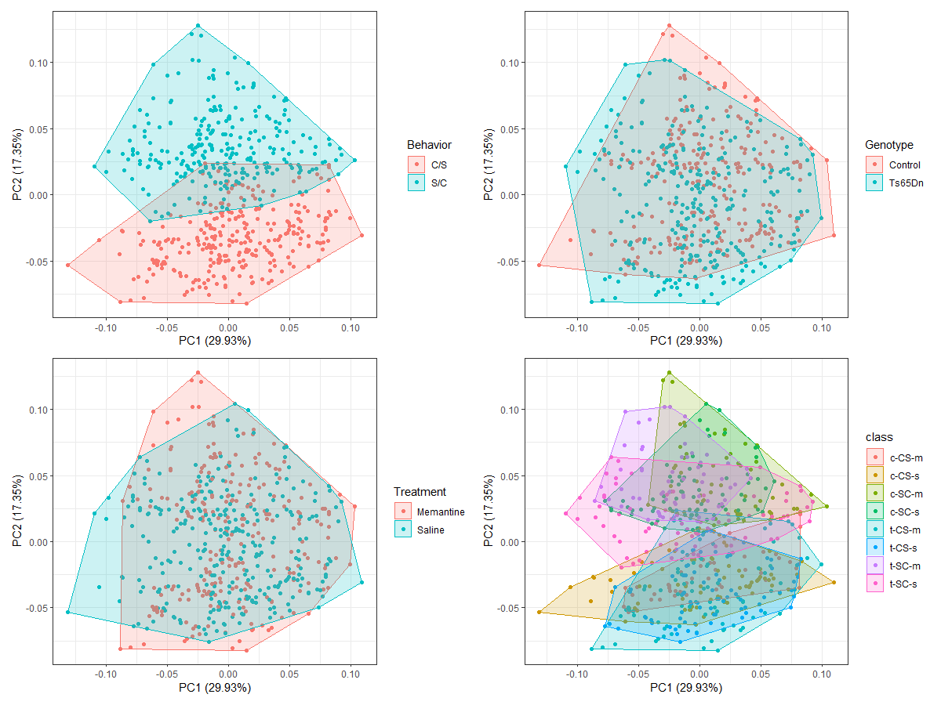
PCA visualization

Slide 22
How to do more with visualizations in R
Colowbrewer
Advanced visualization:
Igraph
Circlize
The R Graph gallery
R Charts
Interactive visualizations
Shiny apps
RMarkdown, Flexdashboard, Shinydashboard, etc.

Slide 23
Final Mission!
Let's make a whole panel of beautiful, publication ready visualizations!

