Slide 1
Bootcamp
Python for Data Science

Slide 2
Using APIS

Slide 3

API
Application Programming Interface
website for programs — no visuals

Slide 4
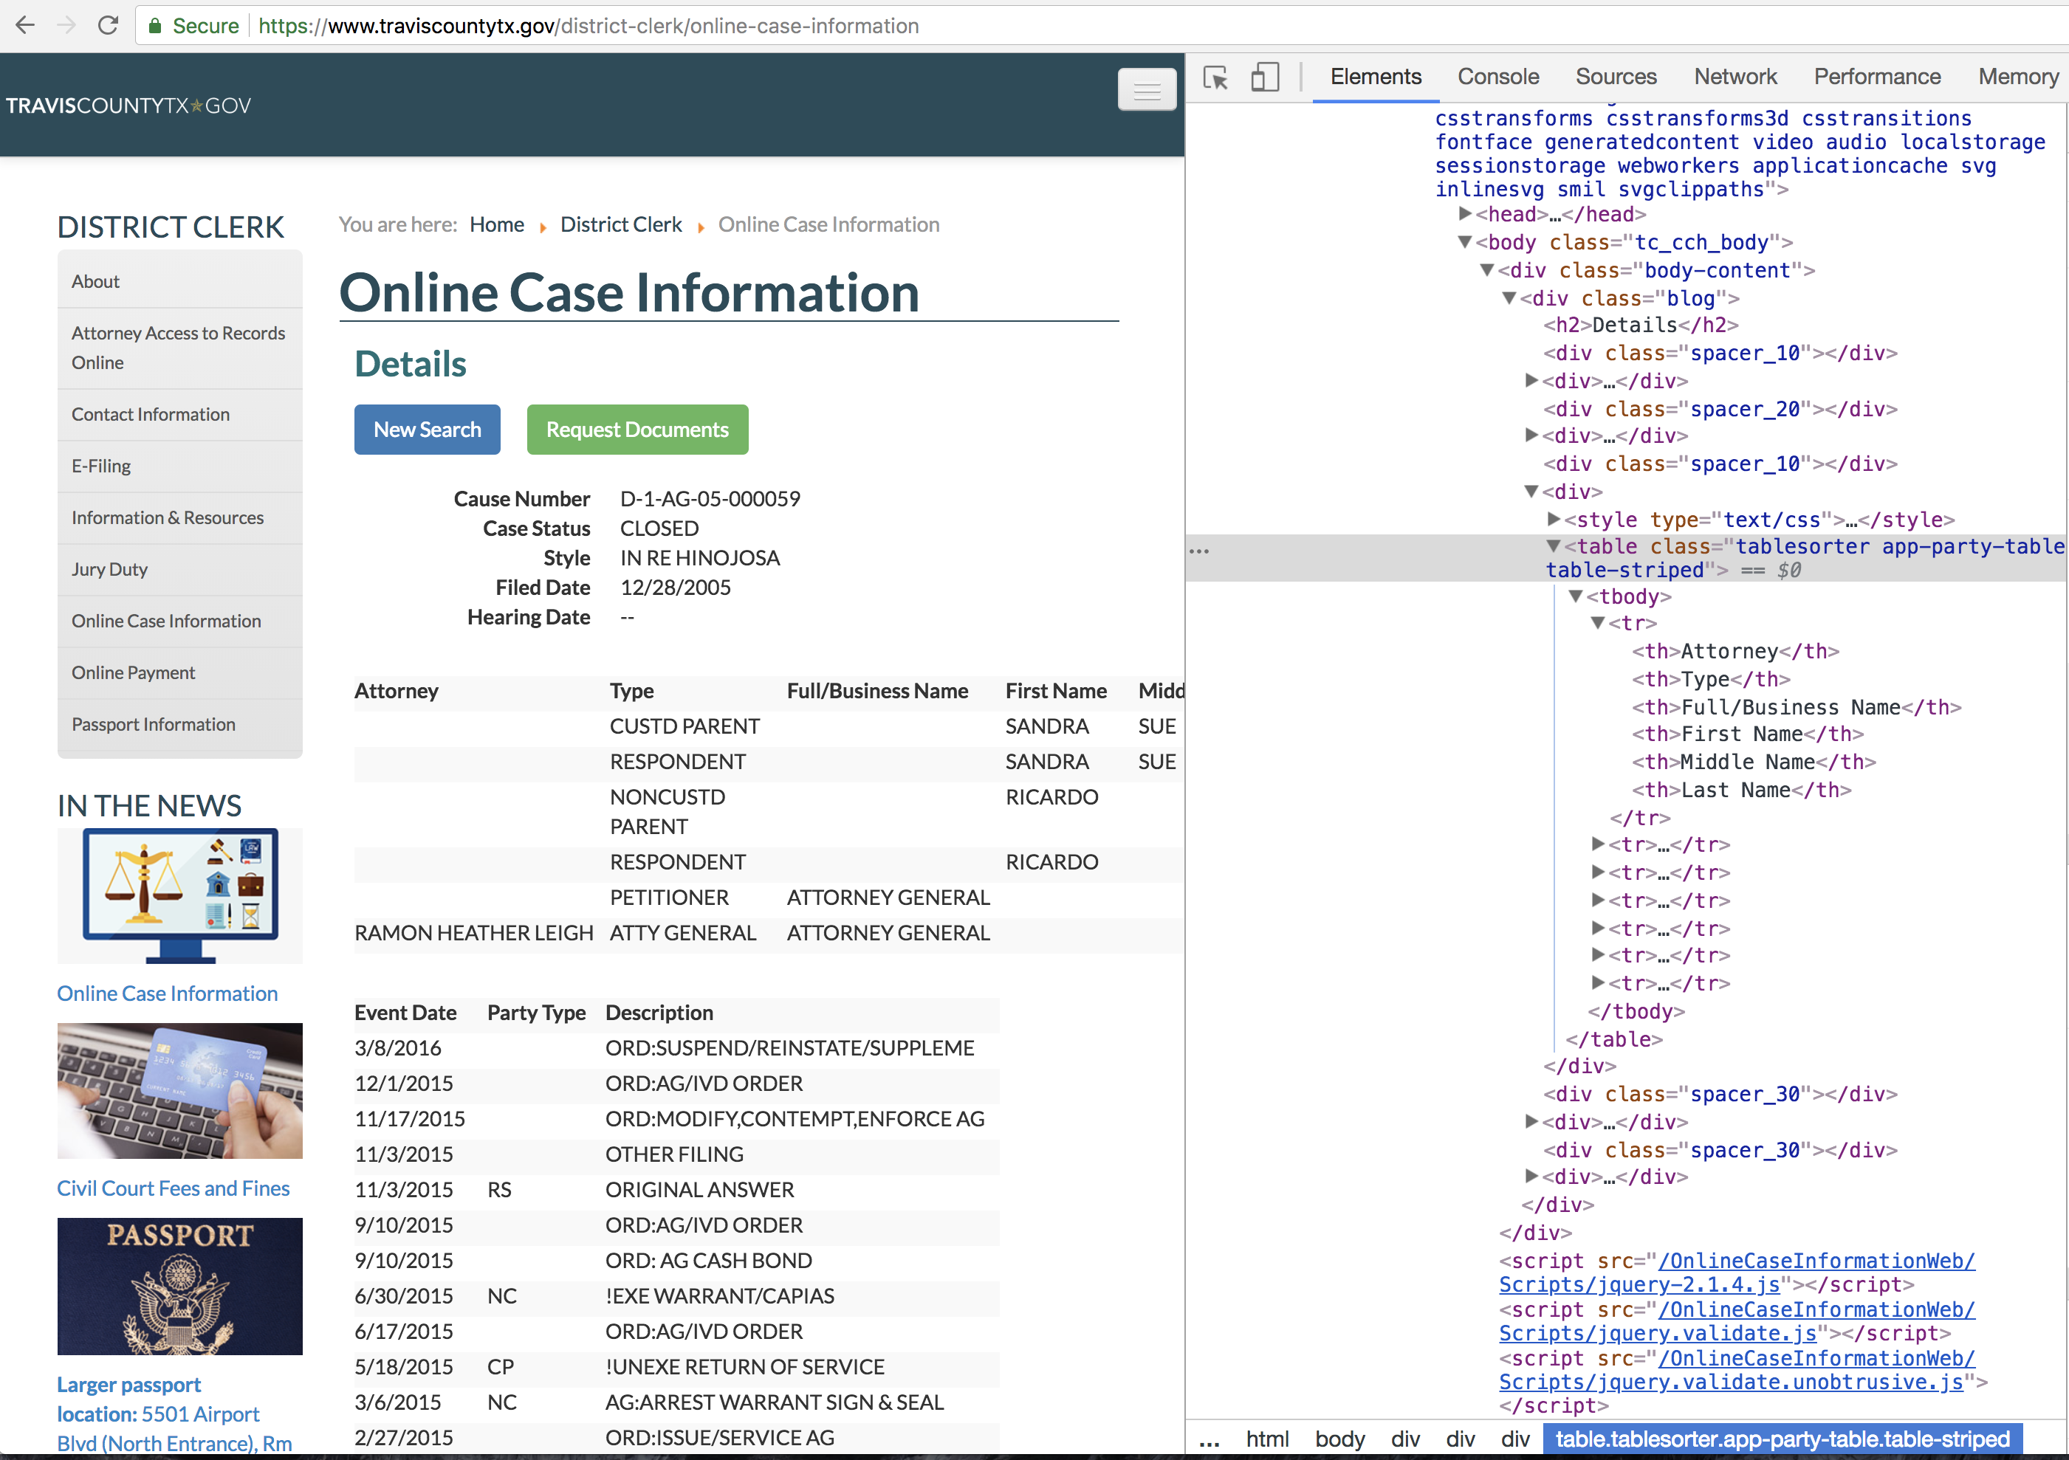

Slide 5

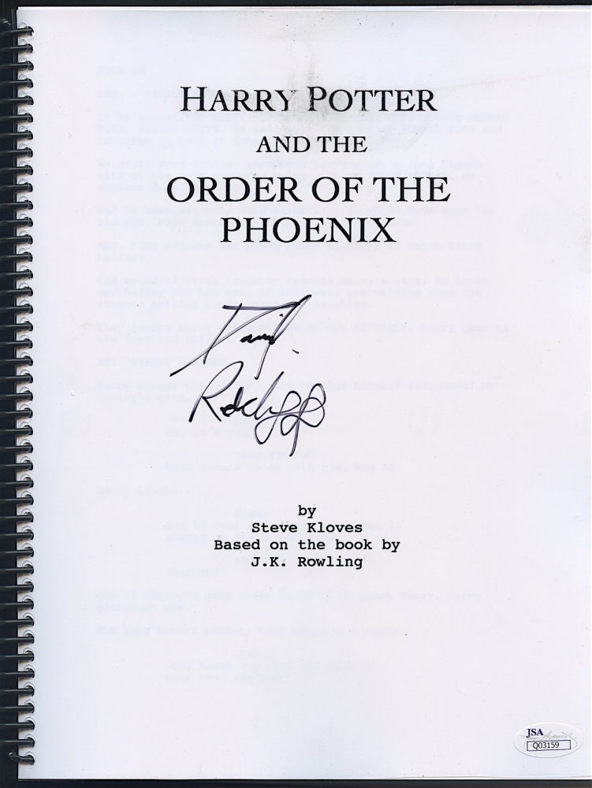
HTML

Slide 6
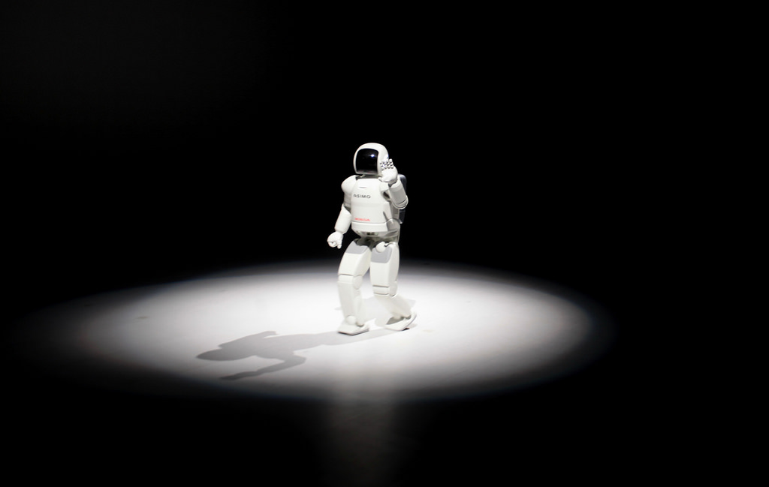
No thanks

Slide 7
Json (Javascript object notation)
Simple format for sending data
Turns into a Python dictionary!

Slide 8
Json
{
"name": “John Smith",
"address": {
"street": "21 2nd Street",
"city": "New York” }
}

Slide 9
API
Going to use IEXTrading.com
No account/password needed!

Slide 10
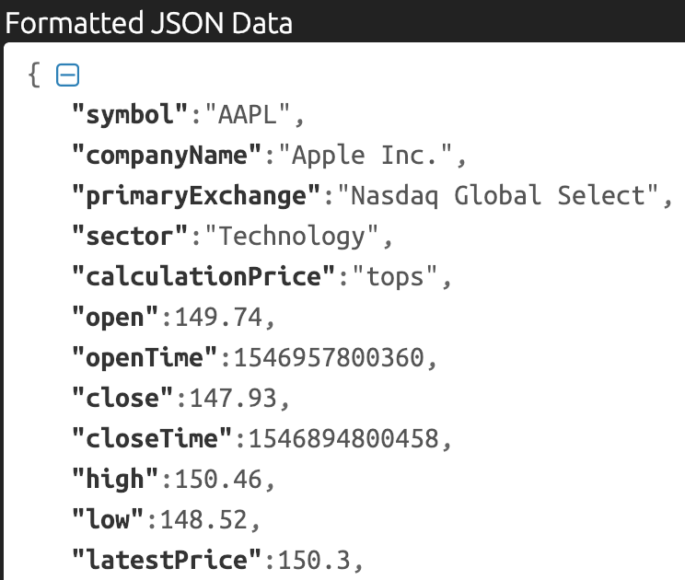

Slide 11
HTTP (Hypertext Transfer Protocol)
Each request has a verb like GET or POST
Data returned in body of response

Slide 12
Requests Package
Most popular Python package
Makes HTTP requests simple

Slide 13
Using Requests
import requests
url = “https://api.kanye.rest/"
response = requests.get(url)
response.text

Slide 14
Using Requests
import requests
url = “https://api.kanye.rest/"
response = requests.get(url)
response.text
body of response

Slide 15
Using Requests
data = response.json()

Slide 16
Using Requests
data = response.json()
{“date":"2019-03-05",
“high":176,
"low":174.54,
"volume":19737419}

Slide 17
Concepts covered so Far
API
JSON
Requests
HTTP/HTTPS

Slide 18
Exercises

Slide 19
Importing time series data
pd.read_csv(‘path.csv',
parse_dates=[‘Date'],
index_col='Date')

Slide 20
Dataframe from dicts
pd.DataFrame.from_dict(dict_list)
Dicts must all have same keys!

Slide 21
Partial string indexing
Pandas translates string to date
Order is: Year - Month - Day

Slide 22
Partial string indexing
df[‘2017’]

Slide 23
Partial string indexing
df[‘2017-02’]

Slide 24
Partial string indexing
df[‘2017-02-01’]

Slide 25
Basic Statistics
df.describe()

Slide 26
.Describe()
Finds all numeric columns
Gives max, min, var, std, etc

Slide 27
Correlation
df.corr()

Slide 28
Correlation

Slide 29
Dataframe from dicts
pd.DataFrame.from_dict(dict_list)

Slide 30
Combining Data

Slide 31
Basic plotting
requires: %matplotlib inline
Index as X-axis, columns as Y-axis

Slide 32
Plotting
df.plot()

Slide 34
Matplotlib
Intro to Data Visualization with

Slide 35
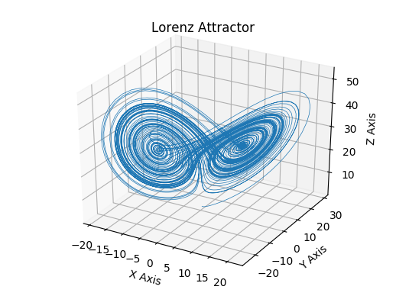

Slide 36
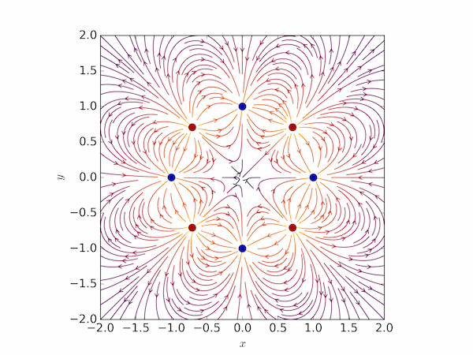

Slide 37
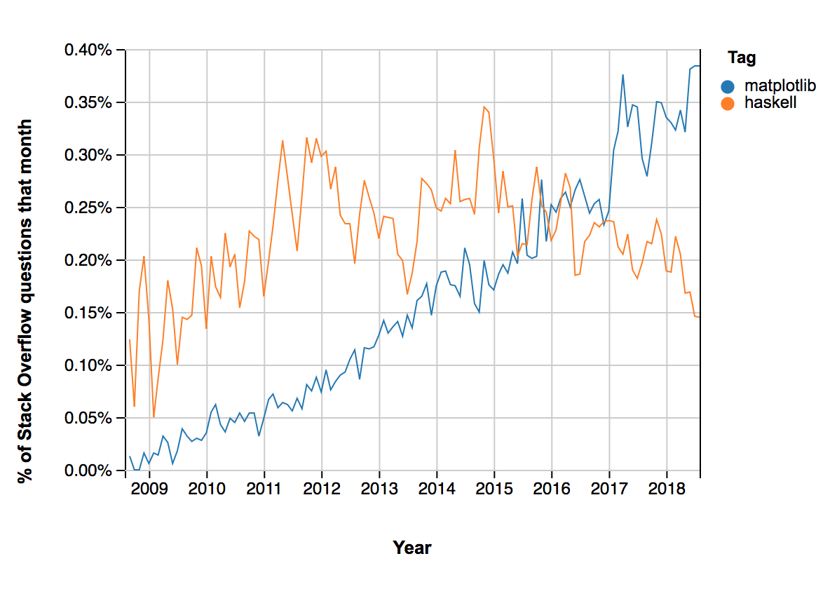

Slide 38
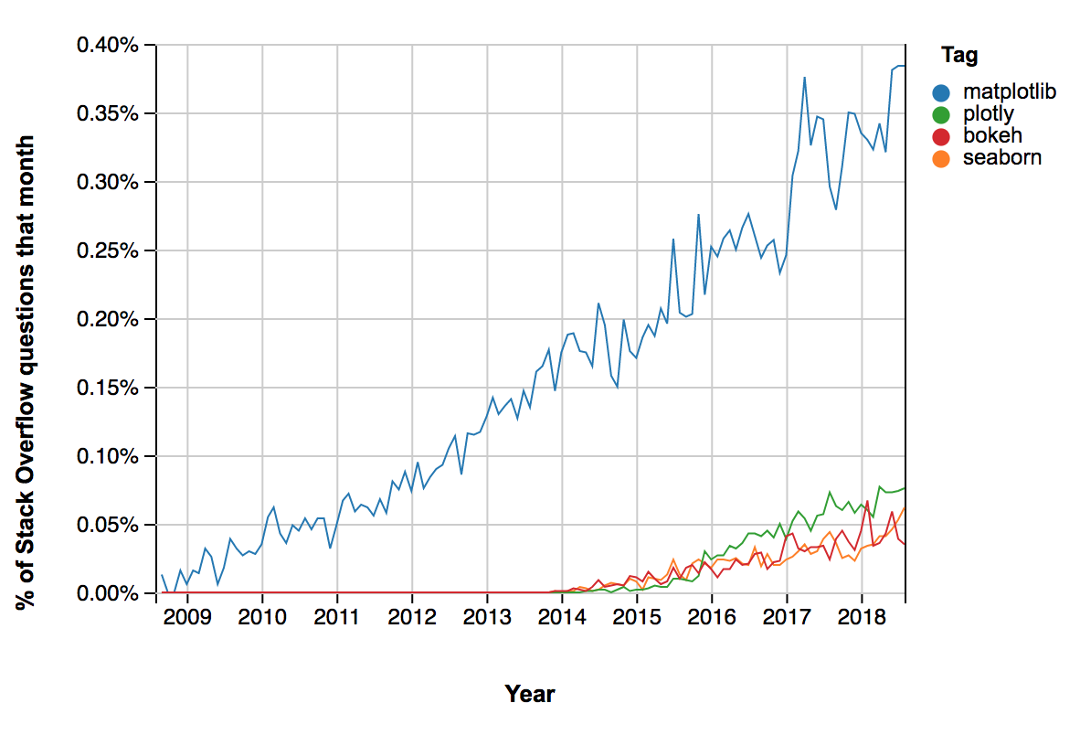

Slide 39
Goal for Today’s lesson

Slide 40
Graphs
Bar charts
Scatter plots
Histograms

Slide 41
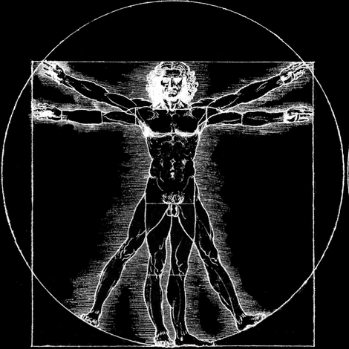
Anatomy of a Graph

Slide 42
The importance of terminology
Foundation
Precise terminology now —> less confusion later
Autonomy
Ability to search documentation or google

Slide 43
Painfully obvious
Vs
Utterly Bizarre

Slide 44
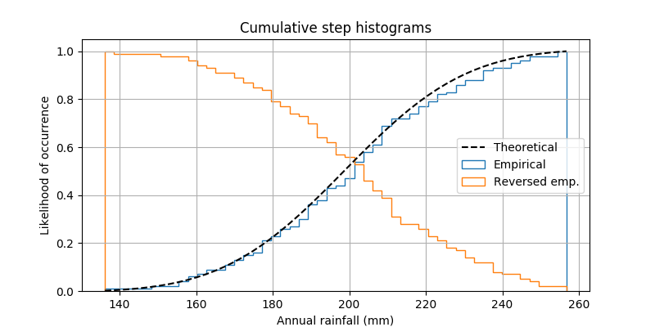
Painfully obvious
Title
Axis
Label
Legend
Grid
Bound

Slide 45
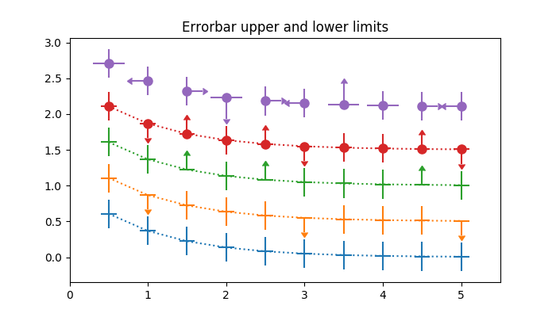
Utterly Bizarre
Pyplot
Figure
Axes
Line
Marker
Facecolor

Slide 46
matplotlib.Pyplot
Imported as plt
Stores global state
Use for setting global style

Slide 47
matplotlib.Pyplot
plt.style.use('seaborn')

Slide 48
matplotlib.Pyplot
plt.gcf()

Slide 49
matplotlib.Pyplot
plt.gcf()
“Grab current figure”

Slide 50
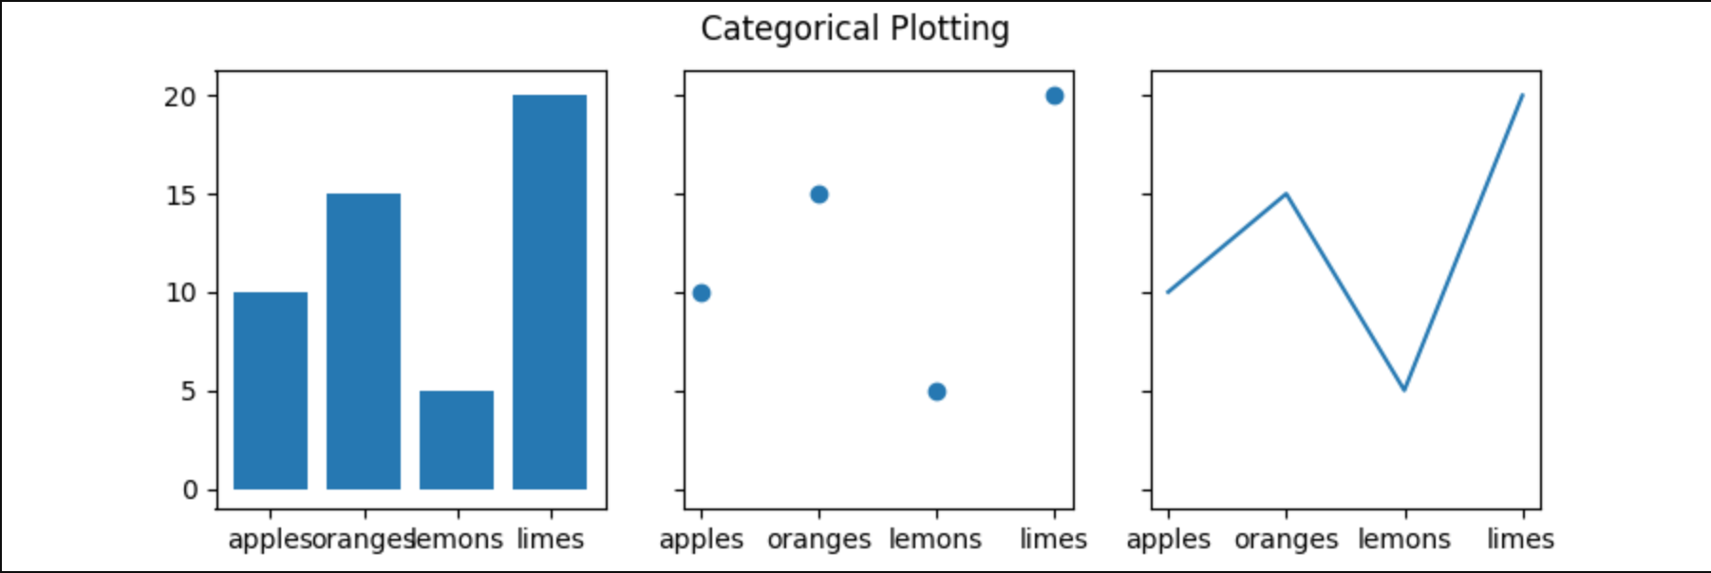
Figure
The entire image output by your code
matplotlib.figure.Figure

Slide 51
Figure
Set overall graph size
Store graph while modifying it
Save graph to disk

Slide 52
Axes
One particular graph within a figure
matplotlib.axes.Axes

Slide 53
Axes
Add title for graph
Change labels or ticks
Change background color/grid

Slide 54
Concepts covered so Far
PyPlot
Figure
Axes
Bar Chart

Slide 55
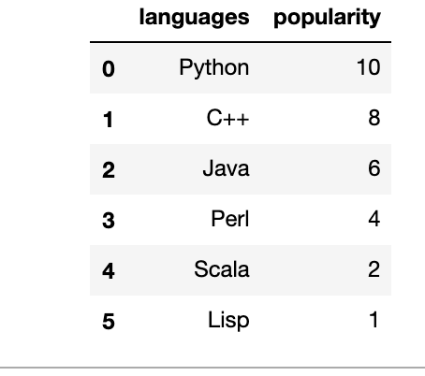

Slide 56
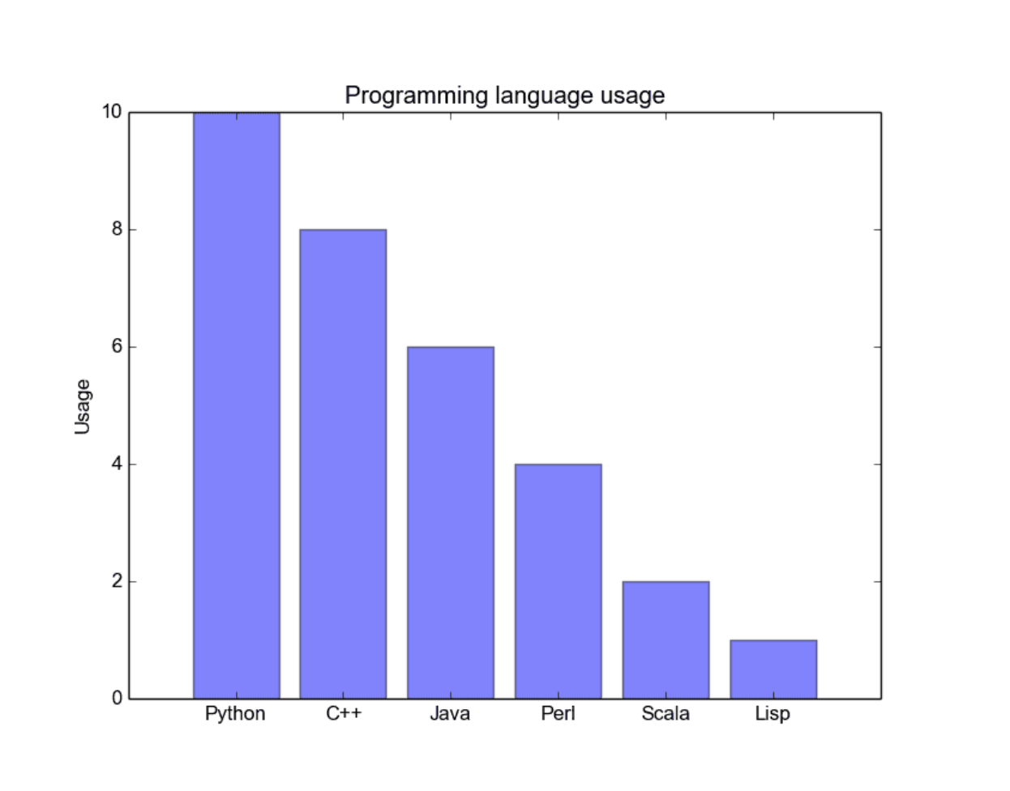
Text

Slide 57
Exercises

Slide 58
Utterly Bizarre
Pyplot
Figure
Axes
Line
Marker
Facecolor

Slide 59
Line
Unlike in math, this can be any curve
matplotlib.lines

Slide 60
Marker
Dot or other symbol centered on a specific point
matplotlib.markers

Slide 61
faceColor
Background color to the data
matplotlib.axes.Axes

Slide 62
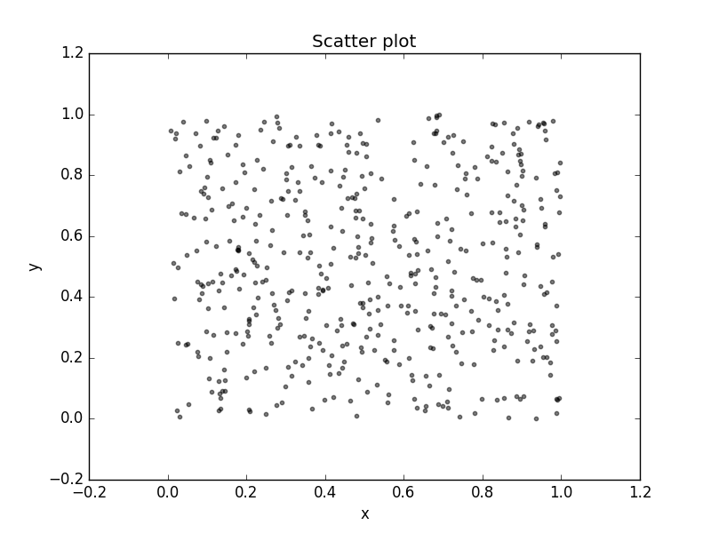

Slide 63
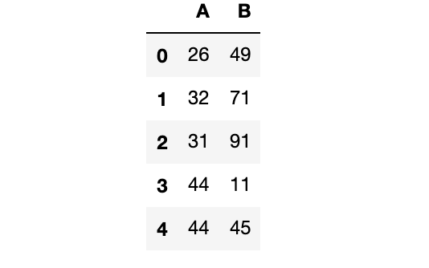
Text

Slide 64
Exercises

Slide 65
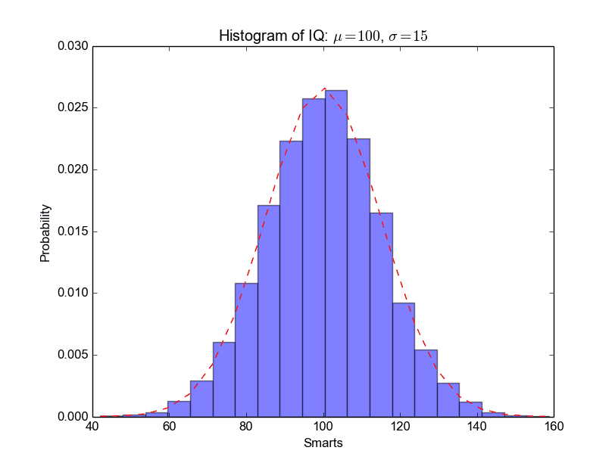

Slide 66
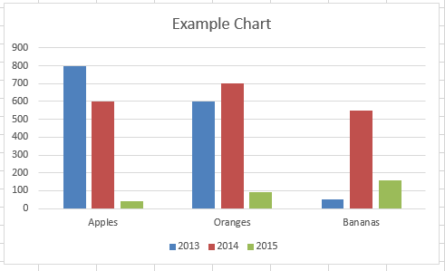
Text

Slide 67
Text

Slide 68
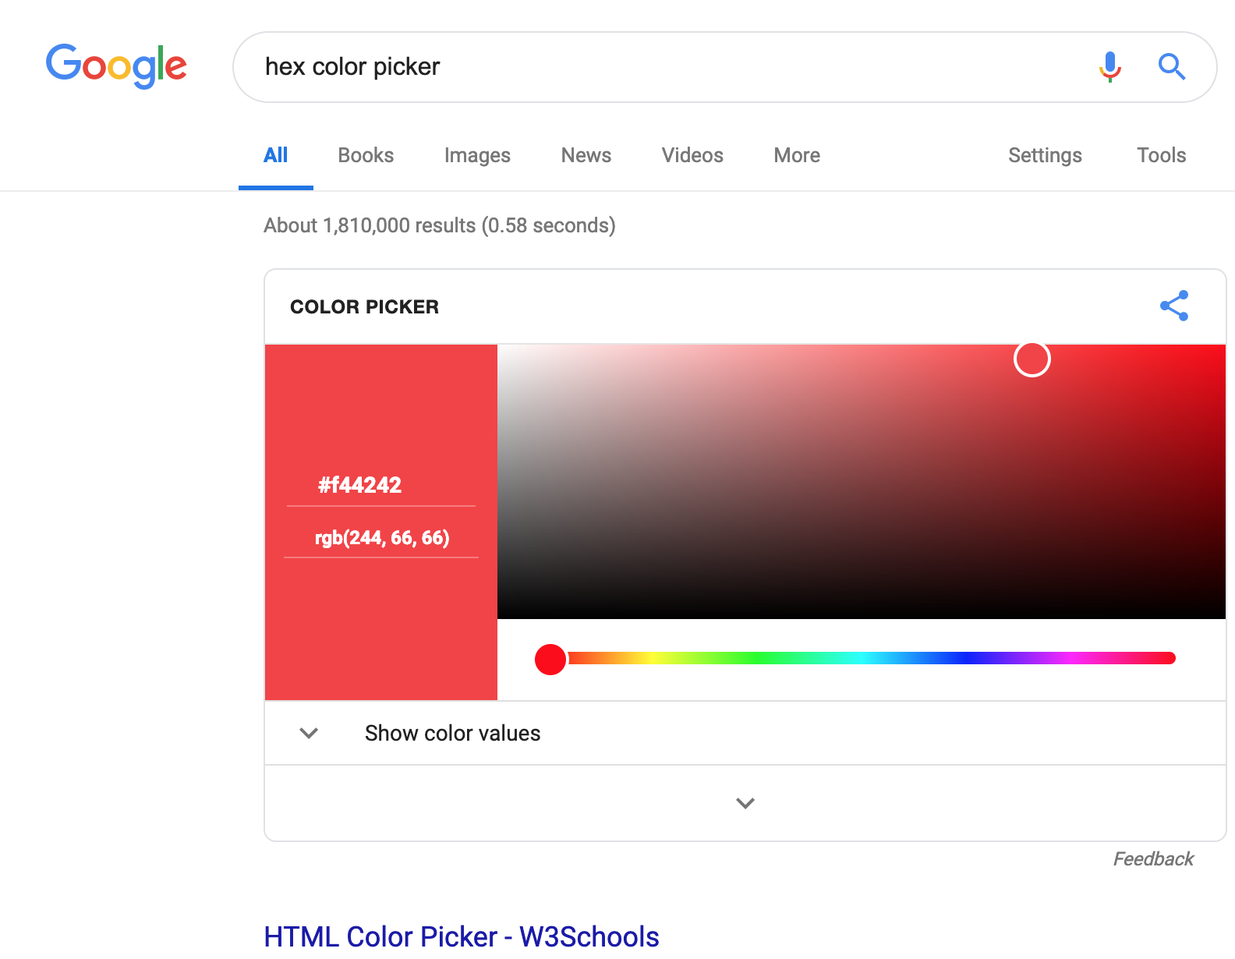
Text

