Slide 1
Bootcamp
Python for Data Science

Slide 2
Review

Slide 3

Group By
Buckets rows by column value
Combines buckets using a ufunc

Slide 5
Pivot table
Similar to groupby
Segments data along multiple axes

Slide 6
matplotlib.Pyplot
Imported as plt
Stores global state
Use for setting global style

Slide 7
matplotlib.Pyplot
from matplotlib import pyplot as plt

Slide 8
matplotlib.Pyplot
plt.style.use('seaborn')

Slide 9
Plotting with Matplotlib
ax = my_df.plot(kind='bar')
fig = plt.gcf()

Slide 10
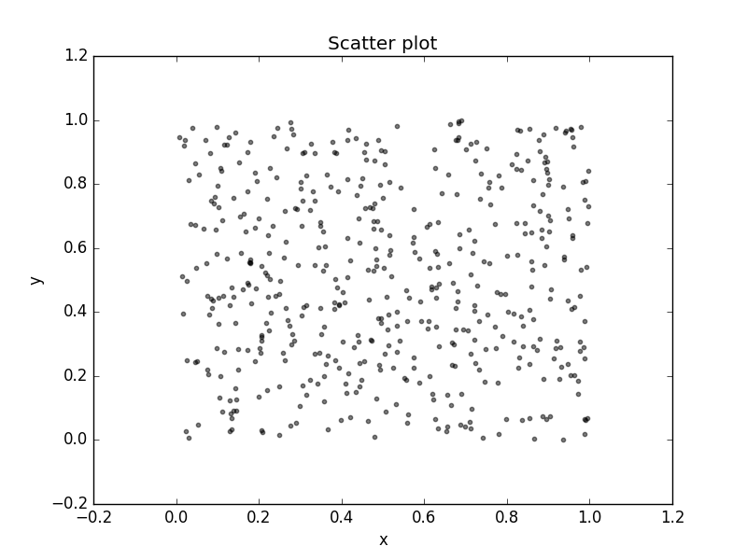

Slide 11
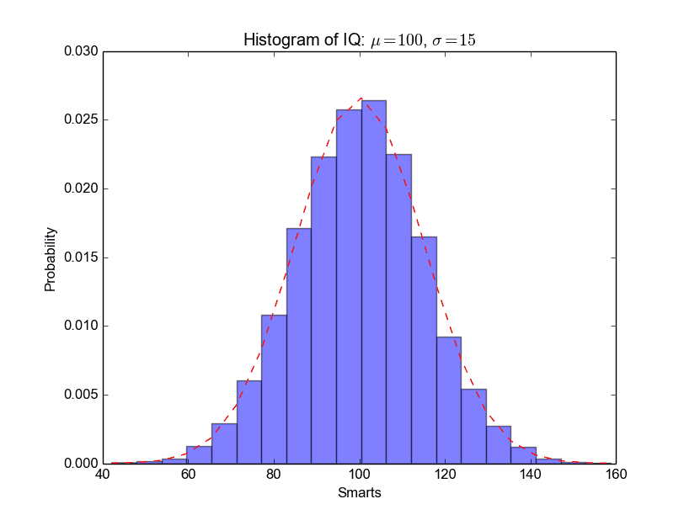

Slide 12
Exercises

Slide 13
Sci-Kit Learn
All-in-one machine learning package
Built on Numpy and matplotlib

Slide 14

Text

Slide 15
Imported as sklearn
import sklearn

Slide 16
Imported as sklearn
from sklearn.linear_model \
import LinearRegression

Slide 17
Linear Regression

Slide 18
Code is not the hard part
model = LinearRegression()
model.fit(data_df, target)

Slide 19
Code is not the hard part
model.predict(new_df)

Slide 20
Code is not the hard part
model.predict(new_df)
target estimate

Slide 21
Linear Regression
Outputs line of best fit
“Best fit” is a function of error

Slide 22
single-variable
y = 2x + 1

Slide 23
single-variable
y = 2x + 1
coefficient AKA slope

Slide 24
single-variable
y = 2x + 1
intercept

Slide 25
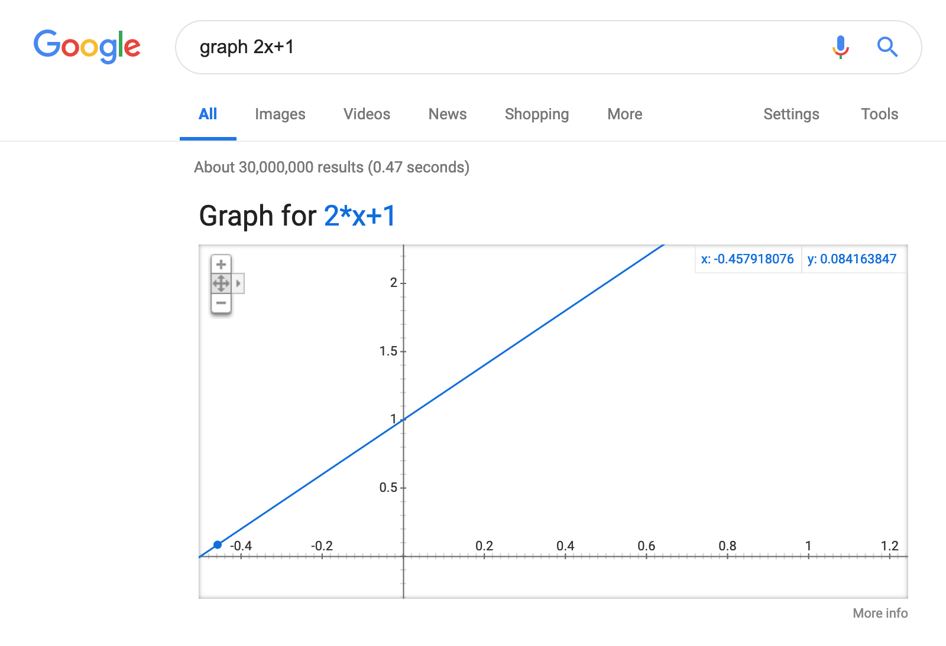
Text

Slide 26
single-variable
y = 2x + 1
1 —> 3
2 —> 5
3 —> 7

Slide 27
Python Equivalent
model = LinearRegression()
model.coef_ = np.array([2.0])
model.intercept_ = 1.0

Slide 28
single-variable
y = model.predict(x)
1 —> 3
2 —> 5
3 —> 7

Slide 29
single-variable Linear models
No magic!
2 dials: coefficient and intercept

Slide 30
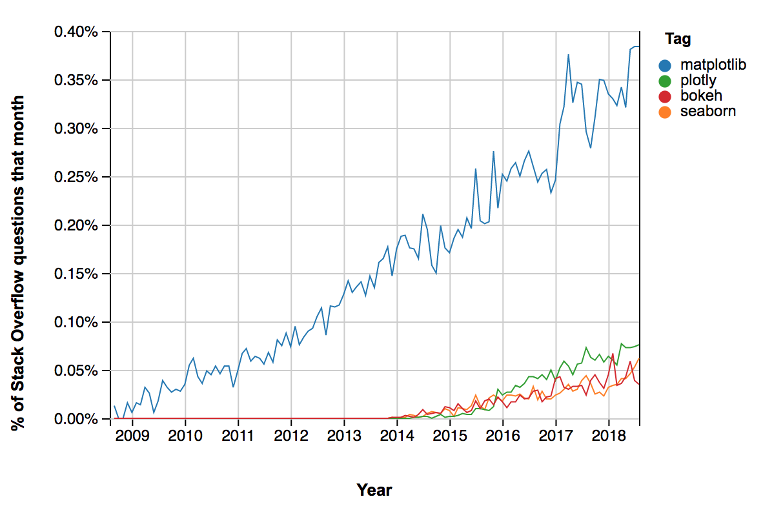
Scatter and Line Plots

Slide 31
Overlaying graphs
axes = df.plot(kind=‘scatter’,
x='avg_num_rooms', y='median_price', color='black')

Slide 32
Overlaying graphs
axes = df.plot(kind=‘scatter’,
x='avg_num_rooms', y='median_price')

Slide 33
Overlaying graphs
axes = data.plot(kind=‘scatter’,
x='avg_num_rooms', y='median_price')
df.plot(
x='avg_num_rooms', y=‘predicted_price’
ax = axes)

Slide 34
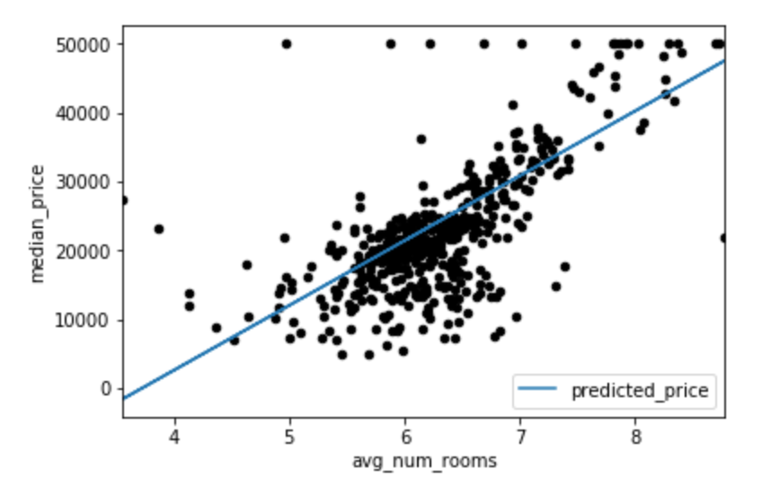

Slide 35
Exercises

Slide 36
Why Least squares?
Math is much simpler
Maximum likelihood estimator, when data is normal

Slide 37
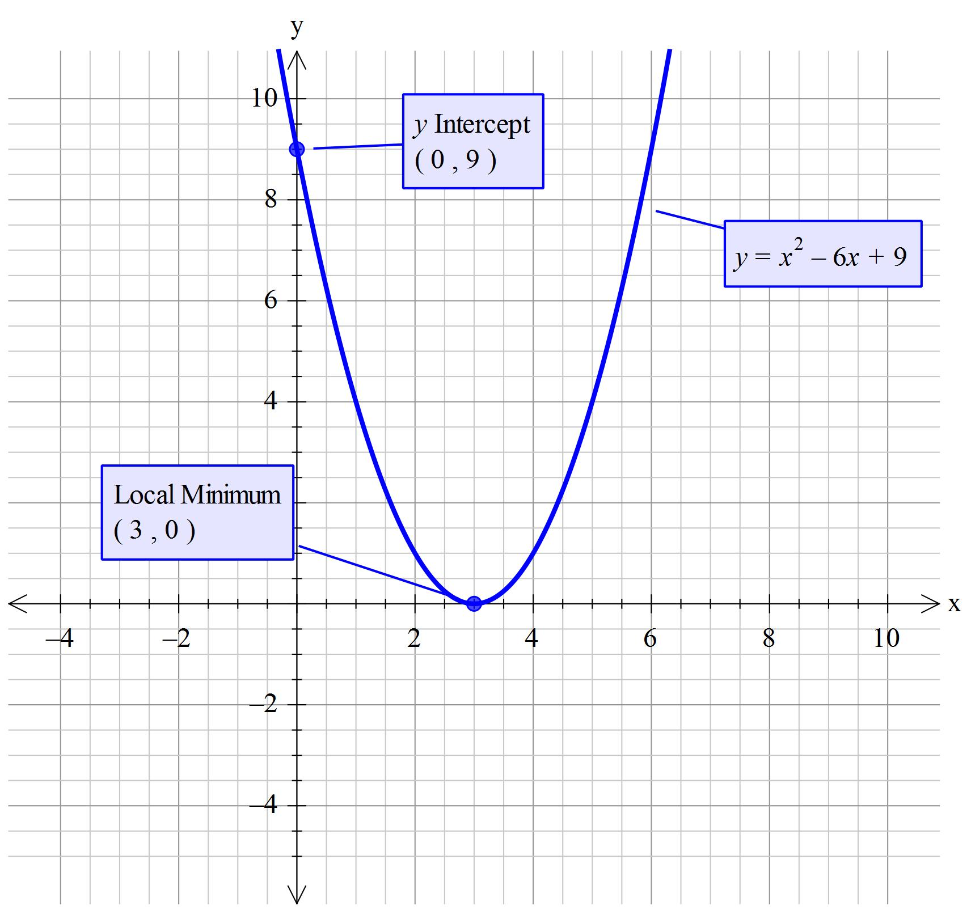
Text

Slide 38
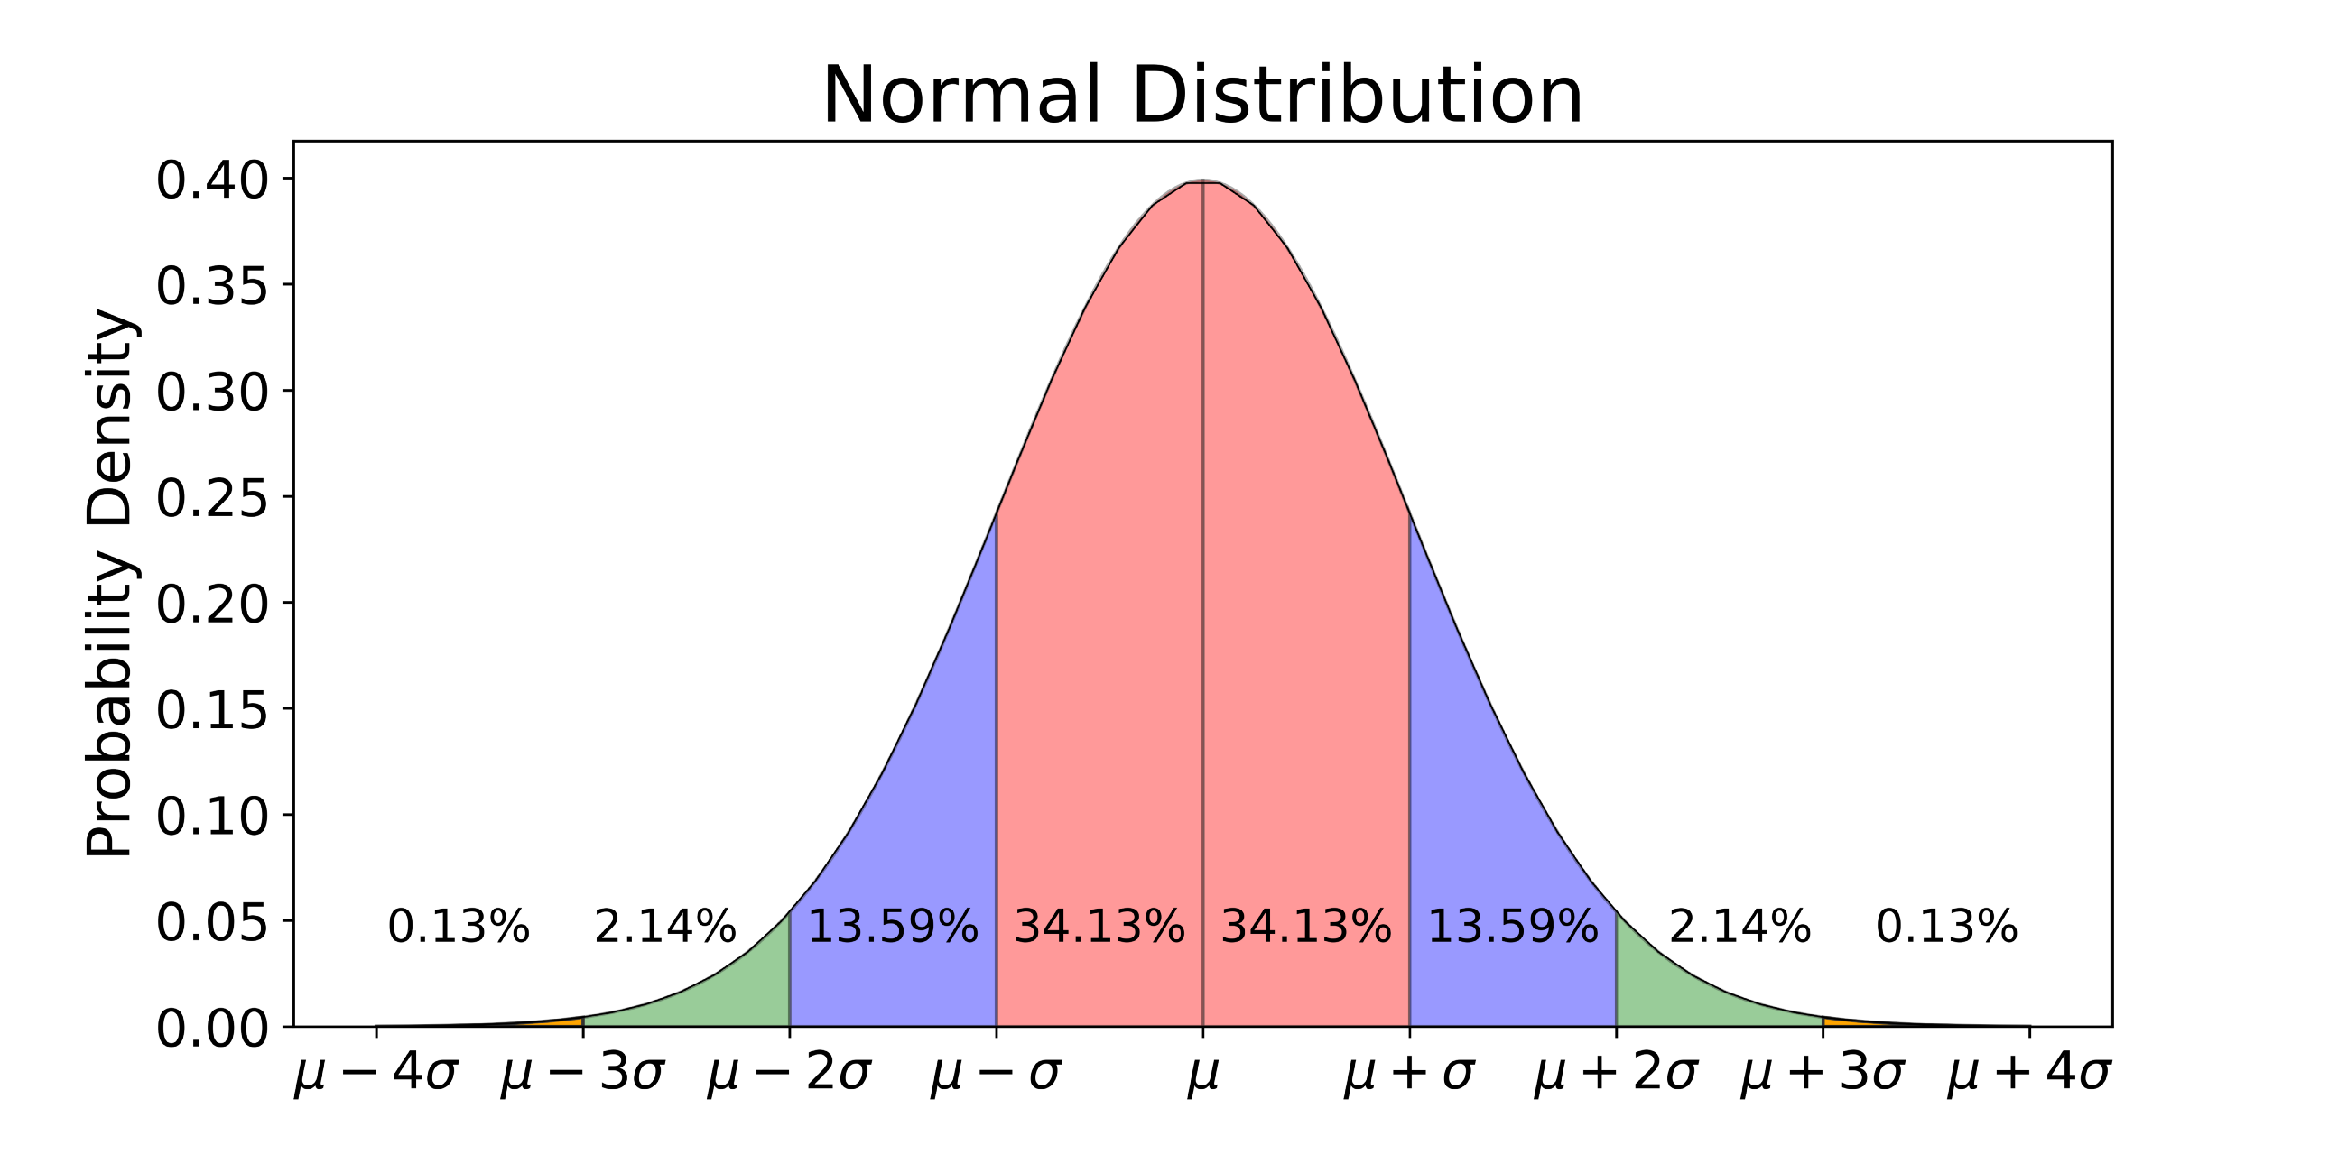

Slide 39
Multi-variable
y = 2x0 + 3x1 + 1

Slide 40
Mean Squared Error
Squared error just like least squares, but average vs total

Slide 41
Mean Squared Error
Squared error just like least squares, but average vs total
Scale is relative to your data!

Slide 42
R2 Score
Proportion of variance that is explained by your model
1.0 is a perfect model

Slide 43
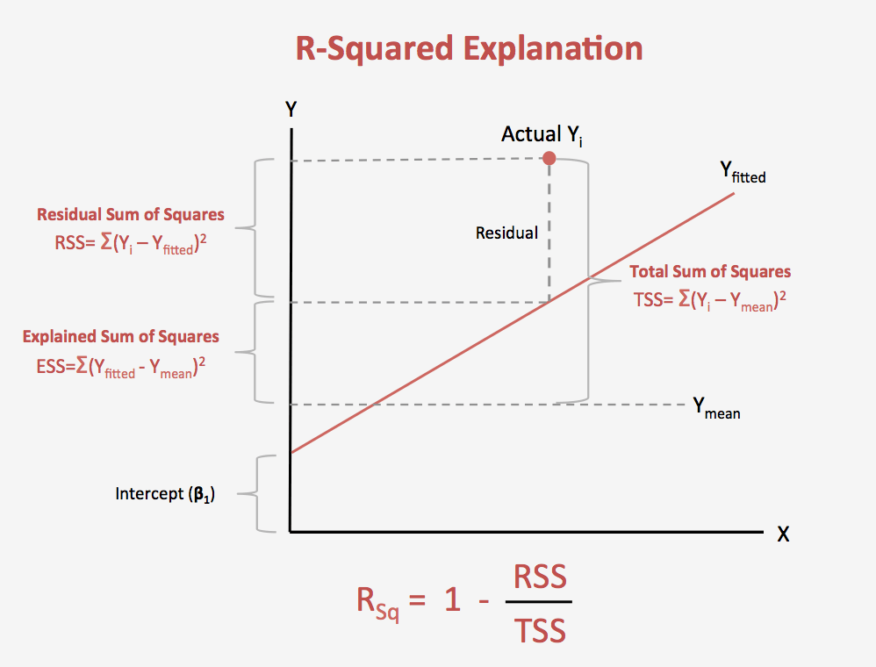
Text

Slide 44
R2 Score
Adding data will always “improve” R2 score even if the data is irrelevant
Only add data with significant R2 boost

Slide 45
Interpreting Linear models
model.coef_

Slide 46
Interpreting Linear models
model.coef_
[-1.840,4.24, …, -9.96])

Slide 47
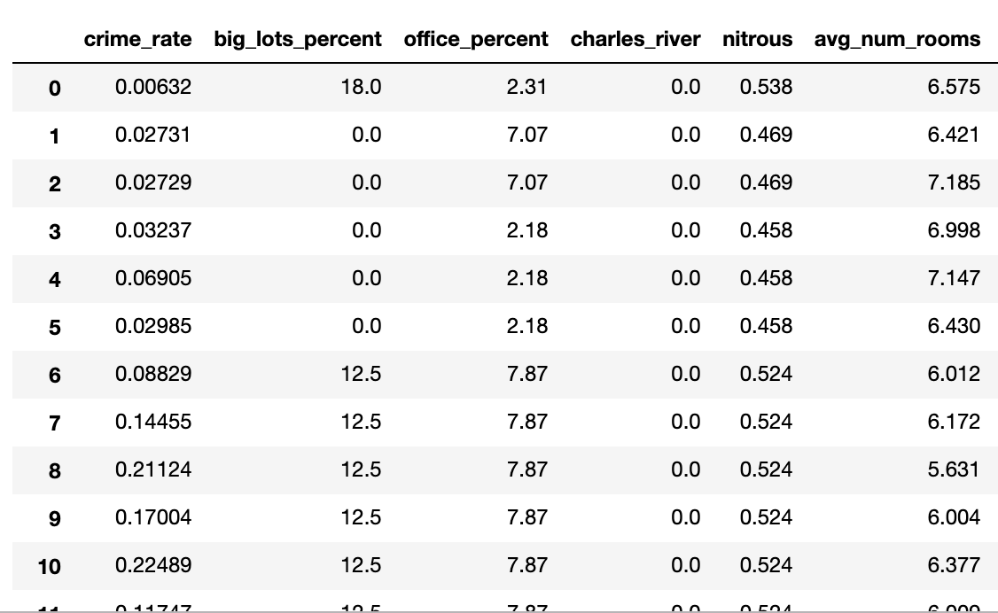
Interpreting Linear models
model.coef_
[-1.840,4.24, …, -9.96])

Slide 48
Exercises

