Slide 1
Bootcamp
Python for Data Science

Slide 2
Review

Slide 3

Lists and slicing

Slide 4
Fetching from an index
my_list[0]

Slide 5
Fetching from an index
my_list[0]
“first element”

Slide 6
Assigning to an index
my_list[0] = “new thing”

Slide 7
Append
my_list.append(“new thing”)
_______

Slide 8
Slice: step
[start_index:end_index:step]

Slide 9
Slice: step
my_list[::-1]
reverse list

Slide 10
Split
“id, name, date”.split(“,”)
[“id”, “name”, “date”]

Slide 11
Functions and methods

Slide 12
Function vs method
Input between parentheses
print(“Rob”)
Main input before dot
“Rob”.replace(“R”,“B”)

Slide 13
Defining A Function
def double(my_name):
answer = my_name + my_name
return answer

Slide 14
Defining A Function
def double(my_name):
answer = my_name + my_name
return answer
arbitrary label for input

Slide 15
Calling A Function
double(“Rob”)

Slide 16
Defining A Function
def double(“Rob”):
answer = “Rob” + “Rob”
return answer

Slide 17
Exercises

Slide 18
Values: What kinds are there?
Int
Float
String
?

Slide 19
Equals
“this str” == “that str”

Slide 20
Booleans
100 > 0
“this str” == “that str”

Slide 21
Booleans
100 > 0
“this str” == “that str”
True
False

Slide 22
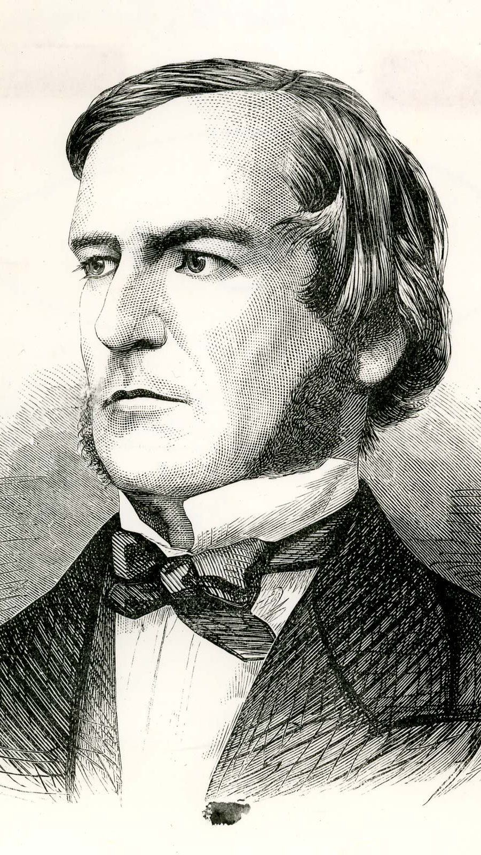
“universal laws of thought which are …mathematical as to their form”
George Boole

Slide 23
Boolean Operators?
True + False
True * False
True / True

Slide 24
Boolean Operators?
True + False
True * False
True / True

Slide 25
Boolean Operators
or
and
not

Slide 26
Boolean Operators
True or False
True and False
not True

Slide 27
Boolean Operators
True or False
True and False
not True
True

Slide 28
Boolean Operators
True or False
True and False
not True
True
False

Slide 29
Boolean Operators
True or False
True and False
not True
True
False
False

Slide 30
Values: What kinds ARE THERE?
Int
Float
String
Bool

Slide 31
Casting between Data types
int()
float()
str()
bool()

Slide 32
Concepts covered so Far
Boolean values (True/False)
Boolean operators (or, and, not)
Casting using bool()

Slide 33
Exercises

Slide 34
Concepts covered so Far
Boolean values (True/False)
Boolean operators (or, and, not)
Casting between data types

Slide 35
What’s missing?

Slide 36
Flow Diagram
Start
Finish

Slide 37


Slide 38

Conditional Statements
Directs route taken by program
Hinges on Boolean expressions

Slide 39
Examples of conditions
my_name == “Rob”
age > 21
name in list_of_guests

Slide 40
if Statement
if condition_is_true:
print(“extra code runs!”)

Slide 41
Flow Diagram
Extra!
Yes
Start
If
No
Finish

Slide 42
if-Else Statement
if condition_is_true:
print(“path #1 runs”)
else:
print(“path #2 runs”)

Slide 43
Flow Diagram
Path 1
Yes
Start
If
Finish
No
Path 2

Slide 44
if-elif-Else Statement
if condition_is_true:
print(“path #1 runs”)
elif second_condition_is_true:
print(“path #2 runs”)
else:
print(“path #3 runs”)

Slide 45
Flow Diagram

Slide 46
Flow Diagram

Slide 47
Conditional Statements
Directs route taken by program
Hinges on Boolean expressions

Slide 48
Exercises

