Slide 1
Bootcamp
Python for Data Science

Slide 2
open Source tools

Slide 3

Packages
Code designed for re-use
Must be installed before use

Slide 4
First Package: Numpy
Short for “numerical python”
Has array that is faster for math

Slide 5
Flexible is slow

Slide 6
Nothing comes for free
List & dictionary hold any value
Also grow to any length
Numbers have no fixed size

Slide 7
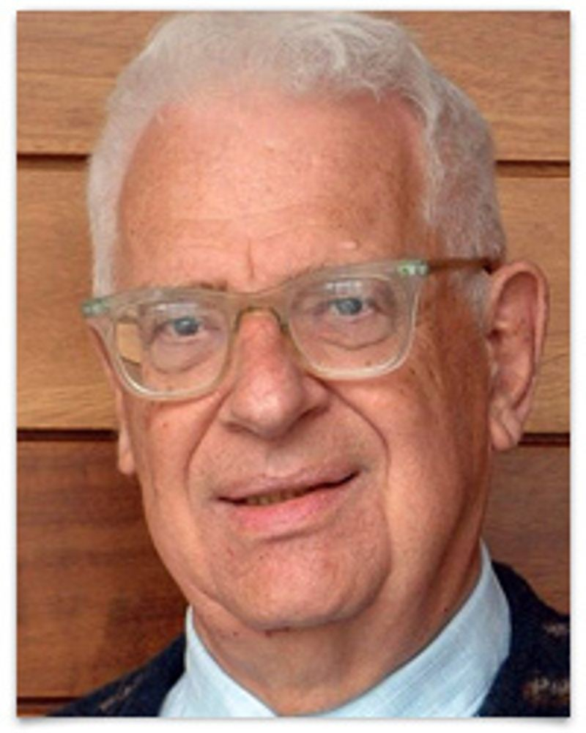
Every problem in computer science can be solved by another layer of indirection
- David Wheeler

Slide 8
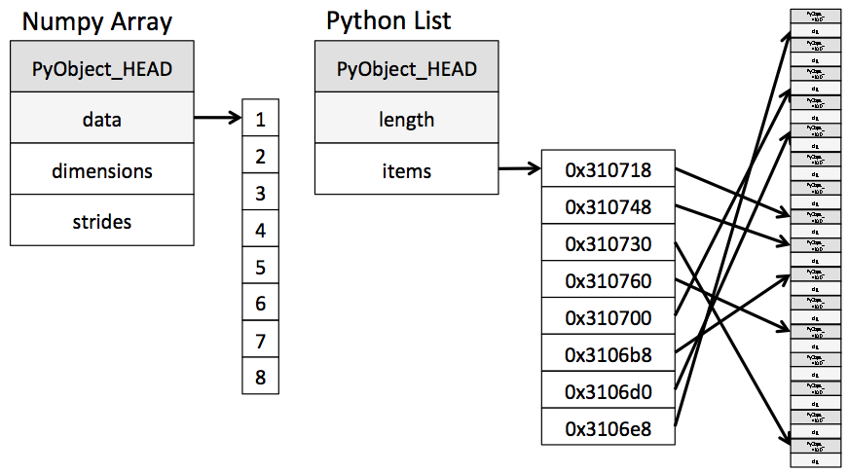

Slide 9
First Package: Numpy
Short for “numerical python”
Has array that is faster for math

Slide 10
importing numpy
import numpy
from numpy import array

Slide 11
importing numpy
import numpy as np

Slide 12
importing numpy
import numpy as np
alias

Slide 13
NDarray
short for “n-dimensional array”
one dimension will be enough

Slide 14
creating an array
np.array([1, 2, 3])

Slide 15
Concepts covered so Far
Package
Import statement
Numpy
Array

Slide 16
Exercises

Slide 17
creating an array
np.array([1, 2, 3])

Slide 18
Ufunc
short for “universal functions”
take arrays as input/output

Slide 20
ufunc
np.add (+)
np.multiply (*)
np.divide (/)
np.power (**)

Slide 21
Element-wise addition
np.array([1, 2]) + np.array([1, 2])

Slide 22
Element-wise addition
np.array([1, 2]) + np.array([1, 2])
array([2, 4])

Slide 23
Broadcasting
np.array([1, 2]) + 2

Slide 24
broaDcasting
np.array([1, 2]) + 2
array([3, 4])

Slide 25
broaDcasting
np.array([1, 2]) * 3

Slide 26
broaDcasting
np.array([1, 2]) * 3
array([3, 9])

Slide 27
Slices: View vs Copy
Slice on list creates a new copy
Slice on array creates a “view”

Slide 28
Slice as view
original = np.array([1, 2, 3])
new_one = original[:1]

Slide 29
Slice as view
original = np.array([1, 2, 3])
new_one = original[1:]
new_one[0] = 0

Slide 30
Slice as view
original = np.array([1, 2, 3])
new_one = original[1:]
new_one[0] = 0
original: [0, 2, 3]

Slide 31
solution
original = np.array([1, 2, 3])
new_one = original[1:].copy()
new_one[0] = 0

Slide 32
solution
original = np.array([1, 2, 3])
new_one = original[1:].copy()
new_one[0] = 0
original: [1, 2, 3]

Slide 33
Concepts covered so Far
Ufunc
Element-wise operations
Broadcasting
View vs Copy

Slide 34
Exercises

Slide 35
Boolean ufuncs
take arrays as input/output

Slide 36
Boolean ufunc
np.equal (==)
np.less (<)
np.greater (>)

Slide 37
Element-wise
np.array([1, 2]) == np.array([1, 2])

Slide 38
Element-wise
np.array([1, 2]) + np.array([1, 2])
array([True, True])

Slide 39
Broadcasting
np.array([1, 2]) < 2

Slide 40
broaDcasting
np.array([1, 2]) < 2
array([True, False])

Slide 41
broaDcasting
np.array([1, 2, 3]) == 3

Slide 42
broaDcasting
np.array([1, 2, 3]) == 3
array([False, False, True])

Slide 43
Boolean INdexing
my_array = np.array([1, 2, 3])
my_array[[True, False, True]]

Slide 44
Boolean INdexing
my_array = np.array([1, 2, 3])
my_array[[False, False, True]]
array([3])

Slide 45
Boolean INdexing
my_array = np.array([1, 2, 3])
my_array[[False, False, True]]
boolean mask

Slide 46
Boolean INdexing
my_array = np.array([1, 2, 3])
my_array[my_array > 2]
boolean mask

Slide 47
Boolean INdexing
my_array = np.array([1, 2, 3])
my_array[my_array > 2]
array([3])

Slide 48
Boolean INdexing
ones = (my_array == 1)
evens = (my_array % 2 == 0)

Slide 49
Boolean INdexing
my_array[ones | evens]

Slide 50
Boolean INdexing
my_array[ones | evens]
works like “or”

Slide 51
Boolean INdexing
my_array[ones & evens]

Slide 52
Boolean INdexing
my_array[ones & evens]
works like “and”

Slide 53
Concepts covered so Far
Boolean ufunc
Element-wise Boolean operations
Broadcasting Boolean operations
Boolean mask

Slide 54
Exercises

