Slide 1
Bootcamp
Python for Data Science

Slide 2
Pandas

Slide 3

Pandas
Short for “panel data”
DataFrame concept from R

Slide 4
importing Pandas
import pandas as pd

Slide 5
Dataframe
Similar to a spreadsheet
Columns are Numpy arrays with special index

Slide 6
creating a Dataframe
df = pd.read_csv(“path_to_file”)

Slide 7
Looking at top rows
new_df.head()

Slide 8
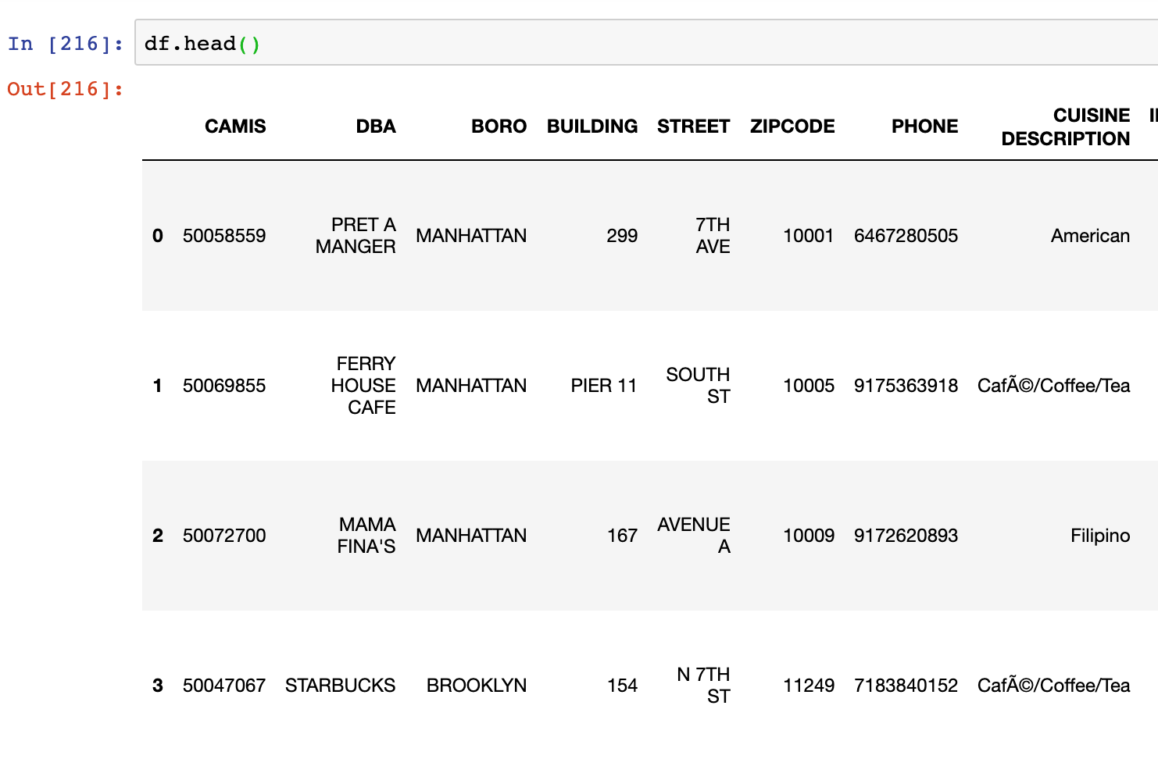
Text

Slide 9
Column AKA “Series”
Column values are Numpy arrays
Fancy index on top

Slide 10
Why?
Meaningful indices (cf. dictionary)
Auto-alignment

Slide 11

Trouble with Lists
Was it my_list[8] or my_list[9]?
Hard to manage lots of data

Slide 13
Series
Numpy array with fancy index
Can still use Boolean indexing!

Slide 14
Boolean indexing
df[df[“SCORE”] > 30]

Slide 15
Boolean indexing
df[(df[“ROI”]>30) & (df[“ROI”]<9)]

Slide 16
Boolean indexing
more_30 = df[“ROI”]>30
less_9 = df[“ROI”]<9
df[more_30 & less_9]

Slide 17
Counting Unique values
new_df[‘first_name’].value_counts()

Slide 18
Counting Unique values
new_df[‘first_name’].value_counts()
“John”: 352
“Chris”: 280
“Tom”: 264

Slide 19
Concepts covered so Far
Pandas
DataFrames
dtype
.head()
Boolean indexing

Slide 20
Exercises

Slide 21

Working with Columns

Slide 22
Checking Data Type
new_df.dtypes

Slide 23
Specifying Data Types
pd.read_csv(“path_to_file”,
dtype={“ZIP”: “str”})

Slide 24
Using Numpy functions
new_df[‘SCORE’].mean()

Slide 25
Creating a New Column
Similar to new dictionary key
Can use Numpy functions

Slide 26
Creating a new Column
df[‘profit’] =
df[‘revenue’] - df[‘expenses’]

Slide 27
Dataframe from columns
df[[‘revenue’, ‘profit’]]

Slide 28
Sorting by a column
df.sort_values(“revenue”)

Slide 29
Sorting in descending order
df.sort_values(“revenue”,
ascending=False)

Slide 30
Concepts covered so Far
dtypes
Create and select columns
Sorting
Group-by

Slide 31
Exercises

Slide 32

Cleaning Data

Slide 33
String ufuncs
All under .str dataframe attribute
Explore and clean raw data

Slide 34
.contains()
Find duplicates with a wide net
Case sensitive

Slide 35
.startswith() and .endsWith()
similar to .contains()
useful with addresses, structured text

Slide 36
.loc[index, column] = ?
Use to overwrite values
Standardize spellings, etc

Slide 37
NaN ufuncs
NaN is a missing value
Drop, replace or ignore

Slide 38
Finding Nans
df['GRADE'].notnull()

Slide 39
Filling Nans
df['GRADE'].fillna('NOT RATED')

Slide 40
Saving a Dataframe
df.to_csv(“path_to_file”)

Slide 41
Exercises

