Slide 1
Bootcamp
Python for Data Science

Slide 2
Rob Carrington
4 years as a Python developer
Worked in FinTech (@Q2eBanking)

Slide 3



Q2

Slide 4
Projects
Recommendation System
Audience Segmentation
Predicting Overdrafts

Slide 5
Why Python?

Slide 6
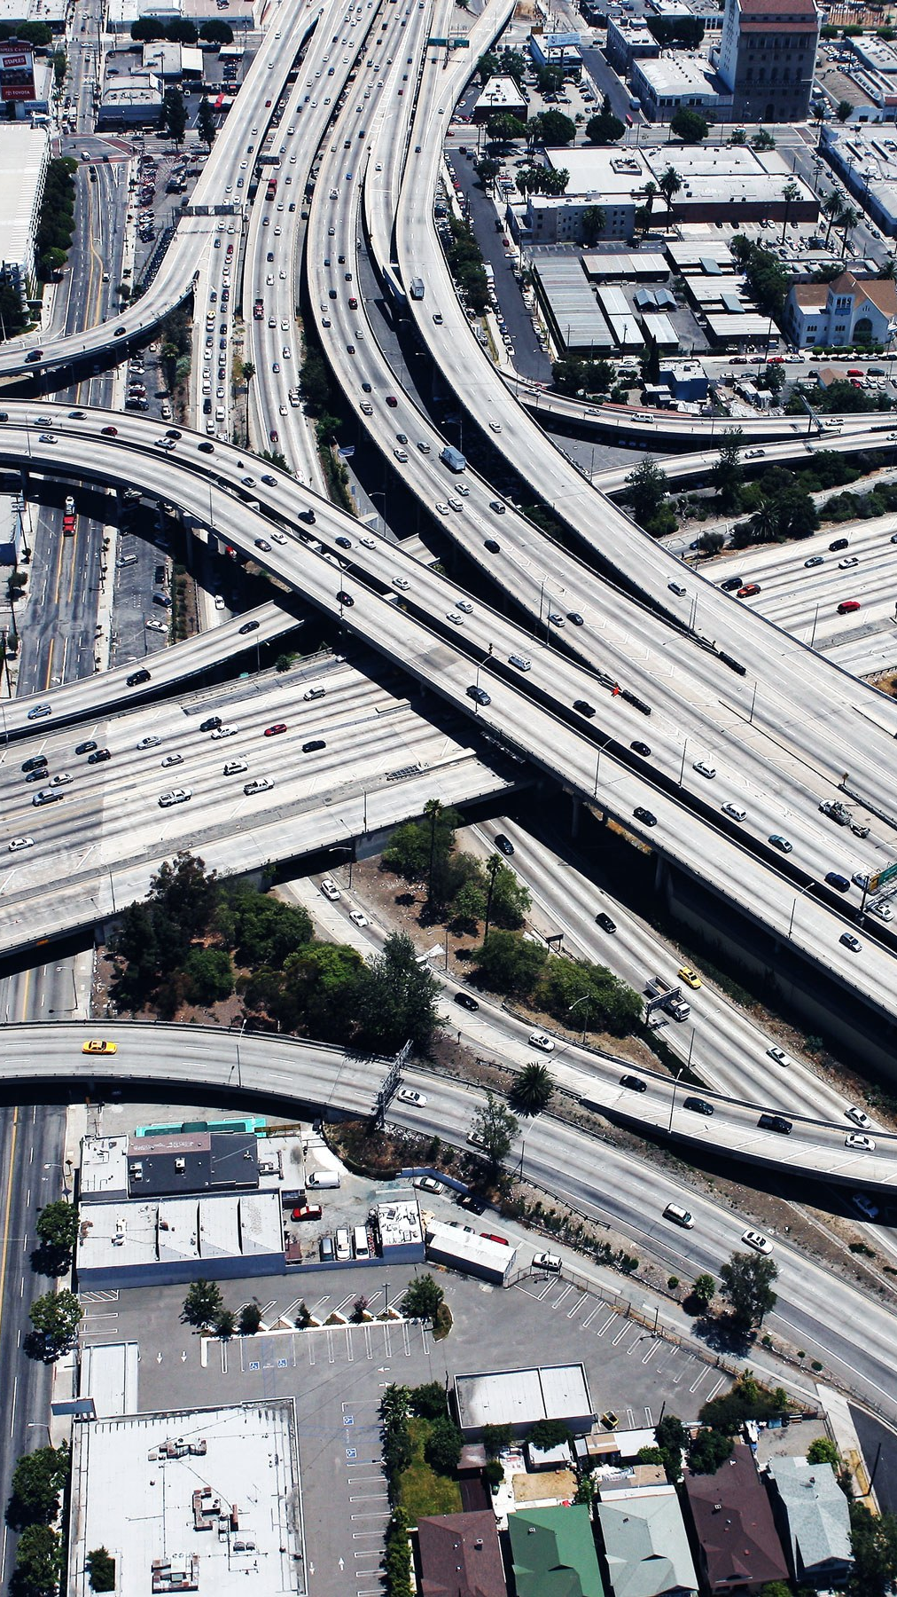
Infrastructure
Modern Software

Slide 7

Community
broad Open-Source

Slide 8
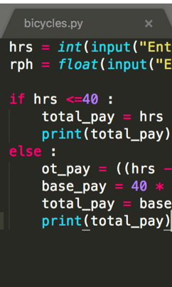
Code
Short, Readable

Slide 9

ME
What’s in it for

Slide 10
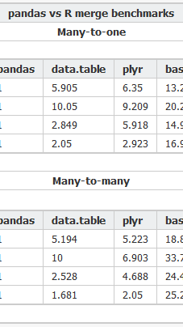
Csv
Analysis of a

Slide 11
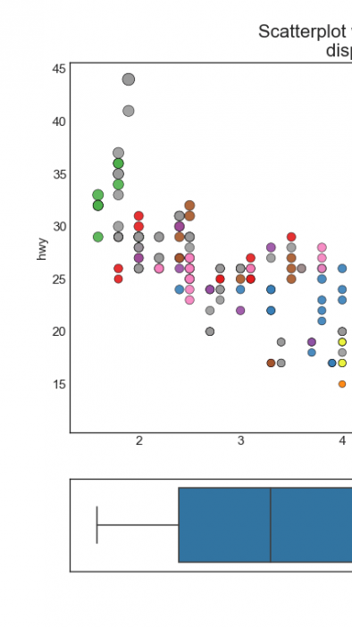
Visualizations
Creating Data

Slide 12
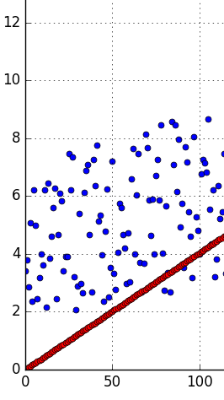
Regression
using Linear

Slide 13
Class format

Slide 14
Class format

Slide 15

Class format
10 minutes for lesson & demo
15 minutes for exercise
Pause to review & ask questions
Rinse and repeat

Slide 16
Fundamentals

Slide 17
How to think about Python
You are giving orders to your computer
Each order is called a “statement”

Slide 18
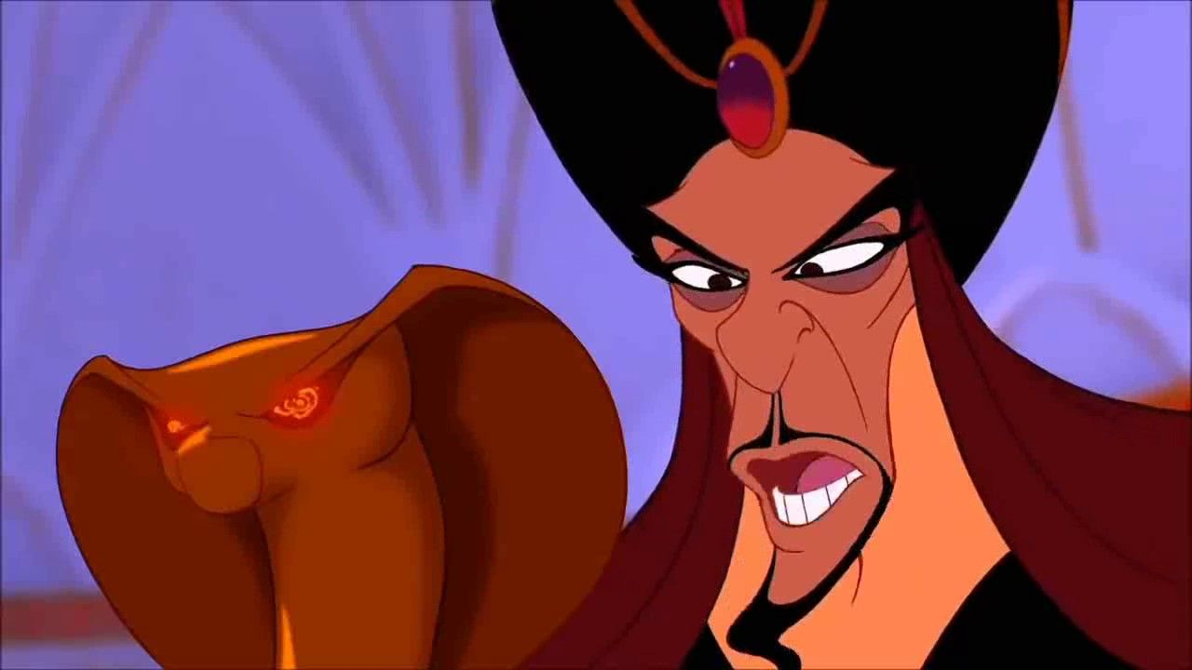
You
Python

Slide 19

Your Computer

Slide 20
ASSIgnment Statement
English:
remember “fav_number” means 3

Slide 21
ASSIgnment Statement
English:
remember “fav_number” means 3
arbitrary label

Slide 22
Assignment Statement
fav_number = 3

Slide 23
ASSIgnment Statement
fav_number = 3
variable

Slide 24
ASSIgnment Statement
fav_number = 3
value
variable

Slide 25
ASSIgnment Statement
fav_number = 3
variable
(integer literal)

Slide 26
Rules for Variables
Must start with a letter or underscore
Cannot start with a number
Only letters, numbers and underscores allowed
Variable names are case-sensitive

Slide 27
Variables
my_number

Slide 28
Variables
my_number

Slide 29
Variables
my_number
3amigos

Slide 30
Variables
my_number
3amigos

Slide 31
Variables
my_number
3amigos
left-handed

Slide 32
Variables
my_number
3amigos
left-handed

Slide 33
ExpressionS
An expression is part of a statement
Noun without a verb

Slide 34
Expression Examples
Variables (like fav_number)
Values (like 3)

Slide 35

Python thinks like your calculator
If you enter 7 + 9, this is still an expression.
Equivalent to 16.

Slide 36
Expression Vs Statement
Equal to a single value —> expression

Slide 37
Expression Vs Statement
Equal to a single value —> expression
Important to know when you’re giving an order vs noun

Slide 38
Why Do I care about calculators?
Compare to Excel formulas
Find compound interest, etc

Slide 39
Old Friends
Integers (called “int”)
Decimals (called “float”)

Slide 40
Old Friends
Addition (+)
Multiplication (*)
Division (/)
Exponents (**)

Slide 41
A New Friend
Modulo (%)
Finds the remainder

Slide 42
Concepts covered so Far
Statement
Expression
Variable
Int, Float

Slide 43
Exercises

Slide 44
New Data Type: String
Text wrapped in quotes
Only meaningful to humans

Slide 45
String Example
greeting = “hello world!”

Slide 46
String Example
greeting = “hello world!”
value

Slide 47
String Example
greeting = “hello world!”
(string literal)

Slide 48
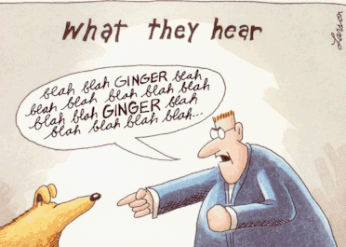

Slide 49
Indexing Syntax
English:
get the first letter in my_string

Slide 50
Indexing Syntax
my_string[0]

Slide 51
Indexing Syntax
English translation:
get the seventh letter in my_string

Slide 52
Indexing Syntax
my_string[6]

Slide 53
Indexing Syntax
English:
get the last letter in my_string

Slide 54
Indexing Syntax
my_string[-1]

Slide 55
Slice Syntax
English:
get the first four letters of my_string

Slide 56
SLICE Syntax
my_string[0:4]

Slide 57
SLICE Syntax
my_string[0:4]
not included!

Slide 58
Slice Syntax
English:
get all the letters up to the third

Slide 59
SLICE Syntax
my_string[:3]

Slide 60
Slice Syntax
English:
grab from the third element through until the end

Slide 61
SLICE Syntax
my_string[2:]

Slide 62
Slice: step
[start_index:end_index]

Slide 63
Slice: step
[start_index:end_index:step]

Slide 64
Slice: step
my_list[::2]

Slide 65
Slice: step
my_list[::2]
even # items in list

Slide 66
Slice: step
my_list[1::2]

Slide 67
Slice: step
my_list[1::2]
odd # items in list

Slide 68
Slice: step
my_list[::-1]

Slide 69
Slice: step
my_list[::-1]
reverse list

Slide 70
Exercises

Slide 71
Values: What kinds ARE THERE?
Int
Float
String

Slide 72
Mixing data types
1 + 7.0 = 8.0

Slide 73
Mixing data types
1 + 7.0 = 8.2
1 + “7.0” = error

Slide 74
Mixing data types
1 + 7.0 = 8
1 + int(“7.0”) = 8.0

Slide 75
F-Strings
Text with variables injected
Normal string but with an “f” before the quotes

Slide 76
F-strings
my_name = “rob”

Slide 77
F-strings
f“Hello, {my_name}!”

Slide 78
F-strings
f“Hello, {my_name}!”
“Hello, Rob”

Slide 79
Anatomy of a function call
int(“7.0”)

Slide 80
Anatomy of a function call
int(“7.0”)
function

Slide 81
Anatomy of a function call
int(“7.0”)
function
input (aka argument)

Slide 82
Function
Performs an action
Action in example: cast to integer

Slide 83
Function vs method
Same: performs an “action” with input
Different: where input comes from

Slide 84
method Example
“Rob”.replace(“R”,“B”)

Slide 85
method Example
“Rob”.replace(“R”,“B”)
“Bob”

Slide 86
method Example
“Rob”.replace(“R”,“B”)
method on string

Slide 87
Function vs method
Input between parentheses
int(“123”)
“Rob”.replace(“R”,“B”)

Slide 88
Function vs method
Input between parentheses
int(“123”)
Main input before dot
“Rob”.replace(“R”,“B”)

Slide 89
Casting between Data types
int()
float()
str()

Slide 90
Concepts covered so Far
Function
Method
Casting

Slide 91
Exercises

