Slide 1
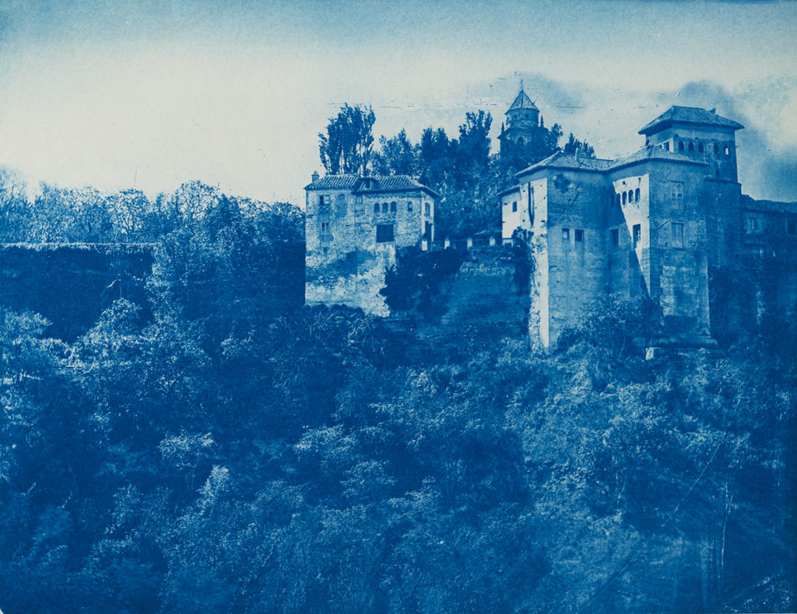
Title of the lecture
Replace this image with one of your choice.
You can use thousands of Creative-Commons images available in Flickr.
This picture: http://www.flickr.com/photos/swedish_heritage_board/4313607930/
Institution
Department
Name
Date

Slide 2
Contents
1. Introduction
2. Theoretical section
  2.1 First topic
  2.2 Second topic
3. Example problems
  3.1 Problem about first topic
  3.2 Problem about second topic
4. Practice
  4.1 Section 1
  4.2 Section 2
5. Homework
6. Suggested reading
References

Slide 3
1. Introduction

