Slide 1
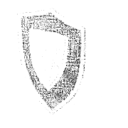


No adaptive immune response:
no antibodies exist
Virus
PI
Virus
evades immunity
Polypreny Immunostimulant
triggers innate, cellular immunity

