Slide 1

Problem Statement

Slide 2
To find the shape and analyse the flow created by a Mobius band.
To analyse the motion of a Mobius band when let to freely fall in a viscous fluid.
To analyse the mixing properties of Mobius band when used as an impeller.
This project has 3 aspects to it:
Shape of a Mobius band
CFD Analysis
Experimental verification.

Slide 3
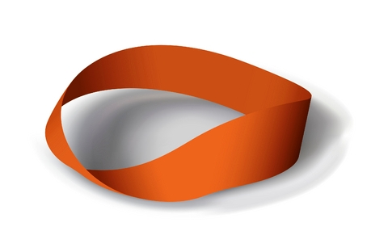
The Shape of a Mobius Band

Slide 4
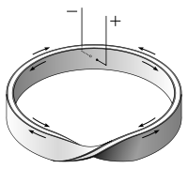
Why a Mobius strip?
Mobius strip is a one sided nonorientable surface.
Which means, a point below and moving along the boundary of the Mobius strip would be above the boundary after travelling the length of the strip.
So, intuitively, if we use this as an impeller at the boundary of two fluids, the mixing of the fluids will be more effective.
At very low Reynolds number, a Mobius strip can probably be used to propeller micro bots.

Slide 5
Mobius Band is defined as the shape taken by a thin band of an elastic material when it is twisted by half a rotation and the two ends are attached.
It can be viewed as the least energy configuration of an elastically deformable body under the given conditions.
We can determine the shape of the Mobius band uniquely once we know the dimensions of the band.
The equations governing the shape of the band can be derived from the elasticity equations formulated in the theory of bending and twisting of thin rods.
The theory of bending and twisting of thin rods is formulated in the book “ A Treatise on Mathematical theory of elasticity” by “A.E.H.Love”.
Referring to that, equations governing the shape of a Mobius strip have been derived in the Paper “ The shape of a Mobius Band” by “ L.Mahadevan and J.B.Keller”.

Slide 6
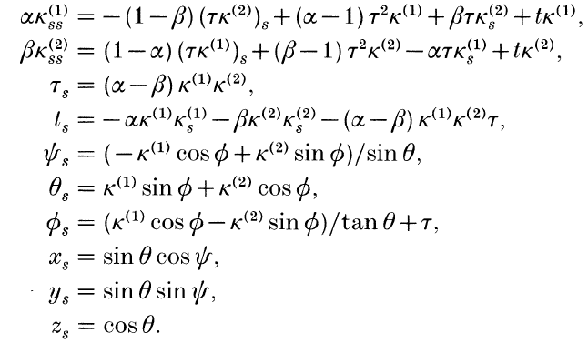
These equations will involve 2 curvatures, 1 twist, 2 bending moments, 1 torsion, 3 stresses, 3 coordinates of the centreline and 3 orientations.
To solve for these, we have a 12th order system of Differential algebraic equations which count to a total of 15 equations.
After simplification, we end up having a system of 12th order ordinary differential equations.
The simplified equations are:

Slide 7
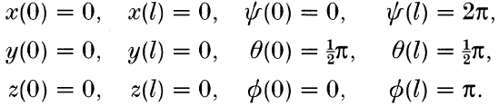
The boundary conditions which would close the set of differential equations are the centre line having the same start and end point and orientation of cross section of strip being equal at start and end points except the angle of twist of the strip being π.
These are given by:
Differential equations
Boundary conditions
Governing equations

Slide 8
Boundary conditions
Initial conditions
Final conditions
Boundary conditions include both initial conditions and final conditions.
In the boundary conditions we’ve established, we have 6 initial conditions and 6 final conditions.
If we observe the system of differential equations we have, we can see that there is only one variable i.e. the distance along the arc of the centre line.
This would mean that if we have all 12 conditions as initial conditions, we can simply integrate the equations to get the solution.

Slide 9
Strategy for solving the equations
The strategy we adopted in solving the equations is to keep guessing the unknown initial values to solve the equations until we match the final values with the final conditions.
This is popularly known as “The Shooting method”.
It is called so because it is like shooting a projectile in air to reach a particular destination.
Solving the equations is done numerically by solving for the values of the parameters at specific points on the arc length axis, called grid points, instead of finding them at every point.
After we guess the initial values, we can march forward in the arc length coordinate by numerically integrating the equations to get the values of the variables at the next grid point.

Slide 10
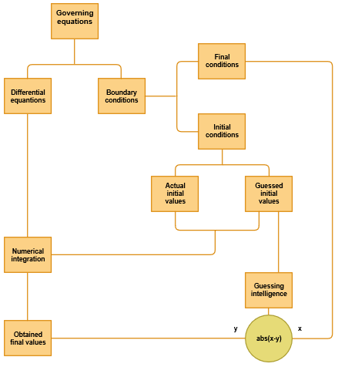

Slide 11


Slide 12
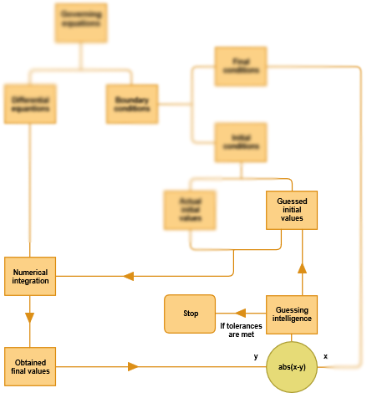

Slide 13
Shooting method

Slide 14
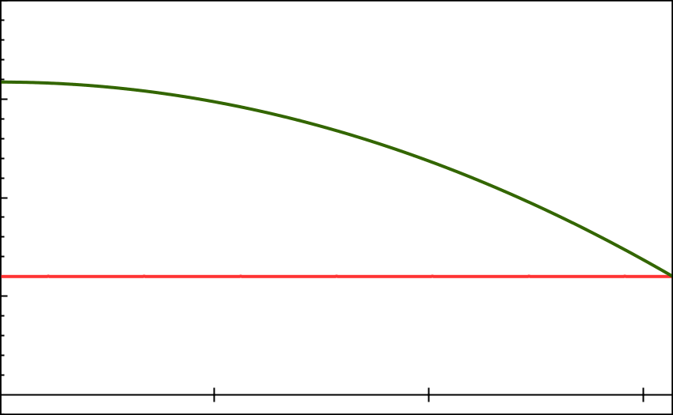
Shooting Method

Slide 15
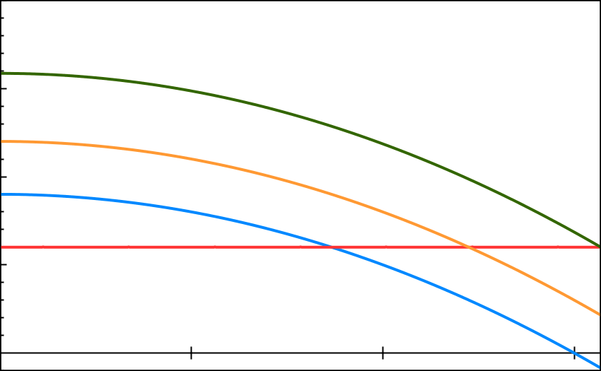
Shooting Method
F^{i}₃
F^{i}₂
F^{i}₁
F^{f}₃
F^{f}₂
F^{f}₁

Slide 16
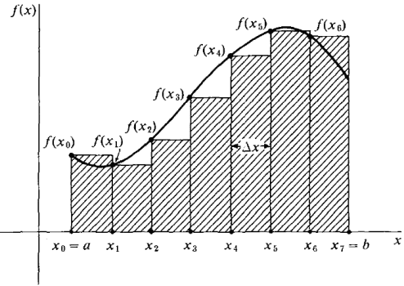

Numerical integration scheme we used was Riemann integration.
Riemann integration scheme is given by:
If even second derivative is known,

Slide 17
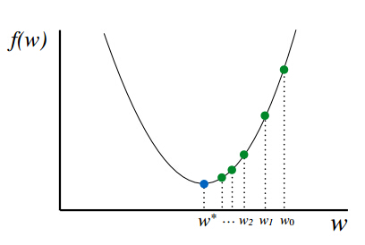
Guessing intelligence
We need algorithms which takes into account the previous guesses and provides intelligence as to how to reach the solution.
There are such many algorithms. Gradient descent is one among them.
Gradient descent is an algorithm where, we simply moves against the gradient of a curve in search for its minimum.

Slide 18
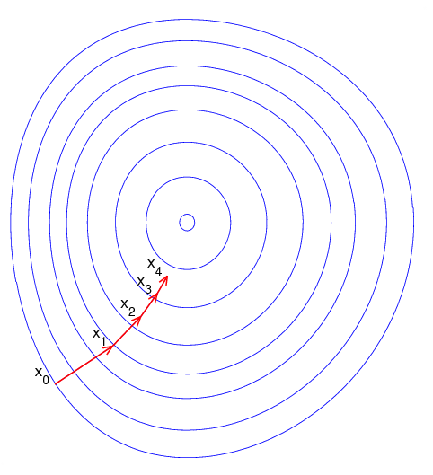
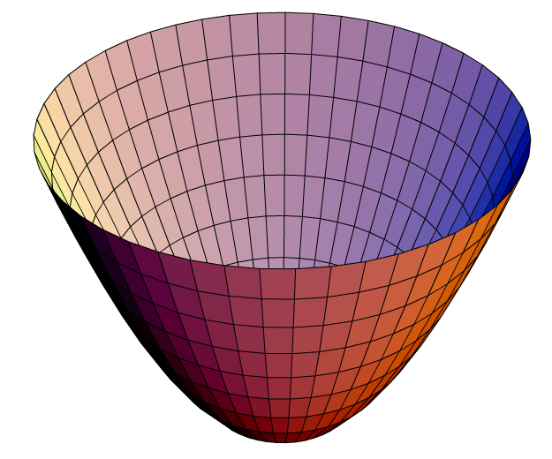
Gradient descent

Slide 19

In our problem, the function to be minimised is:
According to gradient descent algorithm, we must move against the gradient to reach the minimum.
The new guesses are given by moving along the negative gradient of the error function surface.
Thus, by iteratively applying the above procedure, we can converge to a solution where the error function is minimised.

Slide 20
Conversion of solution into solid model
The obtained solution is a text file containing the curvatures, twist, tension, orientations and centre line coordinates.
For CFD analysis, we need a complete solid model to perform meshing and the do the flow analysis.
So, we need to convert our solution into a solid model.
We can do this by using a format called STL (Sterio Lithographic format).
It is basically a text file containing vertices and normal of triangular facets over the surface of the solid.
So, using the data from our solution, we can create triangles all over the solid and extract their vertices and normal vectors and organise them to form an STL file.

Slide 21
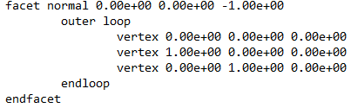
A typical STL file would look like this:
We can write a code to convert the solution into triangles and organise them into the above format.
After saving such a text file as ‘.stl’, any solid modelling software would be able to understand and display the solid model.
This can later on be used for meshing in OpenFoam using SnappyHex generation.

