Slide 1
Computer Architecture
Prof. Saurabh Gandhi (EEE department)

Slide 2
The shortcomings of a single cycle CPU
Simple instructions wait unnecessarily to accommodate loner instructions
Hardware is underutilized
Energy inefficient
  Why?
  Unnecessary switching, charging and discharging of long, monolithic datapath
  Long combinational paths increase capacitance
  Voltage cannot be reduced much because paths are long and timing is tight
Limited clock frequency
  Memory access is very very slow in practice
  Wire delays dominate in long datapaths in the GHz range
  Clock skew becomes dominant at high frequencies and long paths
  Voltage has to increase with frequency → high power dissipation → heating

Slide 3
Long monolithic datapath – the root problem with single cycle CPU
How to break the datapath?
Where to break the datapath?

Slide 4
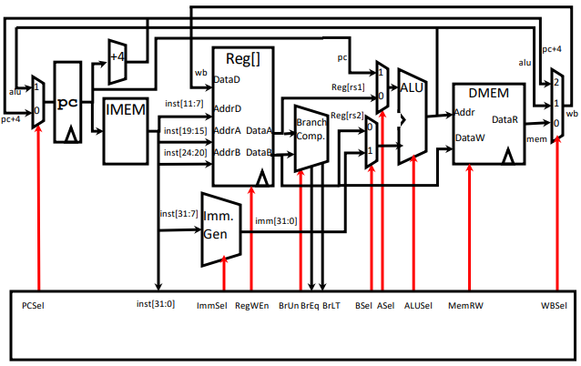
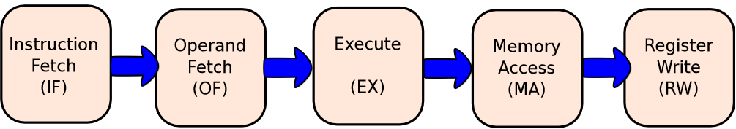
The single cycle RV32l datapath

Slide 5
How to break the datapath?
Break such that one part performs some operation in once cycle
Next part should use o/p of first part as input to the next operation
Must store output in intermediate register
ALU OUT

Slide 6
Where to break the datapath?
Avoid unnecessary computations
What components are optional i.e. instruction-dependent?
Clearly, they should be put into separate stages that may or may not execute based on need
Is that sufficient?... Any other consideration?
ALU OUT
MDR

Slide 7
Where to break the datapath
Reuse datapath components
What parts can be reused for avoiding hardware duplication?
ALU can be reused for:
  PC ← PC + 4
  Comparison (branch comparator)
  Original ALU computations
Will our current breaks be sufficient for ALU reuse?
What about MEM reuse?
Cycle 1: IF → OF → EX (ALU used!)
Cycle 2: PC → PC + 4 (ALU reused!)
What about branch comparison reuse?
IR
ALU OUT
MDR

Slide 8
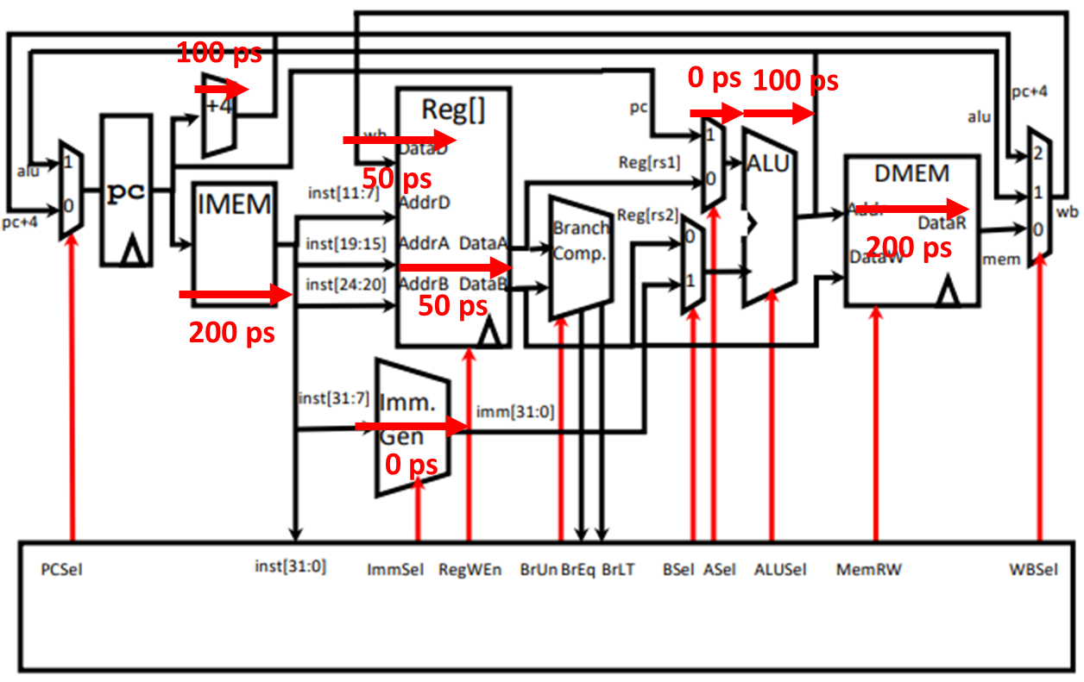
Where to break the datapath?
Optimize critical path length
How long does each stage currently take?
Where to break for better time management?
IR
A
ALU OUT
MDR
B

Slide 9
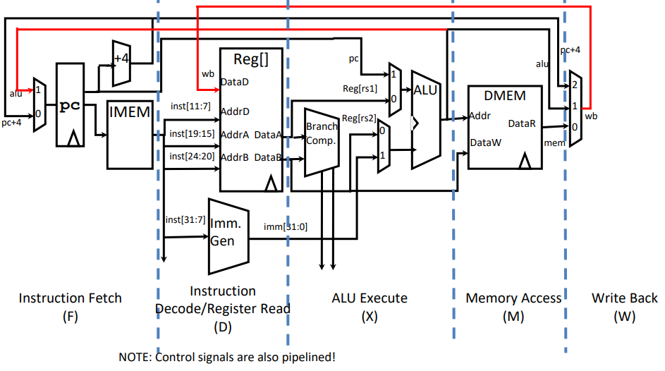
Where to break the datapath?

Slide 10
Example: lw execution
IF
  IR ← Mem[PC]
  PC ← PC + 4
ID
  A ← RegFile[rs1]
  B ← RegFile[rs2]
EX
  ALUOut ← A + Imm
MEM
  MDR ← Mem[ALUOut]
WB
  RegFile[rd] ← MDR
How many cycles for R-type?
How many for branch?

Slide 11

Average execution time
Execution time is no longer fixed, but instruction dependent
Average execution time depends on the mix of instructions
Execution time for R-type multicycle?
Wow… what just happened?
  We wanted to speed up things by not doing unnecessary computations
  We successfully avoided unnecessary computations
  But execution time increased?!
Short stages unnecessarily waste time waiting for infrequent long stages!

Slide 12
Evaluating multicycle
What are the other advantages of multicycle?
Multicycle (without parallelization) was commercially viable in the 80s!
Multicycle allowed complex instruction sets
Under what circumstances can multicycle actually be faster?
Given the slow memory, can we somehow gain speed improvement with multicycle?
Variable latency multicycle

Slide 13
Control becomes sequential → FSM based control
Finite state machine:
States
Input and state-dependent transitions between states
Outputs in each state
  State-dependent output (no input dependence): Moore
    Cleaner timing… why?
    Signals change only at clock cycles, not in between
  State + input dependent output: Mealy

Slide 14
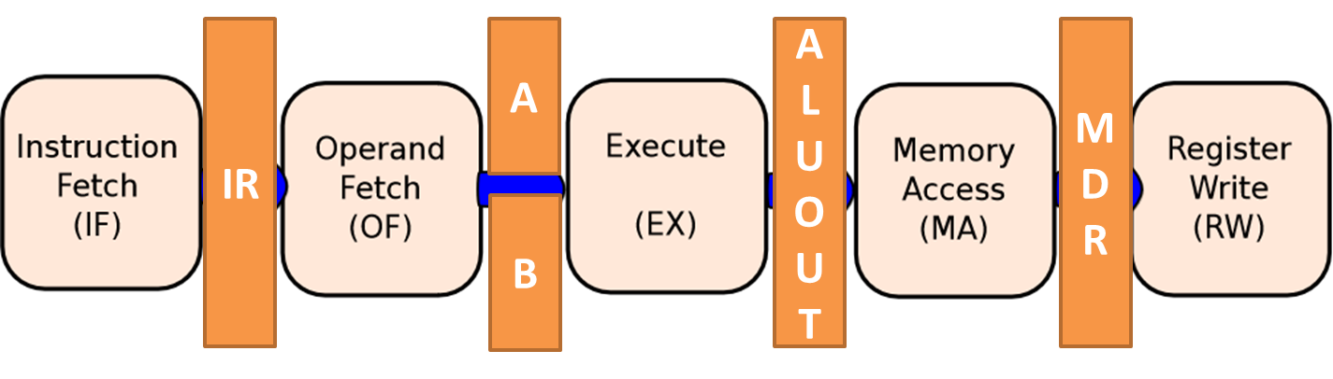
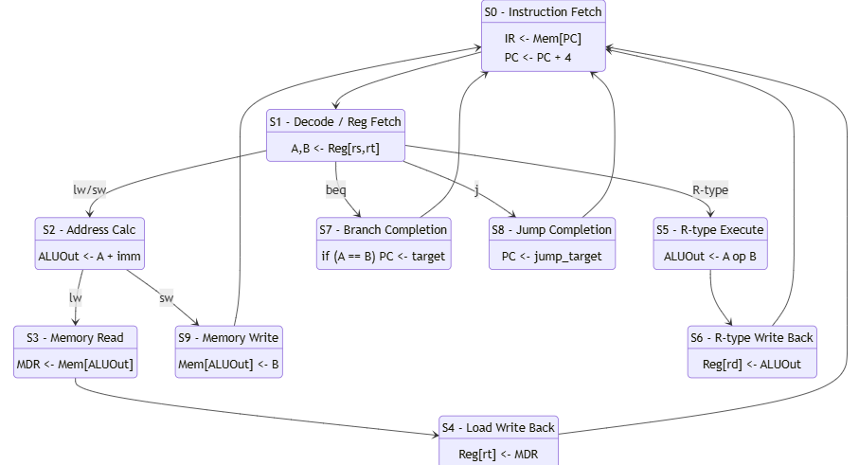
What states do we need in our RV32I multicycle processor?

Slide 15
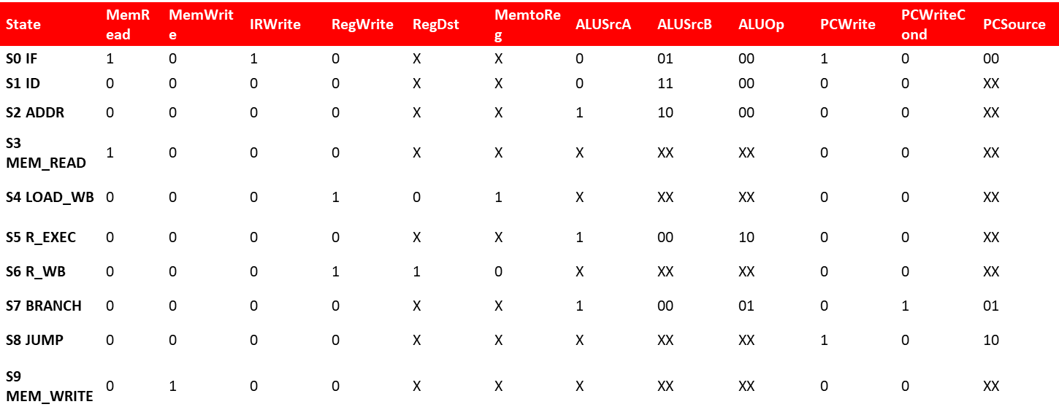
Implementing control
State register
Updated to next state with combinational logic
State-dependent combinational output logic

Slide 16
Transition table
Current State | Instruction / Condition | Next State
S0 (IF) | — | S1
S1 (ID) | R | S5
 | LW | S2
 | SW | S2
 | BEQ | S7
 | J | S8
S2 (ADDR) | LW | S3
 | SW | S9
S3 (MEM_READ) | — | S4
S4 (LOAD_WB) | — | S0
S5 (R_EXEC) | — | S6
S6 (R_WB) | — | S0
S7 (BRANCH) | — | S0
S8 (JUMP) | — | S0
S9 (MEM_WRITE) | — | S0

Slide 17
The challenge with a hardwired FSM
Complex for large ISAs
Difficult to modify
State explosion – adding one new instruction can substantially increase the number of states!

