Slide 1
Computer Architecture
Prof. Saurabh Gandhi (EEE department)

Slide 2
Designing things that compute
Digital design
Combinational logic
Memory elements (registers)
Synchronous sequential circuits
How do we go from here to the modern computer?

Slide 3
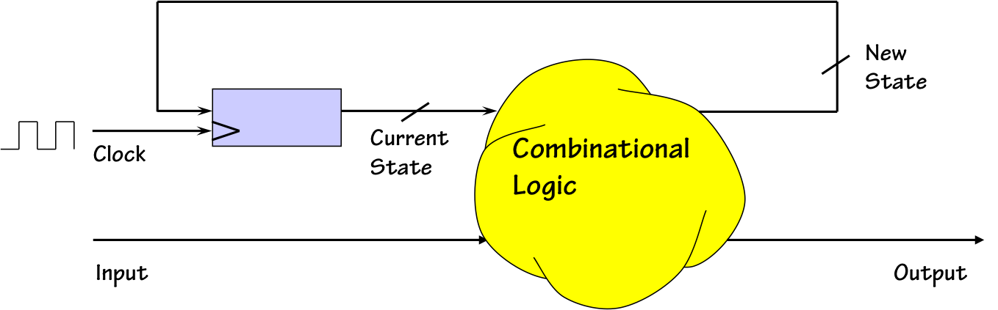
Designing things that compute
Sequential circuits
  Sequence detector – is it a computer? Sequence generator?
  Can we generalize?
Finite State machines
  Storage for current state
  Combinational circuit to generate o/p and next state based on i/p and current state
  Implement the combinational circuit using a ROM (or PLA/PAL)
computationstructures.org

Slide 4
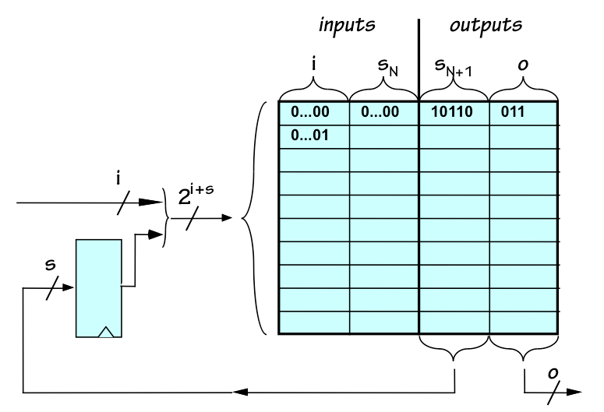
Finite State Machines can accept instructions
Write a ROM that takes 2 2-bit numbers from registers as inputs, reads an operation from a 2-bit encoder (+/- buttons pressed by user) and puts the result back in one of the two registers (again specified by user button). It should execute only when the +/- button is pressed, and otherwise go to a ‘waiting’ state.

Slide 5
FSMs with instructions stored in memory = programmable computer!
We read user input (+/-) and executed…
Read ‘instruction’ from another memory instead
What should instructions specify?
  What operation to perform
  What data to use?
  Where to put results?
An instruction is a compact description of the above three in a standardized format

Slide 6
Implementing the programmable computer
Remember designing sequential circuits in DD? After making the state table, what did you build?
Data path
  Registers
  Memory
  ALU
Control
  Which is the FSM

Slide 7
What instructions to implement?
Toy example: FSM to control a traffic light
Instructions:
  Turn on red light (turns it on for 30 seconds)
  Turn on green light (turns it on for 10 seconds)
New functionality:
  Blink green light on (1s) - off (1s) for 5 seconds (to indicate about to turn red)
  Blink red light on (3s) - off (3s) continuously (signal not working)
Even more functionality, simply based on toggling lights – even more complexity of FSM!
How can we simplify?
Only 3 instructions are needed, can you identify?

Slide 8
The Instruction Set Architecture
Choice of instructions to implement critical for building efficient computers
  Few very basic instructions?
  Many complex instructions?
    Effect on program size?
    Effect on hardware complexity?
    Many other parameters that we will discuss later!
ISA is a formal specification of allowed instructions, their meaning and behavior
ISA defines what the computer does (not how)!

Slide 9
ISA = Hardware – Software Contract
Software assumes instructions behave exactly as specified
Hardware guarantees correct execution of instructions
As long as ISA remains the same, software need not care about the hardware design!
Stable boundary between hardware and software

Slide 10

What all does an ISA specify?
Operations: Add, Load, Store, Branch etc.
Storage: How many registers? How big?
Storage: How much memory to support?
Data types: Integers, Floats, 32-bit, 64-bit etc.
Addressing modes: How to refer to different locations in the memory?
Measuring success:

Slide 11
The Great Debate: RISC vs. CISC
CISC (Complex Instruction Set): Make instructions powerful (e.g., "Multiply memory address X by Y").
  Goal: Reduce Instructions/Program.
RISC (Reduced Instruction Set): Make instructions simple (e.g., "Load," then "Multiply").
  Goal: Reduce CPI and Seconds/Cycle.

Slide 12
The RISC design philosophy
Simplicity Favors Regularity:
  All instructions are the same length (usually 32-bit).
  Easier to decode.
Smaller is Faster:
  Limited number of registers
  Smaller instruction sets allow higher clock speeds.
Make the Common Case Fast:
  Focus on the instructions used 90% of the time (Load, Store, Add).
Good Design Demands Good Compromises:
  Use a Load-Store architecture (Memory only accessed via Load/Store, never directly in an ALU op).

Slide 13
Multiplying two memory locations
Feature | RISC (e.g., RISC-V / MIPS / ARM) | CISC (e.g., Intel x86)
Philosophy | "Small, fast, uniform steps." | "Do more with a single command."
Instruction Count | High (requires 4 separate instructions) | Low (can be done in 1 instruction)
Example Code | LOAD R1, addr_A LOAD R2, addr_B PROD R1, R2 STORE addr_A, R1 | MULT addr_A, addr_B
Memory Access | Only LOAD and STORE touch memory. | Computation instructions can touch memory directly.
Execution Time | Each instruction typically takes 1 cycle. | Instruction takes multiple cycles to finish.
Addressing Modes | Very few (usually just "Base + Offset"). | Dozens of complex modes (e.g., [ebx + esi*4 + 10]).

Slide 14
Implications of ISA choice
Code Density: CISC wins (smaller binaries).
Power Efficiency: RISC wins (simpler logic, fewer transistors).
Compiler Complexity: RISC requires smarter compilers to optimize instruction sequences.

Slide 15
Why RISC-V
RISC is the dominant philosophy today (ARM in phones, RISC-V in research/IoT).
RISC-V:
  Open and clean specification
  Minimal complexity
  Ideal for learning
  Widely adopted in industry
RISC-V details: next class!

Slide 16
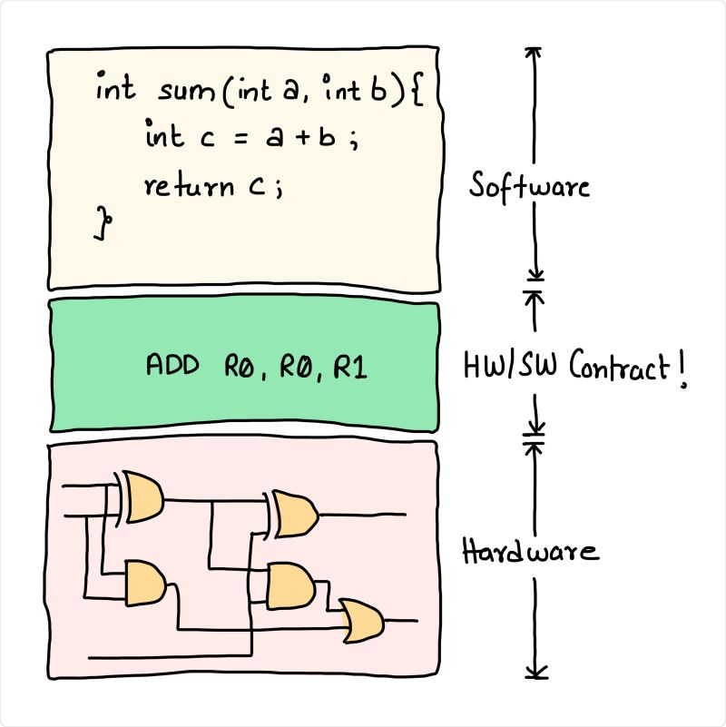
“I can pretty much look at the C code, predict the assembly instructions (and by extension the machine code) it will generate and what the CPU will do as a result.”

Slide 17
Programmer’s model
Seen: What is an ISA? Why do we need one?
It abstracts away the hardware so the programmer does not have to bother
Next: So what does the programmer see?

Slide 18
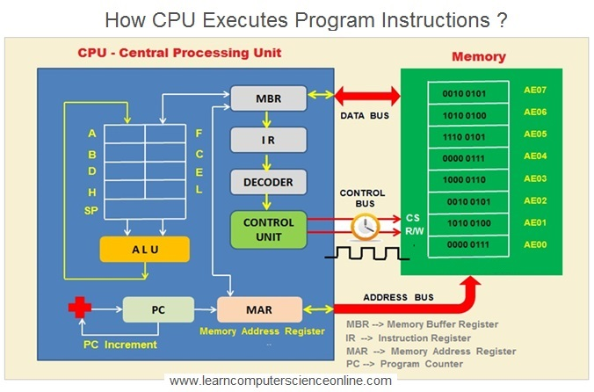
CPU – perform operations on registers using the ALU

Slide 19
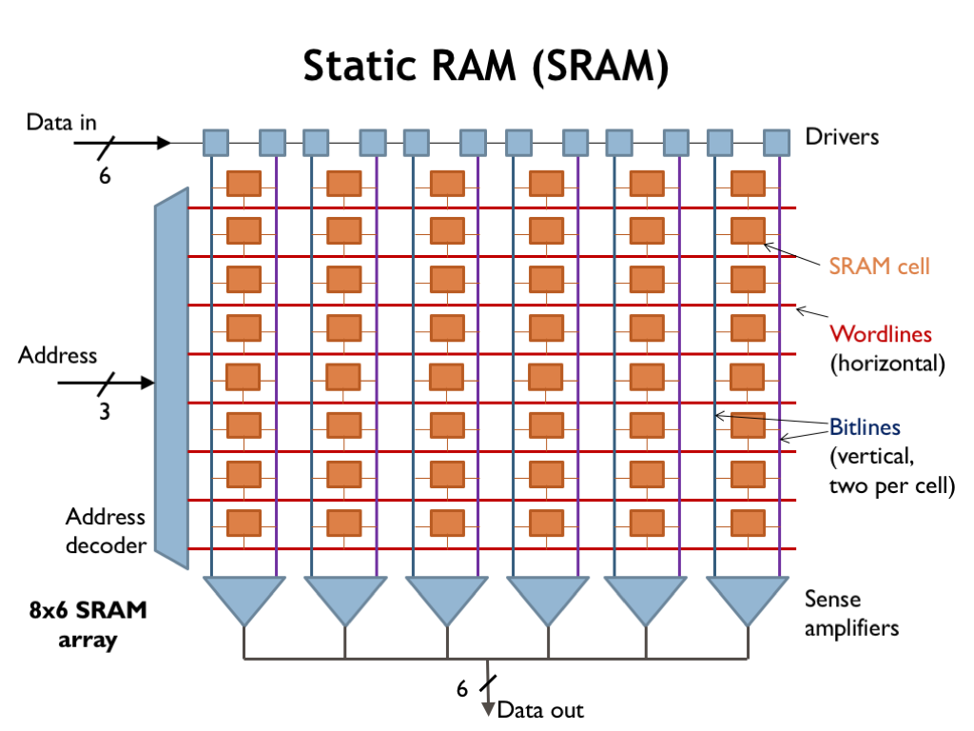
Memory – a simple model

Slide 20
Programmer’s model of a processor – what the programmer sees
What the programmer needs to care about:
  What registers are available (fast local operations)
  What memory is available (slower operation but larger pool)
  What instructions are available and how they are encoded
  Some relevant state changes (change in register value, memory location value, control flow)
    Any state that might actually be relevant to the software (for example, any state elements required for internal implementation of FSM not included)
What they do not care about:
  Pipeline, cache etc.

Slide 21
Registers as programmer resources
General purpose registers: store operands, temporary values or memory addresses
Special registers: for example
  The program counter (PC) stores the address in memory of the next instruction to execute
  The instruction register (IR) stores the instruction being executed
ISA defines what registers are available

Slide 22
Programmer’s models for ARM, x86-64 and RISC-V
Aspect | RISC-V (RV32I) | ARM (AArch32 / AArch64) | x86-64 (Intel/AMD)
Register count | 32 integer registers | 16 (AArch32), 31 GPRs (AArch64) | 16 GPRs
Register roles | All GPRs (except x0) | Mostly GPRs, some conventional roles | Many implicit roles (e.g., stack, flags)
Register width | 32 bits (RV32I) | 32 or 64 bits | 64 bits
Instruction length | Fixed (32 bits) | Fixed (mostly 32 bits) | Variable (1–15 bytes)
Memory model | Load–store only | Load–store only | Memory-to-register allowed
Program counter | Explicit architectural state | Explicit | Mostly implicit
Condition flags | Not implicit (explicit comparisons) | Explicit condition flags | Implicit FLAGS register
ISA philosophy | Minimal, regular | RISC with extensions | CISC (historical), RISC-like internally

Slide 23
Assembly – talking to the low-level hardware
ISA defines what the programmer sees – registers, memory etc.
Did your python (or Java or C) code ever talk about registers?
High-level languages further abstract the hardware
Assembly – language to directly deal with hardware
Assembly == symbolic view of the ISA (human-readable view of ISA)

Slide 24
The RISC-V ISA
Open, modular, clean and minimal ISA
Designed for simplicity and scalability

Slide 25
RV32I – a 32-bit integer ISA
32 bit architecture, i.e. registers, address and data bus are 32-bit wide
32 general-purpose registers
  x0…x31 (x0 is hardwired to 0 …why?)
  Also named ‘zero’, ‘ra’, ‘sp’, ‘t0 – t6’, ‘a0 – a6’ (by convention)
Only integer operations included in the ISA
Each instruction has fixed length – 32 bits!
Byte-addressable memory (i.e. each location is a single byte, not 32-bit / 4-byte word)
Load – store design
Several extensions exist, such as for floating point operations etc.

Slide 26
RV32I instructions (overview)
Integer arithmetic and logical instructions: perform operations on registers
  add, sub, and, or, addi
Load and store instructions: move data between registers and memory
  No other instruction touches memory directly
  lw, sw
Control flow instructions: branching, jumping
  beq, bne, jal, jalr
System-level instructions: will see later

Slide 27
RISC-V arithmetic instructions
All of these have 3 operands
Operand order is fixed
Example:
  C code: A = B + C
  Assembly: add x5, x1, x2 # x5 = x1 + x2
  (Compiler maps C variables to registers)
Example 2:
  C code: A = B + C + D
  Assembly: add x5, x1, x2
  add x5, x5, x3

Slide 28
Design principle: simplicity favors regularity
Variable number of operands would simplify assembly code
BUT hardware becomes more complex
Simple hardware == lower design time and manufacturing cost
Trade-off: more instructions

Slide 29
Design principle: smaller is faster
Only 32 registers…
Smaller circuits => shorter wires => faster signal transmission => faster clocks
Also cheaper

Slide 30
Immediate instructions – one operand is provided in instruction
addi x5, x5, 1 # x5 = x5 + 1
andi x6, x6, 0xFF # mask lower 8 bits
slli x7, x7, 2 # left shift by 2 (×4)

Slide 31
Referring to memory addresses
Only 2 instructions for this:
Load:
lw x6, 12(x2) # x6 ← Mem[x2 + 12]
Store:
sw x7, 4(x8) # Mem[x8 + 4] ← x7

Slide 32
Referring to memory addresses – general modes
Register addressing: register contains address to refer to
Immediate addressing: address provided within the instruction itself as Imm
Base + offset addressing: base address given in register + offset given as Imm gives actual address
PC-relative addressing: actual address is PC + offset given as Imm
  Why is this type of addressing relevant?
Which of these modes is used in RISC-V?

Slide 33
Control flow
How the program counter changes
Influences order of instruction execution
Sequential execution: PC ← PC + 4
Jump to an address:
  jal ra, func # ra ← PC + 4, PC ← func
  Transfer program flow to func, but stores old address so it can return back there
Conditional branches:
  beq x1, x2, label # if x1==x2, PC ← label else PC + 4
PC-relative (only mode in RISC-V)

Slide 34
PC-relative control flow simplifies architecture
Position-independent code
Simplifies linking and relocation
Avoids absolute addresses

Slide 35
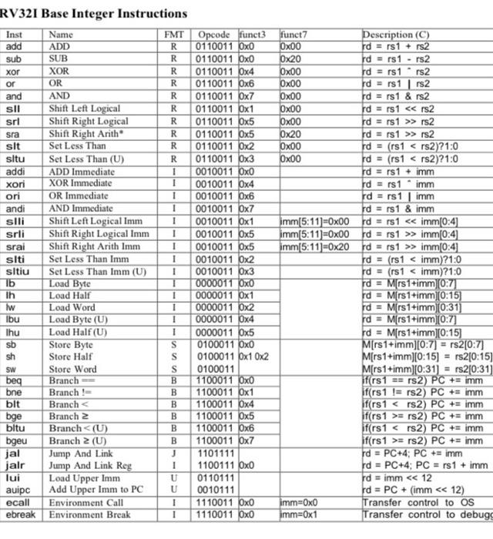
Overview of RV32I instructions

Slide 36
Example snippets

Slide 37
Instructions as seen by hardware

Slide 38
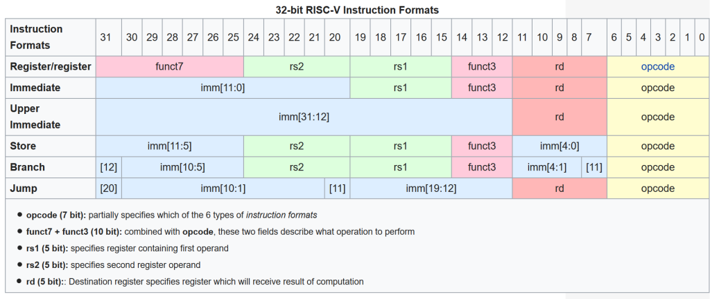
The 6 basic RV32I instruction formats – R, I, S, B, U, J

Slide 39
General structure of instructions
opcode (7 bits): operation code, what operation to perform
rd (5 bits): destination register, for the result of the operation
rs1, rs2 (5 bits each): source registers, or operands
funct3 (3-bit), funct7 (7-bit): refine operation
imm: immediate, directly provide a literal value

Slide 40
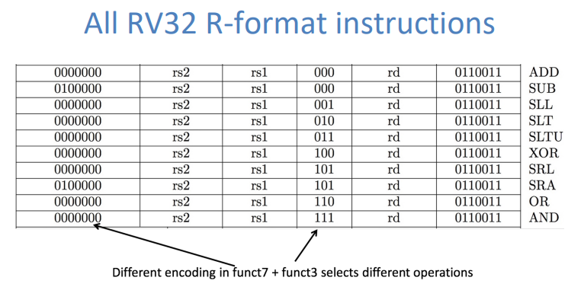
R-format instructions
opcode: instruction class (e.g., integer ALU)
funct3: selects ALU operation group
funct7: refines operation (e.g., add vs sub)

Slide 41
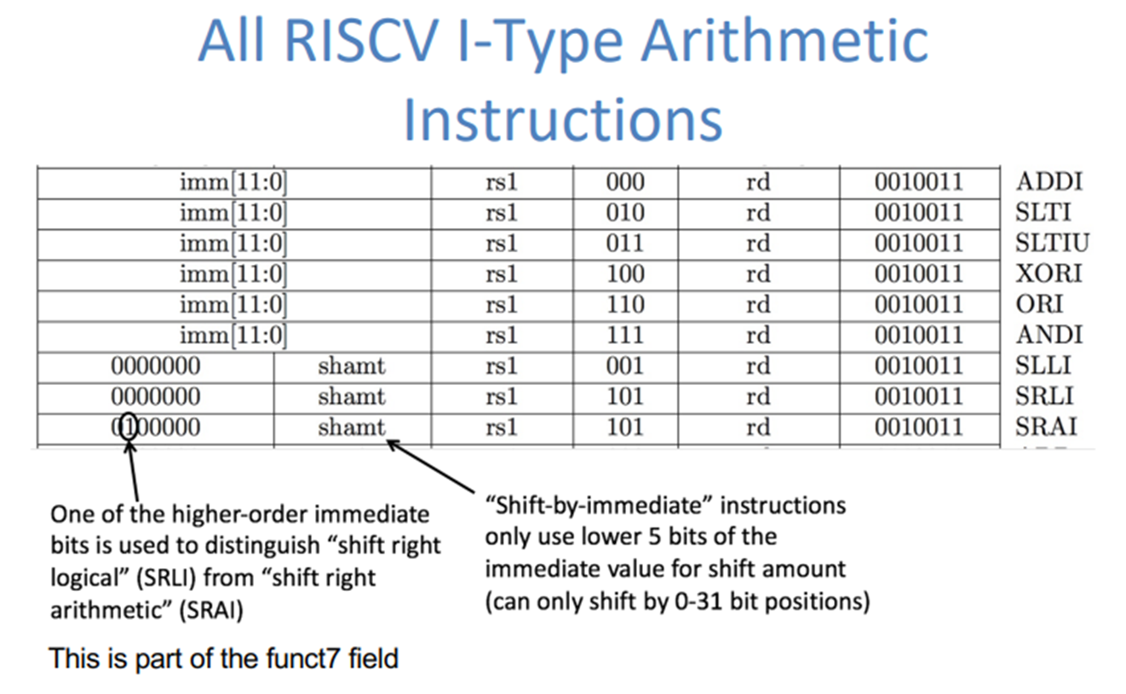
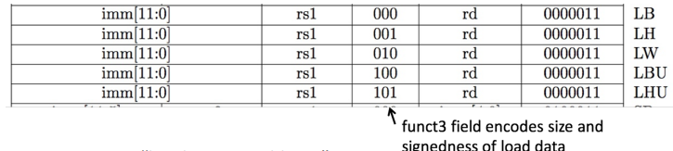
I-format instructions

Slide 42
Notice any quirks?
What happened to func7 in I-type arithmetic?
Why not use the same encoding logic for operation?
I-types prefer more bits for Imm
Why not remove func7 from R-type also?
Fewer R-type instructions supported (currently 10 R-type instructions, so 3 func3 bits insufficient)
I-type does not have subi (and jugglery for shifts)
Hierarchical decoding – next class!

Slide 43
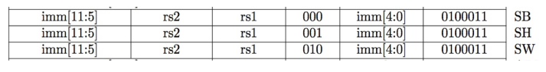
S-format instructions
More quirks!
Why is imm split?
Prefer rs1, rs2, rd (whenever required) in the fixed locations – simplifies decoding circuit

Slide 44
Full picture
Opcode (binary) | Opcode (hex) | Instruction Class | Format(s) | Role of funct3 | Role of funct7
0110011 | 0x33 | Integer register–register ALU | R-type | Selects ALU operation group (ADD/SUB, AND/OR, shifts, SLT) | Distinguishes operations sharing same funct3 (e.g., ADD vs SUB, SRL vs SRA)
0010011 | 0x13 | Integer register–immediate ALU | I-type | Selects immediate ALU operation (ADDI, ANDI, ORI, shifts) | Used only for shift immediates (slli, srli, srai)
0000011 | 0x03 | Loads | I-type | Selects load width (lb, lh, lw, etc.) | Not used
0100011 | 0x23 | Stores | S-type | Selects store width (sb, sh, sw) | Not used
1100011 | 0x63 | Conditional branches | B-type | Selects comparison type (beq, bne, blt, bge, etc.) | Not used
1101111 | 0x6F | Jump and link | J-type | Not used | Not used
1100111 | 0x67 | Jump and link register | I-type | Fixed (000) | Not used
0110111 | 0x37 | Load upper immediate | U-type | Not used | Not used
0010111 | 0x17 | Add upper immediate to PC | U-type | Not used | Not used
1110011 | 0x73 | System / CSR | I-type | Selects CSR operation | Further refines system behavior

Slide 46
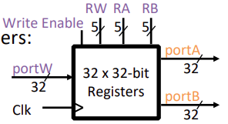
The RV32I Register File
32 integer registers, x0 to x31
  Output ports portA and portB (readout of 32 bit data stored inside)
  Input port portW (32 bit data that we want to write inside)
  RW, RA, RB (address of register inside the RF resp.)
  WEn (whether to copy portW data into register inside or not)
  Clk (clock signal for write operation, read is combinational)!
Register x0 is hardwired to 0 (why?)
General purpose usage (ie registers are not restricted or reserved for specific uses)

