Slide 1
Software for Embedded Systems
Prof. Saurabh Gandhi (EEE department)

Slide 2
Introduction to Embedded Systems
Administratrivia
What is an embedded system?
How do they differ from general purpose computers?
Embedded vs general purpose software
Examples from automotive, medical, industrial systems
Projects

Slide 3
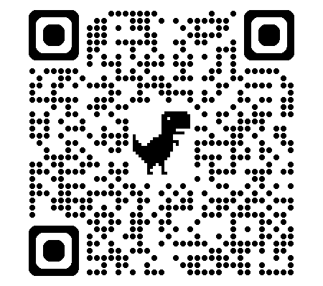
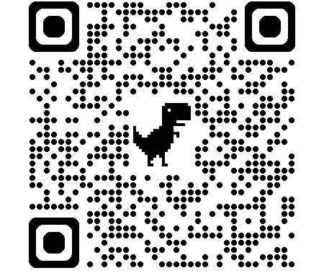
Administratrivia
Evaluation
Midsemester exam: 20%
Comprehensive exam: 30%
In-class quizzes and attendance: 10%
Projects: 20%
Lab reports: 10%
Lab presentations: 10%
Reference books
Miro Samek — Practical UML Statecharts in C/C++
Douglass et al. — Real-Time Design Patterns
Elecia White — Making Embedded Systems
Jane W. S. Liu — Real-Time Systems
Course page
In-class quizzes!
Code: PS52M5

Slide 4
What is an embedded system?
Examples?
Characteristics?

Slide 5
Embedded systems vs general purpose computers
Hardware requirements?
Resource availability?
Use-case challenges?
Development cycle / tools?

Slide 6
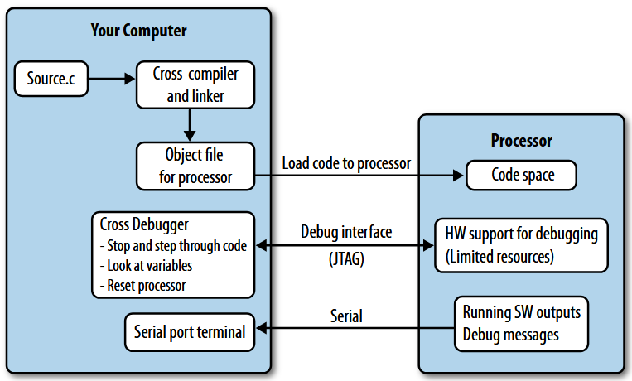
Software development for embedded systems – challenges
Making embedded systems (Fig. 1-1)

Slide 7
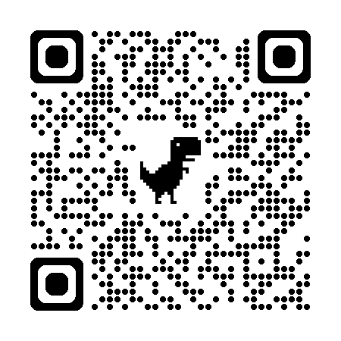
Projects
Teams made by instructor (3-4 students with balanced backgrounds)
Projects will be floated in first lab
Work on projects alongside classwork… directly apply what you learn
More details in first lab…
…fill out lab schedule poll (mark as many times as possible)

