Slide 1
Computer Architecture
Prof. Saurabh Gandhi (EEE department)

Slide 2
What happens if
A garbage instruction gets into the pipeline?
An instruction misbehaves (divide by zero, or arithmetic overflow)?
An interrupt occurs
The ongoing instruction flow needs to be altered to handle the event
Exceptions, interrupts and traps

Slide 3
Exceptions, interrupts and traps
Exception: An unscheduled event that arises inside the CPU
Overflow, illegal instruction, or divide by zero
Synchronous (ie happen at times aligned to the flow of current instruction in the pipeline)
Interrupt: Events that are external to the processor, typically hardware driven
Asynchronous, ie they can happen any time, not related to the instruction flow
Trap: An ‘interrupt’ generated by software
Asynchronous
The terminology is hazy!!!

Slide 4
What should you do when any of these happen?
Not: crash, ignore or do wrong things
Run some code that can address the contingency
How would you do that?
Save current PC (to return to normal execution if required)
Record the cause of the contingency
Flush incomplete pipeline instructions (basically doing a jump…)
Jump to the contingency handler
Resume after handling contingency
How to store the PC?
New register: EPC (Exception PC)
How to record the cause?
New register: m_cause
How to jump to the new code?
New register: mtvec (details to follow)
‘Control and Status Registers (CSRs)’
The ‘m’ is for ‘machine mode’

Slide 5
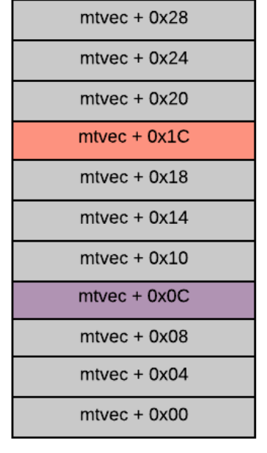
Jumping to the handler
The mtvec register has two fields:
Base [31:2]: 30 MSBs of the handler address
Mode [1:0]: Determines how table behaves
Mode | Name | Description
00 | Direct | All traps (exceptions and interrupts) jump to BASE
01 | Vectored | Exceptions go to BASE, but Interrupts jump to BASE + (4 x cause)
Offset from BASE | Cause Code | Event Type | Description
+ 0 | 0 | Exception | All synchronous exceptions (Illegal Instr, etc.)
+ 4 | 1 | Interrupt | Supervisor Software Interrupt
+ 12 | 3 | Interrupt | Machine Software Interrupt
+ 20 | 5 | Interrupt | Supervisor Timer Interrupt
+ 28 | 7 | Interrupt | Machine Timer Interrupt
+ 36 | 9 | Interrupt | Supervisor External Interrupt
+ 44 | 11 | Interrupt | Machine External Interrupt

Slide 6
Where can exceptions occur?
Stage | Example
IF | instruction fetch fault
ID | illegal instruction
EX | arithmetic overflow
MEM | page fault
WB | (rare)
Other sources:
System calls (intentional traps) Used for giving control to OS, asking OS to perform certain operation etc.
Examples
Exit program, file read / write / open / close, get_time etc.

Slide 7
Precise vs imprecise exceptions
Precise:
All earlier instructions complete execution
Faulty instruction identified
All later instructions flushed
System is in well-defined state
Imprecise:
Some earlier instructions may not have completed
Some later instructions may complete instead of flushing
System state is inconsistent and undefined
Often a result of out-of-order execution architectures
Architectures that use separate units, such as FPUs, that complete at a different time than rest of the instruction

Slide 8
Instruction Level Parallelism
Can we increase speed by executing multiple instructions parallelly?
Instructions Per Cycle (IPC) > 1: superscalar architectures

Slide 9
What we need for parallelization
Multiple hardware units (integer arithmetic units, floating point units)
Multiple RegFile read and write ports
Memory: parallelism via
hierarchy (next few classes)
scheduling (issue multiple load instructions simultaneously)
banking (even and odd addresses fetched simultaneously)
Multiple instruction fetches (similar to memory^)

Slide 10
What can happen in parallel
Only independent instructions can be executed in parallel
What if there are independent instructions, but not one after the other?
Parallel pipeline would stall at 2, but can execute 3 instead
Out of Order (OoO) execution
1: add x1, x2, x3 2: sub x4, x1, x5 ← dependent 3: mul x6, x7, x8 ← independent

Slide 11
Out of Order execution
Execute instructions as soon as operands are ready
Not strictly in program order
Results must be committed in correct order
Writeback to RegFile, memory writes must not violate instruction ordering
Is this necessary if instructions are independent?
What can go wrong if commits are not in order?
Exceptions
Memory operations (load / store from same location)
Syscalls, memory mapped I/O, interrupts

Slide 12
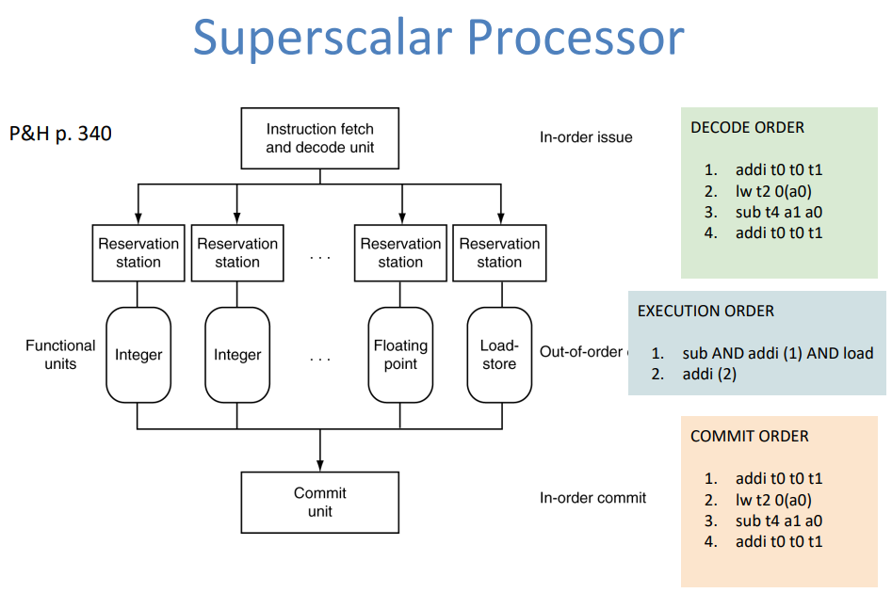
How it works
Reservation stations: Hold instructions waiting for execution
Reorder buffers: circular buffers that hold completed instruction results
Each new instruction dispatched gets a slot in the tail of the buffer
When the earliest instruction still waiting is complete, it is committed, moving the buffer forward
Register renaming
Speculative execution

Slide 13
How it works…
Register renaming
I1 and I3 are actually independent; yet share a register name, causing potential WAW and WAR hazards
Translate logical register names (x0 to X31) to physical registers (even hundred are possible to have)
Speculative execution
Not just prefetch branches, but execute branches
Keep or discard result depending on branch outcome
I1: add x1, x2, x3 I2: add x4, x5, x6 I3: add x1, x7, x8

Slide 14
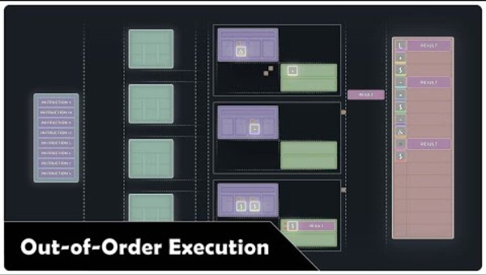
How it looks like

