Slide 1
Computer Architecture
Prof. Saurabh Gandhi (EEE department)

Slide 2
The shortcomings of a single cycle CPU
Simple instructions wait unnecessarily to accommodate loner instructions
Hardware is underutilized
Energy inefficient
Why?
Unnecessary switching, charging and discharging of long, monolithic datapath
Long combinational paths increase capacitance
Voltage cannot be reduced much because paths are long and timing is tight
Limited clock frequency
Memory access is very very slow in practice
Wire delays dominate in long datapaths in the GHz range
Clock skew becomes dominant at high frequencies and long paths
Voltage has to increase with frequency → high power dissipation → heating

Slide 3
Long monolithic datapath – the root problem with single cycle CPU
How to break the datapath?
Where to break the datapath?

Slide 4
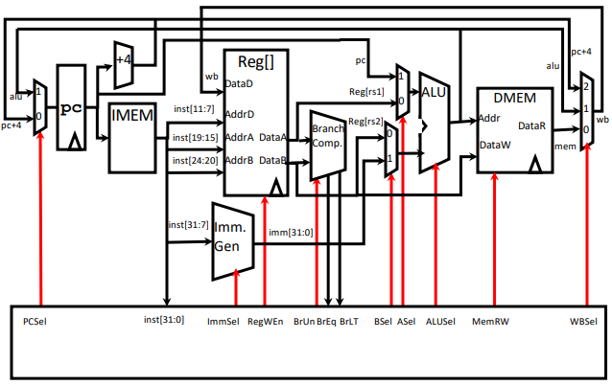
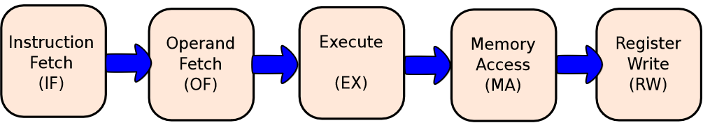
The single cycle RV32l datapath

Slide 5
How to break the datapath?
Break such that one part performs some operation in once cycle
Next part should use o/p of first part as input to the next operation
Must store output in intermediate register
ALU OUT

Slide 6
Where to break the datapath? Avoid unnecessary computations
What components are optional i.e. instruction-dependent?
Clearly, they should be put into separate stages that may or may not execute based on need
Is that sufficient?... Any other consideration?
ALU OUT
MDR

Slide 7
Where to break the datapath Reuse datapath components
What parts can be reused for avoiding hardware duplication?
ALU can be reused for:
PC ← PC + 4
Comparison (branch comparator)
Original ALU computations
Will our current breaks be sufficient for ALU reuse?
What about MEM reuse?
Cycle 1: IF → OF → EX (ALU used!)
Cycle 2: PC → PC + 4 (ALU reused!)
What about branch comparison reuse?
IR
ALU OUT
MDR

Slide 8
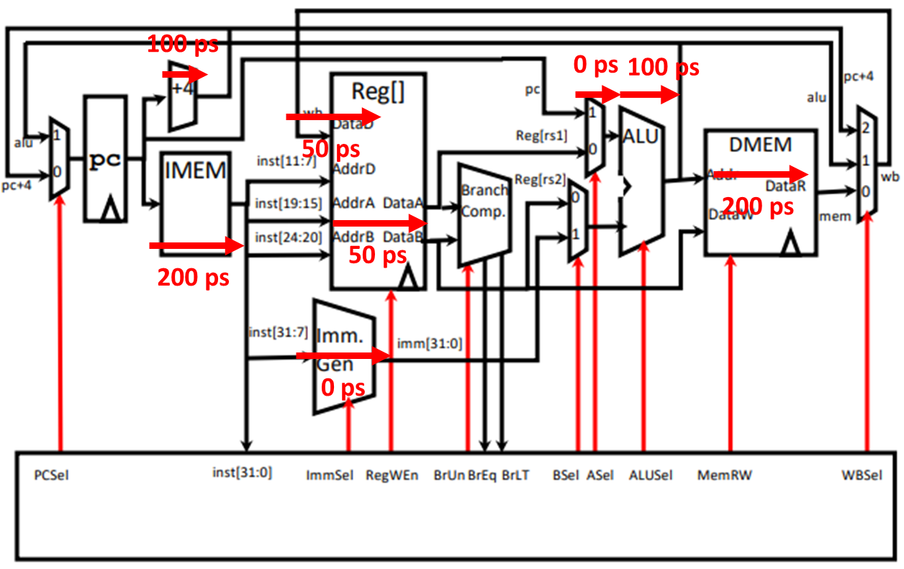
Where to break the datapath? Optimize critical path length
How long does each stage currently take?
Where to break for better time management?
IR
A
ALU OUT
MDR
B

Slide 9
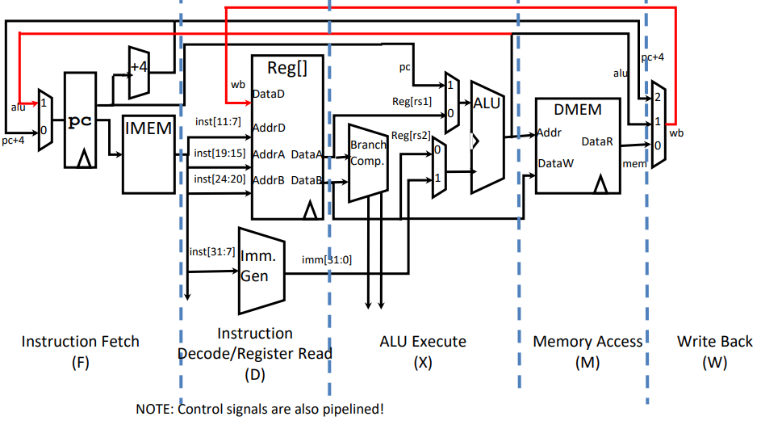
Where to break the datapath?

Slide 10
Example: lw execution
IF
IR ← Mem[PC]
PC ← PC + 4
ID
A ← RegFile[rs1]
B ← RegFile[rs2]
EX
ALUOut ← A + Imm
MEM
MDR ← Mem[ALUOut]
WB
RegFile[rd] ← MDR
How many cycles for R-type?
How many for branch?

Slide 11

Average execution time
Execution time is no longer fixed, but instruction dependent
Average execution time depends on the mix of instructions
Execution time for R-type multicycle?
Wow… what just happened?
We wanted to speed up things by not doing unnecessary computations
We successfully avoided unnecessary computations
But execution time increased?!
Short stages unnecessarily waste time waiting for infrequent long stages!

Slide 12
Evaluating multicycle
What are the other advantages of multicycle?
Multicycle (without parallelization) was commercially viable in the 80s!
Multicycle allowed complex instruction sets
Under what circumstances can multicycle actually be faster?
Given the slow memory, can we somehow gain speed improvement with multicycle?
Variable latency multicycle

Slide 13
Control becomes sequential → FSM based control
Finite state machine:
States
Input and state-dependent transitions between states
Outputs in each state
State-dependent output (no input dependence): Moore
Cleaner timing… why?
Signals change only at clock cycles, not in between
State + input dependent output: Mealy

Slide 14
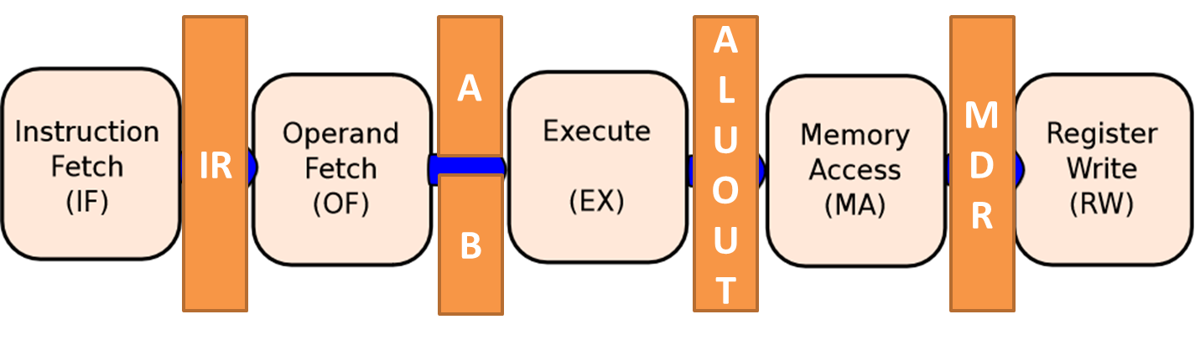
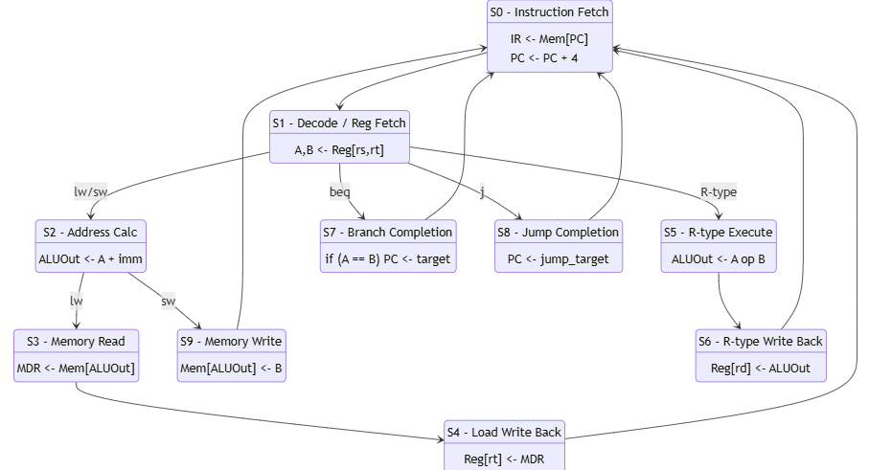
What states do we need in our RV32I multicycle processor?

Slide 15
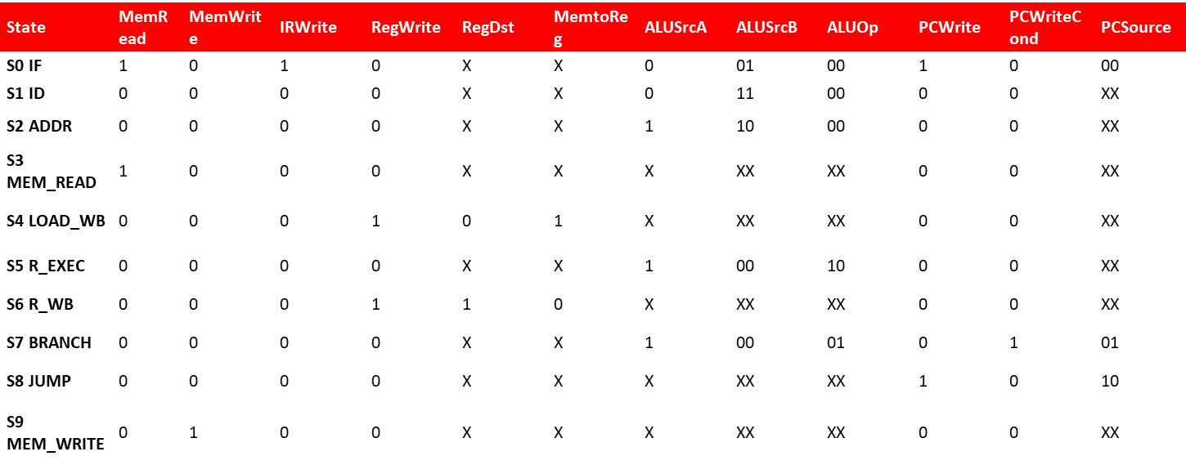
Implementing control
State register
Updated to next state with combinational logic
State-dependent combinational output logic

Slide 16
Transition table
Current State | Instruction / Condition | Next State
S0 (IF) | — | S1
S1 (ID) | R | S5
 | LW | S2
 | SW | S2
 | BEQ | S7
 | J | S8
S2 (ADDR) | LW | S3
 | SW | S9
S3 (MEM_READ) | — | S4
S4 (LOAD_WB) | — | S0
S5 (R_EXEC) | — | S6
S6 (R_WB) | — | S0
S7 (BRANCH) | — | S0
S8 (JUMP) | — | S0
S9 (MEM_WRITE) | — | S0

Slide 17
The challenge with a hardwired FSM
Complex for large ISAs
Difficult to modify
State explosion – adding one new instruction can substantially increase the number of states!

Slide 18
Structure vs behavior
Labs require several things to be modeled structurally. NOT BEHAVIORALLY.
Purpose of the labs: develop conceptual understanding and depth.
GPT is fine. IF USED FOR IMPROVEMENT and not avoidance.
Attendance only if you show results to lab instructors.
Evaluation scheme update.

Slide 19
Updated evaluation
Midsemester exam: 25% (50 marks)
Comprehensive exam: 35% (70 marks)
In-class quizzes and attendance: 15% 10% (30 marks)
Labs:
Lab tasks completion: 7.5% 5% (1.5 marks per lab)
Evaluative take-home: 7.5% 0 (1.5 marks per lab)
Lab exam: 10% 25%

Slide 20
Microprogramming
Pain points for hardwired FSM control
State explosion for rich ISAs
Difficult to modify / extend instruction set in a modular fashion
Difficult verification (verify everything after any modification
Irregular structure – difficult to optimize in silicon

Slide 21
A computer inside the computer – making control itself a program
Break up instruction processing into microinstructions
Several microinstructions → single instruction
FSM State → microinstruction
Control signals for each microinstruction stored in ROM
µPC (Micro-Program Counter): Points to the current micro-instruction
Address Select Logic: Decides the next µPC (state transition in our FSM)

Slide 22
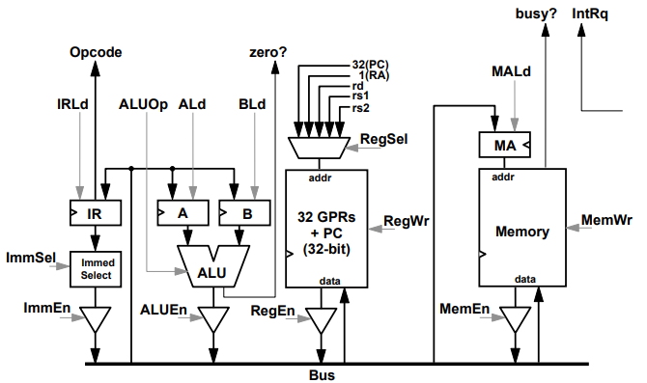
Microprogramming – datapath

Slide 23
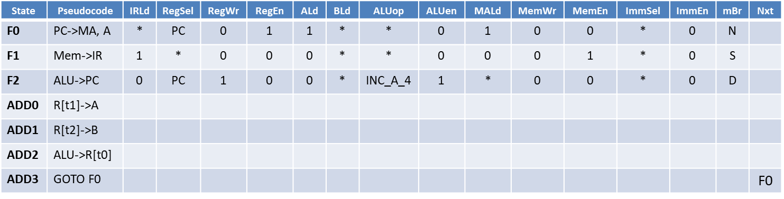
Microprogramming – control
Controller is a state machine (FSM), with transitions defined as:
N: go to next state
S: do nothing (if ‘busy?’ is asserted) else next state
D: check opcode and func and go to correct state
J: Jump to a particular state
EZ, NZ: Jump if condition true else next state
Example: add t0 t1 t2
State | Pseudocode | IRLd | RegSel | RegWr | RegEn | ALd | BLd | ALUop | ALUen | MALd | MemWr | MemEn | ImmSel | ImmEn | mBr | Nxt
F0 | PC->MA, A | * | PC | 0 | 1 | 1 | * | * | 0 | 1 | 0 | 0 | * | 0 | N
F1 | Mem->IR | 1 | * | 0 | 0 | 0 | * | * | 0 | 0 | 0 | 1 | * | 0 | S
F2 | ALU->PC | 0 | PC | 1 | 0 | 0 | * | INC_A_4 | 1 | * | 0 | 0 | * | 0 | D
ADD0 | R[t1]->A
ADD1 | R[t2]->B
ADD2 | ALU->R[t0]
ADD3 | GOTO F0 |  |  |  |  |  |  |  |  |  |  |  |  |  |  | F0

Slide 24
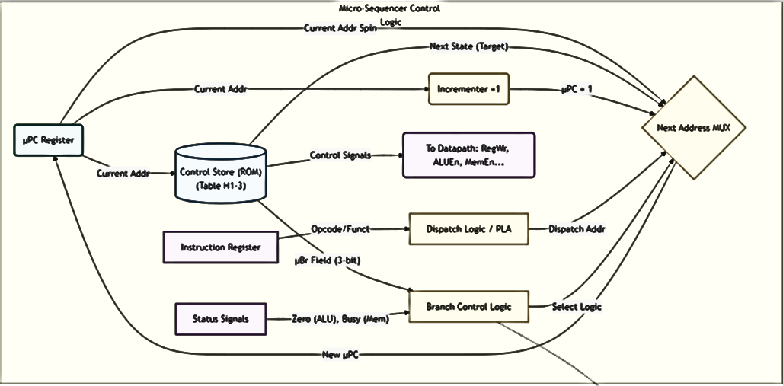
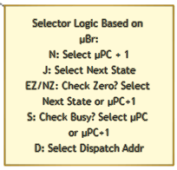
Microsequencer

Slide 25
Horizontal vs vertical microcode
Horizontal microcode:
One bit per signal (one-hot encoding in control word)
Wide control word
No decoding required
Example: 16 different alu operations will have 16 bits in the control word
Vertical microcode:
Signals are grouped into fields
Requires decoder between ROM and datapath
Example: 16 different alu ops encoded in 4-bits in control word

Slide 26
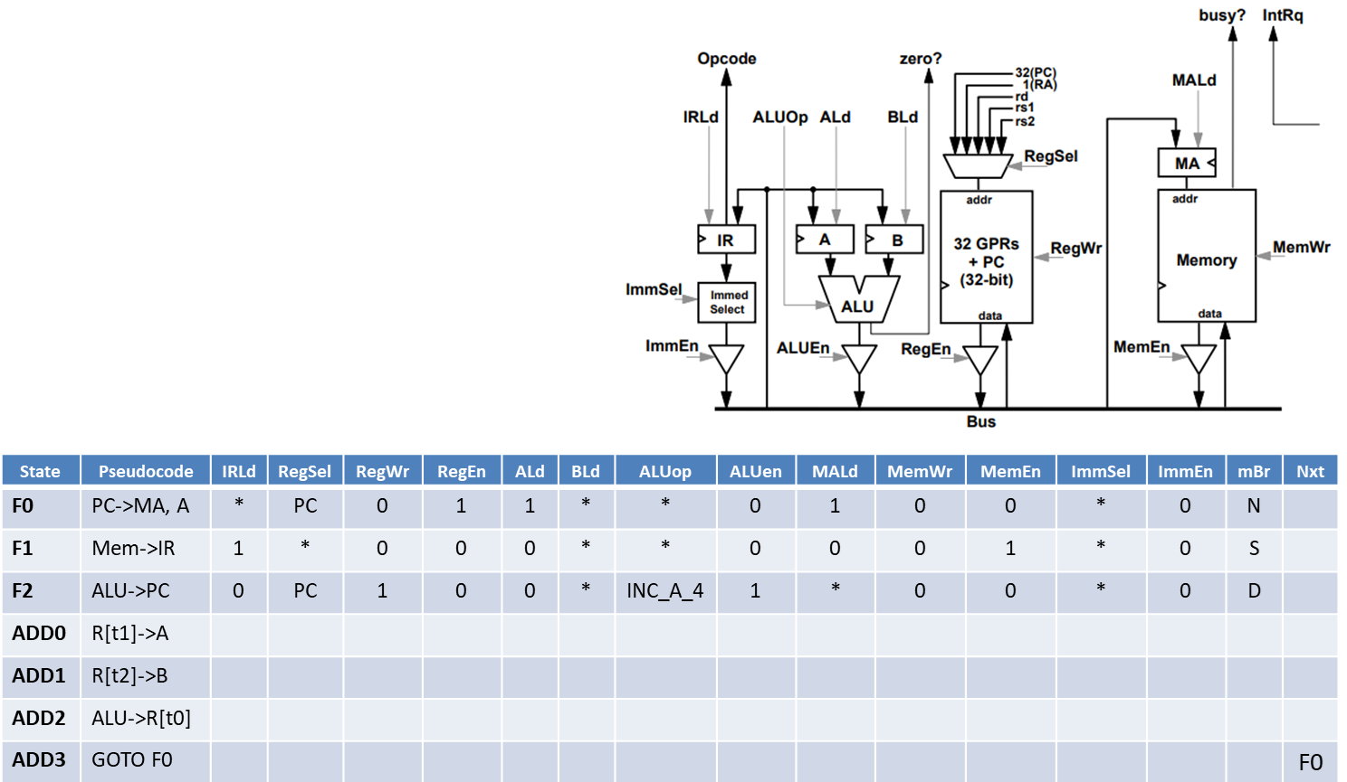
Example microcoded RISC-V implementation

Slide 27
Is microcoding relevant today?
CISC legacy: modern Intel/AMD processors are CISC outside, RISC inside
Provide complex instructions in ISA, which are actually decoded into simpler RISC-like microoperation sequences
Patching hardware bugs: updates distributed via BIOS/OS upgrades to modify ROM (also called WCS – writable control store) to fix bugs
Spectre / meltdown mitigations from Intel
Managing complex system-level algorithms
Boot sequences, frequency scaling and power management
Hybrid designs: Fast frequent path (hardwired and pipelined) + slow rare path (complex and microcoded)

