Slide 1
Computer Architecture
Prof. Saurabh Gandhi (EEE department)

Slide 2
Microprogramming
Pain points for hardwired FSM control
State explosion for rich ISAs
Difficult to modify / extend instruction set in a modular fashion
Difficult verification (verify everything after any modification
Irregular structure – difficult to optimize in silicon

Slide 3
A computer inside the computer – making control itself a program
Break up instruction processing into microinstructions
Several microinstructions → single instruction
FSM State → microinstruction
Control signals for each microinstruction stored in ROM
µPC (Micro-Program Counter): Points to the current micro-instruction
Address Select Logic: Decides the next µPC (state transition in our FSM)

Slide 4
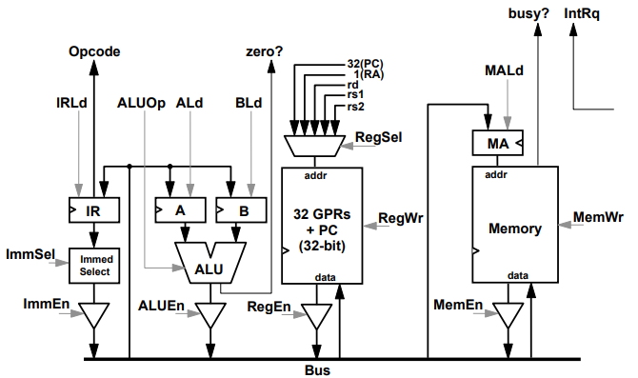
Microprogramming – datapath

Slide 5
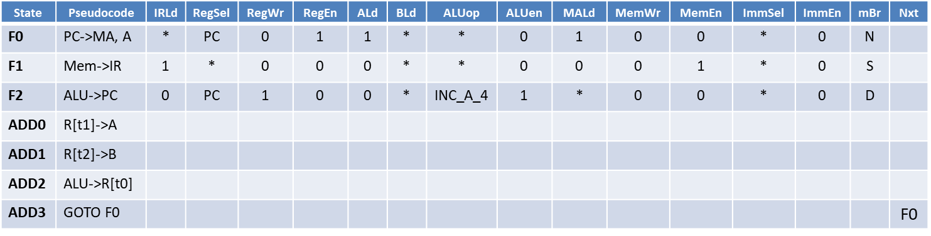
Microprogramming – control
Controller is a state machine (FSM), with transitions defined as:
N: go to next state
S: do nothing (if ‘busy?’ is asserted) else next state
D: check opcode and func and go to correct state
J: Jump to a particular state
EZ, NZ: Jump if condition true else next state
Example: add t0 t1 t2
State | Pseudocode | IRLd | RegSel | RegWr | RegEn | ALd | BLd | ALUop | ALUen | MALd | MemWr | MemEn | ImmSel | ImmEn | mBr | Nxt
F0 | PC->MA, A | * | PC | 0 | 1 | 1 | * | * | 0 | 1 | 0 | 0 | * | 0 | N
F1 | Mem->IR | 1 | * | 0 | 0 | 0 | * | * | 0 | 0 | 0 | 1 | * | 0 | S
F2 | ALU->PC | 0 | PC | 1 | 0 | 0 | * | INC_A_4 | 1 | * | 0 | 0 | * | 0 | D
ADD0 | R[t1]->A
ADD1 | R[t2]->B
ADD2 | ALU->R[t0]
ADD3 | GOTO F0 |  |  |  |  |  |  |  |  |  |  |  |  |  |  | F0

Slide 6
Horizontal vs vertical microcode
Horizontal microcode:
One bit per signal (one-hot encoding in control word)
Wide control word
No decoding required
Example: 16 different alu operations will have 16 bits in the control word
Vertical microcode:
Signals are grouped into fields
Requires decoder between ROM and datapath
Example: 16 different alu ops encoded in 4-bits in control word

Slide 7
Is microcoding relevant today?
CISC legacy: modern Intel/AMD processors are CISC outside, RISC inside
Provide complex instructions in ISA, which are actually decoded into simpler RISC-like microoperation sequences
Patching hardware bugs: updates distributed via BIOS/OS upgrades to modify ROM (also called WCS – writable control store) to fix bugs
Spectre / meltdown mitigations from Intel
Managing complex system-level algorithms
Boot sequences, frequency scaling and power management
Hybrid designs: Fast frequent path (hardwired and pipelined) + slow rare path (complex and microcoded)

Slide 8
Making things faster
Faster clocks
Device speeds
Datapath capacitance
Clock skew
Power consumption and thermal limit
Faster devices
Physical limits (electrons have finite velocity)
Memory is inherently very slow!
Parallelize instructions

Slide 9
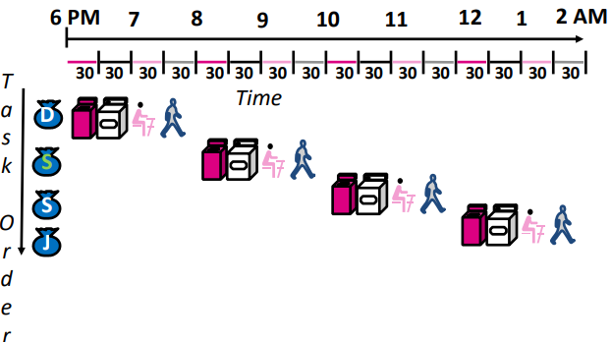
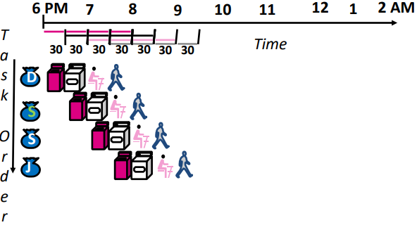
Pipelined multi-cycle processors
Does not change the latency of individual instructions
Increases the throughput of instructions
Speedup ∝ #stages
Rate limited by slowest stage

Slide 10
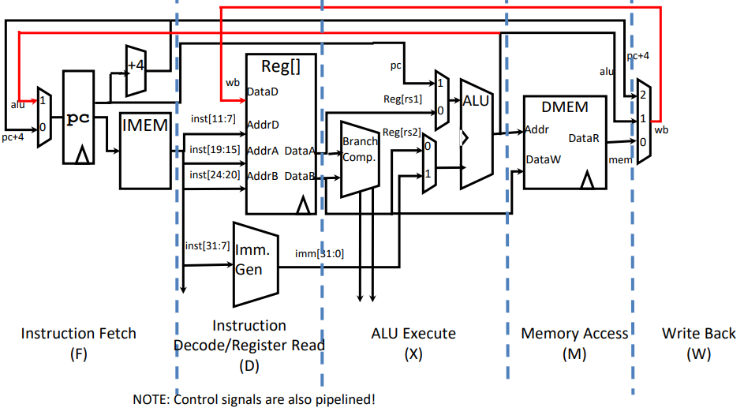
Pipelined RISC-V processor

Slide 11
What about control?
How do we modify the control circuit from the single cycle control?
Pipeline control bits!

Slide 12
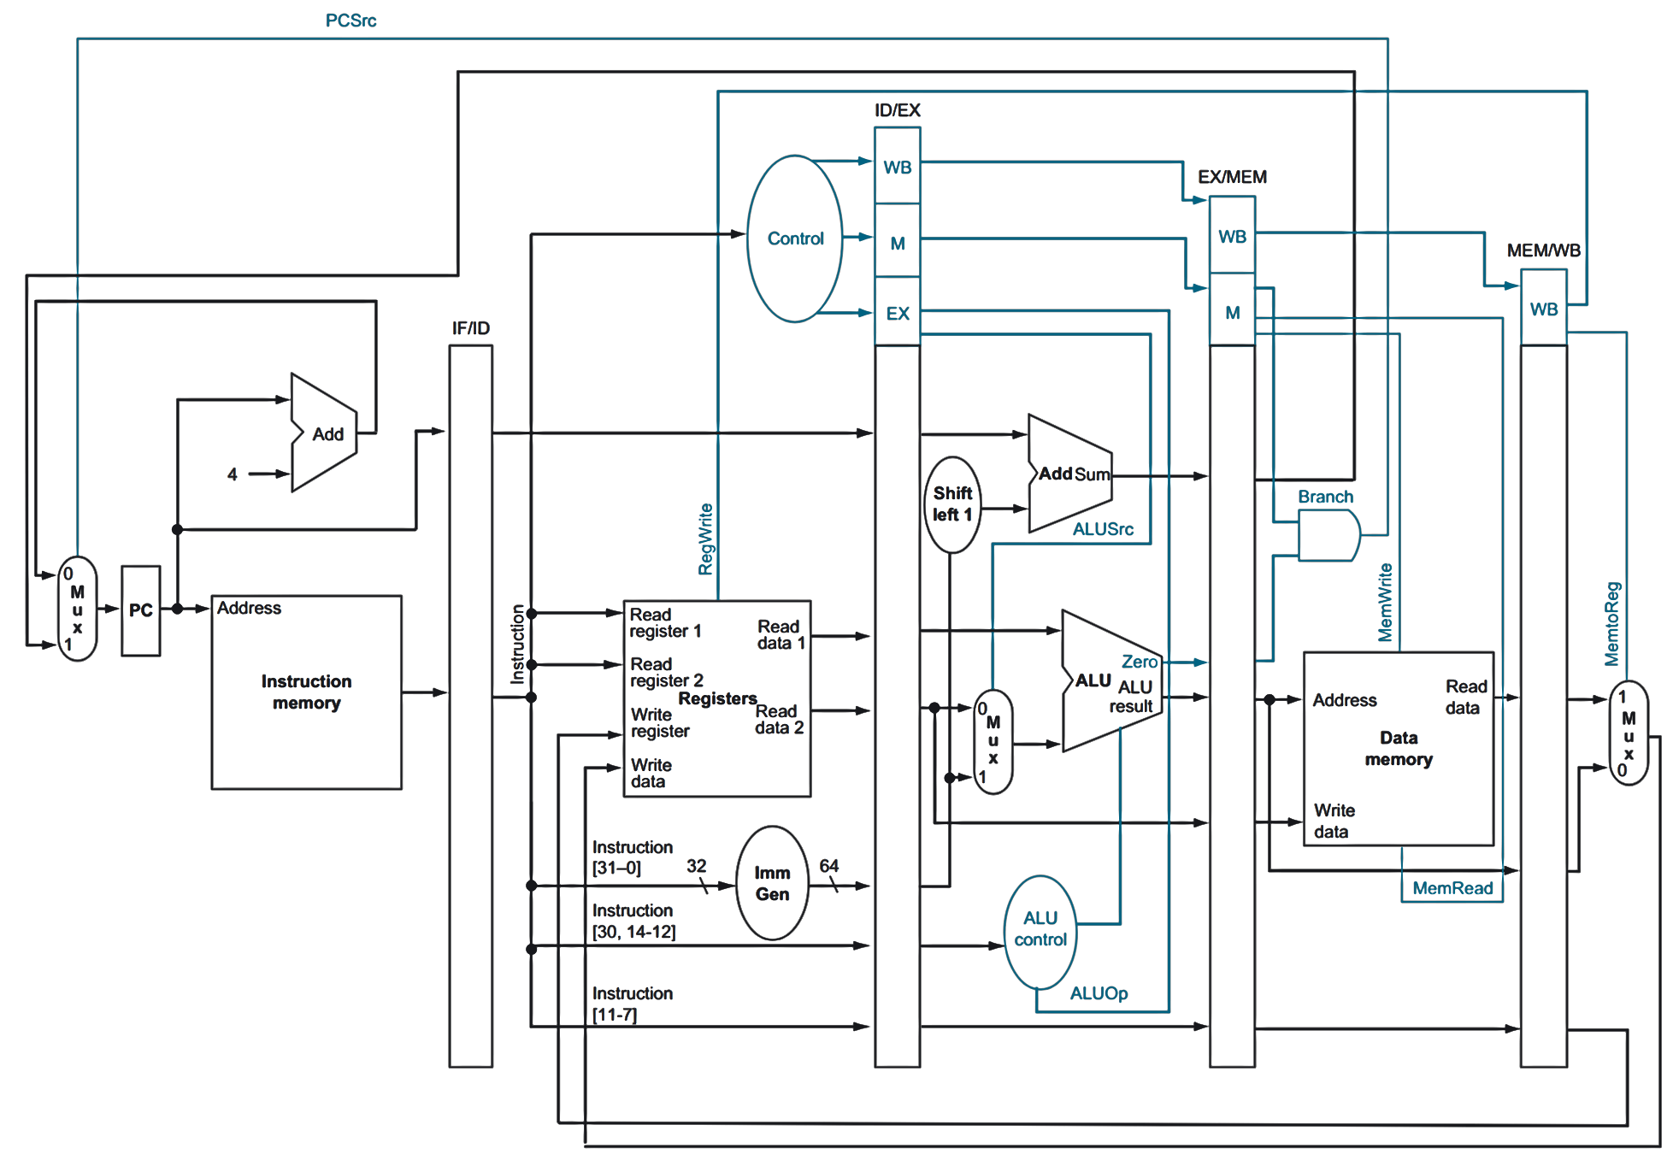
Pipelined datapath and control
What problems do you see here?

Slide 13
Pipelining hazards
A hazard is a situation that prevents starting the next instruction in the next clock cycle
Structural hazard
A required resource is busy
(e.g. needed in multiple stages)
Data hazard
Data dependency between instructions
Need to wait for previous instruction to complete its data write
Control hazard
Flow of execution depends on previous instruction

Slide 14
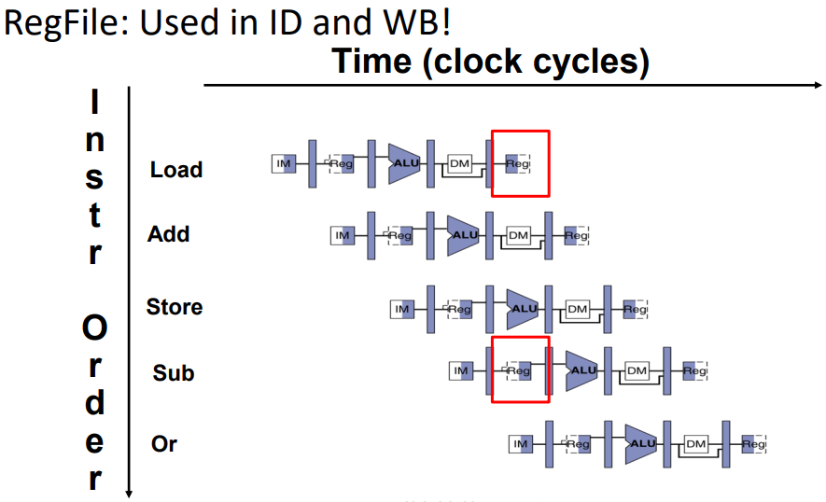
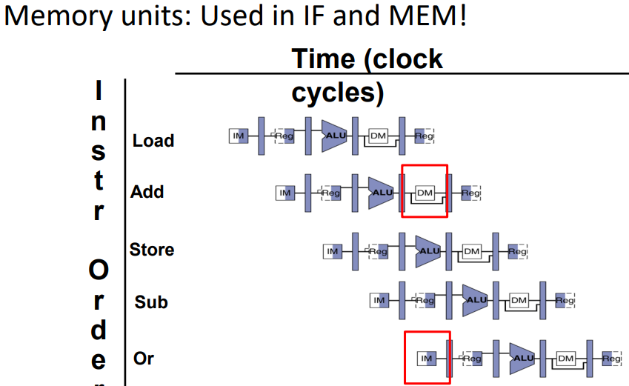
Structural hazard
Problem: Two or more instructions in the pipeline compete for access to a single physical resource
Solution 1: Instructions take turns using resource, some instructions have to stall (wait)
Solution 2: Add more hardware to machine
Can always solve a structural hazard by adding more hardware
Multiple ports to the regfile solves the access problem
Is this a problem for Harvard or von Neuman architecture (or both)?
Soln: Separate data and instruction caches
ISA designed to avoid multiple accesses

Slide 15
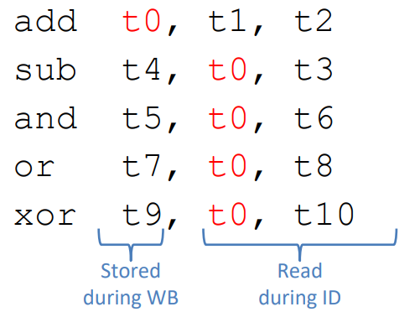
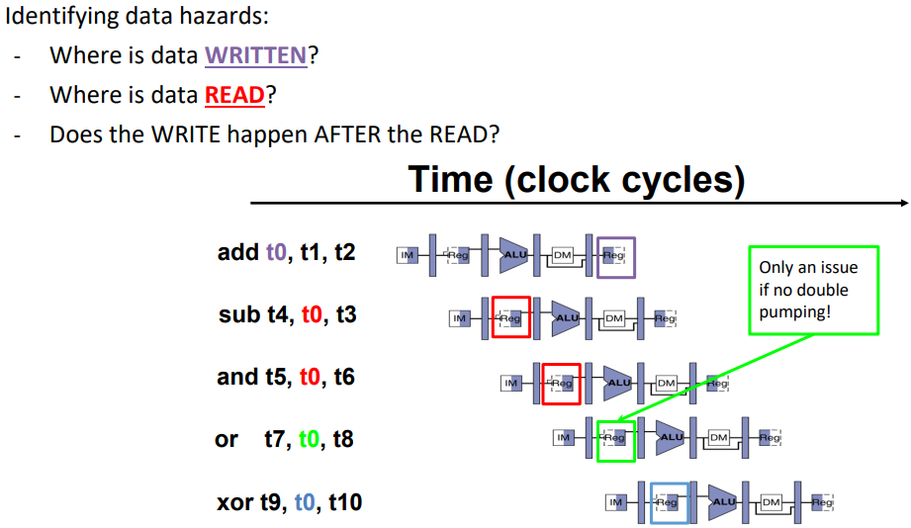
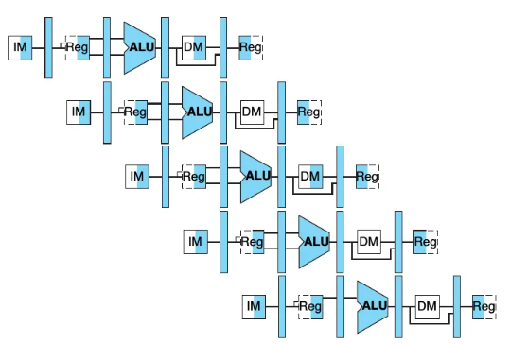
Data hazards
RAW: Read After Write (instruction tries to read before previous instruction has finished writing)
WAR: Write After Read (instruction writes to a register before a previous instruction has read from it)
WAW: Write After Write (instruction writes to a register before an earlier instruction writes to it)

Slide 16
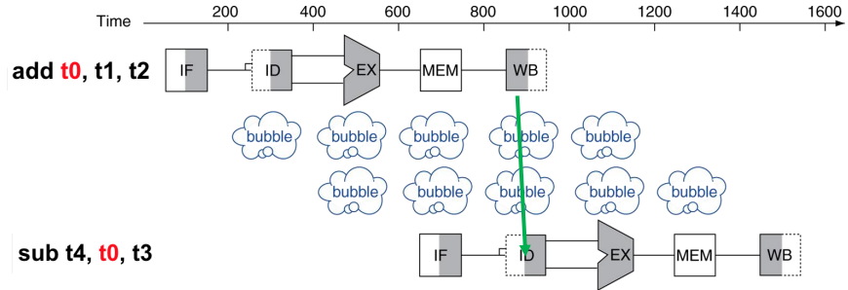


Data hazard solution – bubbles (stalling)
Bubbles: affected pipeline stages do “nothing” for a cycle.
How many bubbles in RAW?
Stalls reduce performance
How to mitigate stall performance degradation?
Compilers can arrange the instructions such that these conditions are avoided
Compilers must know how the pipeline is implemented and how instructions interact
Reduced one stall

Slide 17
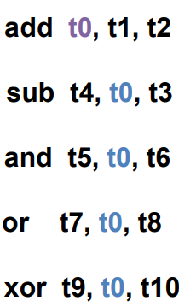

Data hazard solution – forwarding
Forwarding:
Data already available in cycle 3
Grab it from pipeline stage, rather than waiting to update the register file
Needs changes in datapath hardware as well as extra control signals!
From where should you feed the result back to ALU?

Slide 18
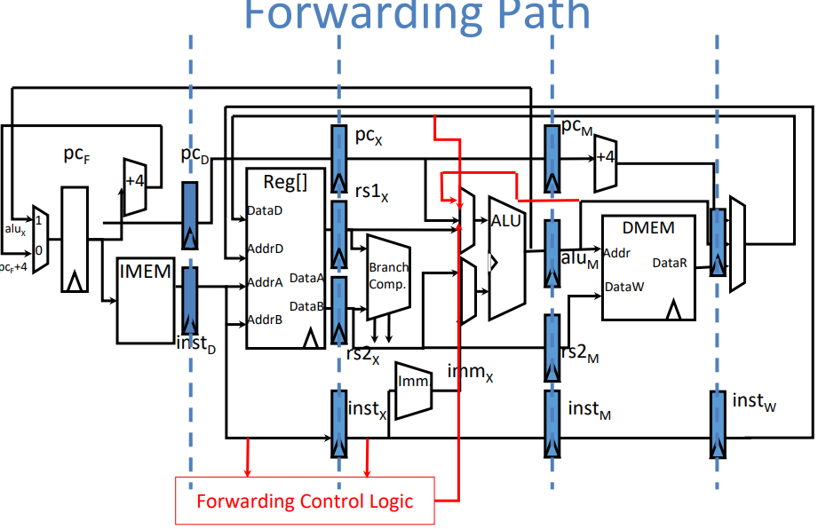
Data hazard solution – forwarding

Slide 19
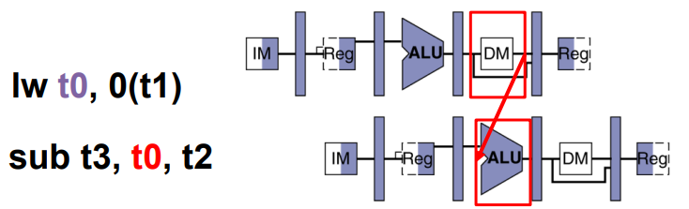
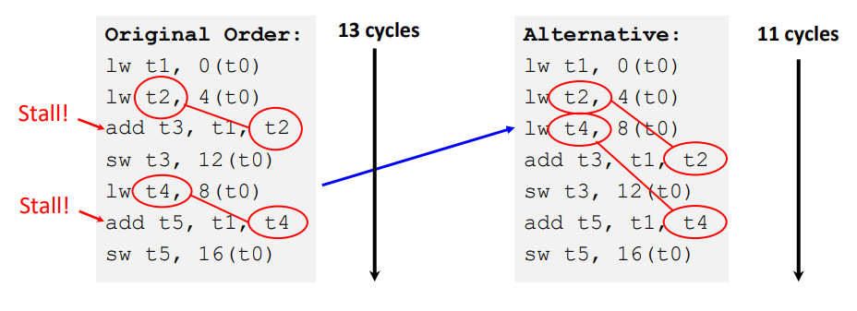
Data hazards – forwarding does not always work!
Analyze this RAW hazard. Will you need a stall if you have forwarding?
Slot after ‘load’ is called a ‘load delay slot’
Re-ordering code, if possible, is always a good solution!

Slide 20
Control hazards – branch stalls
Fetching next instruction depends on branch outcome
Pipeline can’t always fetch correct instruction
Result isn’t known until end of what stage?
Execute (conventional)
Wastes 2 cycles if branch taken
Decode (slightly better design)
Wastes 1 cycle if branch taken
Stall IF till branch decision

Slide 21
Control hazard – solutions
Prefetch one of the branches; flush the two instructions if wrong ones were prefetched
How does flush happen?
Delayed branch:
compare in one instruction
execute some unrelated instructions for next 1-2cycles
continue based on branch decision
Software solution, rarely used in modern processors
Branch prediction – fancy algorithms
Branch history table
Modern processors can predict ~95% of branches!

Slide 22
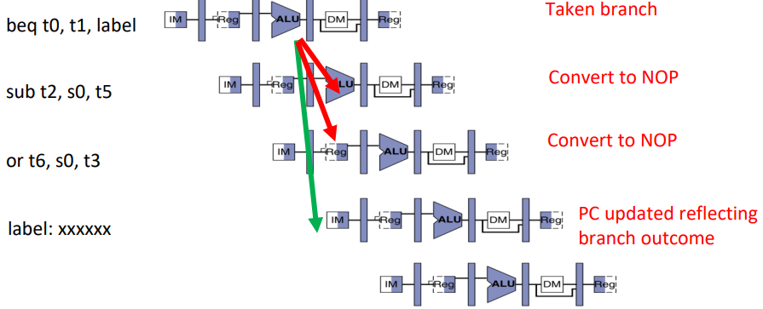
Control hazards – branch stalls
If branch not taken, then instructions fetched sequentially after branch are correct
If branch or jump taken, then need to flush incorrect instructions from pipeline by converting to NOPs
Branch prediction
Branch history tables
Many more innovations…
Notes:
Backward branches are usually taken (loops)

Slide 23
