Slide 1
Computer Architecture
Prof. Saurabh Gandhi (EEE department)

Slide 2
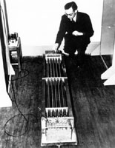
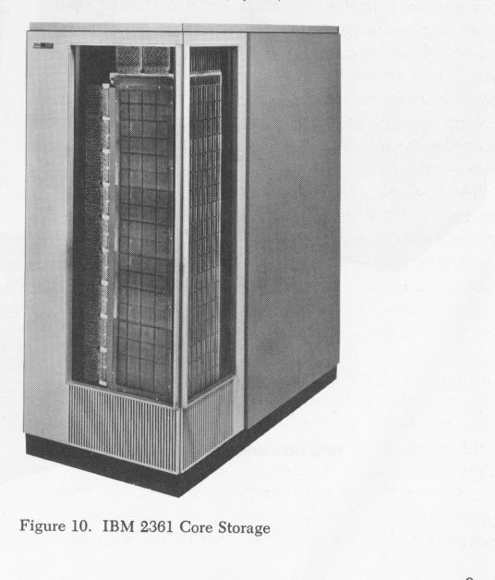
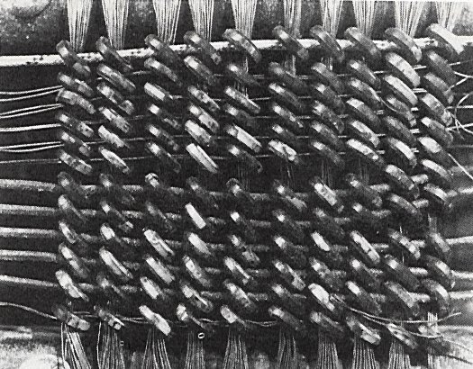

Memory Technology: 1950s
1948: Maurice Wilkes examining
EDSAC’s delay line memory tubes
16-tubes each storing 32 17-bit words
1952: IBM 2361 16KB magnetic core memory
Maurice Wilkes: 2005

Slide 3
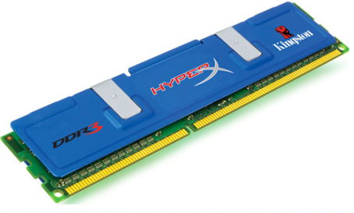
Memory Technology Today: DRAM
DDR SDRAM
Double Data Rate
– Synchronous Dynamic RAM
The dominant memory technology in PC market
Delivers memory on the positive and negative edge of a clock (double rate)
Generations:
DDR (MemClkFreq x 2(double rate) x 8 words)
DDR2 (MemClkFreq x 2(multiplier) x 2 x 8 words)
DDR3 (MemClkFreq x 4(multiplier) x 2 x 8 words)
DDR4 (released in 2014)
DDR5 (in Q3 2021)

Slide 4
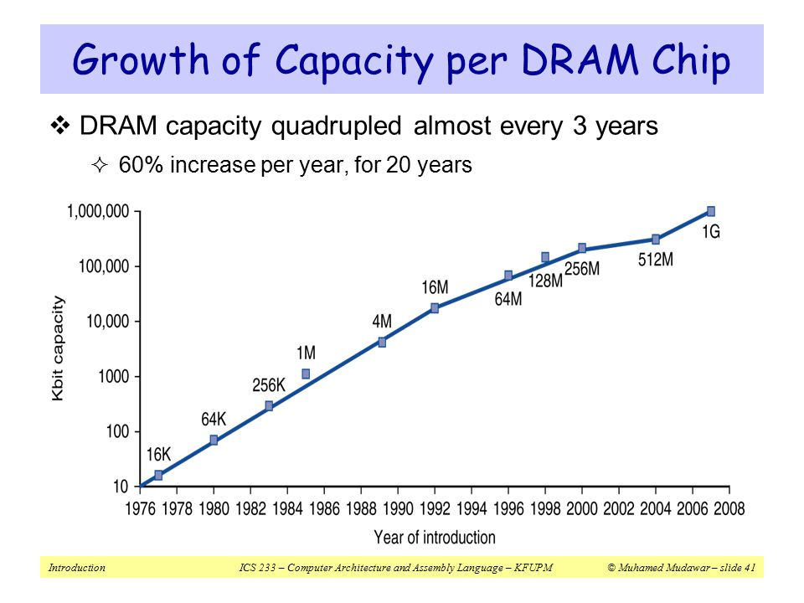
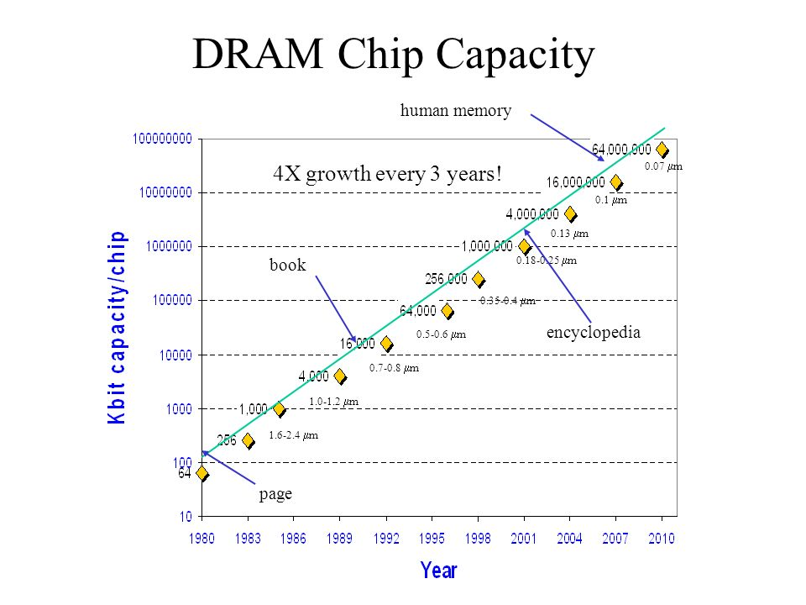
DRAM Capacity Growth
Unprecedented growth in density, but we still have a problem

Slide 5
Processor-DRAM Performance Gap
Memory Wall:
1GHz Processor ➔ 1 ns per clock cycle
50ns for DRAM access ➔ 50 processor clock cycles per memory access!
1000
CPU
“Moore’s Law”
100
Performance
10
DRAM
1
1980
Time
1981
1982
1983
1984
1985
1986
1987
1988
1989
1990
1991
1992
1993
1994
1995
1996
1997
1998
1999
2000

Slide 6
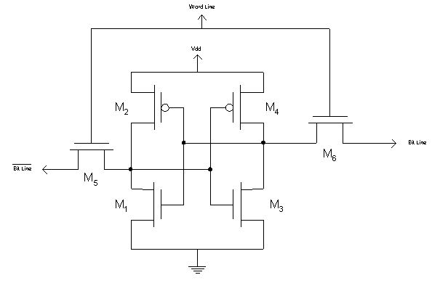
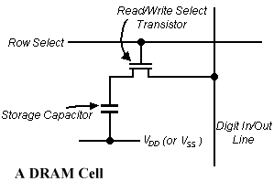
Faster Memory Technology: SRAM
A SRAM Cell
SRAM
6 transistors per memory cell
→ Low density
Fast access latency of 0.5 – 5 ns
More costly
Uses flip-flops
DRAM
1 transistor per memory cell
→ High density
Slow access latency of 50-70ns
Less costly
Used in main memory

Slide 7
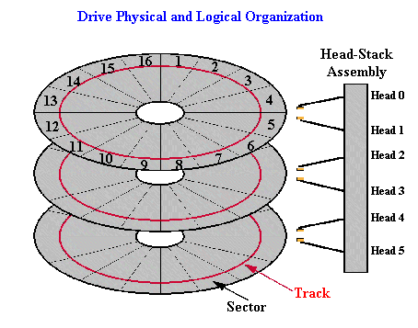
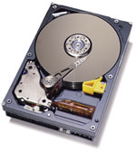
Slow Memory Technology: Magnetic Disk
Typical high-end hard disk:
Average Latency: 4 - 10 ms
Capacity: 500-2000GB

Slide 8
Quality vs Quantity
Processor
Memory
(DRAM)
Devices
Control
Input
Datapath
Registers
Output
(Harddisk)
 | Capacity | Latency | Cost/GB
Register | 100s Bytes | 20 ps | $$$$
SRAM | 100s KB | 0.5-5 ns | $$$
DRAM | 100s MB | 50-70 ns | $
Hard Disk | 100s GB | 5-20 ms | Cents
Ideal | 1 GB | 1 ns | Cheap

Slide 9
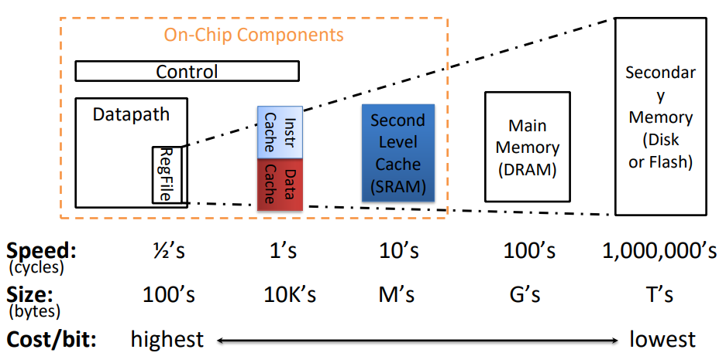
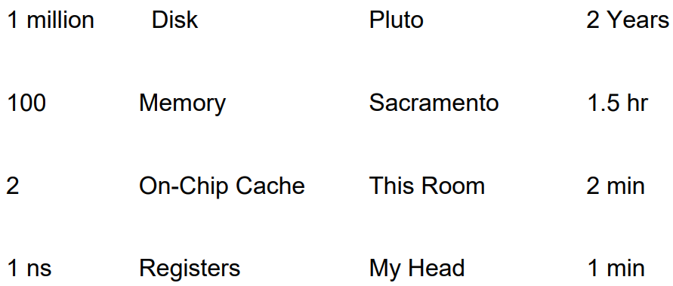
Just how slow is the school bus?
Main memory uses dynamic RAM (DRAM)
Lower power, cheaper ($20 to $40 per GB in 2011)
Slower (typical access times of 50 to 70 ns)
Dynamic: needs to be “refreshed” regularly (~ every 8 ms)
Caches use static RAM (SRAM)
Fast (typical access times of 0.5 to 2.5 ns)
Higher power, expensive ($2000 to $4000 per GB in 2011)
Static: content will last as long as power is on

Slide 10
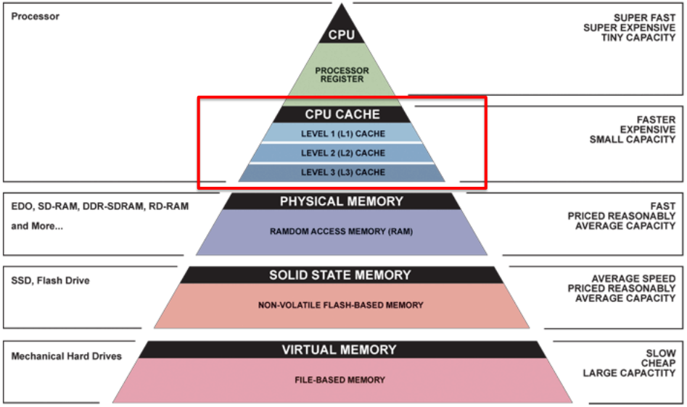
Tradeoffs across a variety of memory technologies

Slide 11
Best of Both Worlds
What we want:
A BIG and FAST memory
Memory system should perform like 1GB of SRAM (1ns access time) but cost like 1GB of slow memory
Key concept:
Use a hierarchy of memory technologies:
Small but fast memory near CPU
Large but slow memory farther away from CPU

Slide 12
Writing reports before the age of internet – an analogy
You have to write a report on the ‘History of computers’, by referring books in the library
You pick 2-3 relevant books and sit at a desk to read
You realize you need to refer to a few more books; what do you do?
Keep the current books on the desk and bring the new ones you need
All the books that you may need are on the desk, easily accessible
Only a small fraction of the total number of books in the library
You are done and want to write the next report on semiconductor technology – what do you do?
Return all ‘history of computer’ books to the shelves and bring ‘semiconductor’ books to your desk

Slide 13
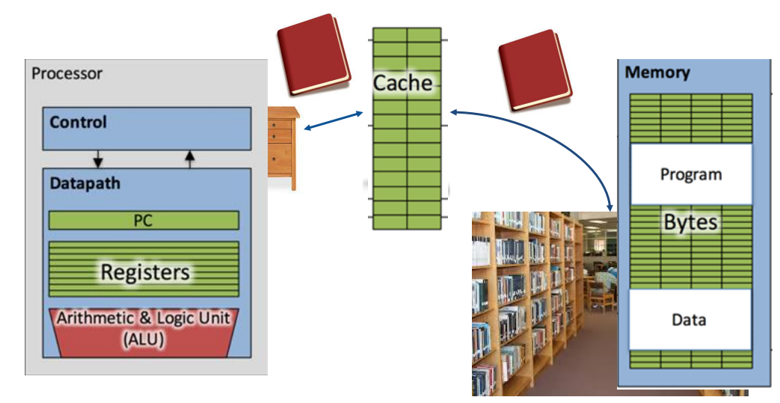
The stack of books on your desk is called a cache

Slide 14
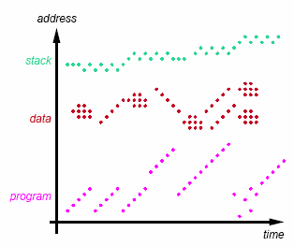
The principle of locality
Programs access only a small portion of memory address space at a given time
Instructions
Sequential execution
Loops
Data
Arrays
Structs
Stack
Heap
Temporal Locality (locality in time)
Go back to the same book on desk multiple times
If a memory location is referenced, then it will tend to be referenced again soon
Spatial Locality (locality in space)
When go to shelves, grab many books on computers since related books are stored together
If a memory location is referenced, the locations with nearby addresses will tend to be referenced soon
Caches: Use the principle of locality to create the illusion of memory being almost as fast as fastest memory and almost as large as biggest memory of the hierarchy

Slide 15
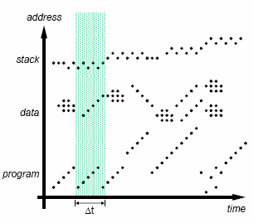
Working Set: Definition
Set of locations accessed during Δt
Different phases of execution may use different working sets
Our aim is to capture the working set and keep it in the memory closest to CPU

Slide 16
Two Aspects of Memory Access
Processor
Memory
(DRAM)
Devices
Control
Input
Datapath
Registers
Cache
(SRAM)
Output
(Harddisk)
How to make SLOW main memory appear faster?
Cache – a small but fast SRAM near CPU
Hardware managed: Transparent to programmer
How to make SMALL main memory appear bigger than it is?
Virtual memory
OS managed: Transparent to programmer

Slide 17
What is a cache?
Memory Cache
Holds a copy of a subset of main memory
We often use $ (“cash”) to abbreviate cache (e.g. D$ = Data Cache, L1$ = Level 1 Cache)
Modern processors have separate caches for instructions and data, as well as several levels of caches implemented in different sizes
Implemented with same IC processing technology as CPU and integrated on-chip
Faster but more expensive than main memory

Slide 18

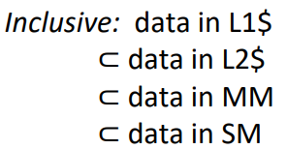
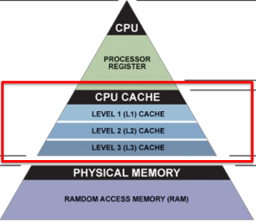
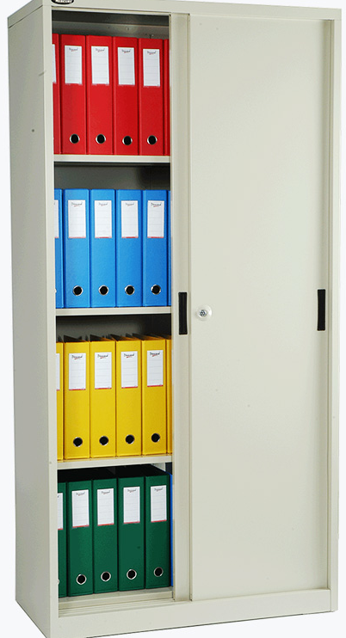

Memory hierarchy
What if we run out of desk space and need more books?
L3: Engineering section
L1: History of computers
L2: All books on Computers
How do we manage all the books in different locations?
When to go to L1 / L2 / L3 / Main memory?
When to bring a book from shelf to cupboard?
When to bring from cupboard to desk?
If desk is full, which book to put back?

Slide 19
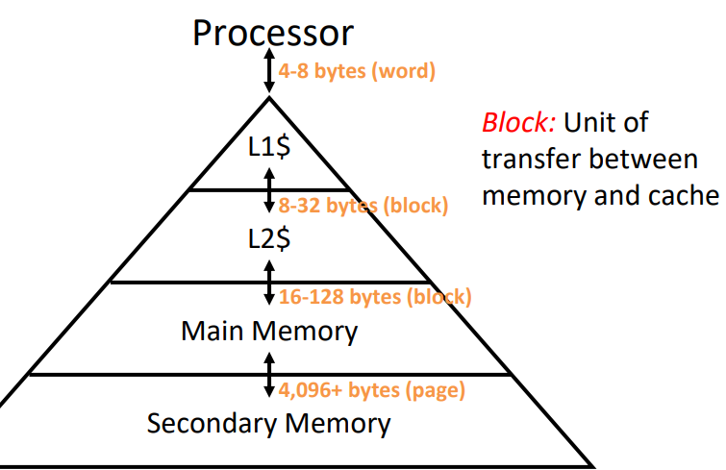
Memory transfer in the hierarchy
registers ↔ memory By compiler (or assembly level programmer)
cache ↔ main memory By the cache controller hardware
main memory ↔ disks (secondary storage)
By the OS (virtual memory)
Virtual to physical address mapping assisted by the hardware (TLB)
By the programmer (files)

Slide 20
Cache management – four important questions to resolve
Where to put the data? When we copy a block of data from main memory to the cache, where exactly should we put it?
How to find the data? How can we tell if a word is already in the cache, or if it has to be fetched from main memory first?
How to replace data? Eventually, the small cache memory might fill up. To load a new block from RAM, we’d have to replace one of the existing cache blocks... which one?
How to write data? How can write operations be handled by the memory system?

Slide 21
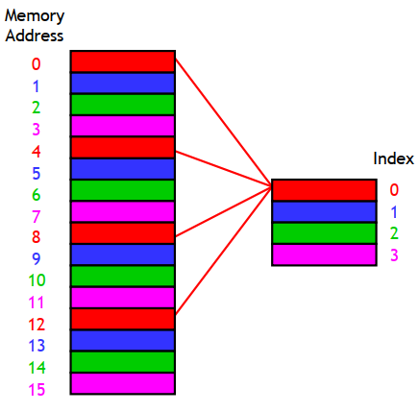
Question 1: Where to put the data?
Direct-mapped cache
Each main memory address maps to exactly one cache block
For example, on the right is a 16-byte main memory and a 4-byte cache (four 1-byte blocks)
Memory locations 0, 4, 8 and 12 all map to cache block 0
Addresses 1, 5, 9 and 13 map to cache block 1, etc.
How can we compute this mapping?
main memory
cache

Slide 22
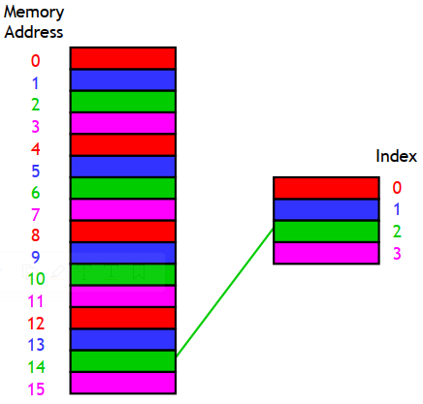
Question 1: Where to put the data?
Computing the mapping – modulo operation
If the cache contains 2^{k} blocks, then the data at memory address i would go to cache block index i mod 2^{k}
For instance, with the four-block cache here, address 14 would map to cache block 2
14 mod 4 = 2
main memory
cache

Slide 23
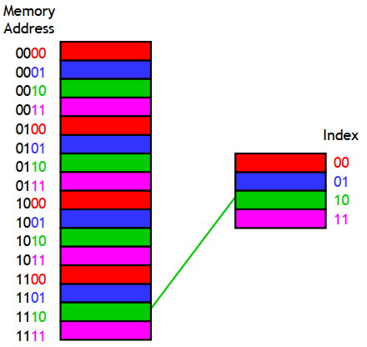
Question 1: Where to put the data?
Computing the mapping – least significant address bits
With our four-byte cache we would inspect the two least significant bits of our memory addresses
Address 14 (1110 in binary) maps to cache block 2 (10 in binary)
Taking the least k bits of a binary value is the same as computing that value mod 2^{k}
main memory
cache

Slide 24
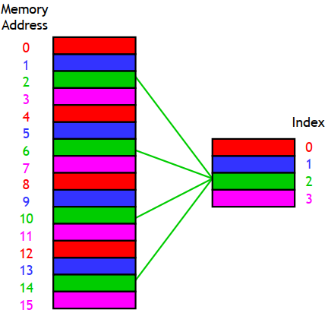
Question 2: How to find the data?
When the CPU wants to read data at a particular main memory address, how can it check whether the cache contains the data?
Problem: Different main memory locations map on to the same location in the cache
For instance, cache block 2 could contain data from addresses 2, 6, 10 or 14
Solution: Store ‘tags’ along with the data to identify the source
main memory
cache

Slide 25
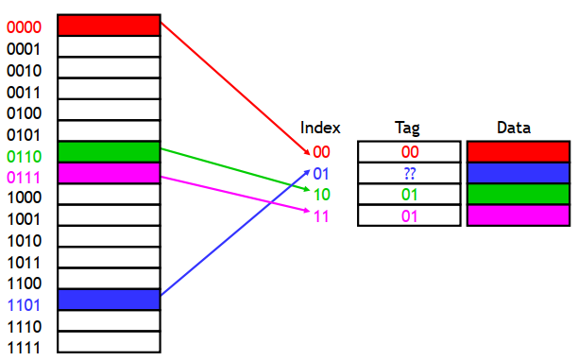
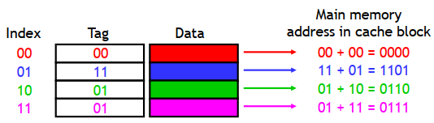
Question 2: How to find the data?
What are the tags?
<Tag><index> == main memory address!

Slide 26
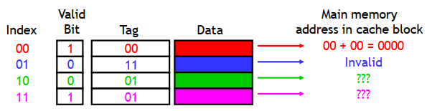
Question 2: How to find the data?
The valid bit
The cache starts out empty, so how do we know if at any location, it is actual data or the default value?
Add a ‘valid’ bit to each location: 0 means invalid and 1 means data is valid

Slide 27
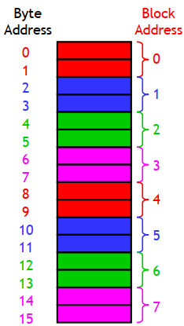
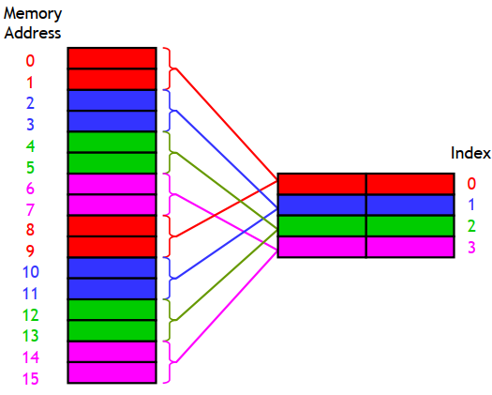
Taking advantage of spatial locality
If we access 0, we are likely to access 4 and perhaps 8 also… but we are keeping only one of them in the cache
Solution: make the cache block size larger than one byte

Slide 28


Locating a byte within the cache block – block offsets
Assume we have a cache with 2^{k} blocks, each containing 2^{n} bytes
k bits of the address will select one of the 2^{k} cache blocks
The lowest n bits are a block offset within the block

Slide 29
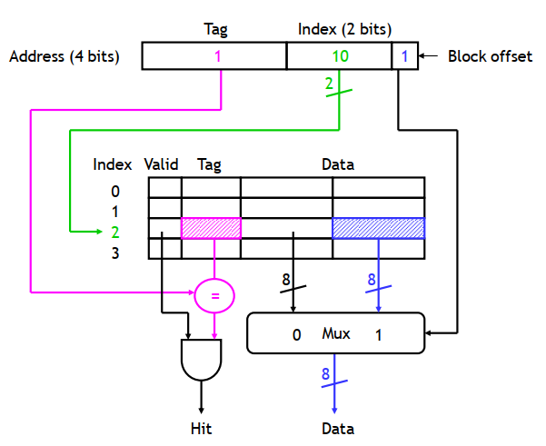
A circuit to implement direct-addressed cache

Slide 30
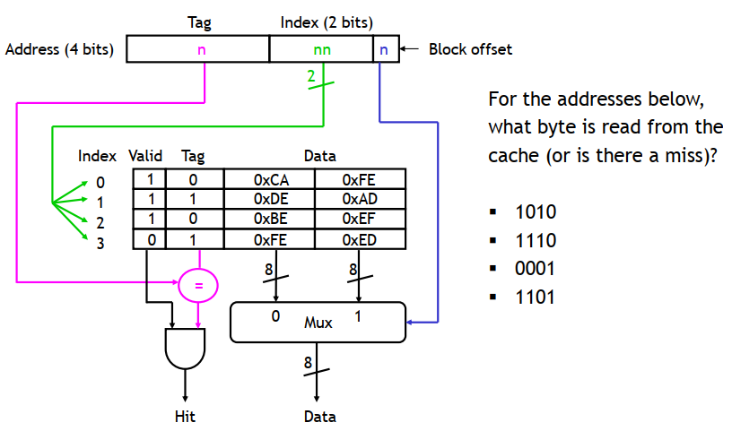
A circuit to implement direct-addressed cache

Slide 31
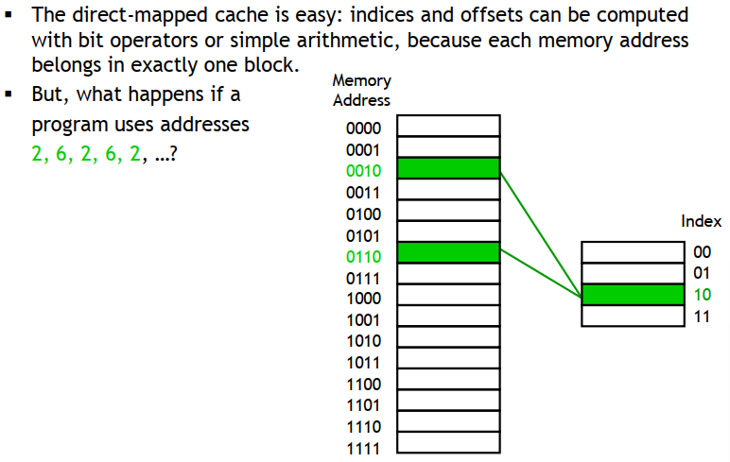
Disadvantage of direct mapped cache
Rendered ineffective!
Cache may also be wasted – empty slots
What about replacement policy? Do we need one?

Slide 32
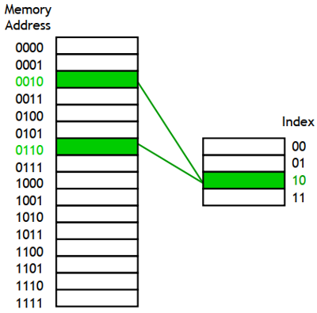
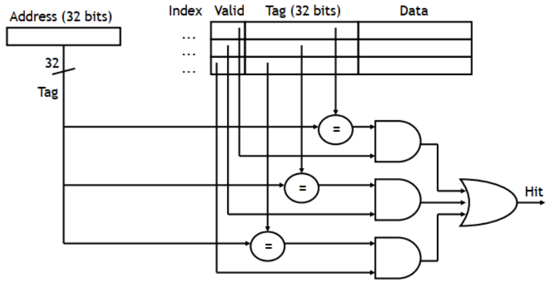
Fully associative caches
Store data in any cache block (where to put the data)
What is the trade-off here?
How to find data?
Entire address must be used as tag (more cache ‘wasted’)
Data can be in any cache block, so each tag must be compared to the address to check if data is available in the cache!
How many comparators do you need?
= # cache blocks
How parallel?
Content Associative Memory – expensive and power hungry

Slide 33
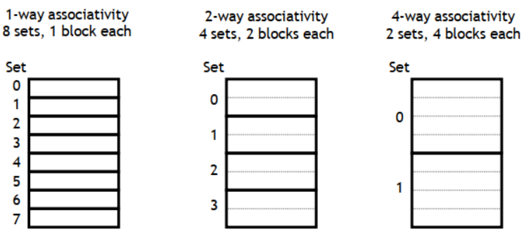
Set associative caches
Somewhere in between direct mapped and fully associative caches
Cache divided into multiple sets of blocks
Each memory address maps to exactly one set, but it can be in any block within the set
If each set has 2^{s} blocks, it is said to be 2^{s}-way associative cache
Example: we have a cache with 8 blocks:

Slide 34
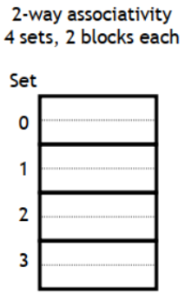
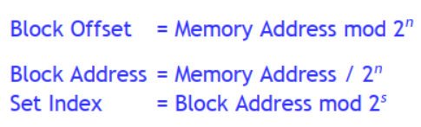

Question 1: Where to put the data (set associative caches)
What set does the data belong to? Within the set it can be put anywhere
Assume the cache has 2^{s} sets, and each block has 2^{n} bytes
Least n bits of address determine the block offset within the block
Next least s bits of address determine the set address (set index)
Remaining bits will be tag

Slide 35
Question 2: How to find the data?
Example: Find data with memory address 6195 Cache has 8 blocks with 16 bytes per block
6195 in binary is 00...0110000 011 0011
How many bits is the block offset?
4
How many sets do we have for 1-way, 2-way and 4-way designs?
8, 4 and 2
How many bits do we need for set index?
3, 2 and 1
Set index for our address will be:
011 for 1-way; 11 for 2-way; and 1 for 4-way
Data can go in any block within the set
Remaining bits are the tag

Slide 36
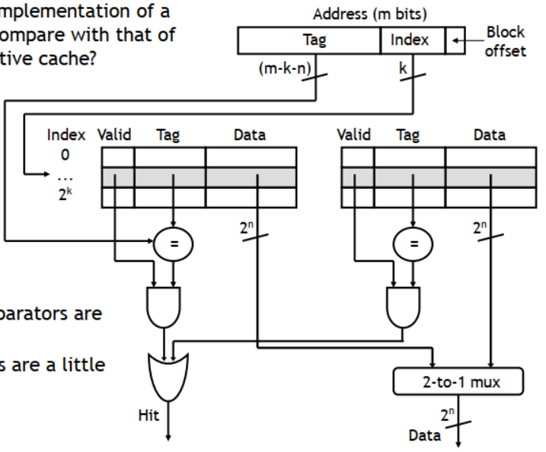
Implementation of a set-associative cache

Slide 37
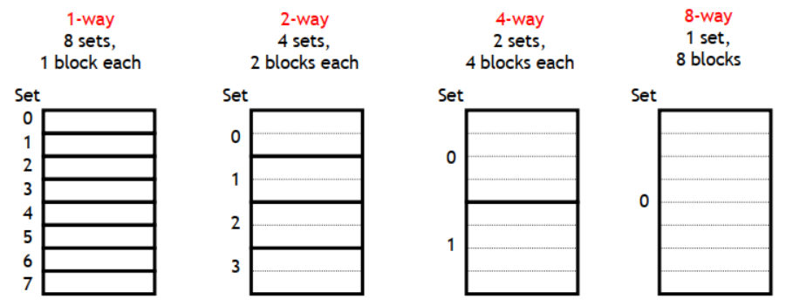
Set associative caches are a general idea
1- way set associative == direct mapped
If a cache has 2^{k} blocks, a 2^{k}-way set associative cache would be the same as a fully-associative cache.

Slide 38
Question 3: How to remove data to accommodate new data?
Block replacement policies
Need to replace a block only if no more empty blocks left in the set and we need to load data
Best policy: remove what will not be needed for the longest time (cannot know beforehand)
Random replacement
Queue based: FIFO, LIFO, FILO
Recency-based: Least Recently Used (LRU), Most Recently Used (MRU), Time-aware LRU
Frequency-based: LFU, MFU (?)
https://en.wikipedia.org/wiki/Cache_replacement_policies for an extensive list
LRU
Have to keep track of ‘last used’ for each block

Slide 39

Replacement policies

Slide 40
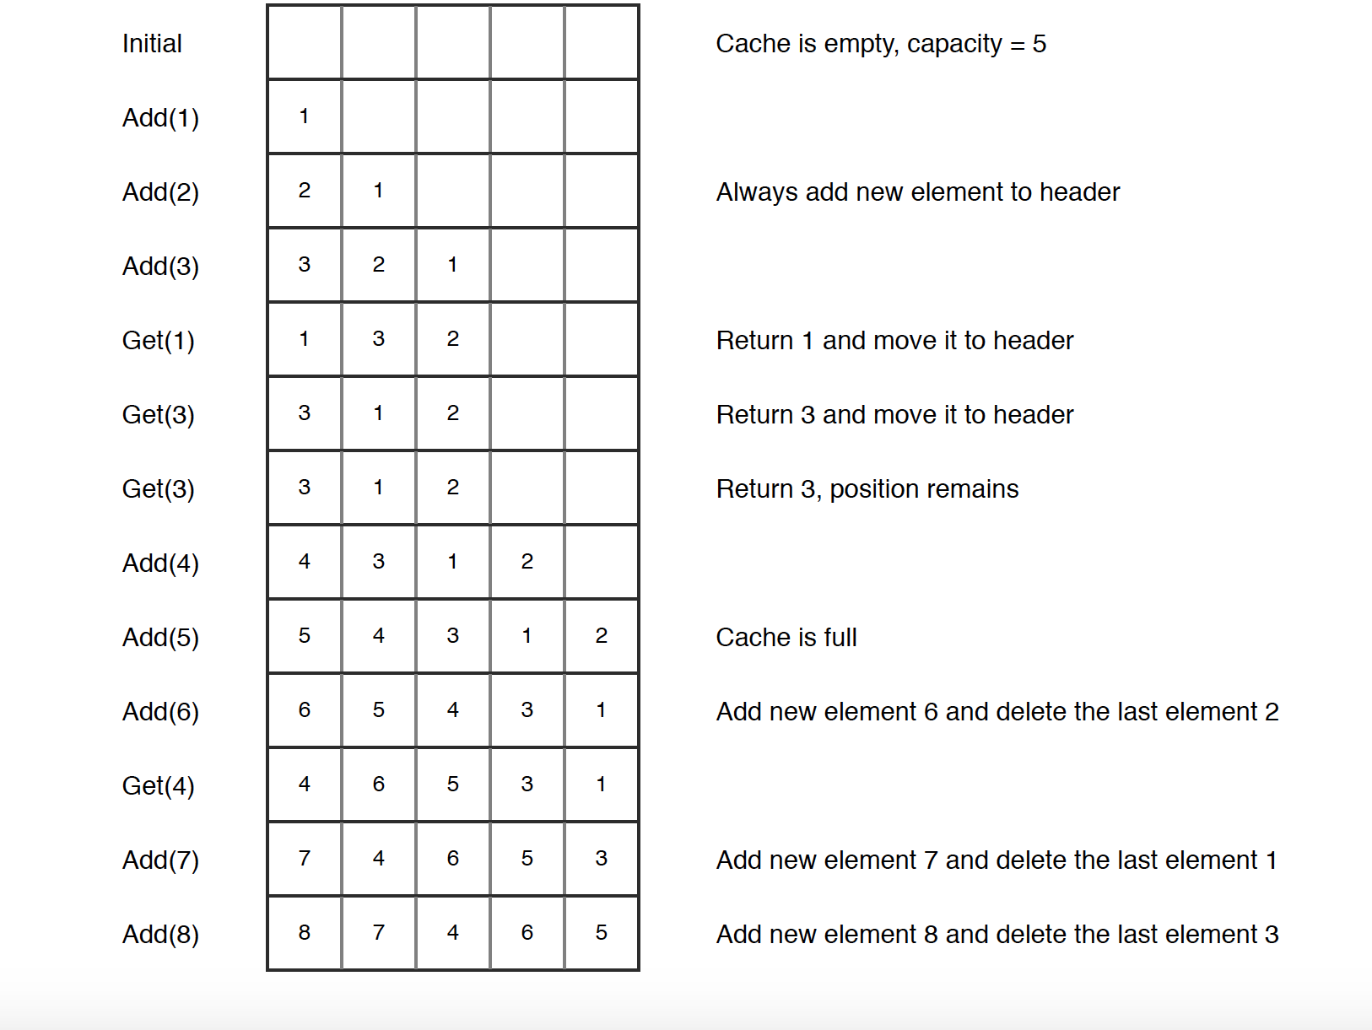
LRU cache

Slide 41
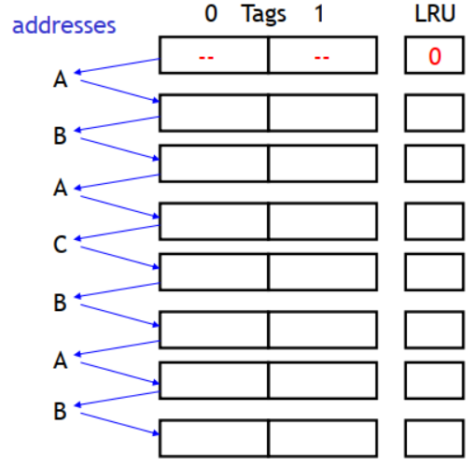
Example of LRU
Assume a fully-associative cache with two blocks, which of the following memory references miss in the cache?
Also assume distinct addresses go to distinct blocks

Slide 42
How to write data?
Write-through policy
Always write data to cache and the memory (i.e. never write to cache-only)
Cache and memory are always forced to be consistent – good!
Each memory write access as slow as main memory access – slow!
Write to a ‘buffer’ and separate hardware updates main memory while processor moves forward
Write-back policy
Write data only to cache; update memory when the block is removed
Cache and memory can be inconsistent for some time
Multiple writes to the same block collected in the cache; written back together
Dirty bit: Extra bit for each cache block to indicate whether it needs to be written back
Write-allocate policy
If there is a miss for a write, bring that data into cache and then update it
Typically paired with write-back
No write allocate: just change the main memory directly
Typically paired with write-through

Slide 43
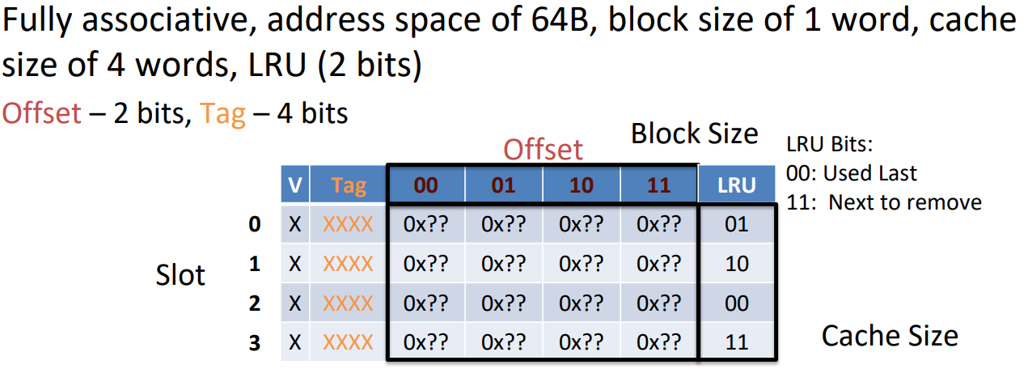
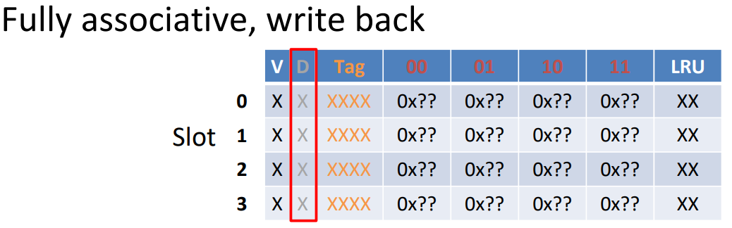
A picture of the cache

Slide 44
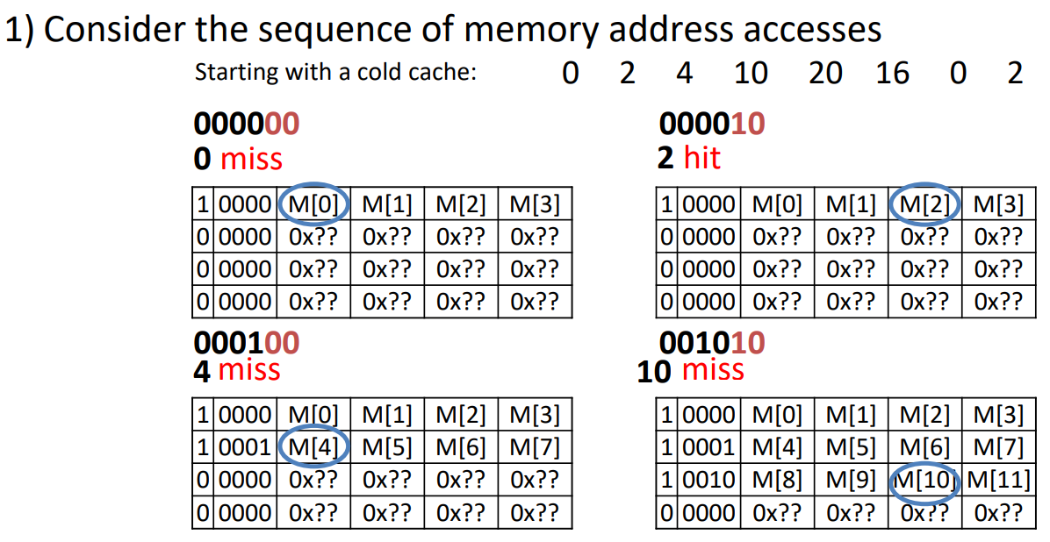
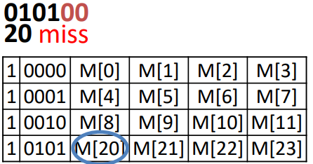
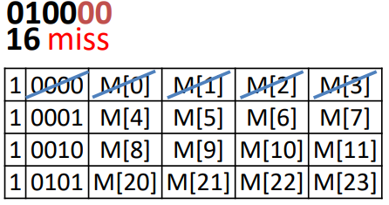
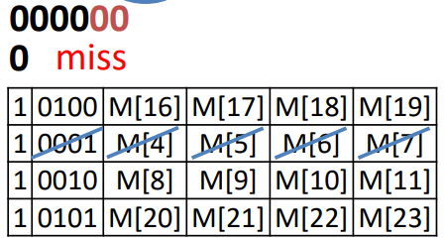
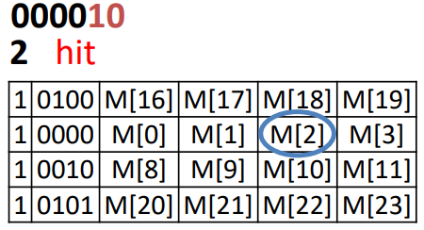
Fully associative cache example operation (LRU)

Slide 45
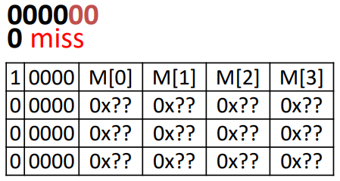
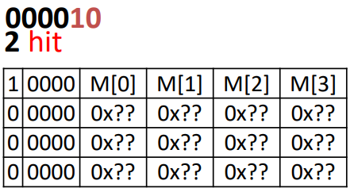







Fully associative cache example operation (LRU)

Slide 46








Fully associative cache example operation (LRU)

Slide 47








Direct mapped cache example operation (LRU)

Slide 48









Set-associative cache example operation (LRU)

Slide 49
Cache terminology
Cache hit: Cache contains valid copy of the block, so return the data
Cache miss: Cache does not contain the desired data, so copy it over from main memory into an empty slot
Replace a slot if all slots are full
How effective is the cache?
Hit rate (HR): percentage of memory accesses (of a program) that result in hit
Miss rate (MR): percentage that result in miss
MR = 1 – HR
How fast is the cache?
Hit time (HT): Time to access cache (including all operations like matching the tag)
Miss penalty (MP): Time to replace a cache block from a lower level

Slide 50
Access time for memory with caches
In a machine without caches, what is the memory access time?
Fixed number of cycles (say 1000)
How does access time change with the introduction of caches?
If hit – hit time
If miss – miss penalty (fetch data into cache) + hit time (read cache)
Variable access time
We can talk about an average access time

Slide 51
Average Memory Access Time (AMAT)
Consider a 2-level hierarchy which has a cache and main memory:
AMAT = (Hit rate * Time to go to cache) + (Miss rate * Time to go to memory)
= (Hit rate * Hit time) + (Miss rate * (Miss penalty + Hit time))
= (Hit rate * Hit time) + (Miss rate * Hit time) + (Miss rate * Hit penalty)
= Hit time + Miss rate × Miss penalty
AMAT = Hit time + Miss rate × Miss penalty
How do the different cache parameters affect AMAT?

Slide 52
Optimizing AMAT = Hit time + Miss rate × Miss penalty
Hit time
How many comparisons you need to do
Cache size
Smaller is better
Associativity
Lower is better
Miss rate
Access pattern of your program
Example: apply f(x) to all values in an array
Apply to blocks of array at a time: good
Apply to elements picked at random / out-of-order: bad
Block size
Bigger is better
Cache size
Bigger is better
Associativity
Higher is better (keeps the data in cache longer)
Miss penalty
Hierarchy depth
Lower is better
Block size
Lower is better

Slide 53
Sources of cache misses
Compulsory: (Many names: cold start, process migration (switching processes), 1st reference)
First access to block impossible to avoid; Effect is small for long running programs
Increase block size
But this increases MP; very large blocks could increase MR
Capacity:
Cache cannot contain all blocks accessed by the program, so full associativity won’t hold all blocks
Increase cache size
But may increase HT
Conflict: (collision)
Multiple memory locations mapped to the same cache location, so there is a lack of associativity
Increase associativity
But may increase HT

Slide 54

Identifying the three types of misses

Slide 55
Set-associative cache example operation (LRU)

Slide 56
AMAT Example
Processor specs: 200 ps clock, miss penalty of 50 clock cycles, miss rate of 0.02 misses/instruction, and hit time of 1 clock cycle.
Which of the following improvements will decrease (better) our AMAT the most?
AMAT = 1 + 0.02 * 50 = 2 cycles = 400 ps
190 ps clock
2 cycles = 380 ps
Change miss penalty to 40 cycles
1 + 0.02 * 40 = 360
Change miss rate to 0.015 per instruction
1 + .015 * 50 = 350

Slide 57
Summarizing parameter trade-offs in cache design
To make AMAT small, we want to have a small hit time, low miss rate, and/or small miss penalty
It is hard to do all these at once!
Direct mapped caches have small hit time
Fully-Associative caches have a low miss rate
Small blocks help with lowering miss penalty, so do many opportunities to store data
Can we combine all these things into one structure to achieve our goal?
Multi-level caches!

Slide 58

Multi-level cache design
L1$ focus on low hit time
Small size (less comparisons)
Low associativity (less comparisons)
OK to have a higher miss rate because there is L2$...
L2$, L3$ focus on low miss rate
Larger cache
Larger blocks
Larger associativity

Slide 59
Multi-level cache AMAT
AMAT = L1 HT + L1 MR × L1 MP
Now L1 MP depends on other cache levels
Must trace ENTIRE path to memory
L1 MP = L2 HT + L2 MR × L2 MP
If more levels, then continue this chain (i.e. MPi = HTi+1 + MRi+1 × MPi+1)
Final MP is main memory access time
For two levels: AMAT = L1 HT + L1 MR × (L2 HT + L2 MR × L2 MP)

Slide 60
AMAT Example 2
Processor specs:
1 cycle L1 HT, 2% L1 MR,
5 cycle L2 HT, 5% L2 MR,
100 cycle main memory HT
Calculate AMAT:
without $L2, with $L2
3 1.3
2 1.2
2 1.1
3 1.2
AMAT1 = 1 + 0.02 × 100 = 3
AMAT2 = 1 + 0.02 × (5 + 0.05 × 100) = 1.2

Slide 61


Effect of block and cache sizes, associativity on Miss Rate

Slide 62


Example cache configurations
Why software developers should care about caches: https://medium.com/software-design/why-software-developers-should-care-about-cpu-caches-8da04355bb8a

Slide 63

Questions on cache

Slide 64


Slide 65


Slide 66


Slide 67


Slide 68


Slide 69


Slide 70


Slide 71


Slide 72

C: cache size; K: block size; N: set size

Slide 73



Slide 74


Slide 75


Slide 76


Slide 77


Slide 78


Slide 79


Slide 80


Slide 81


Slide 82


Slide 83


Slide 84


