Slide 1
Computer Architecture
Prof. Saurabh Gandhi (EEE department)

Slide 2
Extra class 😭😭😭
Please give your preference on the phone.

Slide 3
Designing things that compute
Digital design
Combinational logic
Memory elements (registers)
Synchronous sequential circuits
How do we go from here to the modern computer?

Slide 4
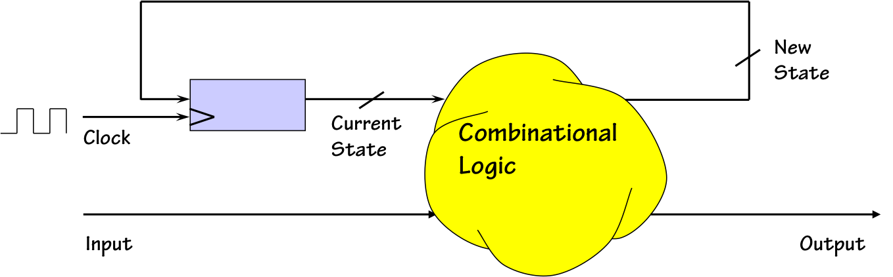
Designing things that compute
Sequential circuits
  Sequence detector – is it a computer? Sequence generator?
  Can we generalize?
Finite State machines
  Storage for current state
  Combinational circuit to generate o/p and next state based on i/p and current state
  Implement the combinational circuit using a ROM (or PLA/PAL)
computationstructures.org

Slide 5
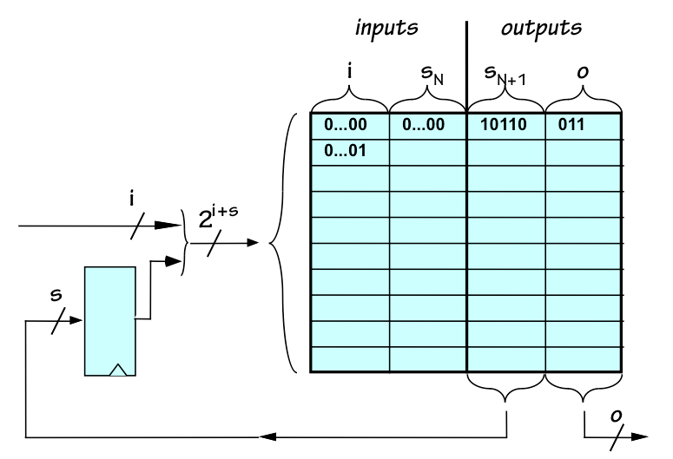
Finite State Machines can accept instructions
Write a ROM that takes 2 2-bit numbers from registers as inputs, reads an operation from a 2-bit encoder (+/- buttons pressed by user) and puts the result back in one of the two registers (again specified by user button). It should execute only when the +/- button is pressed, and otherwise go to a ‘waiting’ state.

Slide 6
FSMs with instructions stored in memory = programmable computer!
We read user input (+/-) and executed…
Read ‘instruction’ from another memory instead
What should instructions specify?
  What operation to perform
  What data to use?
  Where to put results?
An instruction is a compact description of the above three in a standardized format

Slide 7
Implementing the programmable computer
Remember designing sequential circuits in DD? After making the state table, what did you build?
Data path
  Registers
  Memory
  ALU
Control
  Which is the FSM

Slide 8
What instructions to implement?
Toy example: FSM to control a traffic light
Instructions:
  Turn on red light (turns it on for 30 seconds)
  Turn on green light (turns it on for 10 seconds)
New functionality:
  Blink green light on (1s) - off (1s) for 5 seconds (to indicate about to turn red)
  Blink red light on (3s) - off (3s) continuously (signal not working)
Even more functionality, simply based on toggling lights – even more complexity of FSM!
How can we simplify?
Only 3 instructions are needed, can you identify?

Slide 9
The Instruction Set Architecture
Choice of instructions to implement critical for building efficient computers
  Few very basic instructions?
  Many complex instructions?
    Effect on program size?
    Effect on hardware complexity?
    Many other parameters that we will discuss later!
ISA is a formal specification of allowed instructions, their meaning and behavior
ISA defines what the computer does (not how)!

Slide 10
ISA = Hardware – Software Contract
Software assumes instructions behave exactly as specified
Hardware guarantees correct execution of instructions
As long as ISA remains the same, software need not care about the hardware design!
Stable boundary between hardware and software

Slide 11

What all does an ISA specify?
Operations: Add, Load, Store, Branch etc.
Storage: How many registers? How big?
Storage: How much memory to support?
Data types: Integers, Floats, 32-bit, 64-bit etc.
Addressing modes: How to refer to different locations in the memory?
Measuring success:

Slide 12
The Great Debate: RISC vs. CISC
CISC (Complex Instruction Set): Make instructions powerful (e.g., "Multiply memory address X by Y").
  Goal: Reduce Instructions/Program.
RISC (Reduced Instruction Set): Make instructions simple (e.g., "Load," then "Multiply").
  Goal: Reduce CPI and Seconds/Cycle.

Slide 13
The RISC design philosophy
Simplicity Favors Regularity:
  All instructions are the same length (usually 32-bit).
  Easier to decode.
Smaller is Faster:
  Limited number of registers
  Smaller instruction sets allow higher clock speeds.
Make the Common Case Fast:
  Focus on the instructions used 90% of the time (Load, Store, Add).
Good Design Demands Good Compromises:
  Use a Load-Store architecture (Memory only accessed via Load/Store, never directly in an ALU op).

Slide 14
Multiplying two memory locations
Feature | RISC (e.g., RISC-V / MIPS / ARM) | CISC (e.g., Intel x86)
Philosophy | "Small, fast, uniform steps." | "Do more with a single command."
Instruction Count | High (requires 4 separate instructions) | Low (can be done in 1 instruction)
Example Code | LOAD R1, addr_A LOAD R2, addr_B PROD R1, R2 STORE addr_A, R1 | MULT addr_A, addr_B
Memory Access | Only LOAD and STORE touch memory. | Computation instructions can touch memory directly.
Execution Time | Each instruction typically takes 1 cycle. | Instruction takes multiple cycles to finish.
Addressing Modes | Very few (usually just "Base + Offset"). | Dozens of complex modes (e.g., [ebx + esi*4 + 10]).

Slide 15
Implications of ISA choice
Code Density: CISC wins (smaller binaries).
Power Efficiency: RISC wins (simpler logic, fewer transistors).
Compiler Complexity: RISC requires smarter compilers to optimize instruction sequences.

Slide 16
Why RISC-V
RISC is the dominant philosophy today (ARM in phones, RISC-V in research/IoT).
RISC-V:
  Open and clean specification
  Minimal complexity
  Ideal for learning
  Widely adopted in industry
RISC-V details: next class!

