Slide 1
Computer Architecture
Prof. Saurabh Gandhi (EEE department)

Slide 2
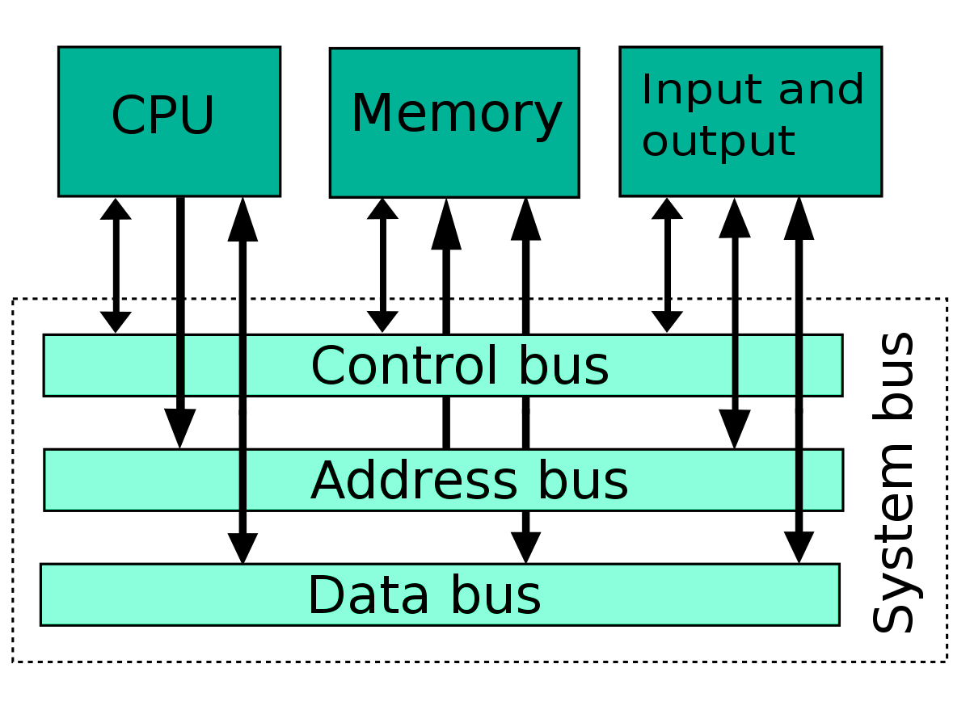
How does the computer start up?
What happens when you power on the system?
CPU puts an address on the address bus; gets some instruction on the data bus and executes it
Start with some pre-determined address to start executing instructions
Where does that address point to?
RAM is empty when the computer is powered up…
“Bootloader” in ROM (BIOS): Copies programs from secondary memory into RAM
But our computers are running multiple programs… how? Operating systems!

Slide 3
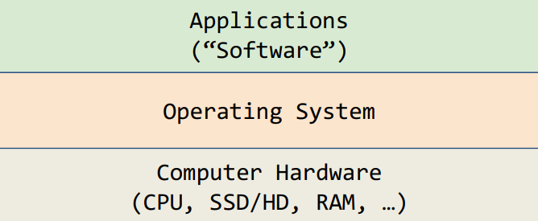
What is an operating system?
Operating systems control how software applications access and use hardware on your computer
They provide a general interface for common actions (ex. reading/writing disk) and allow software to run without knowledge of the machine it lives on!

Slide 4
What does the OS do?
One of the first things that runs when your computer starts (right after firmware/bootloader)
Loads, runs and manages programs:
Multiple programs at the same time (time-sharing)
Isolate programs from each other (isolation)
Multiplex resources between applications (e.g., devices)
Services: File System, Network stack, etc.
Finds and controls all the devices in the machine in a general way (using “device drivers”)

Slide 5
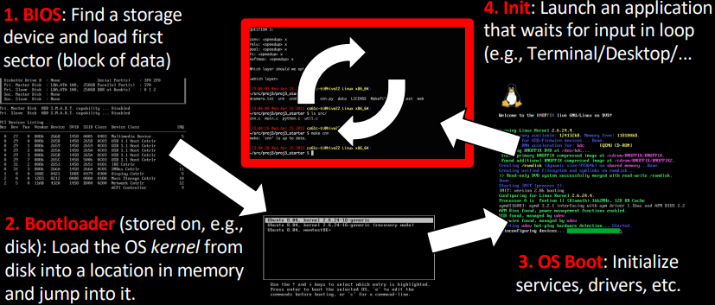
Back to how a computer starts running programs…
Applications are called “processes” in most OSes
Created by another process calling into an OS routine (using a “syscall”, more details later
Loads executable file from disk (using the file system service) and puts instructions & data into memory (.text, .data sections), prepare stack and heap
Set argc and argv, jump into the main function.

Slide 6
OSes are special – Supervisor mode
If something goes wrong in an application, it can crash the entire machine. What about malware, etc.?
The OS may need to enforce resource constraints to applications (e.g., access to devices)
To protect the OS from the application, CPUs have a supervisor mode bit (also need isolation, more later)
You can only access a subset of instructions and (physical) memory when not in supervisor mode (user mode)
You can change out of supervisor mode using a special instruction, but not into it (unless there is an interrupt).
How to switch back to OS? OS sets timer interrupt, when interrupts trigger, drop into supervisor mode
What if we want to call into an OS routine? (e.g., to read a file, launch a new process, send data, etc.)
Need to perform a syscall: set up function arguments in registers, and then raise software interrupt
OS will perform the operation and return to user mode
This way, the OS can mediate access to all resources, including devices, the CPU itself, etc

Slide 7
Multiprogramming
OS runs multiple applications at the same time
But not really (unless have a core per process)
Switches between processes very quickly. This is called a “context switch”
Deciding what process to run is called scheduling
Programs can be scheduled in a variety of ways!
Most/least resources needed, “fastest” to run, most important, etc.
Where in the main memory does each program reside?
For jump, call, branch instructions, how does the PC jump to the right address?
How does the context switch happen when multiple programs are running together?

Slide 8
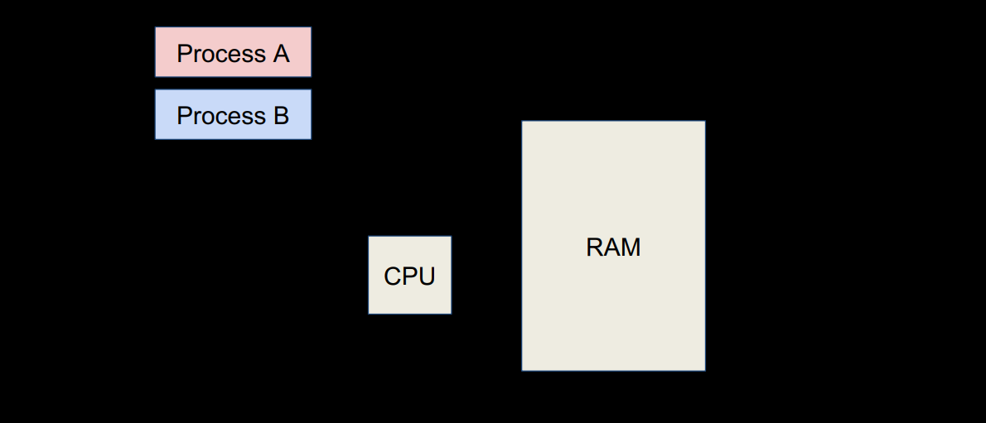
A picture for multiple applications in user mode

Slide 9
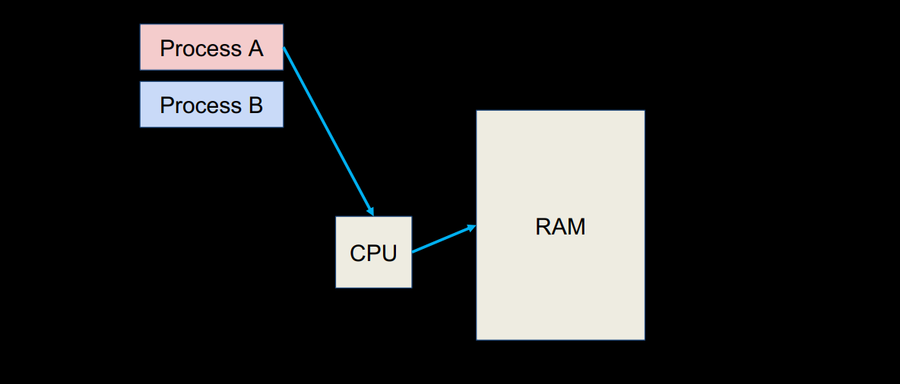
A picture for multiple applications in user mode

Slide 10
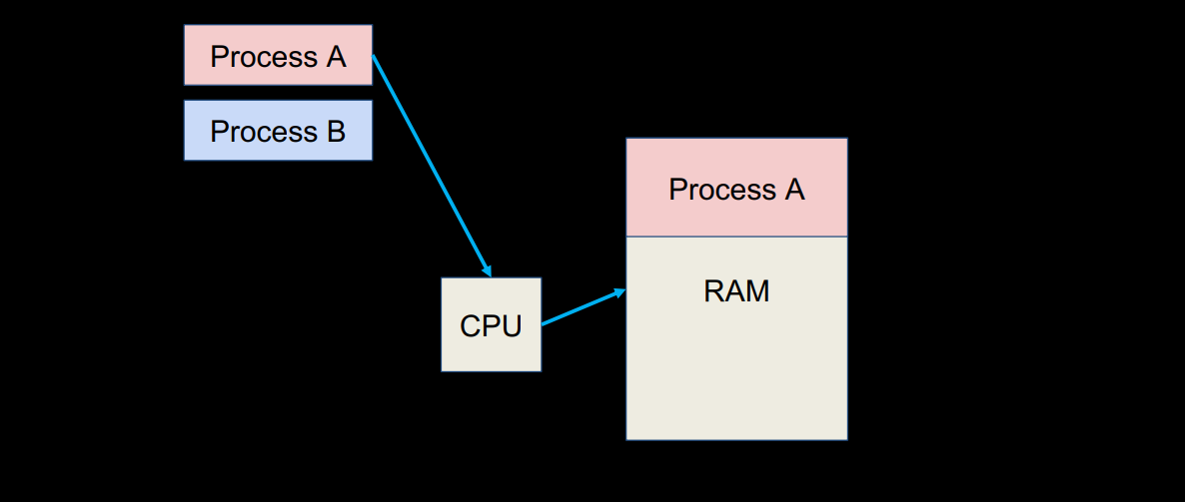
A picture for multiple applications in user mode

Slide 11
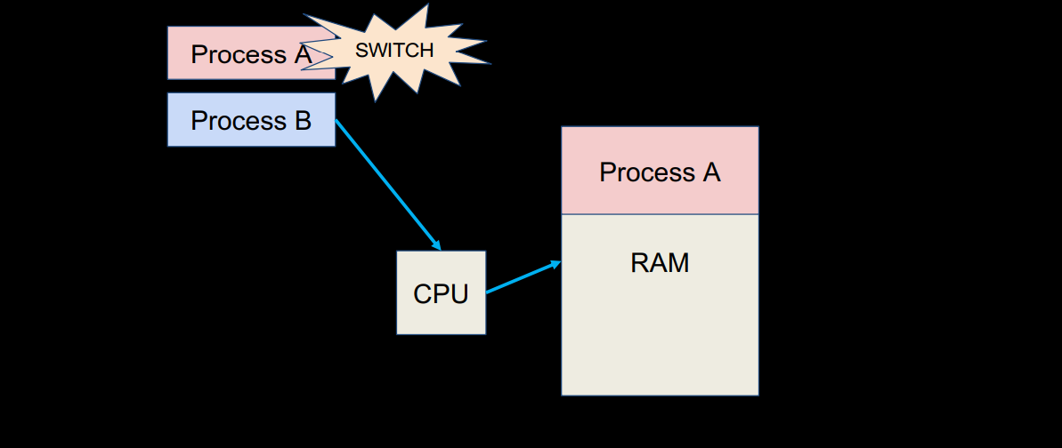
A picture for multiple applications in user mode

Slide 12
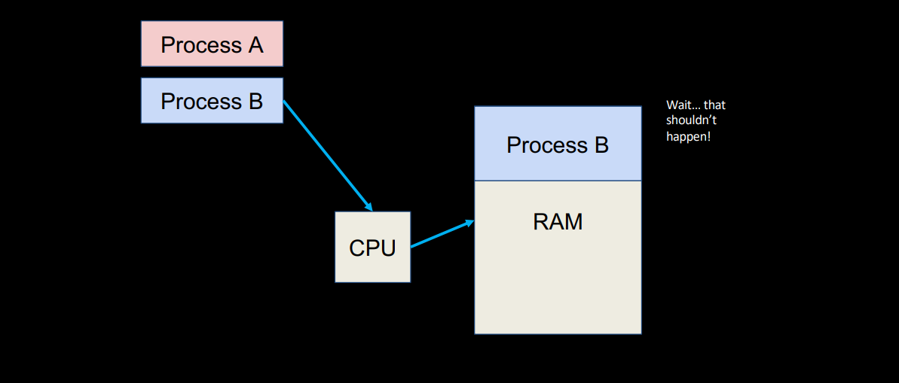
A picture for multiple applications in user mode

Slide 13
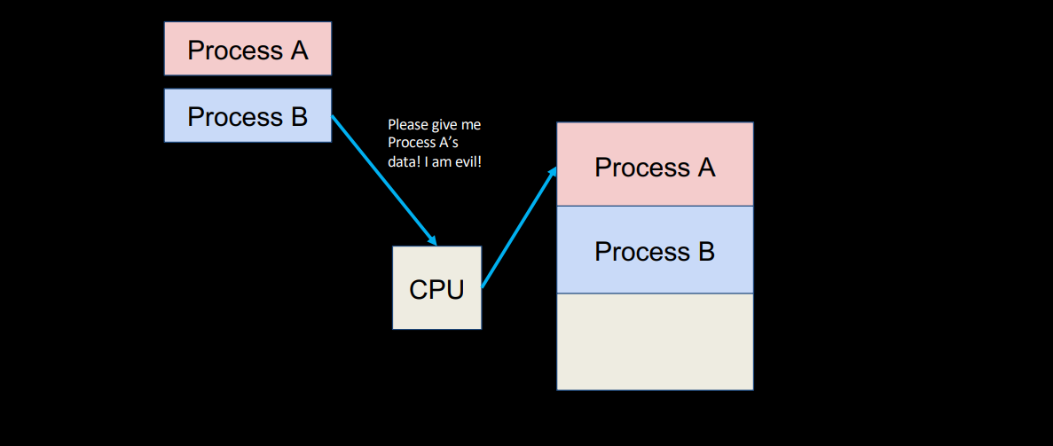
A picture for multiple applications in user mode

Slide 14
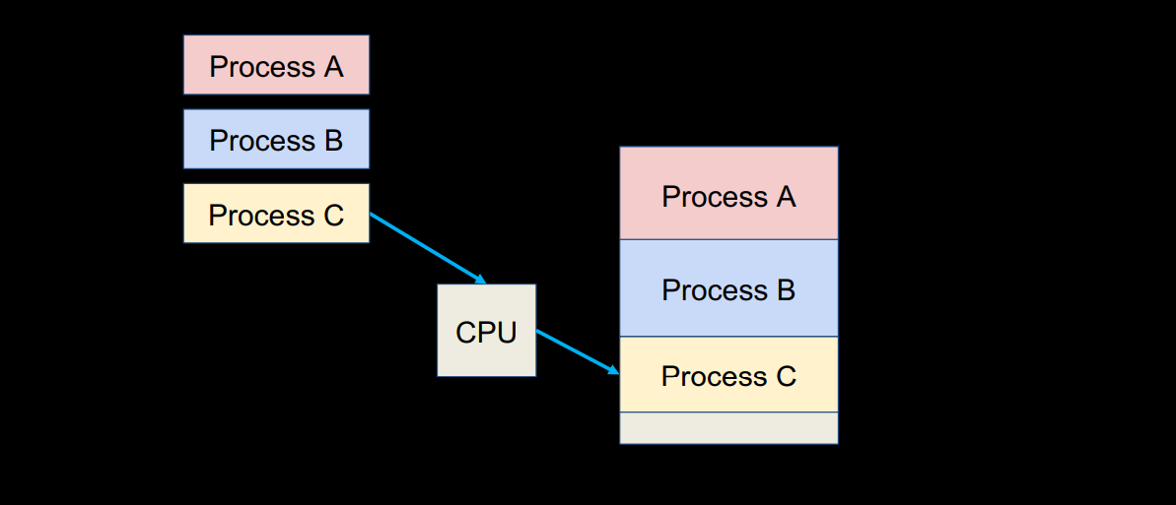
A picture for multiple applications in user mode

Slide 15
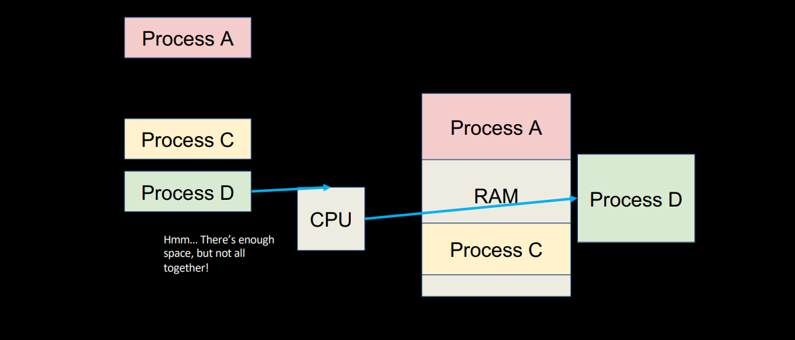

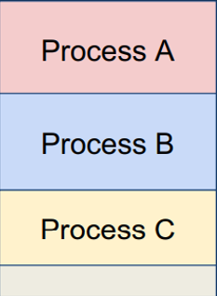
A picture for multiple applications in user mode

Slide 16
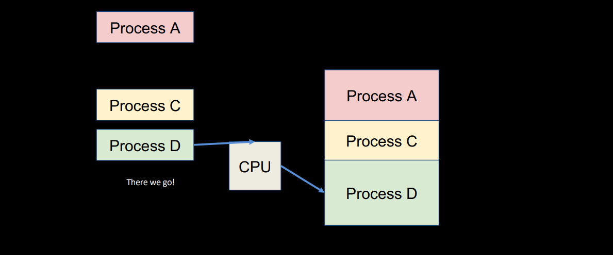
A picture for multiple applications in user mode

Slide 17
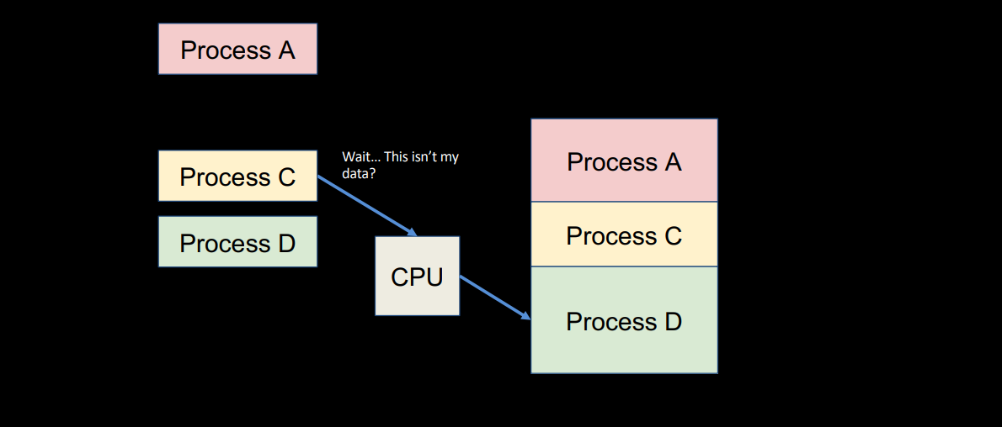
A picture for multiple applications in user mode

Slide 18
Multiprogramming requires protection, translation and paging
Supervisor mode does not fully isolate applications from each other or from OS
Application could overwrite another application’s memory
Remember the linker in CALL: application assumes that code is in certain location. How to prevent overlaps?
May want to address more memory than we actually have
Solution: Virtual Memory
Give each process the illusion of a full memory address space that it has completely to itself
From here on out, we’ll be working with two different memory spaces:
Virtual Memory (VM): A large (~infinite) space that a process believes it, and only it, has access to
Physical Memory (PM): The limited RAM space your computer must share among all processes and processors
Goals:
Process/program isolation (protection)
Make transition from infinite to finite seamless, or not noticeable to the program
Translate between VM, PM addresses

Slide 19
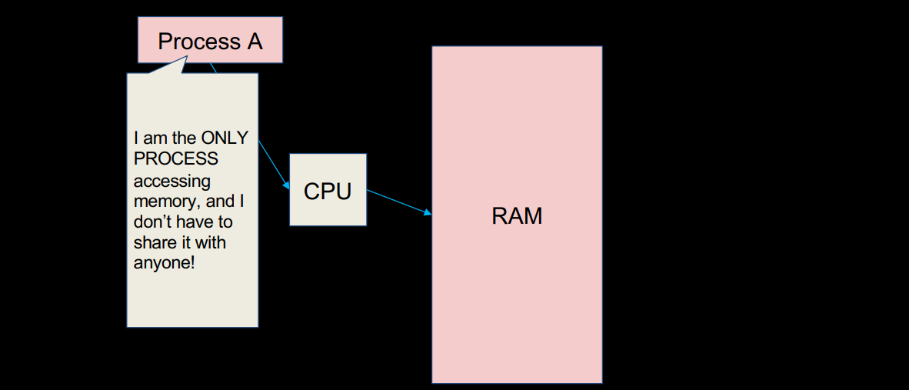
Virtual memory – how it appears to the process

Slide 20
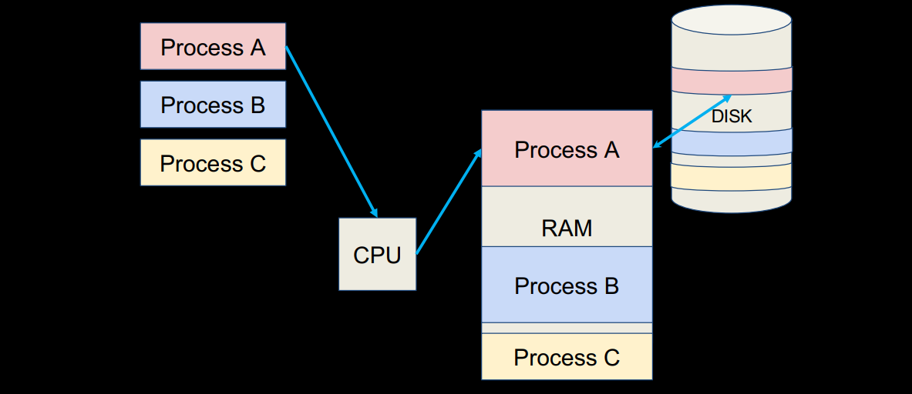
Virtual memory – what it is actually like

Slide 21
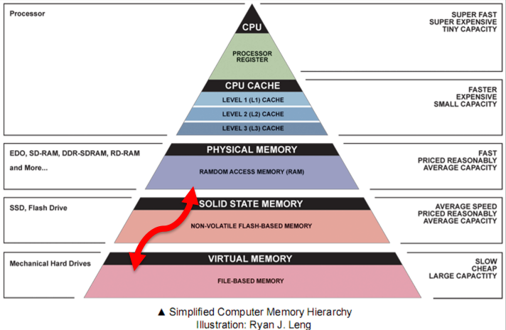
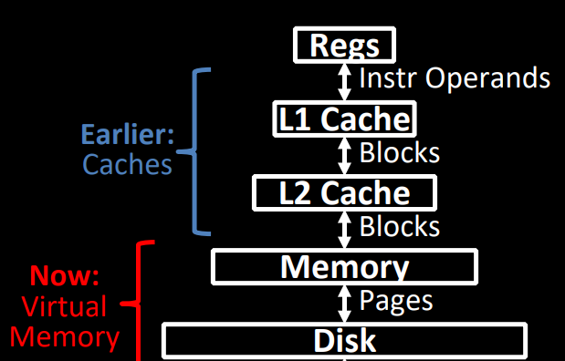
VM connects SM to MM

Slide 22
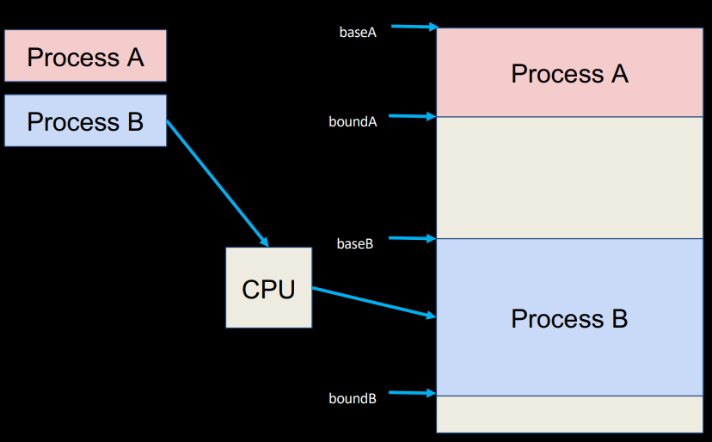
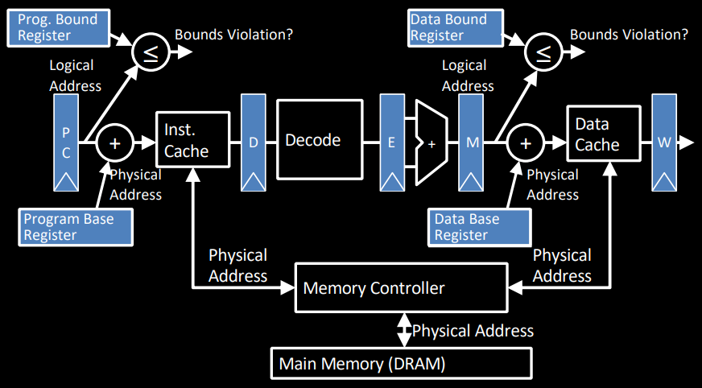
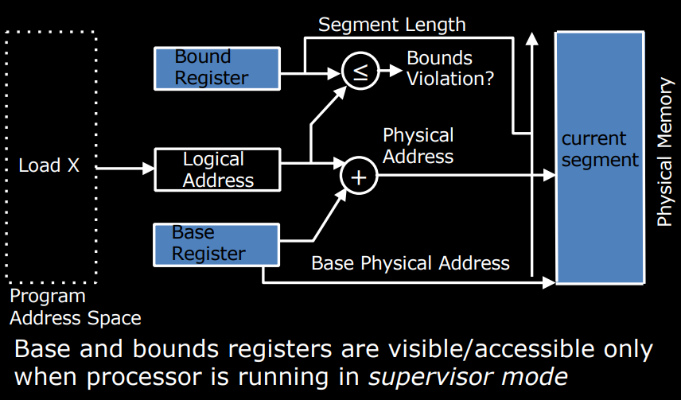
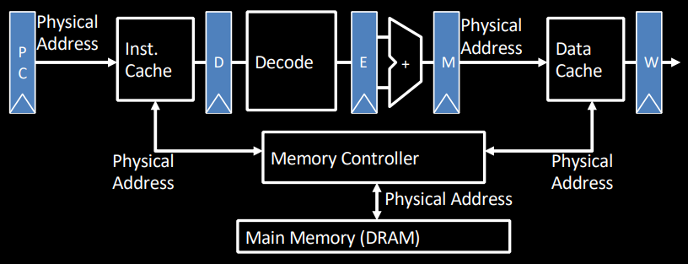
Segmentation
Divide RAM into segments with a “base” and “bound”
Each program has access to its segment only!
Program has a virtual address range 0x0...0 - 0xF...FE
To get location of data in segment (physical address), add to base value!

Slide 23
Problems with base and bound
What if we need more space than our segment allows?
Increase segment? What if no more RAM?
Use disk? How do we decide what data to move in or out? How much data?
What if we require 500MB of space, but RAM is fragmented, so there isn’t a contiguous chunk available?
How can we fix this?
Must provide protection b/t processes
Programs can only find/access their own data
Must be able to work with more data than RAM can hold
Swap to and from disk
Must not fragment memory in an unusable way
If need 500MB, and have 500MB available overall, should be usable

Slide 24
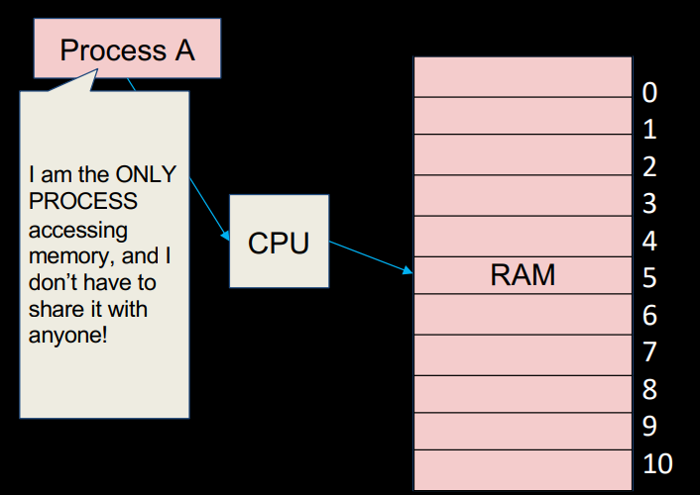
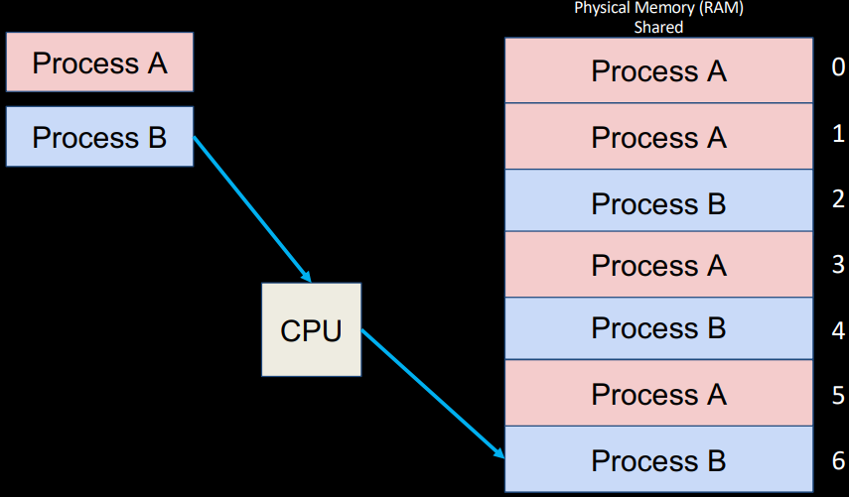
Paged memory
Instead of having segments of various sizes, let’s divide physical memory and virtual memory into equal units called pages!
Pages are all the same size, regardless of program, and RAM is an integer multiple of pages
Page size is the same in both virtual and physical memory
What does our memory layout look like now?

Slide 25
Paged memory details
Each program has access to one or more pages
Pages do not have to be contiguous, or next to each other
Pages are not organized by program
How do we continue to enforce protection?
How do we find a piece of data given our virtual address between 0x0..0 and 0xF...FE?
Per program, maintain a list (or table) of pages in physical memory that they own
For each page, note the data it contains
Sufficient to just note virtual page number! This will tell us the range of addresses!
Just like base and bound: use this table to translate addresses so programs cannot reach physical addresses outside of their assigned range!

Slide 26
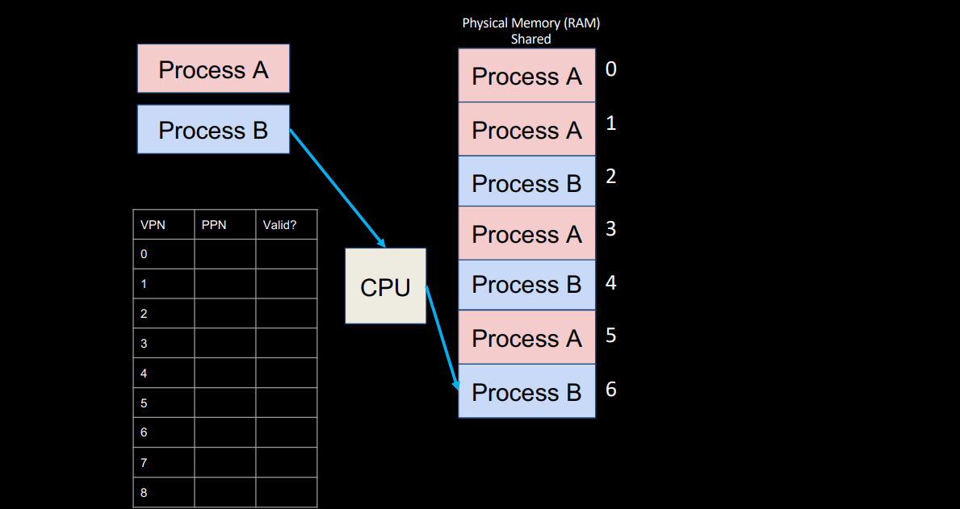
Paged memory working

Slide 27
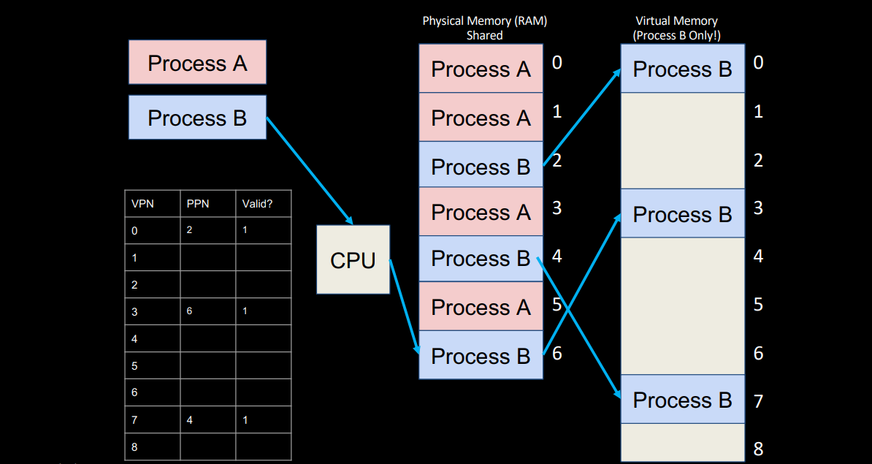
Paged memory working

Slide 28
Summary of virtual memory
Protection: several programs, each with their private address space and one or more shared address spaces
Demand Paging: Provides the ability to run programs larger than the primary memory Hides differences in machine configurations
The price is address translation on each memory reference
Next level in the memory hierarchy:
Provides program with illusion of a very large main memory
Working set of “pages” reside in main memory while others reside on disk
Also allows OS to share memory, protect programs from each other
Today, more important for protection vs. just another level of memory hierarchy
Each process thinks it has all the memory to itself
(Historically, it predates caches)

Slide 29
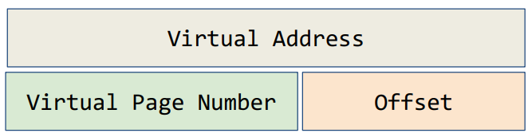
Address translation
The process of converting a virtual address to a physical address is called address translation
Virtual addresses can be broken into two parts (much like we broke them down for T/I/O): we’ll call the two parts the virtual page number and the offset:
What determines the size of offset?
Size of VPN?
Similarly break down the physical address into physical page number and offset
How do we go from a VPN to a PPN?

Slide 30
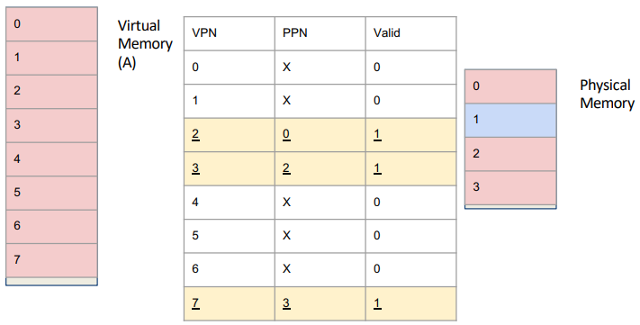
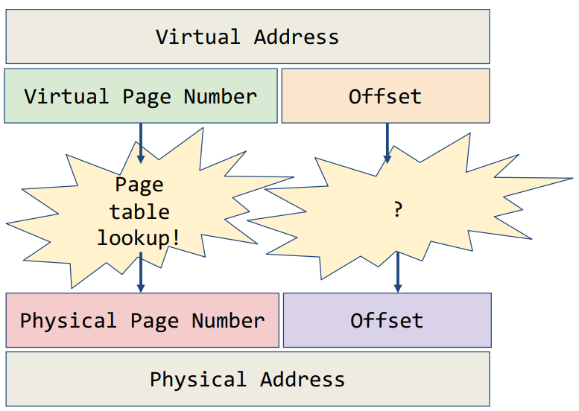
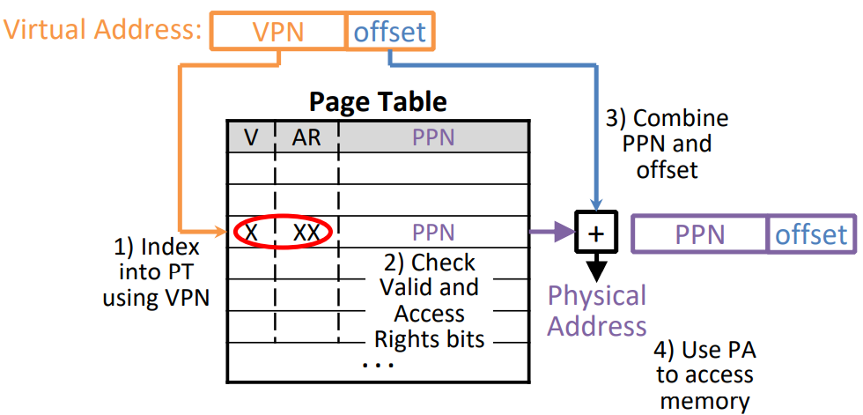
Page Tables
Contains either PPN or indication not in main memory
Dirty = Page has been modified recently
Valid = Valid page table entry
1 → virtual page is in physical memory
0 → OS needs to fetch page from disk Page Fault!
Access Rights checked on every access to see if allowed (provides protection)
Read, Write, Executable: Can fetch instructions from page
Protection Fault! …How?

Slide 31
How big is the page table?
64 MiB RAM
32-bit virtual address space
1 KiB pages
Less than 1 Page
Less than 100 Pages
Less than 1000 Pages
More than 1000 Pages
How many offset bits?
10
How many VPN bits?
32-10 = 22
#physical page number bits?
26-10 = 16
#bytes in page table?
2²²*2 = 2²³
Number of pages for page table itself?
2¹³ pages!
Page tables must be stored in main memory! …any problems with this?
To find anything in MM we need the page table (itself in MM)
PT Base Register: Stores physical address of current page table

Slide 32
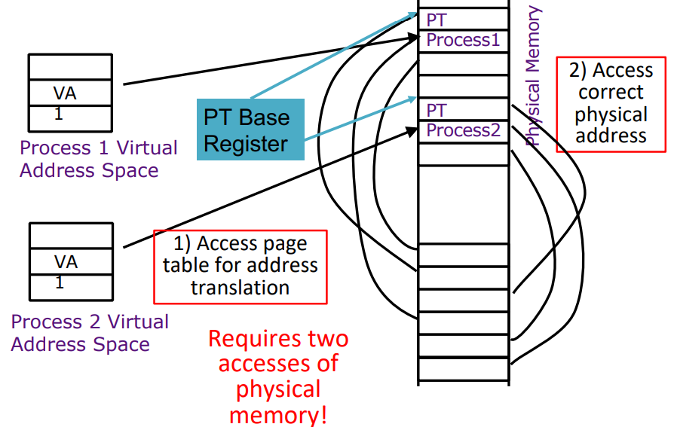
Using page tables leads to 2 PM accesses per VM access

Slide 33
Example
RAM
Virtual address space: 64 KB
Physical address space: 16 KB
Page size: 4 KB
Page table for a process (PTBR = 0x2000):
PT Entry format:
Physical Address | Data (Hex)
0x1ABC | 0xDE
0x1ABD | 0xBE
... | ...
0x2000 | 0x29
0x2001 | 0x5D
0x2002 | 0x00
0x2003 | 0x19
0x2004 | 0x3F
... | ...
0x3ABC | 0xFE
Bits [7:4] | Bit 3 | Bit 2 | Bit 1 | Bit 0
PPN (4 bits) | R (Read) | W (Write) | X (Execute) | V (Valid)

Slide 34
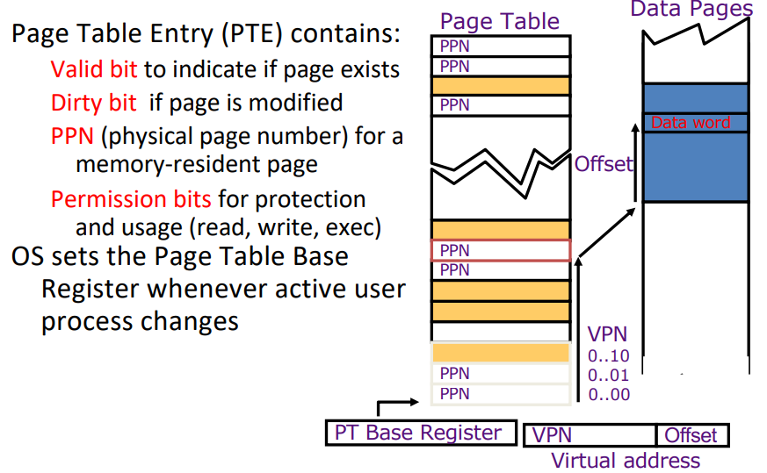
Linear page tables
Problems with linear page tables:
Can be very large (depends on VM size)
Sparsely populated (what if a program uses only first and last page?
Entire page table must be loaded!
Can we load only small sections of a page table at a time?

Slide 35
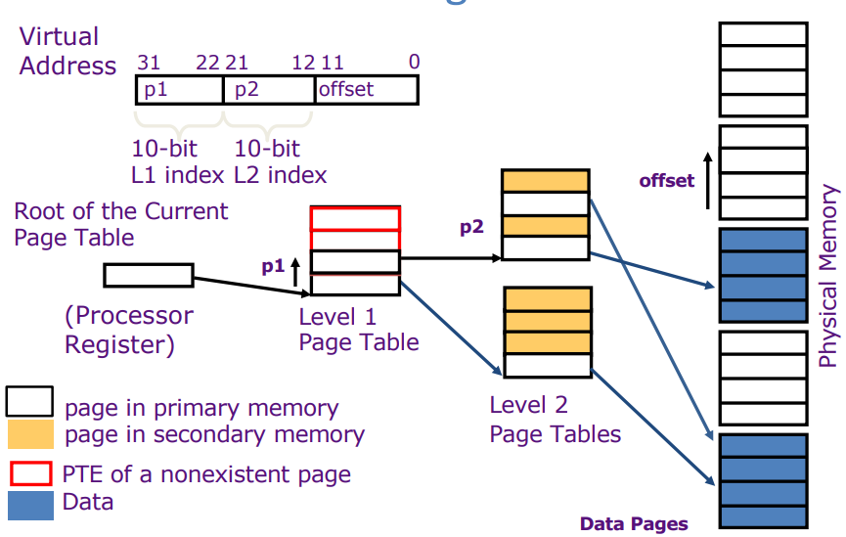
Hierarchical page tables

Slide 36
Example
Virtual address space: 32 GB
Page size: 64 KB
Level 1 and level 2 VPNs: 8 bits each
PTE size: 4 bytes

Slide 37
Example
Physical Address | Value (Hex)
0x0100 | 0x89
0x0101 | 0x80
0x0105 | 0x19
... | ...
0x0800 | 0xAA
0x0801 | 0xBB
... | ...
0x2000 | 0x11
0x2001 | 0x00
0x2002 | 0x8D
0x2003 | 0x09
Virtual address space: 64 KB
Page size: 256 bytes
2-level page table (4 bits each for VPN1 and VPN2)
Page table for a process (PTBR = 0x2000):
PT Entry format:
Bits [7:4] | Bit 3 | Bit 2 | Bit 1 | Bit 0
PPN (4 bits) | R (Read) | W (Write) | X (Execute) | V (Valid)

Slide 38
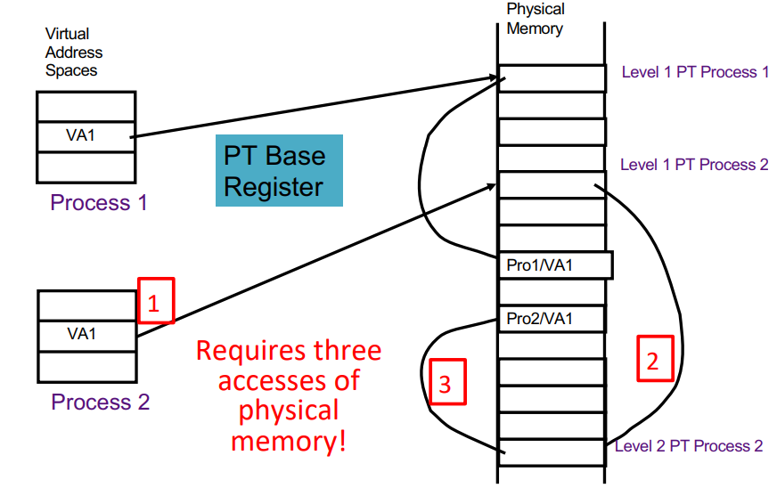
Hierarchy means even more MM accesses per VM access!

Slide 39
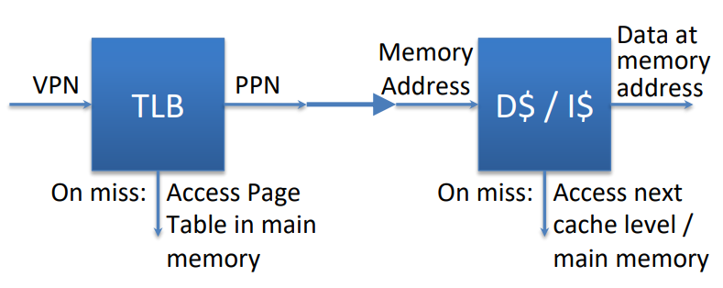
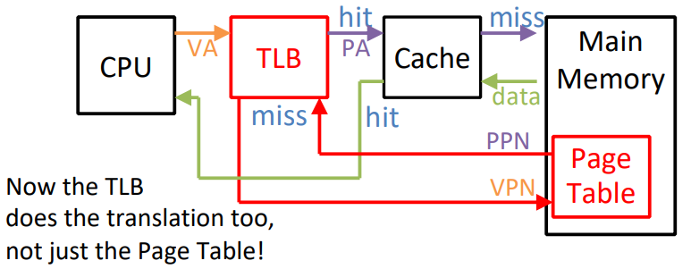
3 PM accesses per VM access – how can we make this faster?
A cache for the page tables!
Called a ‘Translation Lookaside Buffer (TLB)’
TLBs usually small, typically 32–128 entries
TLB access time comparable to cache (much faster than accessing main memory)
TLBs usually are fully/highly associativity
When accessing data, where should we check first – cache or TLB?

Slide 40
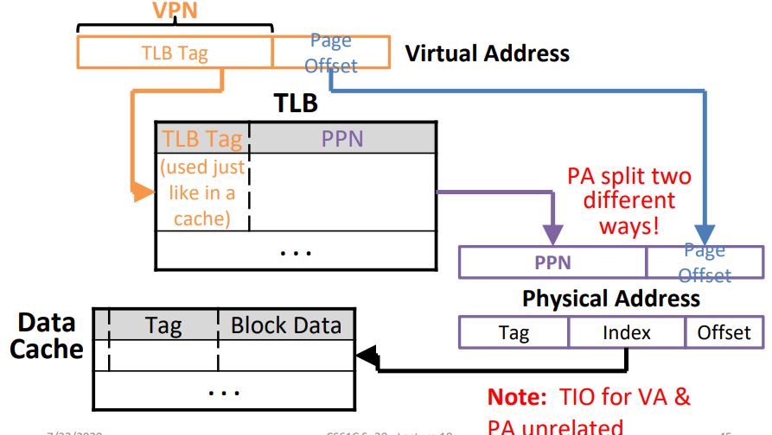
Finding data using TLBs and caches
Check TLB (input VPN, output PPN)
TLB Hit: Fetch translation, return PPN
TLB Miss: Check PT in MM
PT Hit: Copy PT entry to TLB, return PPN
PT Miss (page fault):
Fetch page from disk to MM
Update PT entry for the page
Load entry into TLB
Check cache (input PA, output Data)
Cache hit: Return data to processor
Cache miss: Fetch data from memory, store in cache and return it to processor

Slide 41

Typical TLB entry format
Valid whether that TLB ENTRY is valid (unrelated to PT)
Access Rights: Data from the PT
Dirty: Consistent with PT
Ref: Used to implement LRU
Set when page is accessed, cleared periodically
PPN: Data from PT
VPN: Data from PT

Slide 42
Handling page faults (PT misses)
Load the page off the disk into a free page of memory
Switch to some other process while we wait
What happens to TLBs when we switch processes?
All entries must be set to invalid!
Interrupt thrown when page loaded and the process’ page table is updated
When we switch back to the task, the desired data will be in memory
If memory full, replace page (LRU), writing back if necessary, and update both page table entries
Continuous swapping between disk and memory called “thrashing”

Slide 43
Measuring VM performance
TLB miss rate
PT miss rate
Same AMAT equations, now considering MM as another ‘cache’ level
If TLB hit, can we say it will be a cache hit?
If cache hit, will it be a TLB hit also?
If TLB miss, will it be a cache miss?
If cache miss, will it be a TLB miss also?

Slide 44
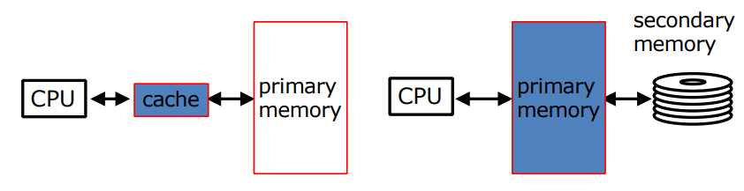
Caching vs paging
Cache entry
Cache block (≈32 bytes)
Cache miss rate (≈1% – 20%)
Cache hit time (≈1 cycle)
Cache miss penalty (≈100 cycles)
Page frame
Page (≈4 Ki bytes)
Page miss rate (<0.001%)
Page hit time (≈100 cycles)
Page fault (≈5M cycles)

Slide 45
AMAT with paging
Memory Parameters:
L1 cache hit = 1 clock cycles, hit 95% of accesses
L2 cache hit = 10 clock cycles, hit 60% of L1 misses
DRAM = 200 clock cycles (≈100 nanoseconds)
Disk = 20,000,000 clock cycles (≈10 milliseconds)
Average Memory Access Time (no paging):
1 + 5%×10 + 5%×40%×200 = 5.5 clock cycles
Average Memory Access Time (with paging):
5.5 (AMAT with no paging) + ?
5.5 + 5%×40%× (1-HR_{Mem})×20,000,000
AMAT if HR_{Mem} = 99%?
5.5 + 0.02×0.01×20,000,000 = 4005.5 (≈728x slower)
1 in 20,000 memory accesses goes to disk: 10 sec program takes 2 hours!
AMAT if HR_{Mem} = 99.9%?
5.5 + 0.02×0.001×20,000,000 = 405.5
AMAT if HR_{Mem} = 99.9999%?
5.5 + 0.02×0.000001×20,000,000 = 5.9
What if we also consider MM page table access times (without TLBs)?

Slide 46
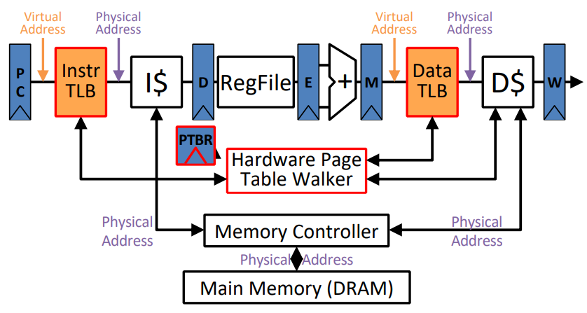
Impact of TLBs on performance
Each TLB miss to Page Table ~ L1 Cache miss
TLB Reach: Amount of virtual address space that can be simultaneously mapped by TLB:
TLB typically has 128 entries of page size 4-8 KiB
128 × 4 KiB = 512 KiB = just 0.5 MiB
What can you do to have better performance?
Multi-level TLBs
Variable page size (segments)
Special situationally-used “superpages”

Slide 47
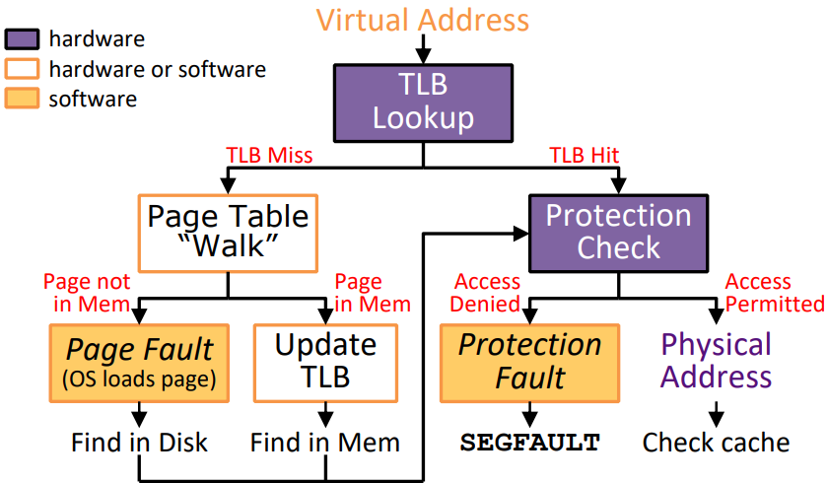
Summary of address translation

