Slide 1
Software for Embedded Systems
Prof. Saurabh Gandhi (EEE department)

Slide 2
Building a multitasking embedded software system
Multitasking introduces:
Concurrent execution
Shared data
Asynchronous events
Race conditions
Inconsistent state of the system
Need for synchronization and inter process communication (IPC)

Slide 3
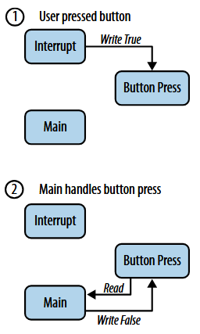
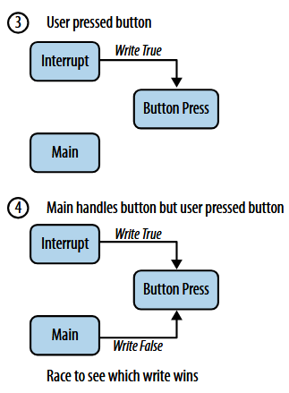
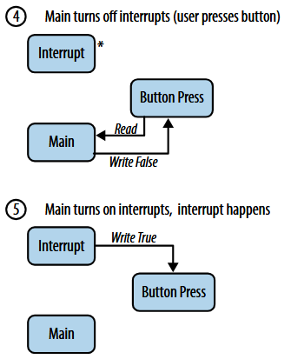
Race conditions

Slide 4
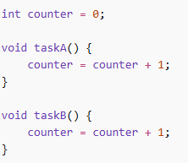
Race conditions
What problem do you foresee with this code?
Multiple correct operations
But depending on timing / order, result can be incorrect / non-deterministic

Slide 5
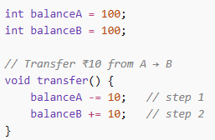
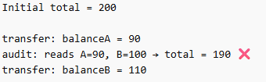

Inconsistent system state

Slide 6
How do we avoid these?
Problem areas:
Data exchange ←→ IPC
Safe access / ordering ←→ Synchronization
Communication paradigms:
Shared memory
Message passing

Slide 7
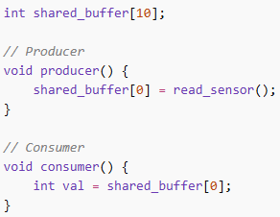

Shared memory
Critical section
Limit access of shared memory ( / resource) to only one task at a time
Mutex
Binary lock to ensure resource is not used by other processes
Problematic – race condition possible

Slide 8
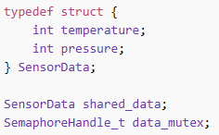
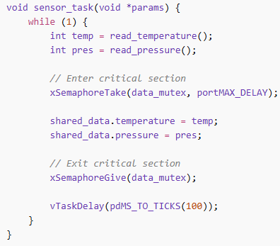
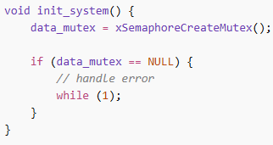
Mutex example
Shared resource
Producer task
Initialize the mutex for this resource

Slide 9
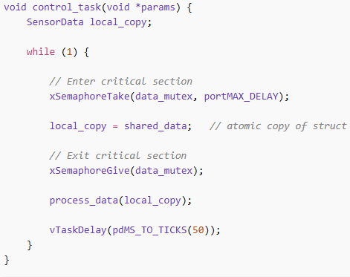
Mutex example
Producer task
Consumer task

Slide 10

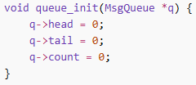
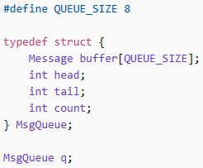
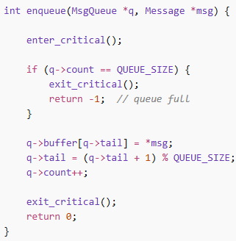
Message passing
Message = type + payload
Initialization of a queue
Queue = buffer for messages + pointers to head and tail + queue size
Adding an item to the queue

Slide 11
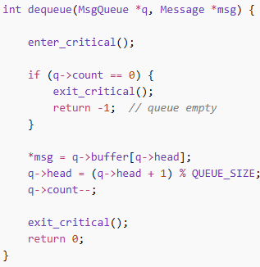
Message passing
Adding an item to the queue
Receiving an item from the queue

Slide 12
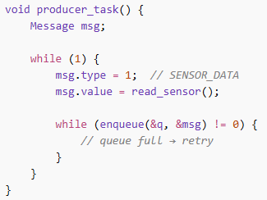
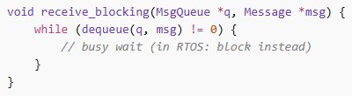
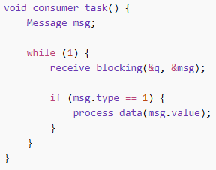
Message passing

Slide 13
Example – Event Driven Systems
System reacts to events
Event producer process must communicate with event consumer
Events placed in queue
Tasks consume events
Decouples producers and consumers
Supports asynchronous systems

Slide 14
Shared memory vs message passing
Feature | Shared Memory (with Mutex) | Message Passing
Speed | Maximum (zero-copy) | Slower (copy overhead)
Safety | High risk of race conditions | Safer, encapsulated data
Synchronization | Explicit (Mutex/Semaphore) | Implicit (Send/Receive)
Topology | Single system only | Distributed/Multi-processor
Kernel Role | Setup only | Involved in every transfer

Slide 15
Practical guidelines
Keep critical sections short
Prefer message passing for complex systems
Use bounded queues
Avoid nested locks
Use priority protocols

